Slide 1
Engineering Management
University of Mustansiriyah 2019-2020
College of Engineering 3rd Stage
High. & Trans Eng. Dep.
Lecture No.7, Programming Techniques: Gantt Chart
Lecturers: Dr. Ali Jabbar
Dr Abeer K. Jameel

Slide 2
Programming Techniques
1. Gantt (Bar) Chart
2. Network Analysis
3. Programming Evaluation and Review Technique (PERT)
4. Line of Balance

Slide 3
Programming Techniques: Gantt Chart
Gantt Chart
Activities
A
B
C
Time (weeks)

Slide 4
Gantt Chart :activities relationships
Finish to start relationships

Slide 5
Gantt Chart :activities relationships
Start to start relationships

Slide 6
Gantt Chart :activities relationships
Overlapping relationships

Slide 7
Gantt Chart :activities relationships
Finish to finsh relationships

Slide 8
Programming Techniques: Gantt Chart
Gantt Chart
The following information should always be shown on the engineering project Gantt charts

Slide 9
Programming Techniques: Gantt Chart
Gantt Chart : Advantages

Slide 10
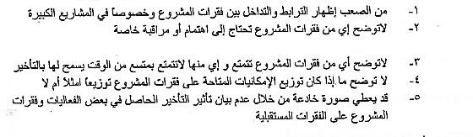
Programming Techniques: Gantt Chart
Gantt Chart Disadvantages

