Slide 1
The Basic Properties of CNTs and Synthesis
By
Asst. Prof. Dr. Raouf Mahmood

Slide 2
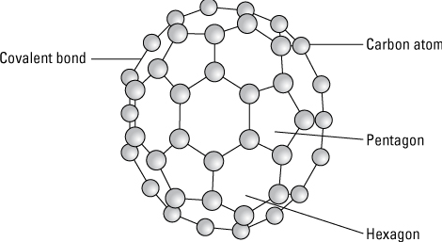
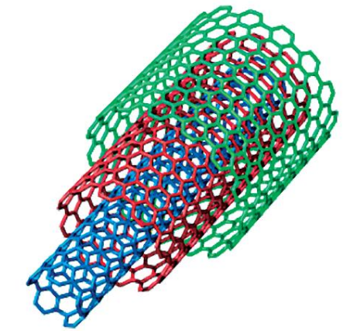
Introduction
In 1991, using a high current arc runs through graphite, a hollow tube like buckyball were discovered which contained multiple tubes, or shells, one within another. This new material is called multiwall nanotubes (MWNTs) because of their nanometer-scale diameters. MWNTs are composed of larger-diameter nanotubes surrounding smaller nested nanotubes, where each successive outer shell has a larger diameter but retains the characteristic rolled graphene structure.

Slide 3
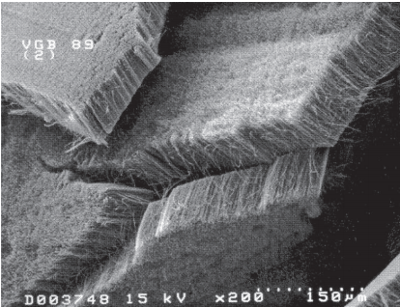
Introduction
Then, nanotubes with only one wall or shell were synthesized and called single-walled nanotubes (SWNTs). These nanotubes were made in the arc process.
Carbon nanotubes may be though of as rolled-up sheets of graphite, although they are not literally made this way. Both SWNTs and MWNTs can be grown in tangled structures or ordered close-packed structures .The SWNTs and MWNTs produced at lower temperatures have a larger number of defects in the walls and caps than nanotubes produced at higher temperatures.

Slide 4
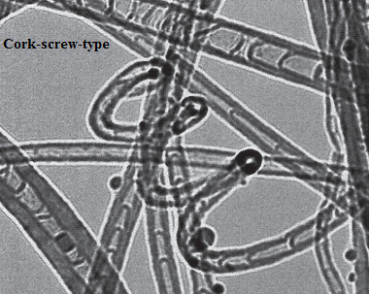
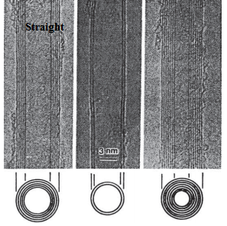
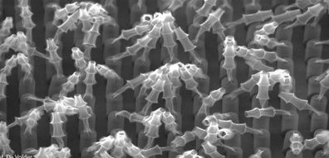
Introduction
Consequently, several forms of nanotubes have been produced: straight, cork-screw, and bamboo structured. Well-aligned, straight MWNTs are most similar to the ideal structure,

Slide 5
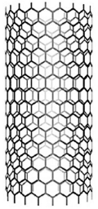
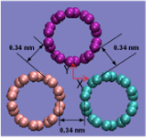
Bonding Characteristics
The bonding within the CNT walls is covalent, while the bonding between CNTs, either in a bundle or between CNTs arranged in a MWNT structure, is van der Waals. The spacing between the nanotubes in a MWNT is examined with TEM and ranges from 0.34 to 0.39 nm, with the spacing changing as the nanotube diameters increase. Note that the spacing between the shells in the MWNT decreases as the nanotube outer diameter increases and approaches a value of about 0.344 nm at a diameter of about 10 nm. The larger inter-shell spacing at smaller nanotube diameters is attributed to the larger repulsive forces associated with the high curvature of the nanotube walls at small diameters.

Slide 6
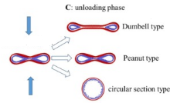
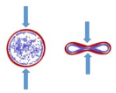
CNTs strain energy
The strain energy related with forming the cylindrical shape is calculated to vary as the inverse of the CNT radius squared and is not predicted to depend on the helical structure of the CNT. Additional calculations have quantified this phenomenon by examining the stability of circular and collapsed SWNTs of various helical structures. The results indicate that at radii below 10 Å, only nanotubes with circular cross-sections are stable, while at radii between 10 and 30 Å both the circular and collapsed cross-sections are stable.At radii above 30 Å, the calculations indicate that only the collapsed cross-section radius is stable because of the energy gain from van der Waals bonding across the collapsed nanotube.

Slide 7
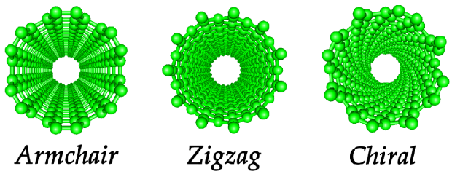
Defects and Variations in CNTs Structure
A common defect one finds on nanotube walls is a pair of pentagons and heptagons called 5/7 defects. Calculations show that two types of equivalent bonds are broken to make 5/7 defects in zigzag and armchair CNTs. The formation energy of a 5/7 defect for several junctions between two dissimilar SWNTs is found to be about 6 eV.

Slide 8
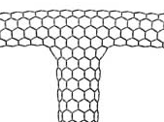
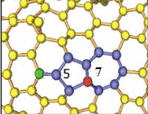
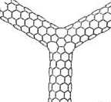
Defects and Variations in CNTs Structure
Although nanotubes are usually thought of as long cylinders other shapes are possible. For example, nanotubes can form a “Y” structure or similar “T” structures. Nanotubes can also exist as nanotori (also called crop-circles or nanorings), nanohorns, and nanoonions.

Slide 9
CNTs SYNTHESIS
Several synthesis methods are used to produce CNTs and related materials. The three most commonly used methods are the arc, laser, and chemical vapour deposition techniques.
Chemical Vapour Deposition Methods.
Laser Methods.
Arc Methods.
Industrial Methods.

Slide 10
REFERENCES
Dresselhaus, M.S., Dresselhaus, G., and Eklund, P.C., Science of fullerenes and carbon nanotubes, Academic Press, San Diego, 1996.
Ebbesen, T.W., Carbon nanotubes: Preparation and properties, CRC Press, Boca Raton, 1997.

