Slide 1
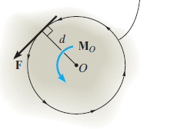
Moment of a Force
Lecture 4
When a force is applied to a body it will produce a tendency for the body to rotate about a point that is not on the line of action of the force. This tendency to rotate is sometimes called a torque, but most often it is called the moment of a force or simply the moment.
The magnitude of the moment is directly proportional to the magnitude of F and the perpendicular distance or moment arm d.
Magnitude. The magnitude of is Mo
Direction. The direction of Mo is defined by its moment axis, which is perpendicular to the plane that contains the force F and its moment arm d. The right-hand rule is used to establish the sense of direction of Mo. Since in this case the moment will tend to cause a counterclockwise rotation, the moment vector is actually directed out of the page.

Slide 2
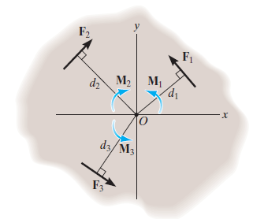
Resultant Moment.
For two-dimensional problems, where all the forces lie within the x–y plane, Fig. below, the resultant moment (MR)O about point O (the z axis) can be determined by finding the algebraic sum of the moments caused by all the forces in the system. As a convention, we will generally consider positive moments as counterclockwise since they are directed along the positive z axis (out of the page). Clockwise moments will be negative.
Important Points
● The moment of a force creates the tendency of a body to turn
about an axis passing through a specific point O.
● Using the right-hand rule, the sense of rotation is indicated by the
curl of the fingers, and the thumb is directed along the moment
axis, or line of action of the moment.
● The magnitude of the moment is determined from MO = Fd, where d is called the moment arm, which represents the perpendicular or shortest distance from point O to the line of action of the force.
● The principle of moments states that the moment of a force about a point is equal to the sum of the moments of the force’s components about the point. This is a very convenient method to use in two dimensions.

Slide 3
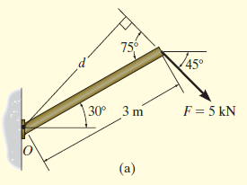
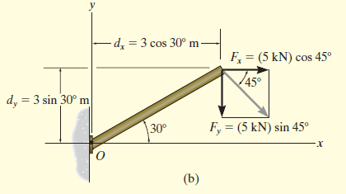
EXAMPLE: Determine the moment of the force in Fig. a below about point O.
SOLUTION
The x and y components of the force are indicated in Fig.b. Considering counterclockwise moments as positive, and applying the principle of moments, we have
+ MO = - Fxdy - Fydx
= -(5 cos 45° kN)(3 sin 30° m )- (5 sin 45° kN)(3 cos 30° m)
= -14.5 kN.m = 14.5 kN.m

