Slide 1
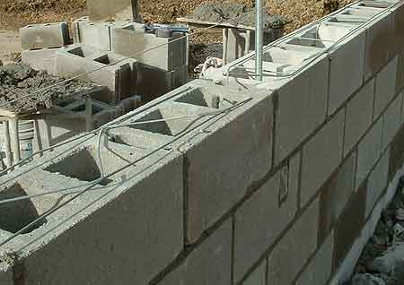
Masonry units

Slide 2
Masonry units

Slide 3
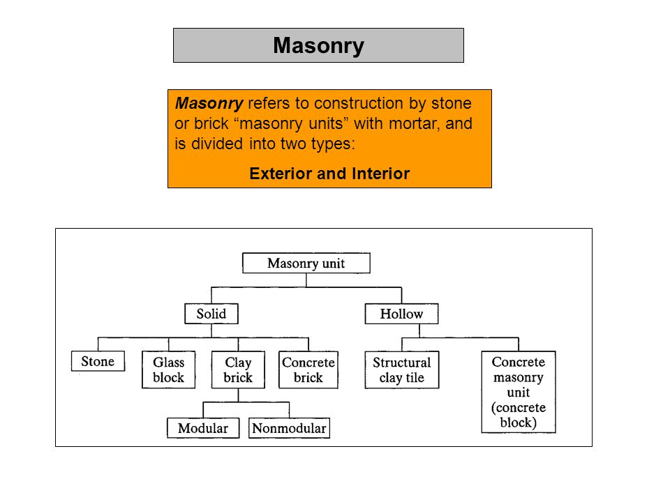

Slide 4
Masonry units
A masonry structure (wall) is formed by combining masonry units, such as stone, blocks, or brick, with mortar. Masonry is one of the oldest construction materials. Examples of ancient masonry structures include the pyramids of Egypt, the Great Wall of China, and Greek and Roman ruins. Bricks of nearly uniform size became commonly used in Europe during the beginning of the 13th century. The first extensive use of bricks in the United States was around 1600. In the last two centuries, bricks have been used in constructing sewers, bridge piers, tunnel linings, and multistory buildings.

Slide 5
There is two types of masonry:
• Structured/load-bearing this is used for exterior walls.
• Non structured/non load-bearing this is used for interior walls.
Masonry units, shown in Figure 1, are a popular construction material throughout the world and competes favorably with other materials, such as wood, steel, and concrete for certain applications.
Several different types of masonry units are commonly used. Common masonry unit types include clay and concrete units, which may be solid or hollow, and glazed or unglazed. Other masonry unit types include cast stone and calcium silicate units.

Slide 6
Concrete masonry units
A Concrete masonry unit (CMU) – also called concrete block, cement block, and foundation block – is a large rectangular brick used in construction. Concrete blocks are made from cast concrete, example:
Portland cement and aggregate, usually sand and fine gravel for high-density blocks. Lower density blocks may use industrial wastes as an aggregate.

Slide 7
Solid concrete units are commonly called concrete bricks, while hollow units are known as concrete blocks, hollow blocks, or cinder blocks.
Hollow units have a net cross-sectional area in every plane parallel to the bearing surface less than 75% of the gross cross-sectional area in the same plane.
If this ratio is 75% or more, the unit is categorized as solid
Concrete masonry units are specified by their nominal dimensions. The nominal dimension is greater than its specified (or modular) dimension by the thickness of the mortar joint, usually 10 mm.

Slide 8
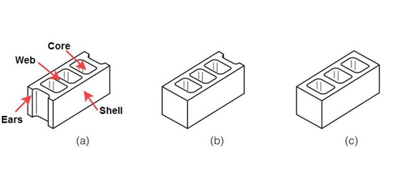
Figure (2): Concrete masonry units: (a) stretcher, (b) single-corner, and (c) double-corner.

Slide 9
Nominal vs. Actual Dimensions
As with Block , CMUs have actual dimensions and nominal dimensions. The nominal dimension of a CMU is the actual dimension plus the width of the mortar joint. Typical CMU mortar joints are 3/8". The nominal dimension works within the 4" grid that other construction materials follow. The graphic below shows the difference between nominal and actual sizes.

Slide 10
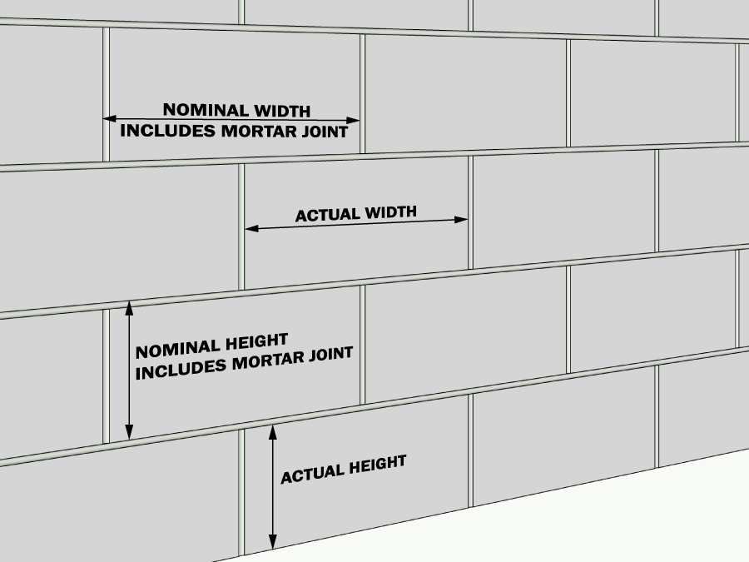

Slide 11
Concrete Block Dimensions
A 200 x 200 x 400 block has an actual width of 190 mm, height of 190 mm, and length of 390 mm.
Load-bearing concrete masonry units are available in nominal widths of 100 mm, 150 mm, 200 mm, 250 mm, and 300 mm, heights of 100 mm and 200 mm, and lengths of
300 mm, 400 mm, and 600 mm.

Slide 12
Advantages:
1. High durability
2. Different surfaces with different color shades
3. Very good variability of use
Disadvantages:
1. High weight
2. Lower thermal resistance
3. Demanding – labour consumption

Slide 13
Manufacturing of CMU
Manufacturing process of concrete blocks consists of four basic processes: (a) mixing, (b) molding, (c) curing, and (d) cubing as shown in Figure 3
(a) Mixing:
Raw materials are weighed out in proportions and transported to the mixer.
All raw materials are mixed for 6 to 8 minutes
Very dry, no-slump concrete

Slide 14
(b) Molding
From the mixer the materials enter the block molding machine
The molds consist of an outer mold box containing several mold liners.
The molds are vibrated for 7 seconds.
After the mold is removed the block are able to stand by themselves
(c) Curing
The concrete blocks are placed in a curing rack. Each rack holds several hundred blocks.
When a rack is full, it is rolled onto a set of rails and moved into a curing kiln.
Blocks remain in the curing kilns for 24 hours. They are baked in a moist steam heat at 60 ^{ο}C
(d) Cubing.
The rake of cured blocks is rolled out of the kiln.
The blocks pass through a cuber which aligns each block and then stacks them into a cube
Three blocks across by six blocks deep by three or four blocks high.
These cubes are carried outside with a forklift and placed in storage.

Slide 15
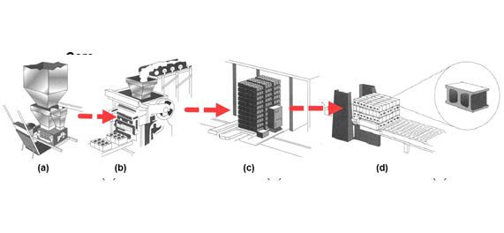
Figure (3) : Four basic processes of the manufacturing process of concrete blocks: (a) mixing, (b) molding, (c) curing, and (d) cubing.

Slide 16
Properties of Concrete Masonry units
Concrete masonry units are manufactured in three classes, based on their density: lightweight units, medium-weight units, and normal-weight units, with dry unit weights as shown in Table 1. Well graded sand, gravel, and crushed stone are used to manufacture normal-weight units. Lightweight aggregates such as pumice, scoria, cinders, expanded clay, and expanded shale are used to manufacture lightweight units.

Slide 17
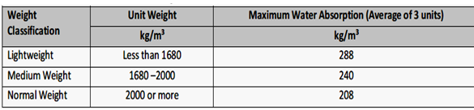
Table (1): Weight classifications and allowable maximum water absorption of concrete masonry units

Slide 18
Water Absorption
The amount of water absorption of concrete masonry units is controlled to reduce the effect of weathering and to limit the amount of shrinkage due to moisture loss after construction. The absorption of concrete masonry units is determined by immersing the unit in water for 24 hours. The absorption and moisture content are calculated as follows.

Slide 19
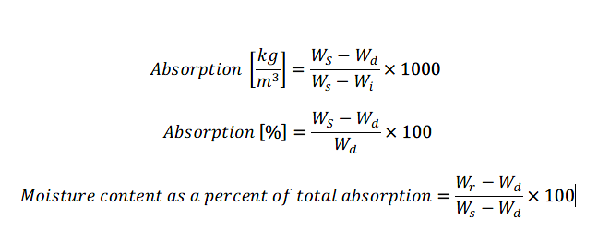
Where:
Ws = saturated weight of specimen, (kg)
Wd = oven-dry weight of unit, (kg),
Wi = immersed weight of specimen, (kg), and
Wr = weight of specimen as received
Table 1 shows the allowable maximum water absorption for load-bearing concrete masonry units.

Slide 20

Compressive Strength
Concrete masonry units can be classified as load bearing and non–load bearing. Load-bearing units must satisfy a higher minimum compressive strength requirement than non–load-bearing units, as shown in Table 2.

Slide 21
Applications of CMU
The typical uses for concrete block include:
Foundation walls - typically rock faced.
Basement walls.
Partition walls - usually plain faced.
Exterior walls - usually plain faced and then often covered with stucco.
Most concrete block was used as a back-up material or for cavity wall construction.
Coatings are often are applied to concrete block in order to prevent water penetration.
Lightweight units have higher thermal and fire resistance properties and lower sound resistance than normal weight units.

Slide 22
Types of Masonry Walls
Masonry walls are the most durable part of any building or structure. They provide strength, durability to the structure and also helps to control indoor temperature. Based on the wall construction, the types of masonry walls are:
Load Bearing Masonry Walls
Reinforced Masonry Walls
Hollow Masonry Walls
Composite Masonry Walls
Post-tensioned Masonry Walls

Slide 23
Load Bearing Masonry Walls
Load bearing masonry walls are constructed with bricks, stones or concrete blocks. These walls directly transfer loads from the roof to the foundation. These walls can be exterior as well as interior walls. The construction system with load bearing walls are economical than the system with framed Structures.

Slide 24
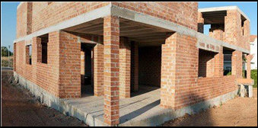
The thickness of load bearing walls is based on the quantity of load from roof it has to bear. For example, a load bearing wall with just a ground floor can have its outer walls of 230mm, while with one or more floors above it, based on occupancy type, its thickness may be increased. The load bearing walls can be reinforced or unreinforced masonry walls.

Slide 25
Reinforced masonry walls
Reinforced masonry walls can be load bearing walls or non-load bearing walls. The use of reinforcement in walls helps it to withstand tension forces and heavy compressive loads. The unreinforced masonry walls are prone to cracks and failure under heavy compressive loads and during earthquakes. They have little ability to withstand lateral forces during heavy rain and wind. Cracks also develop in un-reinforced masonry walls due to earth pressure or differential settlement of foundations.

Slide 26
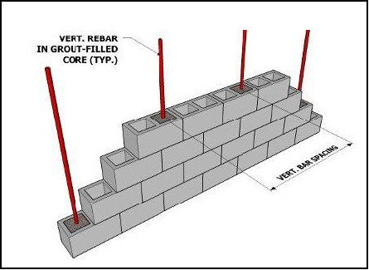
Figure: Example of a vertically reinforced masonry wall
To overcome such problems, reinforced masonry walls are used. Reinforcement in walls are at required intervals both horizontally and vertically is used. The size of reinforcement, their quantity and spacing are determined based on the loads on the walls and structural conditions.

Slide 27
Hollow Masonry Walls
Hollow or Cavity masonry walls are used to prevent moisture reaching the interior of the building by providing hollow space between outside and inside face of the wall. These walls also help in temperature control inside the building from outside wall as the hollow space restricts heat to pass through the wall.

Slide 28
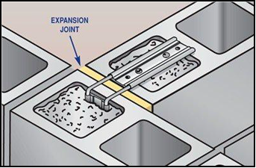
When the wall is exposed to moisture for a sustained period and penetrates through the outer face, the water reaches the cavity or the hollow space and flows down. Then they are drained through the weep holes to the exterior of the building. These hollow spaces may be coated with water repellent coating or damp-proofing to further reduce the ingress of moisture.
Figure: Hollow masonry walls

Slide 29
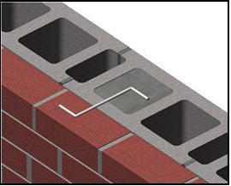
Composite Masonry Walls
These walls are constructed with two or more units such as stones or bricks and hollow bricks. This type of masonry wall construction is done for better appearance with economy.

Slide 30
In composite masonry walls, two wythes of masonry units are constructed bonding with each other. While one wythe can be brick or stone masonry while the other can be hollow bricks. A wythe is a continuous vertical section of masonry one unit in thickness. These wythes are interconnected either by horizontal joint reinforcement or by using steel ties.

Slide 31
Post-Tensioned Masonry Walls
Post-tensioned masonry walls are constructed to strengthen the masonry walls against the forces that may induce tension in the wall such as earthquake forces or wind forces. These walls are constructed from the foundation level and post-tensioning rods are anchored into the foundation.

Slide 32
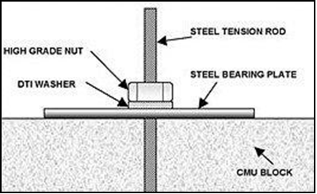
These rods are run vertically between the wythes or in the core of concrete masonry units. After the masonry wall construction is completed and cured, these rods are tensioned and anchored on the steel place at the top of the wall.
Figure: Post-tensioning of masonry walls.

Slide 33
THANK YOU FOR LISTENING

