Slide 1
Structural Design of Highway
Flexible Pavement Design
Highway and Transportation Engineering
Al-Mustansiriyah University
2019-2020
Dr. Rana Amir Yousif & Dr. Abeer K. Jameel

Slide 2
References
Nicholas J. Garber and Lester A. Hoel.”Traffic and Highway Engineering”, Fourth Edition.
Yoder; E. J. and M. W. Witczak, “Principles of Pavement Design”, A Wiley- Interscience Publication, John Wiley & Sons Inc., U.S.A., 1975.
Yaug H. Huang, “Pavement Analysis and Design”, Prentic Hall Inc., U.S.A., 1993.
“AASHTO Guide for Design of Pavement Structures 1993”, AASHTO, American Association of State Highway and Transportation Officials, U.S.A., 1993.
Oglesby Clarkson H., “Highway Engineering”, John Wiley & Sons Inc., U.S.A., 1975.

Slide 3

11.3 AASHTO METHOD
11.3.3 Effective Roadbed Soil Resilient Modulus
The effective roadbed soil resilient modulus is an equivalent modulus that would result in the same damage if seasonal modulus values were actually used . The equation for evaluating the relative damage to flexible pavements and the method for computing are discussed next .
Relative Damage: From Eq.11.37, the effect of MR on W18 can be expressed as
in which log C is the sum of all but the last two terms in Eq.11.37 . Equation 1138 can be written as

Slide 4

11.3 AASHTO METHOD
11.3.3 Effective Roadbed Soil Resilient Modulus
If WT is the predicted total traffic, the damage ratio, which is a ratio between predicted and allowable number of load repetitions, can be expressed as.
If WT is uniformly distributed over n periods, the cumulative damage ratio is

Slide 5

11.3 AASHTO METHOD
11.3.3 Effective Roadbed Soil Resilient Modulus
Equating Eq.11.40 to Eq.11.41 gives:
Equation 11 .42 can be used to determine the effective roadbed soil resilient modulus MR in terms of seasonal moduli MRi . Although the coefficient can be canceled out to simplify the equation, the AASHTO design guide keeps the coefficient and defines the relative damage as

Slide 6
11.3 AASHTO METHOD
11 .3.3 Effective Roadbed Soil Resilient Modulus
Computation of Effective Roadbed Soil Resilient Modulus
Figure 11.26 is a worksheet for estimating effective roadbed soil resilient modulus, in which Eq.11.43, together with a vertical scale for graphical solution of , is also shown . A year is divided into a number of periods during which different roadbed soil resilient moduli are specified. The shortest time period is half a month . These seasonal moduli can be determined from correlations with soil moisture and temperature conditions or from nondestructive deflection testing.

Slide 7
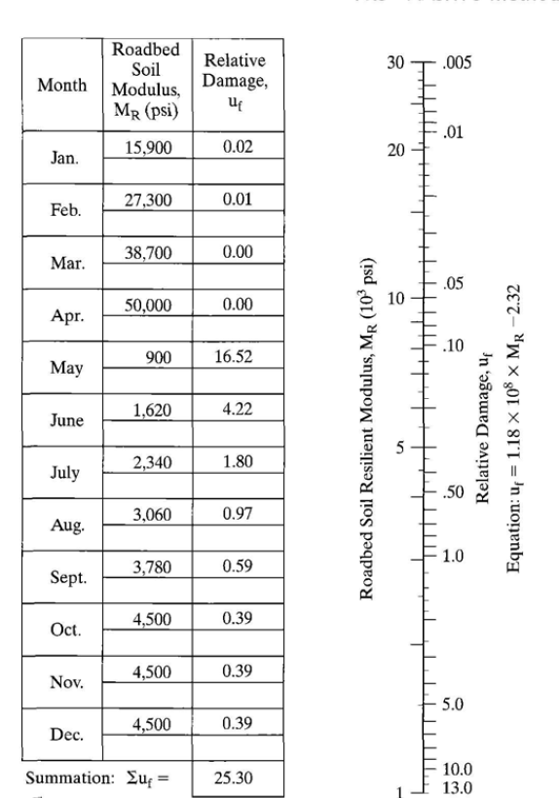

11.3 AASHTO METHOD
11.3.3 Effective Roadbed Soil Resilient Modulus
Effective Roadbed Soil Resilient Modulus, MR (psi) = 2,200 (corresponds to )
FIGURE 11.26
Worksheet for estimating effective roadbed soil resilient modulus (1 psi = 6 .9 kPa) .

Slide 8
11.3 AASHTO METHOD
11.3.4 Structural Number
Structural number is a function of layer thicknesses, layer coefficients, and drainage coefficients and can be computed from Eq.11.35
Layer Coefficient The layer coefficient , is a measure of the relative ability of a unit thickness of a given material to function as a structural component of the pavement.
Layer coefficients can be determined from test roads or satellite sections, as was done in the AASHO Road Test, or from correlations with material properties, as was shown in Figures 7.13, 7.15, and 7.16 .

Slide 9
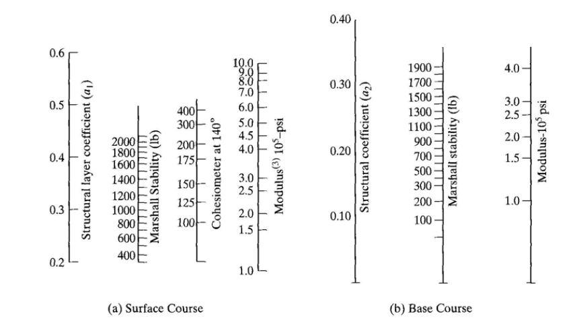
11.3 AASHTO METHOD
11.3.4 Structural Number
FIGURE 7.13
Correlation charts for estimating resilient modulus of HMA (1 lb = 4.45 N, 1 psi = 6 .9 kPa) . (After Van Til et al. (1972) )

Slide 10
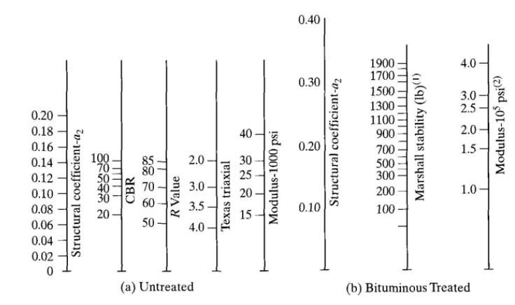
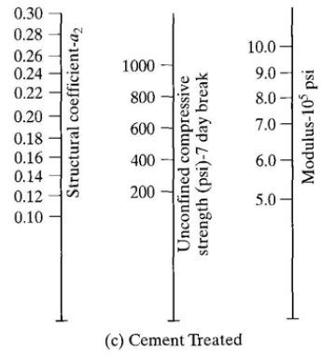
11.3 AASHTO METHOD
11.3.4 Structural Number
FIGURE 7.15
Correlation charts for estimating resilient modulus of bases (1 lb = 4 .45 KN, 1 psi = 6.9 kPa) . (After Van Til et al . (1972) )

Slide 11
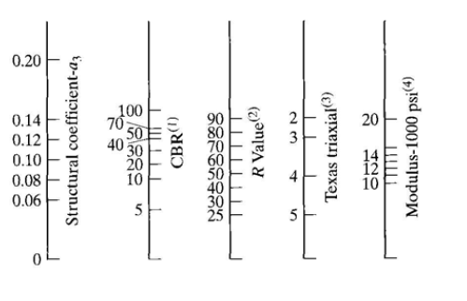
11.3 AASHTO METHOD
11.3.4 Structural Number
FIGURE 7.16
Correlation chart for estimating resilient modulus of subbases (1 psi = 6 .9 kPa) . (After Van Til et al. (1972))

Slide 12
11.3 AASHTO METHOD
11.3.4 Structural Number
It is recommended that the layer coefficient be based on the resilient modulus, which is a more fundamental material property. The procedure for determining the resilient modulus of a particular material varies with its type . Except for the higher stiffness materials, such as HMA and stabilized bases, that may be tested by the repeated load indirect tensile test (ASTM D-4123), all materials should be tested by the resilient modulus test methods (AASHTO T274) . Methods for determining the resilient modulus were described in Section 7.1.
In following the AASHTO design guide, the notation MR, as used herein, refers only to roadbed soils, whereas El , E2 , and E3 apply to the HMA, base, and sub-base, respectively.

Slide 13
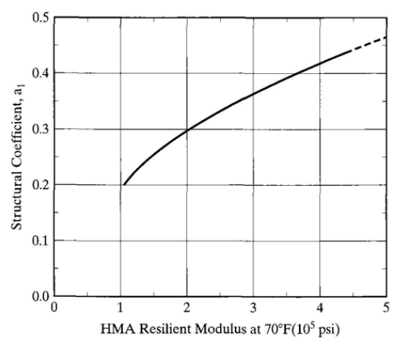
11.3 AASHTO METHOD
11.3.4 Structural Number
Asphalt - Concrete Surface Course: Figure 11.27 is a chart relating the layer coefficient of a dense-graded HMA to its resilient modulus at 70°F (21°C) .
a1= 0.36
FIGURE 11 .2 7
Chart for estimating layer coefficient of dense-graded asphalt concrete based on elastic modulus (1 psi = 6.9 kPa) . (After
Van Til et al. (1972) )
MR=3

Slide 14
11.3 AASHTO METHOD
11.3.4 Structural Number
Untreated and Stabilized Base Courses: Figure 7.15 shows the charts that can be used to estimate the layer coefficient for untreated, bituminous-treated, and cement-treated base courses . In lieu of Figure 7.15a, the following equation can also be used to estimate for an untreated base course from its resilient modulus :
The layer coefficient for the granular base material used in the AASHO Road Test is 0.14, which corresponds to a base resilient modulus of 30,000 psi (207 GPa) .
The resilient modulus of untreated granular materials depends on the stress state θ, as indicated by Eq.3.8 and rewritten here as

Slide 15
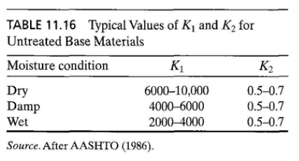
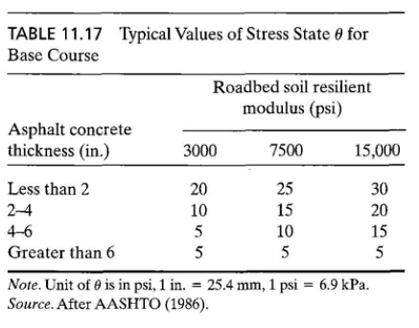
11.3 AASHTO METHOD
11.3.4 Structural Number
The resilient modulus of the base course is a function not only of Kl and K2 , but also of the stress state θ.

Slide 16
11.3 AASHTO METHOD
11.3.4 Structural Number
Granular Sub-base Course : Figure 7.16 provides the chart that may be used to estimate layer coefficient of granular sub-base courses. The relationship between and can be expressed as
As with granular base courses, values of Kl and K2 for granular sub-base courses can be determined from the resilient modulus test (AASHTO T274) or estimated from Table11.18. Values of K1 , K2, θ, and E3 for the sub-base in the AASHO Road Test are shown in Table 11.19 .

Slide 17
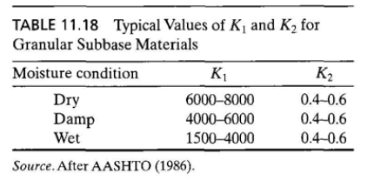
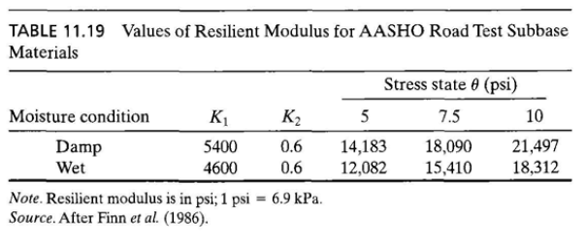
11.3 AASHTO METHOD
11.3.4 Structural Number

Slide 18
11.3 AASHTO METHOD
11.3.4 Structural Number
Drainage Coefficient : Depending on the quality of drainage and the availability o f moisture, drainage coefficients m2 and m3 should be applied to granular bases and sub - bases to modify the layer coefficients, as shown in Eq.11.35.
At the AASHTO Road Test site, these drainage coefficients are all equal to 1, as indicated by Eq.11.32.

Slide 19
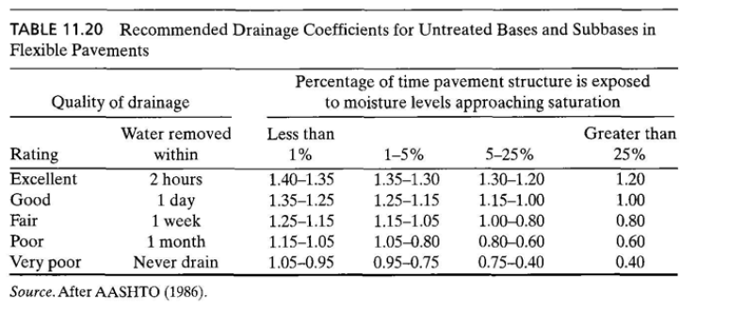
11.3 AASHTO METHOD
11.3.4 Structural Number
Table 11.20 shows the recommended drainage coefficients for untreated base and subbase materials in flexible pavements . The quality of drainage is measured by the length of time for water to be removed from bases and subbases and depends primarily on their permeability. The percentage of time during which the pavement structure is exposed to moisture levels approaching saturation depends on the average yearly rain fall and the prevailing drainage conditions .
M2=1.2
M2=0.7

Slide 20
11.3 AASHTO METHOD
11.3.5 Selection of Layer Thicknesses
Once the design structural number SN for an initial pavement structure is determined , it is necessary to select a set of thicknesses so that the provided SN, as computed by Eq.11.35, will be greater than the required SN. Note that Eq.11.35 does not have a single unique solution .
Many combinations of layer thicknesses are acceptable, so their cost effectiveness along with the construction and maintenance constraints must be considered to avoid the possibility of producing an impractical design . From a cost-effective view point, if the ratio of costs for HMA and granular base is less than the corresponding ratio of layer coefficients times the drainage coefficient, then the optimum economical design is to use a minimum base thickness by increasing the HMA thickness .

Slide 21
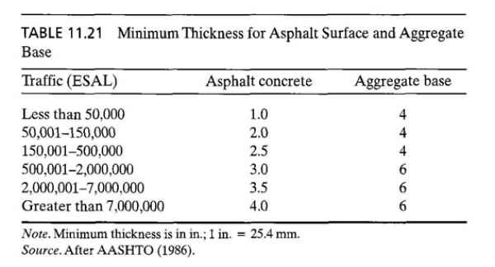
11.3 AASHTO METHOD
11.3.5 Selection of Layer Thicknesses
Minimum Thickness It is generally impractical and uneconomical to use layers of material that are less than some minimum thickness . Furthermore, traffic considerations may dictate the use of a certain minimum thickness for stability . Table 11.21 shows the minimum thicknesses of asphalt surface and aggregate base . Because such minimums depend somewhat on local practices and conditions, they may be changed if needed.

Slide 22
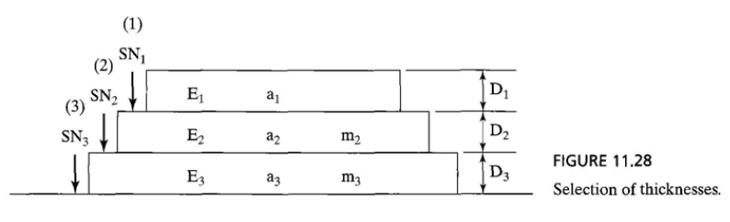
11.3 AASHTO METHOD
11.3.5 Selection of Layer Thicknesses
General Procedure The procedure for thickness design is usually started from the top, as shown in Figure 11.28 and described as follows:

Slide 23


11.3 AASHTO METHOD
11.3.5 Selection of Layer Thicknesses
Step 1
1. Using E2 as MR, determine from Figure 11.25 the structural number SN1 required to protect the base, and compute the thickness of layer 1 from
Step 2
2. Using E3 as MR, determine from Figure 11.25 the structural number SN2 required to protect the sub-base, and compute the thickness of layer 2 from

Slide 24
11.3 AASHTO METHOD
11.3.5 Selection of Layer Thicknesses
Step 3
3. Based on the roadbed soil resilient modulus MR, determine from Figure 11.25 the total structural number SN3 required, and compute the thickness of layer 3 from

Slide 25
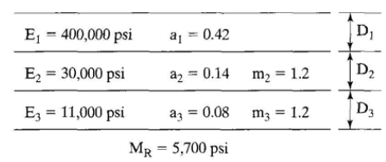
11.3 AASHTO METHOD
11.3.5 Selection of Layer Thicknesses
Example 11.12 :
Figure 11.29 is a pavement system with the resilient moduli, layer coefficients, and drainage coefficients as shown .
If predicted ESAL = 18.6 *
R = 95%,
So = 0.35
and ΔPSI = 2.1
select thicknesses Dl , D2 , and D3 .
FIGURE 11 .2 9
Example 11 .12 (1 psi = 6 .9 kPa) .

Slide 26
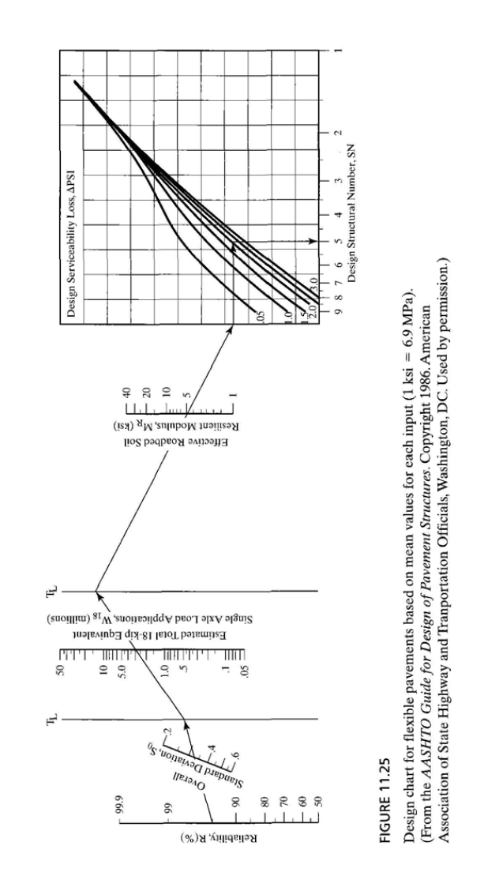
11.3 AASHTO METHOD
11.3.5 Selection of Layer Thicknesses
Solution : with

Slide 27
11.3 AASHTO METHOD
11.3.5 Selection of Layer Thicknesses
Note that a surface thickness of 8 in . (203 mm) and a base thickness of 7 in . (178 mm) meet the minimum thicknesses shown in Table11.21 .

Slide 28
11.3 AASHTO METHOD
11.3.5 Selection of Layer Thicknesses

Slide 29
11.3 AASHTO METHOD
11.3.5 Selection of Layer Thicknesses

Slide 30
Structural Design of Highway
Thanks for ATTENSION
Dr. Rana Amir Yousif & Dr. Abeer K. Jameel

