Slide 1
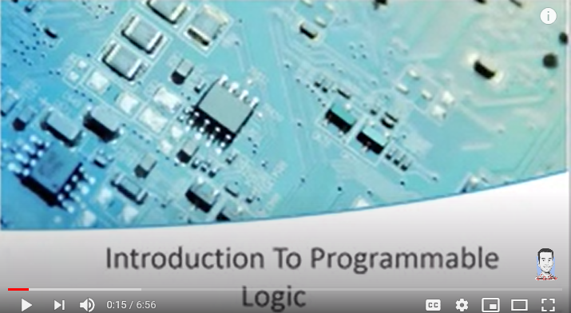
A programmable logic device (PLD) is an electronic component used to build reconfigurable digital circuits. Unlike integrated circuits (IC) which consist of logic gates and have a fixed function, a PLD has an undefined function at the time of manufacture.^{[1]} Before the PLD can be used in a circuit it must be programmed (reconfigured) by using a specialized program.

Slide 2
Digital Electronic Systems
1
Memory
2
Microprocessors
3
Logic

Slide 3
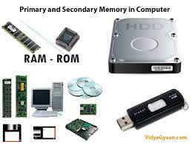
Memory
Computer memory is any physical device capable of storing information temporarily, like RAM (random access memory), or permanently, like ROM (read-only memory). Memory devices utilize integrated circuits and are used by operating systems, software, and hardware.

Slide 4
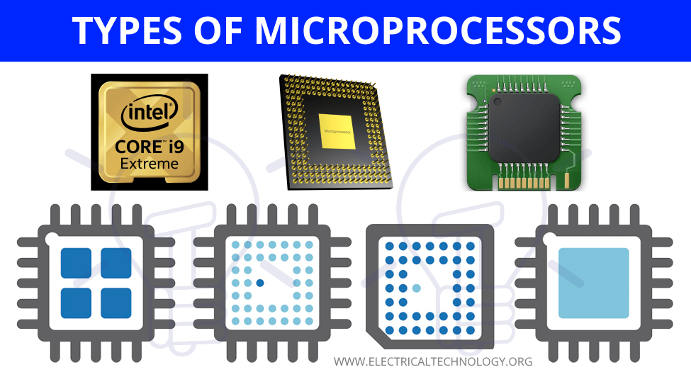
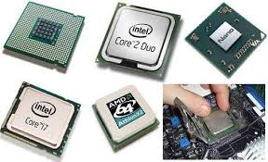
Microprocessors
A microprocessor is an electronic component that is used by a computer to do its work. It is a central processing unit on a single integrated circuit chip containing millions of very small components including transistors, resistors, and diodes that work together.

Slide 5
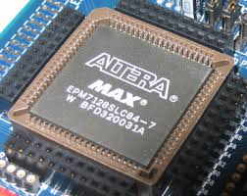
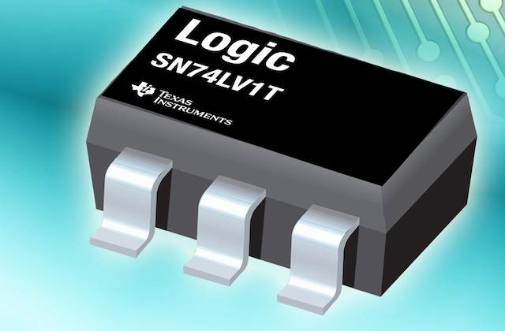
Logic Devices
Logic devices provide specific functions, including device-to-device interfacing, data communication, signal processing, data display, timing and control operations, and almost every other function a system must perform

Slide 6
Logic Devices
1
Fixed Function Logic Devices
2
Programmable Logic Devices

Slide 7
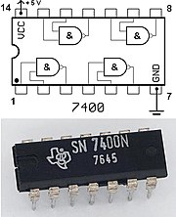
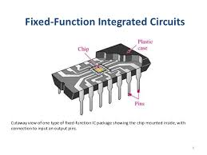
Fixed-Function Logic Devices
Fixed function logic refers to digital logic devices, such as a 7408 quad 2-input AND gate, whose operation cannot change. Circuits that require digital logic other than that in a particular device must use other logic devices.

Slide 8
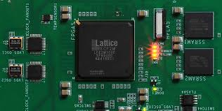
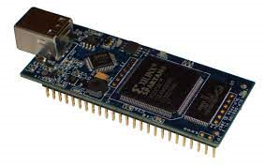
Programmable Logic Devices
A programmable logic device (PLD) is an electronic component used to build reconfigurable digital circuits. Unlike integrated circuits (IC) which consist of logic gates and have a fixed function, a PLD has an undefined function at the time of manufacture.

Slide 9
Advantages of Programmable Logic Devices
Advantages of using PLDs are
1- less board space,
2- faster,
3-lower power requirements (i.e., smaller power supplies),
4- less costly assembly processes,
5- higher reliability (fewer ICs and circuit connections means easier troubleshooting),
6-availability of design software.

Slide 10
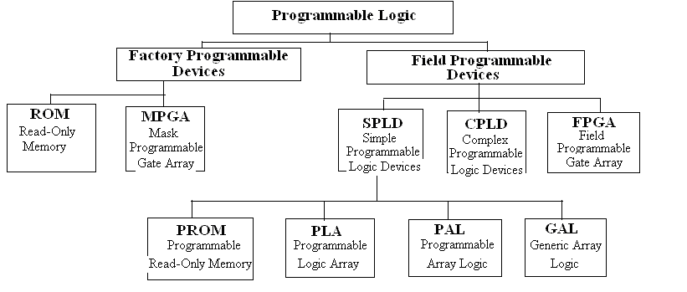
Types of Programmable Logic Devices

