Slide 1
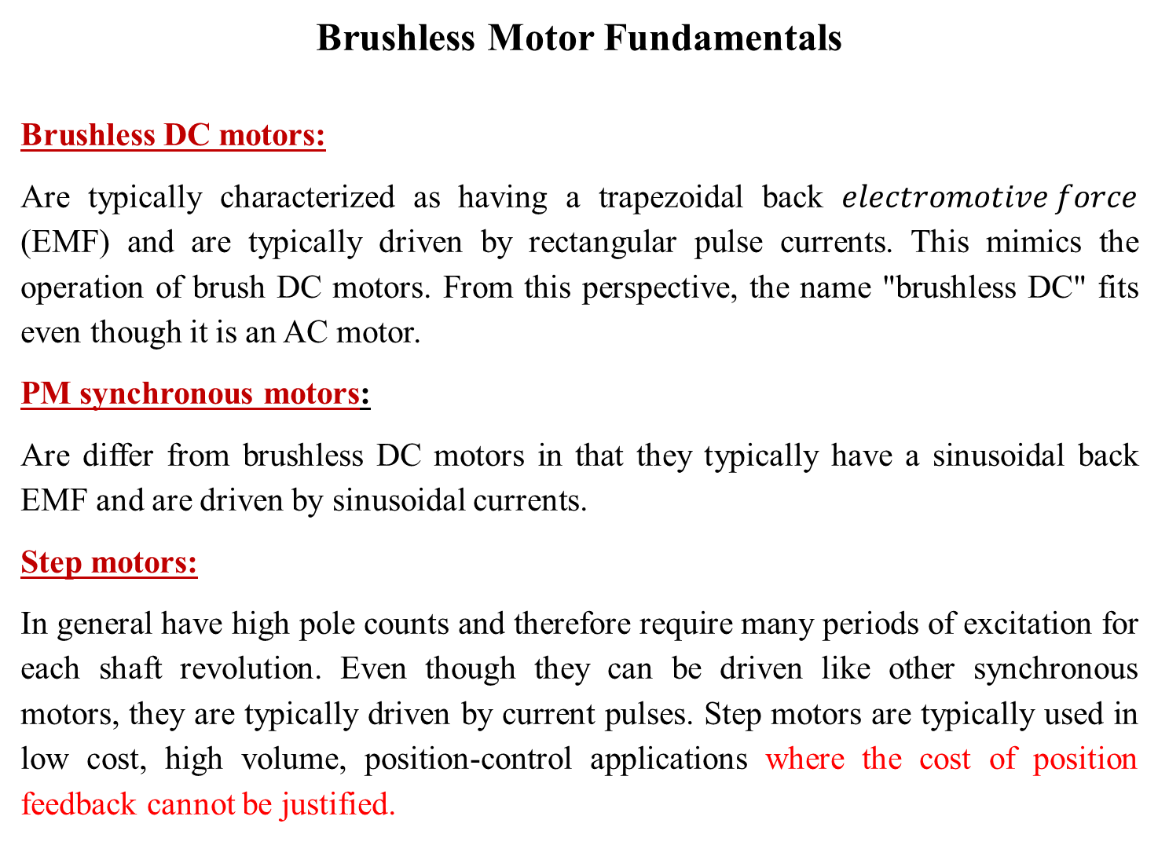
Brushless Motor Fundamentals
Brushless DC motors:
Are typically characterized as having a trapezoidal back $electromotive force$ (EMF) and are typically driven by rectangular pulse currents. This mimics the operation of brush DC motors. From this perspective, the name "brushless DC" fits even though it is an AC motor.
PM synchronous motors:
Are differ from brushless DC motors in that they typically have a sinusoidal back EMF and are driven by sinusoidal currents.
Step motors:
In general have high pole counts and therefore require many periods of excitation for each shaft revolution. Even though they can be driven like other synchronous motors, they are typically driven by current pulses. Step motors are typically used in low cost, high volume, position-control applications where the cost of position feedback cannot be justified.

Slide 2
The Permanent Magnet Motors (PMM) Group:
This group composed of three main types of motors
PM synchronous motor (PMSM)
Brushless DC motor (BLDCM)
Stepper Motor.
Due to their construction the rotary motors have different possibilities as shown in figure (n-1). The principle of operation of PMM can be summarized by a figure (n-2). It is clear that the direction of coil current determines the sense of rotation of the PM rotor. Also, it is clear that the alignment of the rotor with the magnetic axis of the stator produces no torque in both cases, and this preferred resting position will cause to stop the rotor and will act as a breaking arrangement.

Slide 3
Figure (n-1) [(a) Radial flux typical cylindrical type. (b) Radial flux, cylindrical an inside-out motor type. (c, d) Axial flux, pancake type

Slide 4
Figure (n-2) represents the effect of current directions in the sense of the generated torque

Slide 5
Figure (n-3) show a structure of a 3-phase arrangement motor.

Slide 6
Figure (n-4) A motor with distributed windings

Slide 7
Motor Design Possibilities
PMM types
A 4-pole 12-slot PMM

Slide 8
Radial Flux Motors
Inner Rotor:

Slide 9
Inner Rotor Possibilities
Stator Possibilities for Inner Rotor Motors

Slide 10
Outer Rotor:
Cross Section of Outer Rotor Possibilities

Slide 11
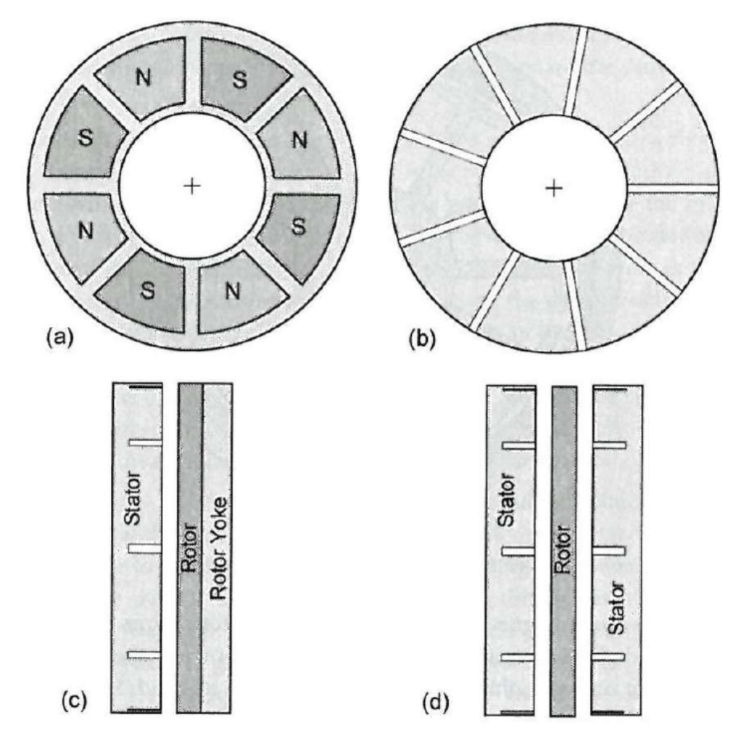
Axial Flux Motors
Axial Flux Motor Configuration

Slide 12
Linear Motors
Simple Linear Motor Structure

Slide 13
Alternative Linear Motor Structure

