Slide 1
Construction Engineering Management
University of Mustansiriyah 2020-2021
College of Engineering 3rd Stage
High. & Trans Eng. Dep.
Lecture No.1 (Week 1): Introduction (Part 1)
Construction Management Principles and Functions
Lecturers: Dr. Ali Jabbar
Dr. Abeer K. Jameel

Slide 2
Syllabus
1.Introduction
Construction Management Principles and functions
Project Phases
Term Definitions
Project Resources
Types of contracts
2. Project Programing techniques (Bar Charts)
3. Project Programing techniques ( Network Analysis)
AOA [C.P.M] method
AON method
4. Project Programing techniques( Programme Evaluation and Review Technique (PERT))
5. Project Programing techniques (Line of Balance)
6. Resource allocation

Slide 3
Basic References
Principle of construction management ; By Roy Pilcher
These lectures has been edited by Dr. Ali Jabbar

Slide 4

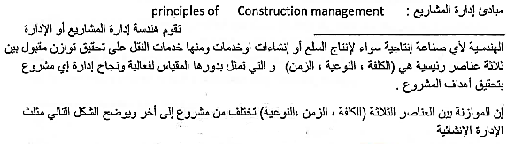
Introduction: Construction Management Principles
Cost
Quality
Time

Slide 5

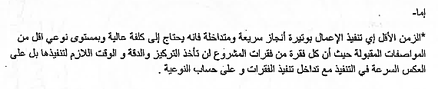
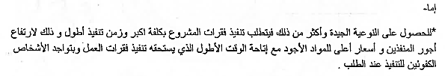
Introduction: Construction Management Principles
Cost
Quality
Time

Slide 6



Introduction: Construction Management Principles
Cost
Quality
Time

Slide 7
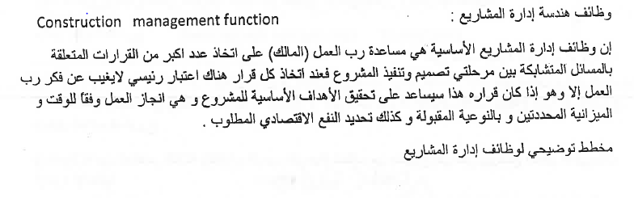
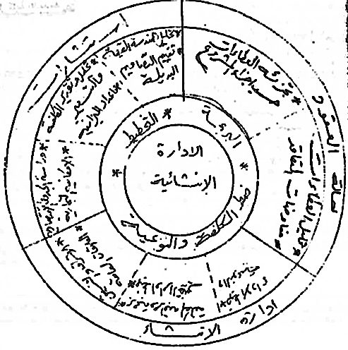
Introduction: Construction Management Functions
Construction management functions

Slide 8
Construction Engineering Management
University of Mustansiriyah 2020-2021
College of Engineering 3rd Stage
High. & Trans Eng. Dep.
Lecture No.1: Introduction (Part 2), Project Phases
Lecturers: Dr. Ali Jabbar
Dr. Abeer K. Jameel

Slide 9
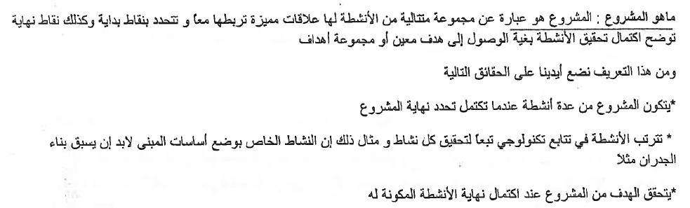
Introduction: Project Phases

Slide 10
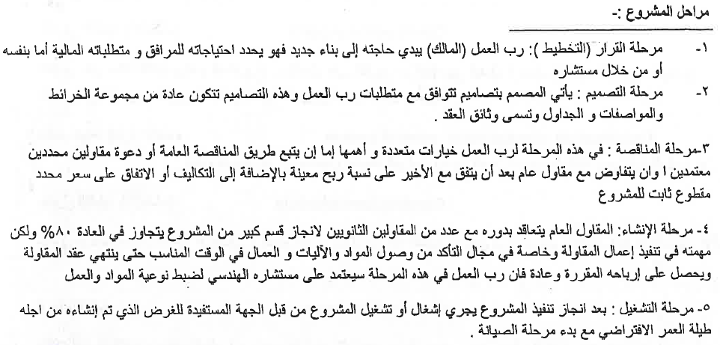
Introduction: Construction Management Functions

Slide 11
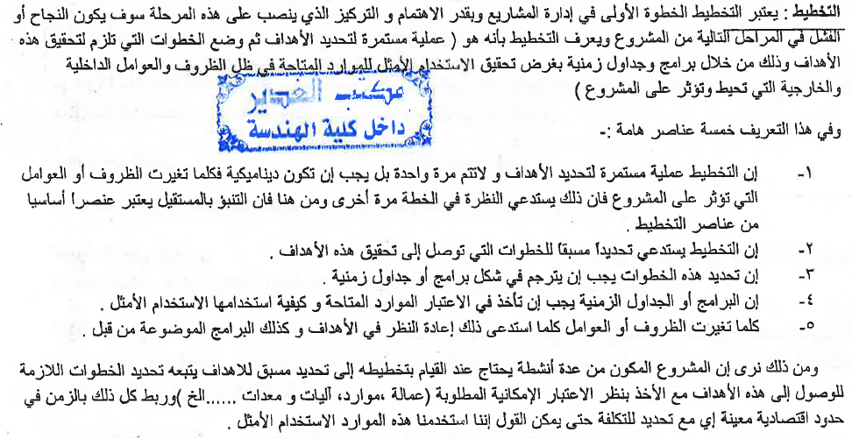
Introduction: Construction Management Functions

Slide 12
Introduction: Construction Management Functions

Slide 13
Construction Engineering Management
University of Mustansiriyah 2020-2021
College of Engineering 3rd Stage
High. & Trans Eng. Dep.
Lecture 1: Introduction (Part 3), Definitions of terms used in Construction Management
Lecturers: Dr. Ali Jabbar
Dr. Abeer K. Jameel

Slide 14
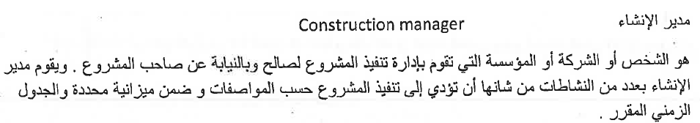
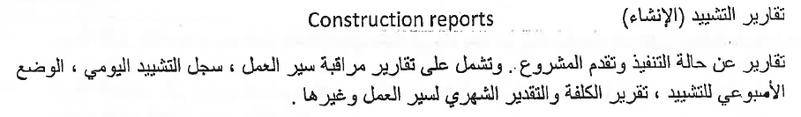
Introduction: Terms Definitions

Slide 15


Introduction: Terms Definitions

Slide 16
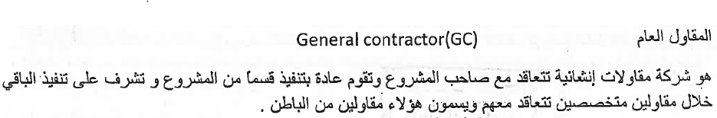
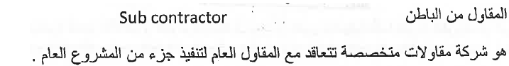
Introduction: Terms Definitions

Slide 17
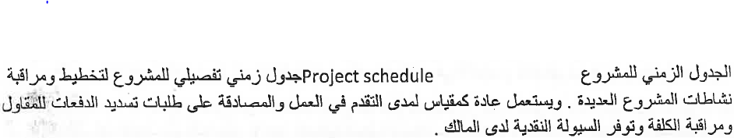
Introduction: Terms Definitions

Slide 18
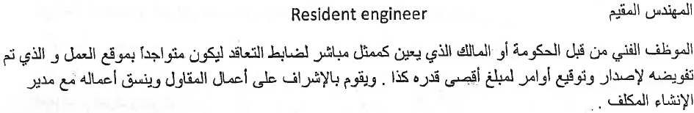
Introduction: Terms Definitions

Slide 19
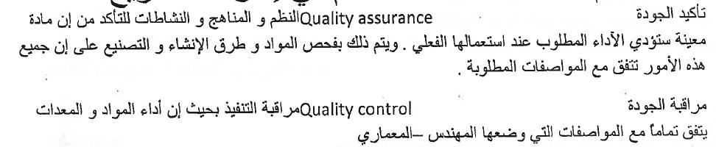
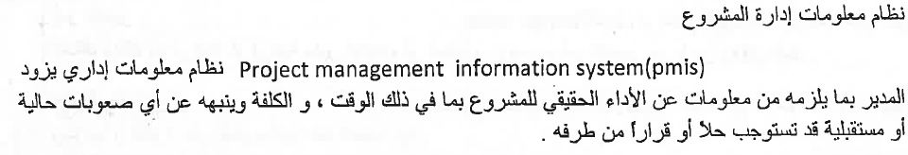
Introduction: Terms Definitions

Slide 20
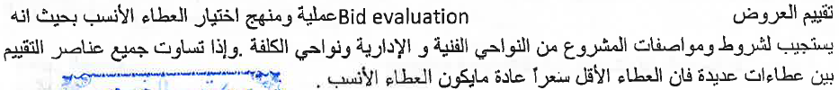
Introduction: Terms Definitions

Slide 21
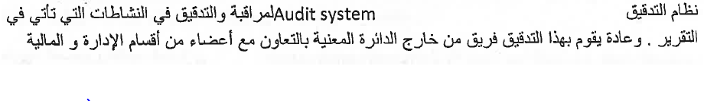
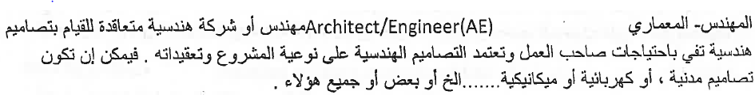
Introduction: Terms Definitions

Slide 22
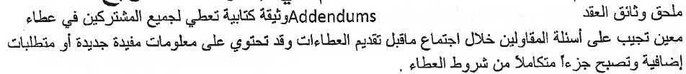
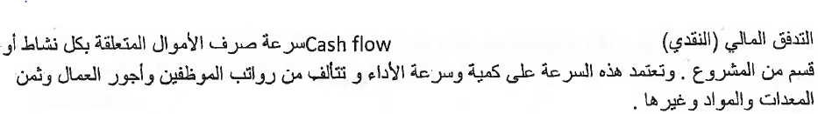
Introduction: Terms Definitions

Slide 23
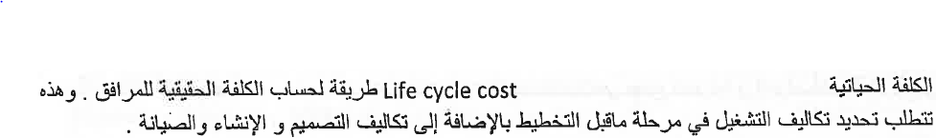
Introduction: Terms Definitions

Slide 24
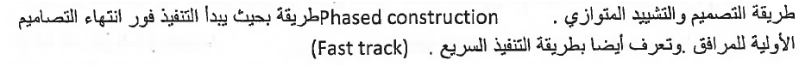
Introduction: Terms Definitions

Slide 25
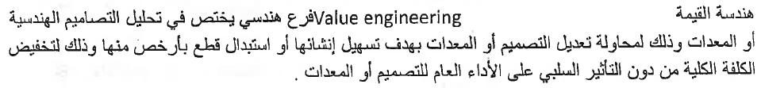
Introduction: Terms Definitions

Slide 26

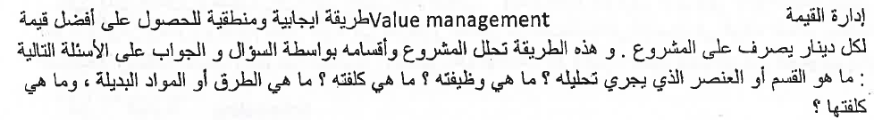
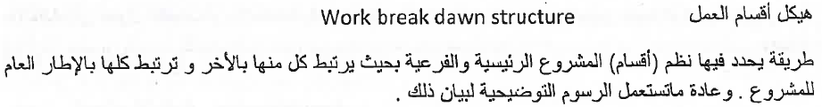
Introduction: Terms Definitions

Slide 27
Introduction: Terms Definitions

