Slide 1
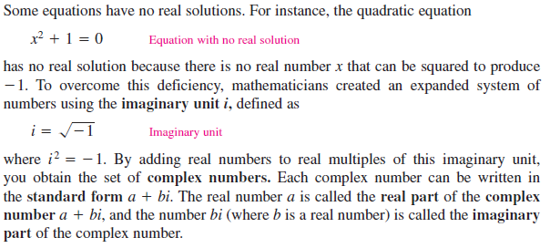
Complex Number
A complex number is , generally denoted by the letter z,
$z=a+bi , a=real part of z and bis imaginary part of z$

Slide 2
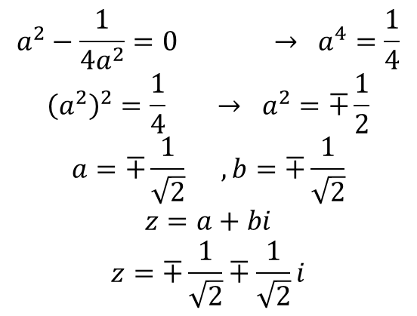
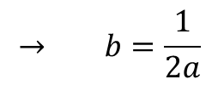
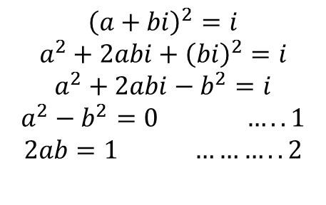
$$Example: Find all these z that satisfy z^{2}=i$$
$${\left(a+bi\right)}^{2}=i$$
$$a^{2}+2abi+{\left(bi\right)}^{2}=i$$
$$a^{2}+2abi−b^{2}=i$$
$$a^{2}−b^{2}=0 …..1$$
$$2ab=1 ………..2$$
$$→ b=\frac{1}{2a}$$
$$a^{2}−\frac{1}{4a^{2}}=0 → a^{4}=\frac{1}{4}$$
$${\left(a^{2}\right)}^{2}=\frac{1}{4} → a^{2}=∓\frac{1}{2}$$
$$a=∓\frac{1}{\sqrt{2}} , b=∓\frac{1}{\sqrt{2}}$$
$$z=a+bi$$
$$z=∓\frac{1}{\sqrt{2}}∓\frac{1}{\sqrt{2}}i$$
Example

Slide 3
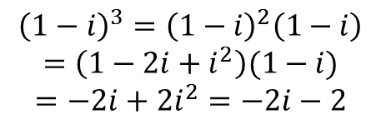
$Example: Evaluate in standard form {\left(1+i\right)}^{6}+{\left(1−i\right)}^{3}$
$${\left(1+i\right)}^{6}={\left[{\left(1+i\right)}^{2}\right]}^{3}={\left(1+2i+i^{2}\right)}^{3}={\left(2i\right)}^{3}=−8i$$
$${\left(1−i\right)}^{3}={\left(1−i\right)}^{2}\left(1−i\right)$$
$$=\left(1−2i+i^{2}\right)(1−i)$$
$$=−2i+2i^{2}=−2i−2$$
$${\left(1+i\right)}^{6}+{\left(1−i\right)}^{3}=−8i−2i−2$$
$$=−2−10i$$

Slide 4
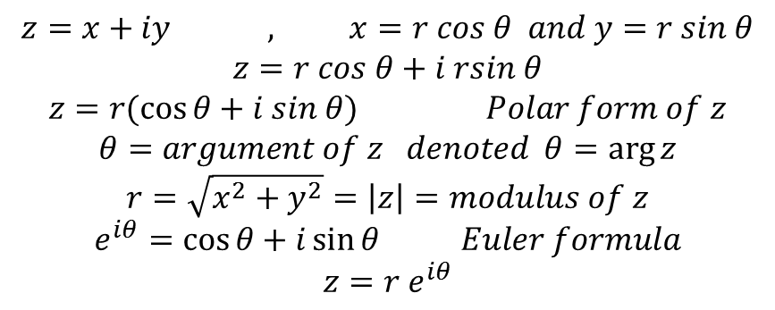
$$Let z=a+ib be a complex number. Then a complex number obtained by changing$$
$$the sign of imaginary part of the complex number is called the conjugate of z and$$
$$it is denoted by \overline{z}, i.e. \overline{z}=a−ib$$
$$\left|\overline{z}\right|=\left|x−iy\right|=\sqrt{x^{2}+y^{2}}=\left|z\right|=length of z$$
$$\overline{z_{1}+z_{2}}=\overline{\left(x_{1}+iy_{1}\right)+\left(x_{2}+{iy}_{2}\right)}$$
$$=\overline{\left(x_{1}+x_{2}\right)+i\left(y_{1}+y_{2}\right)}$$
$$=\left(x_{1}+x_{2}\right)−i\left(y_{1}+y_{2}\right)$$
$$=\left(x_{1}−{iy}_{1}\right)+\left(x_{2}−iy_{2}\right)$$
$$=\overline{z_{1}}+\overline{z_{2}}$$
$$The conjugate of the sum is equal of the sum of the congugates$$
$$z=x+iy , x=r cos θ and y=r sin θ$$
$$z=r cos θ+i rsin θ$$
$$z=r(\cos{θ+i sin θ) Polar form of z}$$
$$θ=argument of z denoted θ=\arg{z}$$
$$r=\sqrt{x^{2}+y^{2}}=\left|z\right|=modulus of z$$
$$e^{iθ}=\cos{θ+i\sin{θ}} Euler formula$$
$$z=r e^{iθ}$$

Slide 5
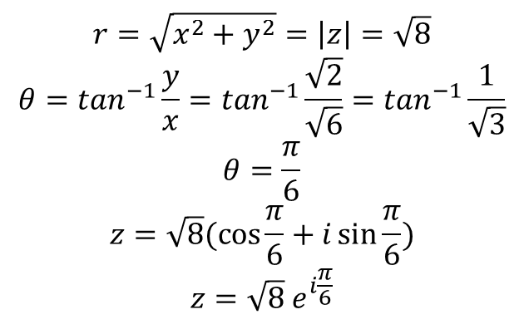
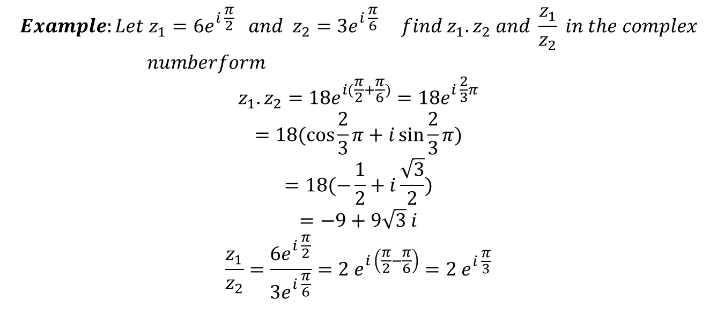
$Example: Determine the polar form of complex number z=−\sqrt{6} −\sqrt{2} i$
$$r=\sqrt{x^{2}+y^{2}}=\left|z\right|=\sqrt{8}$$
$$θ=\tan^{−1}\frac{y}{x}=\tan^{−1}\frac{\sqrt{2}}{\sqrt{6}}=\tan^{−1}\frac{1}{\sqrt{3}}$$
$$θ=\frac{π}{6}$$
$$z=\sqrt{8}(\cos{\frac{π}{6}+i\sin{\frac{π}{6})}}$$
$$z=\sqrt{8}{ e}^{i\frac{π}{6}}$$
$$Example:Let z_{1}=6e^{i \frac{π}{2}} and z_{2}=3e^{i \frac{π}{6}} find z_{1}.z_{2} and \frac{z_{1}}{z_{2}} in the complex$$
$numberform$
$$z_{1}.z_{2}=18e^{i(\frac{π}{2}+\frac{π}{6})}=18e^{i \frac{2}{3}π}$$
$$=18(\cos{\frac{2}{3}π+i\sin{\frac{2}{3}π)}}$$
$$=18(−\frac{1}{2}+i\frac{\sqrt{3}}{2})$$
$$=−9+9\sqrt{3} i$$
$$\frac{z_{1}}{z_{2}}=\frac{6e^{i \frac{π}{2}}}{3e^{i \frac{π}{6}}}=2{ e}^{i \left(\frac{π}{2}−\frac{π}{6}\right)}=2 e^{i \frac{π}{3}}$$

Slide 6
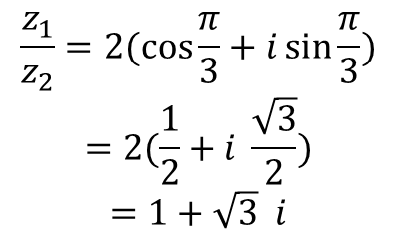
$$\frac{z_{1}}{z_{2}}=2(\cos{\frac{π}{3}+i\sin{\frac{π}{3})}}$$
$$=2(\frac{1}{2}+i \frac{\sqrt{3}}{2})$$
$$=1+\sqrt{3} i$$
$$r^{2}{\left(\cos{θ+isin θ}\right)}^{2}$$
$$r^{2}(\cos^{2}θ+2icosθsinθ−\sin^{2}θ)$$
$$r^{2}(cos2θ+isin2θ$$

Slide 7
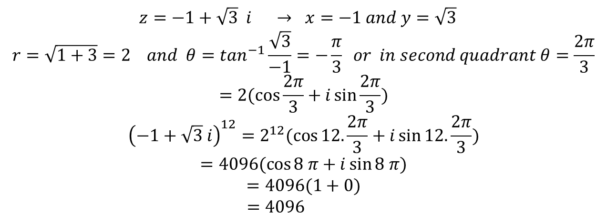
Example:
$$z=−1+\sqrt{3} i → x=−1 and y=\sqrt{3}$$
$$r=\sqrt{1+3}=2 and θ=\tan^{−1}\frac{\sqrt{3}}{−1}=−\frac{π}{3} or in second quadrant θ=\frac{2π}{3}$$
$$=2(\cos{\frac{2π}{3}+i\sin{\frac{2π}{3})}}$$
$${\left(−1+\sqrt{3} i\right)}^{12}=2^{12}(\cos{12.\frac{2π}{3}+i\sin{12.\frac{2π}{3})}}$$
$$=4096(\cos{8 π+i\sin{8 π)}}$$
$$=4096(1+0)$$
$$=4096$$

Slide 8
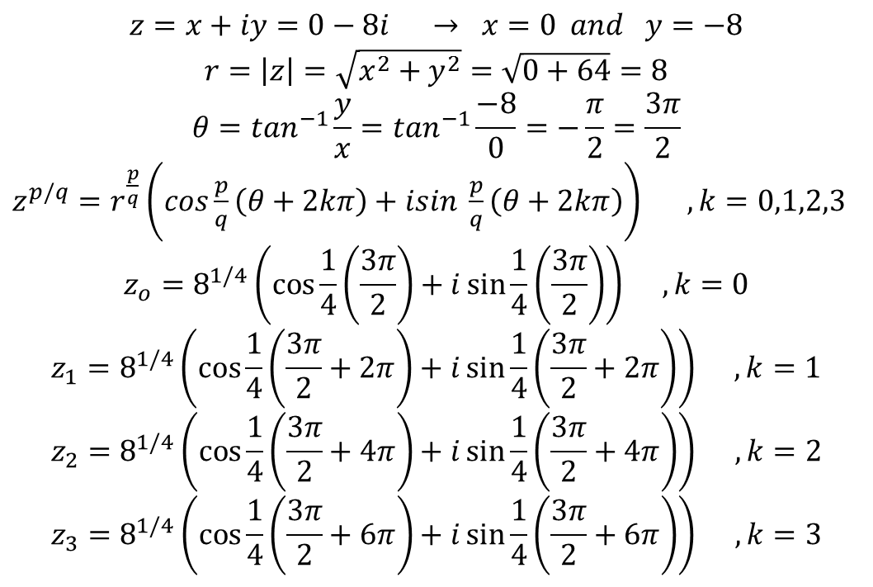
$$or using the following equation to find roots of complex numbers$$
$$z^{\frac{p}{q}}=r^{\frac{p}{q}} \left(e^{i \frac{p}{q}(θ+2kπ)}\right) , k=0.1 2, 3, …….q−1$$
$$=r^{\frac{p}{q}}(\cos{\frac{p}{q}\left(θ+2kπ\right)+i\sin{\frac{p}{q}(θ+2kπ)}}$$
$$Example:find the roots of \sqrt[4]{−8i}={\left(−8i\right)}^{1/4}$$
$$z=x+iy=0−8i → x=0 and y=−8$$
$$r=\left|z\right|=\sqrt{x^{2}+y^{2}}=\sqrt{0+64}=8$$
$$θ=\tan^{−1}\frac{y}{x}=\tan^{−1}\frac{−8}{0}=−\frac{π}{2}=\frac{3π}{2}$$
$z^{p/q}=r^{\frac{p}{q}}\left(cos\frac{p}{q}\left(θ+2kπ\right)+isin \frac{p}{q}\left(θ+2kπ\right)\right) , k=0,1,2,3$
$$z_{o}=8^{1/4}\left(\cos{\frac{1}{4}\left(\frac{3π}{2}\right)+i\sin{\frac{1}{4}\left(\frac{3π}{2}\right)}}\right) , k=0$$
$$z_{1}=8^{1/4}\left(\cos{\frac{1}{4}\left(\frac{3π}{2}+2π\right)+i\sin{\frac{1}{4}\left(\frac{3π}{2}+2π\right)}}\right) , k=1$$
$$z_{2}=8^{1/4}\left(\cos{\frac{1}{4}\left(\frac{3π}{2}+4π\right)+i\sin{\frac{1}{4}\left(\frac{3π}{2}+4π\right)}}\right) , k=2$$
$$z_{3}=8^{1/4}\left(\cos{\frac{1}{4}\left(\frac{3π}{2}+6π\right)+i\sin{\frac{1}{4}\left(\frac{3π}{2}+6π\right)}}\right) , k=3$$

Slide 9
Example:

