Slide 1



Controlled Single-phase Half-wave Rectifier
Lecture 8
Electrical Engineering Department
Power Electronics and Special Machine
By
Dr. Mustafa Fadel

Slide 2
Important Notice
Note to Students:
These lecture materials are provided as supplementary support to help clarify and reinforce the concepts discussed in the main course lectures. They are not a substitute for the official course materials or the primary references assigned. Students are encouraged to refer to the original sources and attend the main lectures to ensure full understanding of the subject.

Slide 3
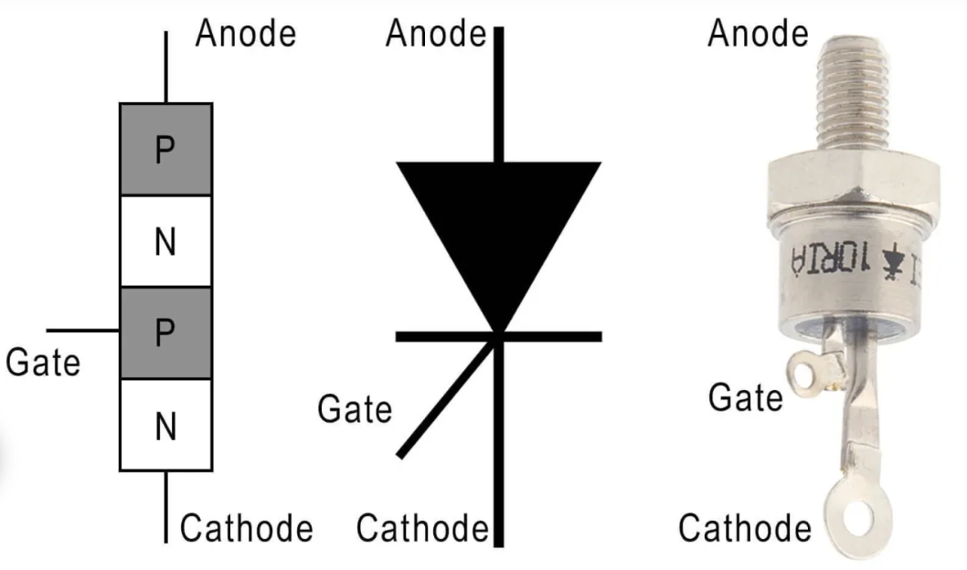
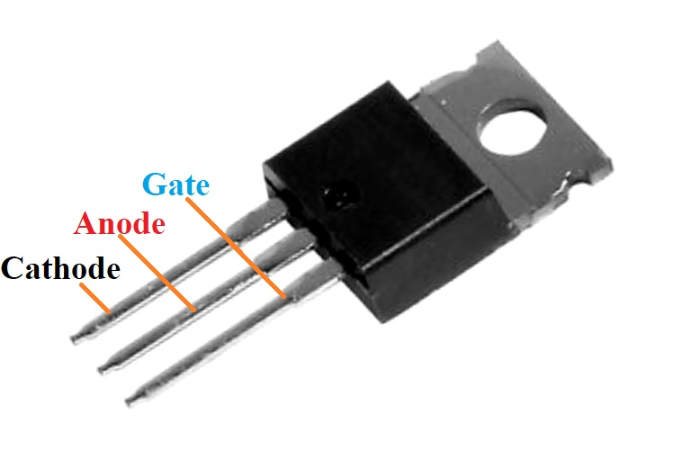
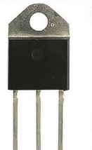
Single-phase Half-wave Controlled Rectifier

Slide 4
Single-phase Half-wave Controlled Rectifier
Difference Between Uncontrolled Rectifiers (Diodes) and Controlled Rectifiers (SCRs)
Feature | Uncontrolled Rectifier (Diode) | Controlled Rectifier (SCR / Thyristor)
Control of Output Voltage | No control, output depends only on input AC | Yes, output can be controlled by adjusting firing angle (α)
Conduction Control | Conducts automatically when forward biased | Conducts only when gate signal is applied, even if forward biased
Gate/Trigger Requirement | No gate terminal; operation is automatic | Requires a gate pulse to start conduction
Output Voltage Level | Fixed average DC output | Variable average DC output
Complexity | Simple circuit, easy to implement | Requires firing circuits, sometimes more complex control
Application | Simple power supplies where voltage regulation isn’t needed | Adjustable power, motor control, heating control, battery charging.

Slide 5
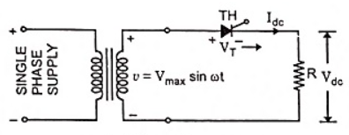
Single-phase Half-wave Controlled Rectifier with Resistive Load
The circuit diagram for single-phase half-wave controlled rectifier with resistive load is shown in figure below:

Slide 6
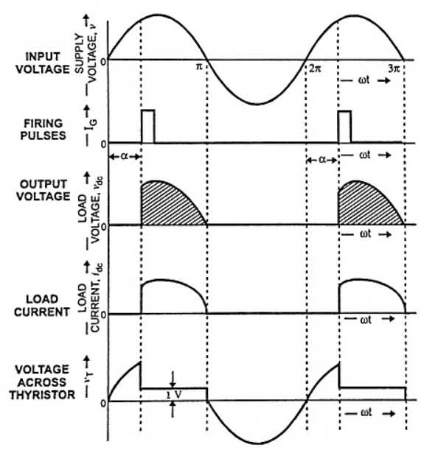
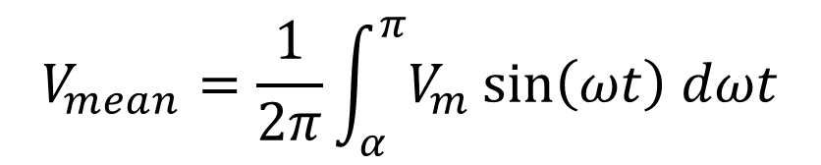
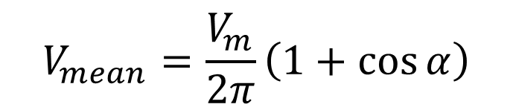
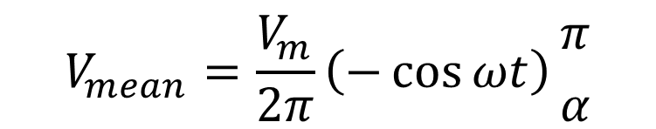
Single-phase Half-wave Controlled Rectifier with Resistive Load
$$V_{mean}=\frac{1}{2π}\int_{α}^{π}{V_{m}\sin\left(ωt\right) dωt}$$
Where α is the firing angle
$$V_{mean}=\frac{V_{m}}{2π}\left(−\cos{ωt}\right){π \atop α}$$
$$V_{mean}=\frac{V_{m}}{2π}\left(1+\cos{α}\right)$$

Slide 7
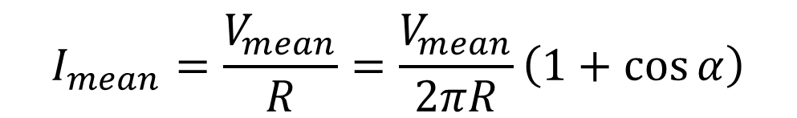
Single-phase Half-wave Controlled Rectifier with Resistive Load
$$I_{mean}=\frac{V_{mean}}{R}=\frac{V_{mean}}{2πR}\left(1+\cos{α}\right)$$
Maximum output (acts like diode)
α = 0° →
α = 90° →
α → 180° →
Half power
Zero output
Do rectifiers have efficiency?

Slide 8
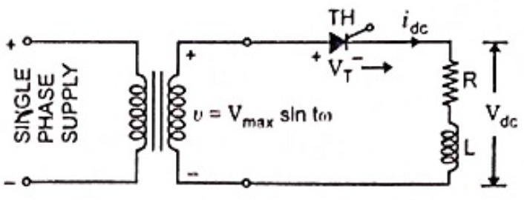
Single-phase Half-wave Controlled Rectifier with Inductive Load (R-L load)
The circuit diagram for single-phase half-wave controlled rectifier with inductive load is shown in figure below:

Slide 9
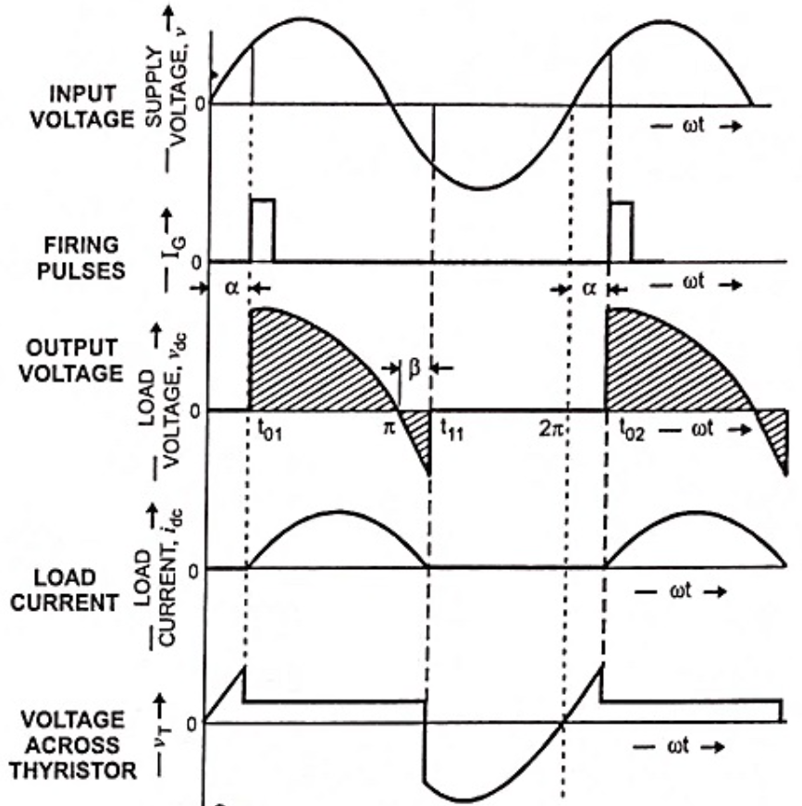

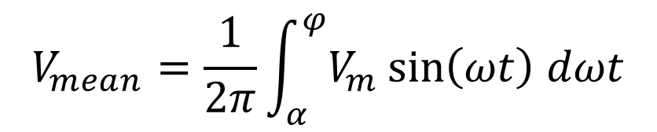
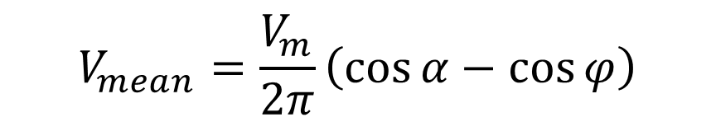
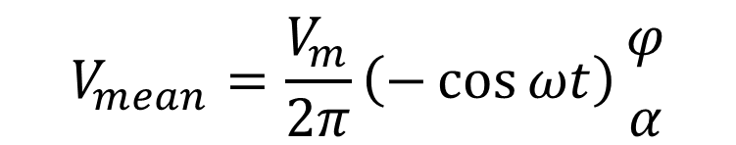
Single-phase Half-wave Controlled Rectifier with Inductive Load (R-L load)
$$V_{mean}=\frac{1}{2π}\int_{α}^{φ}{V_{m}\sin\left(ωt\right) dωt}$$
Where α is the firing angle and $φ$ is the extinction angle
$$V_{mean}=\frac{V_{m}}{2π}\left(−\cos{ωt}\right){φ \atop α}$$
$$V_{mean}=\frac{V_{m}}{2π}\left(\cos{α}−\cos{φ}\right)$$

Slide 10
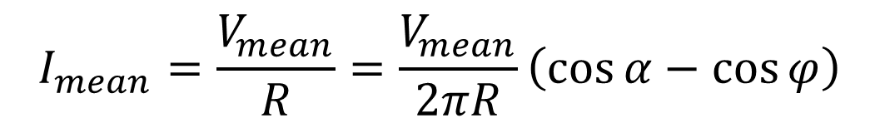
Single-phase Half-wave Controlled Rectifier with Inductive Load (R-L load)
$$I_{mean}=\frac{V_{mean}}{R}=\frac{V_{mean}}{2πR}\left(\cos{α}−\cos{φ}\right)$$

Slide 11
Single-phase Half-wave Controlled Rectifier with Resistive Load
Example: Consider a single-phase half-wave controlled rectifier supplying a series R–L load with R=10 Ω and L=30 mH. The rectifier is fed from an AC source of 100 V peak supply voltage and 50 Hz frequency. If the SCR is fired at 60° firing angle and extinction angle is 103°. Determine
1- The average output voltage and current.
2- The phase angle (θ) of current Lag.
2- If the input AC power is180 W, what is the rectifier efficiency?

Slide 12
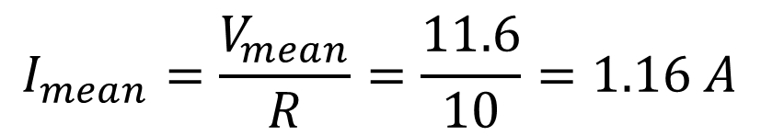
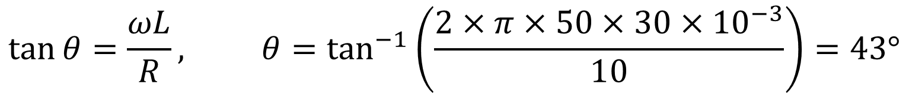
Single-phase Half-wave Controlled Rectifier with Resistive Load
Solution:
$$V_{mean}=\frac{V_{m}}{2π}\left(\cos{α}−\cos{φ}\right)=\frac{100}{2×3.14}\left(\cos{(60)}−cos(103)\right)=11.6 V$$
$$I_{mean}=\frac{V_{mean}}{R}=\frac{11.6}{10}=1.16 A$$
$$\tan{θ=\frac{ωL}{R}}, θ=\tan^{−1}\left(\frac{2×π×50×30×{10}^{−3}}{10}\right)=43°$$

Slide 13
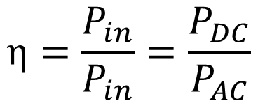
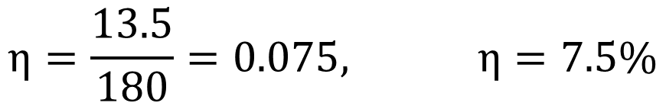
Single-phase Half-wave Controlled Rectifier with Resistive Load
Solution:
$$η=\frac{P_{in}}{P_{in}}=\frac{P_{DC}}{P_{AC}}$$
$$P_{DC}=I_{mean}^{2}×R={(1.16)}^{2}×10=13.5 W$$
Why the efficiency is low?
$$η=\frac{13.5}{180}=0.075, η=7.5\%$$
Half-wave controlled rectifiers have low efficiency because they use only half of the AC waveform, and inductive loads further reduce power transfer due to current lag.

Slide 14
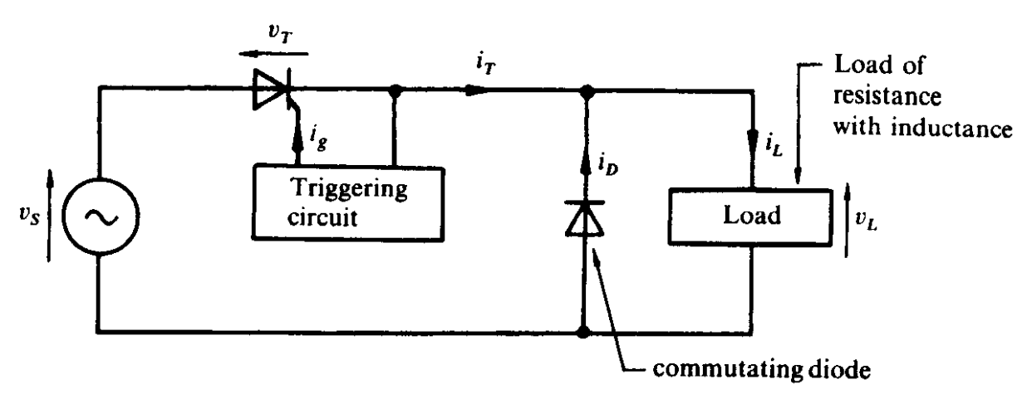
Single-phase Half-wave Controlled Rectifier with Inductive Load (R-L load) and Freewheeling Diode
The circuit diagram for single-phase half-wave controlled rectifier with inductive load and freewheeling diode is shown in figure below:

Slide 15
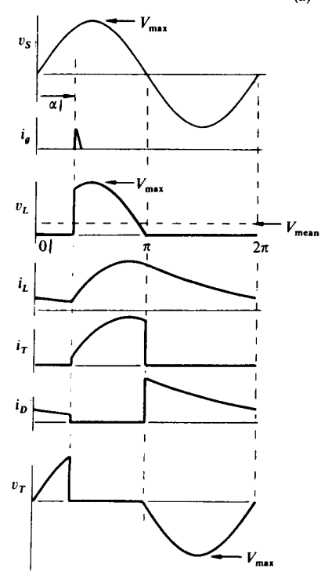
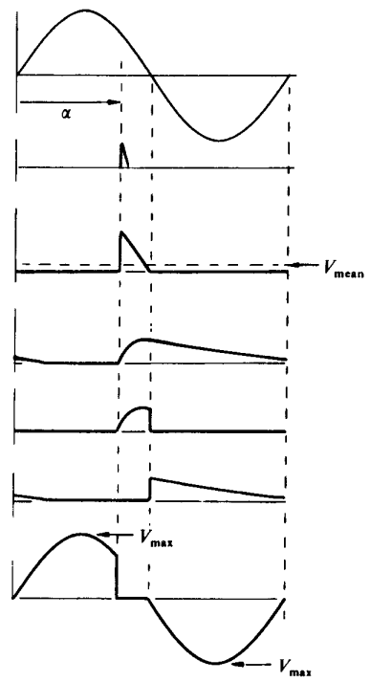
Single-phase Half-wave Controlled Rectifier with Inductive Load (R-L load) and Freewheeling Diode

Slide 16
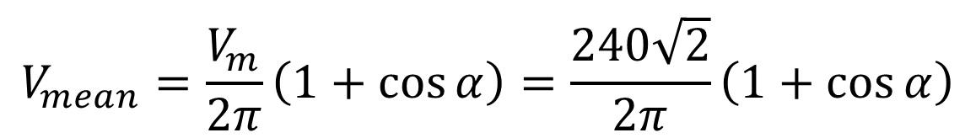
Single-phase Half-wave Controlled Rectifier with Inductive Load (R-L load) and Freewheeling Diode
Example: Consider a single-phase half-wave controlled rectifier with commutating diode is used to supply a heavily load for up to 15 A peak current from a 240 V AC supply. Determine the mean load voltage for firing delay angles of 0°, 45°, 90°, 135°, and 180°, neglect the thyristor and diode voltage drops. Specify the required rating of the thyristor and diode.
Solution:
$$V_{mean}=\frac{V_{m}}{2π}\left(1+\cos{α}\right)=\frac{240\sqrt{2}}{2π}\left(1+\cos{α}\right)$$

Slide 17
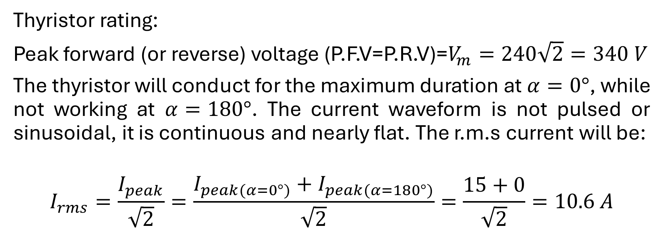
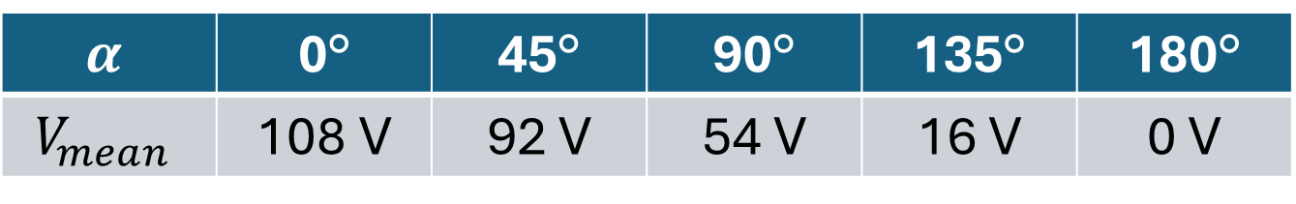
Single-phase Half-wave Controlled Rectifier with Inductive Load (R-L load) and Freewheeling Diode
$$α$$ | 0° | 45° | 90° | 135° | 180°
$$V_{mean}$$ | 108 V | 92 V | 54 V | 16 V | 0 V
Thyristor rating:
Peak forward (or reverse) voltage (P.F.V=P.R.V)=$V_{m}=240\sqrt{2}=340 V$
The thyristor will conduct for the maximum duration at $α=0°$, while not working at $α=180°$. The current waveform is not pulsed or sinusoidal, it is continuous and nearly flat. The r.m.s current will be:
$$I_{rms}=\frac{I_{peak}}{\sqrt{2}}=\frac{I_{peak(α=0°)}+I_{peak(α=180°)}}{\sqrt{2}}=\frac{15+0}{\sqrt{2}}=10.6 A$$

Slide 18
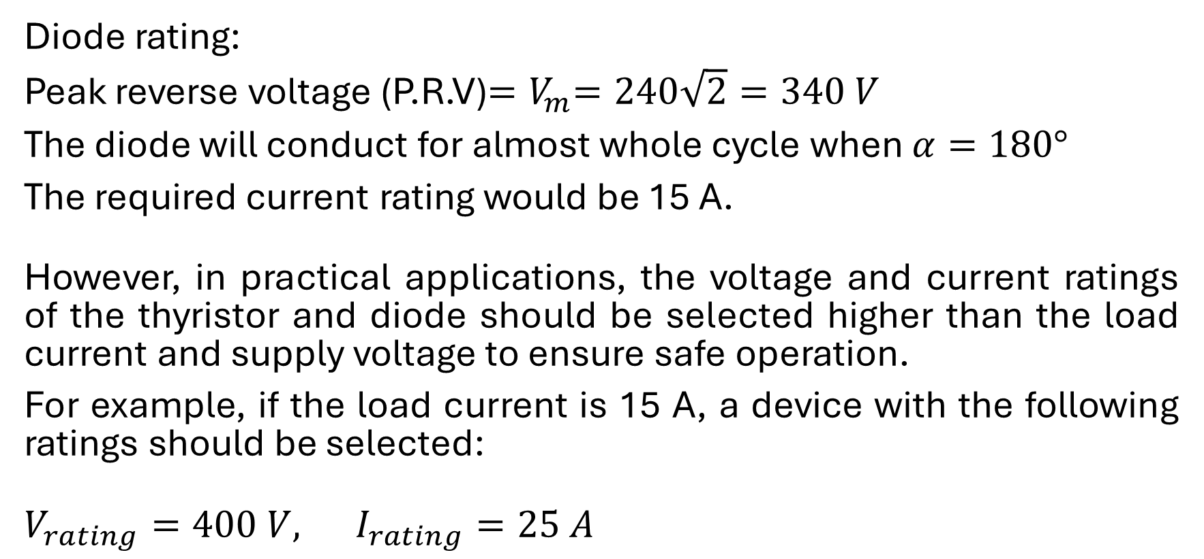
Single-phase Half-wave Controlled Rectifier with Inductive Load (R-L load) and Freewheeling Diode
Diode rating:
Peak reverse voltage (P.R.V)${=V}_{m}=240\sqrt{2}=340 V$
The diode will conduct for almost whole cycle when $α=180°$
The required current rating would be 15 A.
However, in practical applications, the voltage and current ratings of the thyristor and diode should be selected higher than the load current and supply voltage to ensure safe operation.
For example, if the load current is 15 A, a device with the following ratings should be selected:
$V_{rating}=400 V, I_{rating}=25 A$

Slide 19
Thanks for listening!

