Slide 1



Single-phase Half-wave Rectifiers
Lecture 9
Electrical Engineering Department
Power Electronics and Special Machine
By
Dr. Mustafa Fadel

Slide 2
Important Notice
Note to Students:
These lecture materials are provided as supplementary support to help clarify and reinforce the concepts discussed in the main course lectures. They are not a substitute for the official course materials or the primary references assigned. Students are encouraged to refer to the original sources and attend the main lectures to ensure full understanding of the subject.

Slide 3
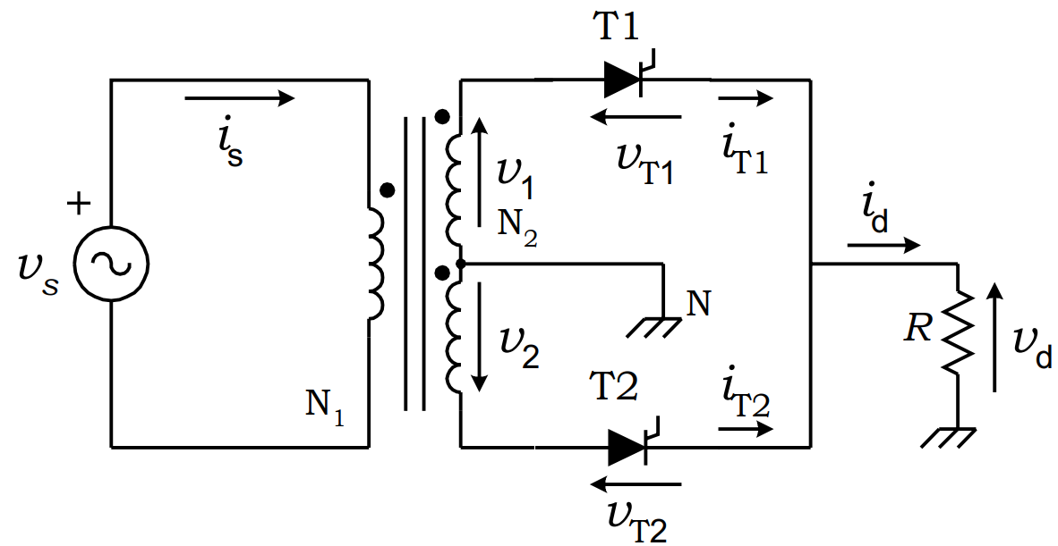
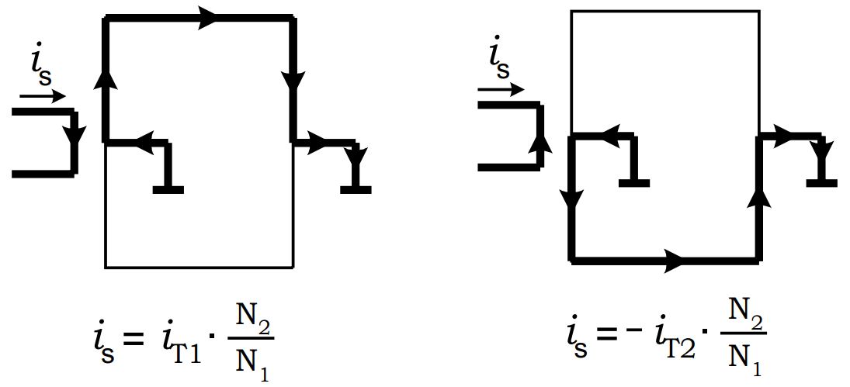

Bi-phase Half-wave (or Single-way) Rectifier with Resistive Load (R load)
The bi-phase half-wave rectifier shown in Figure below uses a center-tapped transformer to provide two voltages v₁ and v₂. These two voltages are $180°$ out-of-phase with respect to the mid-point neutral N. In this scheme, the load is fed via a thyristor in each positive cycle of voltages v₁ and v₂ and the load current returns via the neutral N.

Slide 4
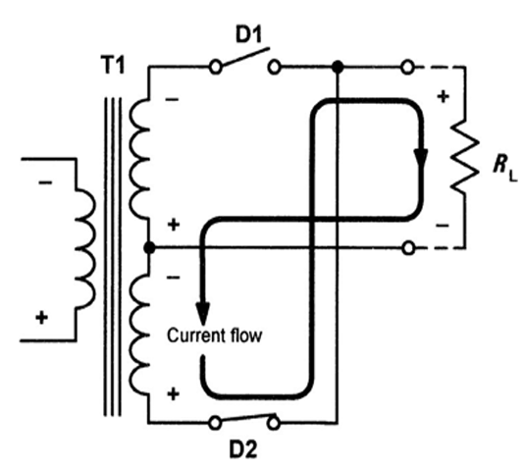
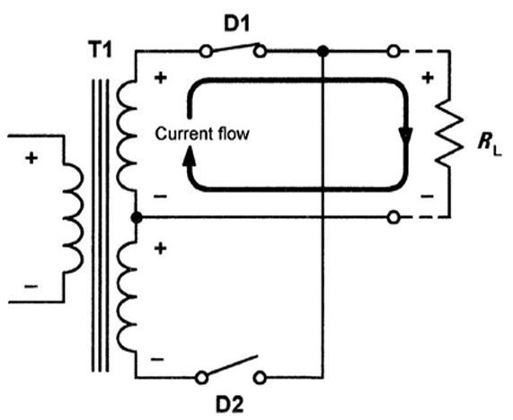

Bi-phase Half-wave (or Single-way) Rectifier with Resistive Load (R load)
The ac supply current is equal to $i_{T1}\left(\frac{N_{2}}{N_{1}}\right)$ when T₁ is in the on-state and ${−i}_{T2}\left(\frac{N_{2}}{N_{1}}\right)$when T₂ is in the on-state, where $\left(\frac{N_{2}}{N_{1}}\right)$ is the transformer turns ratio.

Slide 5
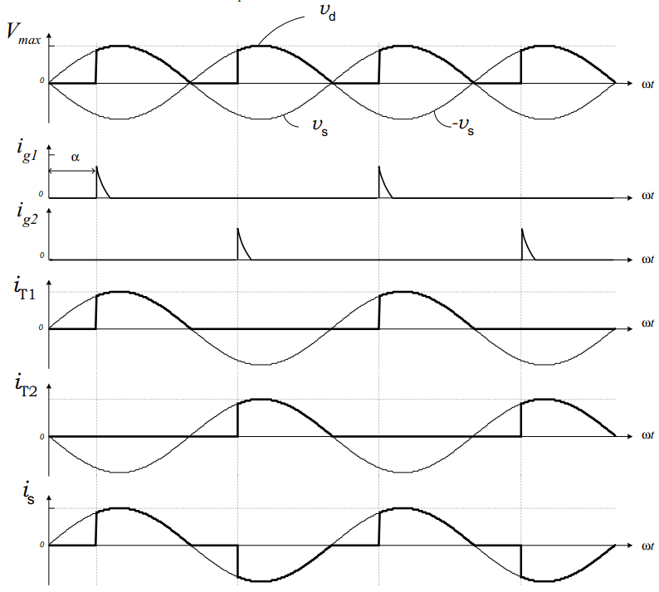
Bi-phase Half-wave (or Single-way) Rectifier with Resistive Load (R load)
The thyristor T1 can be fired into the ON state at any time provided that voltage v_{T1} > 0. The firing pulses are delayed by an angle a with respect to the instant where diodes would conduct. The side figure illustrates the current paths for each conduction state. Thyristor T₁ remains in the ON state until the load current tries to go to a negative value. Thyristor T₂ is fired into the ON state when v_{T2} > 0, which corresponds to the condition at which v₂ > 0.

Slide 6
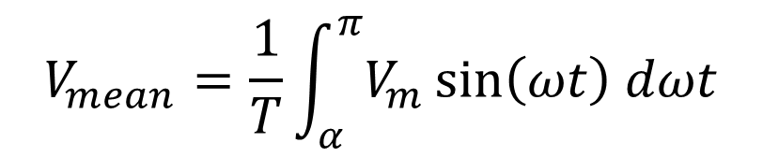
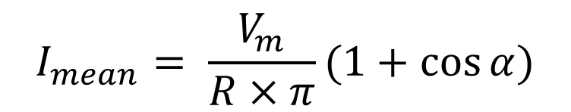
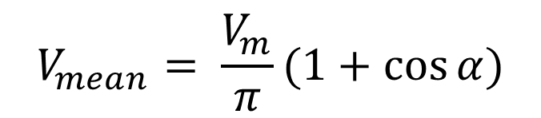
Bi-phase Half-wave (or Single-way) Rectifier with Resistive Load (R load)
$$V_{mean}=\frac{1}{T}\int_{α}^{π}{V_{m}\sin\left(ωt\right) dωt}$$
$$V_{mean}= \frac{V_{m}}{π}(1+cos{α)}$$
$$I_{mean}= \frac{V_{m}}{R×π}(1+cos{α)}$$

Slide 7
Bi-phase Half-wave (or Single-way) Rectifier with Resistive Load (R load)
Example: A single-phase half-wave controlled rectifier is supplied from a 220 V (rms), 50 Hz AC source. The load is purely resistive, with R = 20 Ω. The thyristor firing angle is α = 60°. Determine:
The peak voltage (V_{m}) of the AC source
The average output (DC) voltage (V_{dc})
The average output current (I_{dc})
Sketch descriptions of the voltage and current waveforms

Slide 8
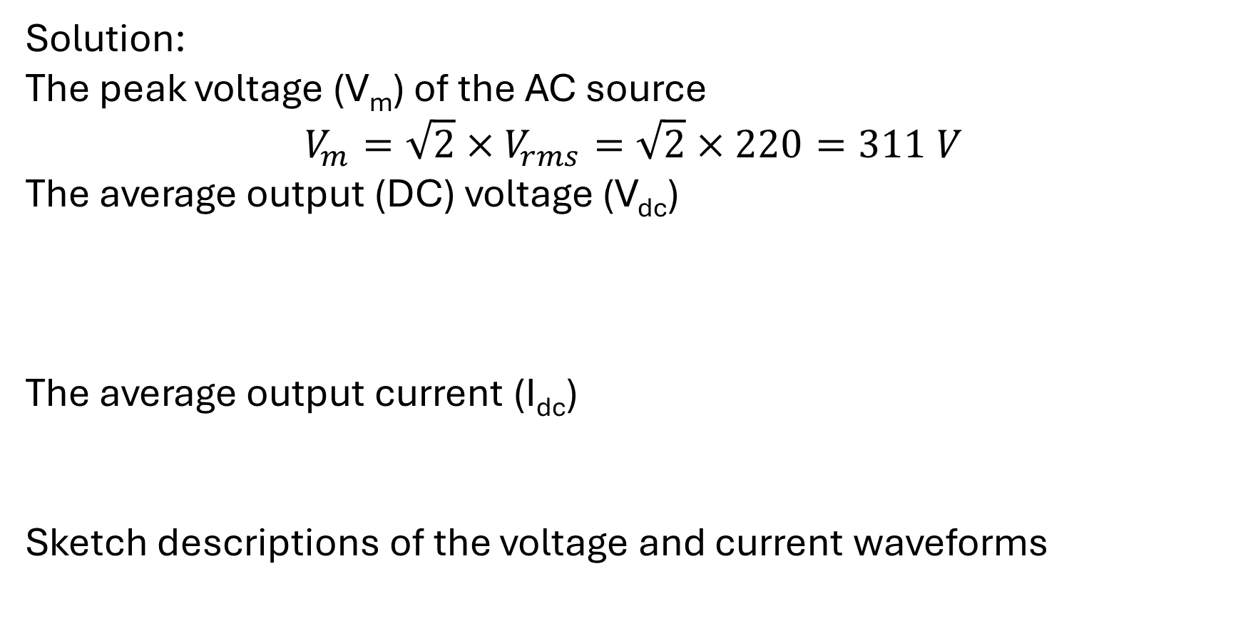
Bi-phase Half-wave (or Single-way) Rectifier with Resistive Load (R load)
Solution:
The peak voltage (V_{m}) of the AC source
$$V_{m}=\sqrt{2}×V_{rms}=\sqrt{2}×220=311 V$$
The average output (DC) voltage (V_{dc})
The average output current (I_{dc})
Sketch descriptions of the voltage and current waveforms
$$V_{mean}= \frac{V_{m}}{π}(1+cos{α)=\frac{311}{3.14}(1+\cos{60°)=148.6 V}}$$
$$I_{mean}= \frac{V_{mean}}{R}=\frac{148.6}{20}=7.43 A$$

Slide 9
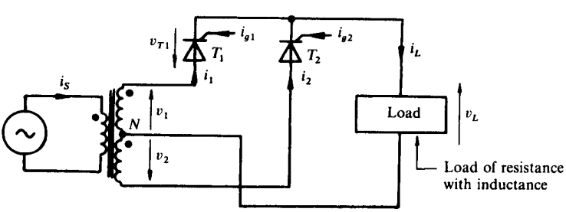
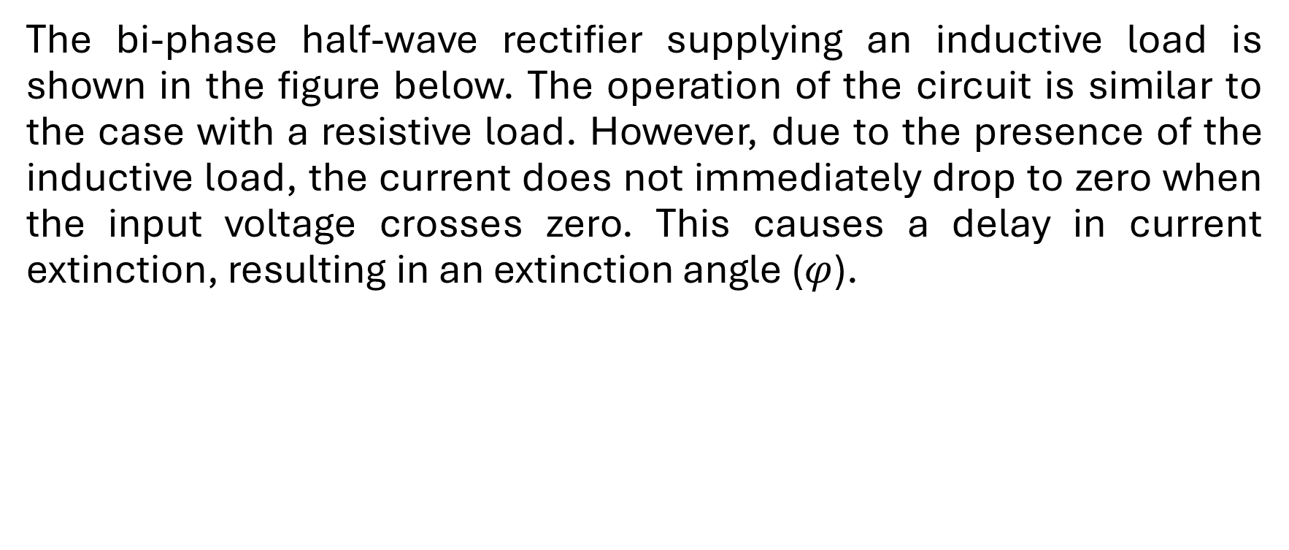
Bi-phase Half-wave (or Single-way) Rectifier with Inductive Load (R-L load)
The bi-phase half-wave rectifier supplying an inductive load is shown in the figure below. The operation of the circuit is similar to the case with a resistive load. However, due to the presence of the inductive load, the current does not immediately drop to zero when the input voltage crosses zero. This causes a delay in current extinction, resulting in an extinction angle ($φ$).

Slide 10
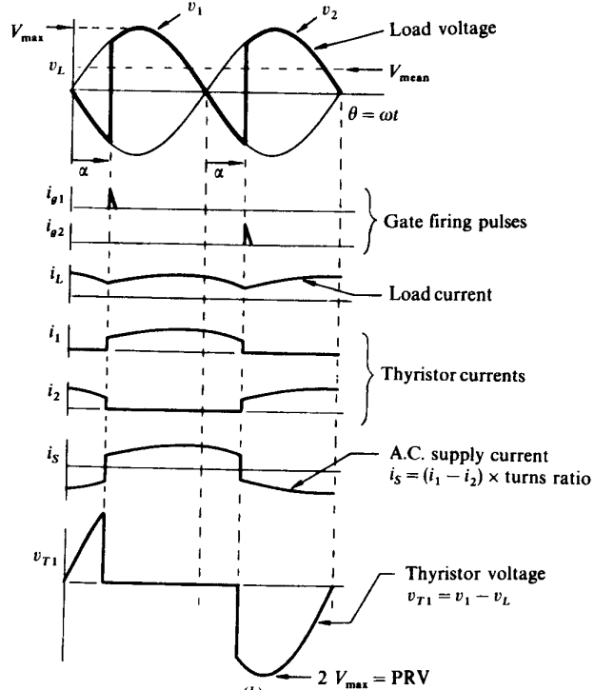
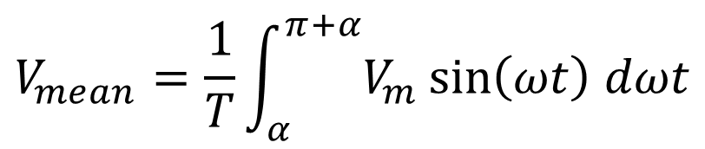
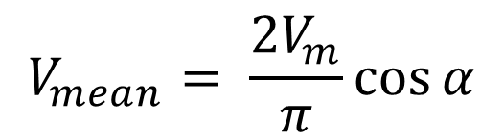
Bi-phase Half-wave (or Single-way) Rectifier with Inductive Load (R-L load)
The circuit waveforms illustrated in the figure. The peak reverse (and forward) (PRV and PFV) voltage that appears across the thyristor is 2V_{max} .
$$V_{mean}=\frac{1}{T}\int_{α}^{π+α}{V_{m}\sin\left(ωt\right) dωt}$$
$$V_{mean}= \frac{{2V}_{m}}{π}\cos{α}$$

Slide 11
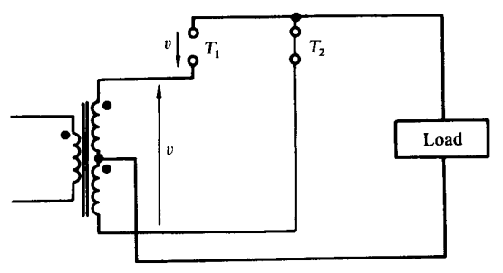
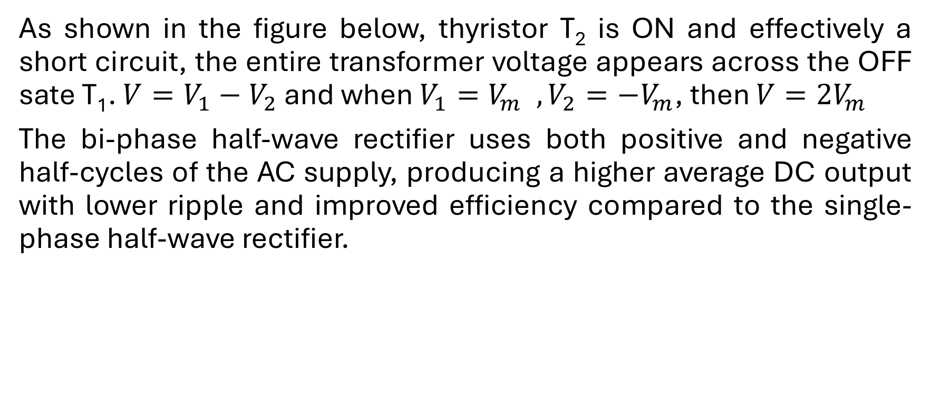
Bi-phase Half-wave (or Single-way) Rectifier with Inductive Load (R-L load)
As shown in the figure below, thyristor T₂ is ON and effectively a short circuit, the entire transformer voltage appears across the OFF sate T₁. $V=V_{1}−V_{2}$ and when $V_{1}=V_{m} , V_{2}=−V_{m}$, then $V=2V_{m}$
The bi-phase half-wave rectifier uses both positive and negative half-cycles of the AC supply, producing a higher average DC output with lower ripple and improved efficiency compared to the single-phase half-wave rectifier.

Slide 12
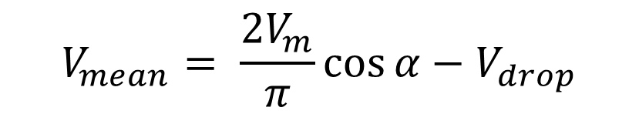
Bi-phase Half-wave (or Single-way) Rectifier with Inductive Load (R-L load)
Example: The bi-phase half-wave circuit is supplied at 120 V line to neutral. Determine the mean load voltage for firing delay angles of 0°, 30°, 60°, and 90°, assuming the load current to be continuous and level with a constant 1.5 V drop on each thyristor. Determine the required thyristor ratings given that the load current is 15 A.
Solution:
$$V_{mean}= \frac{{2V}_{m}}{π}\cos{α}−V_{drop}$$

Slide 13
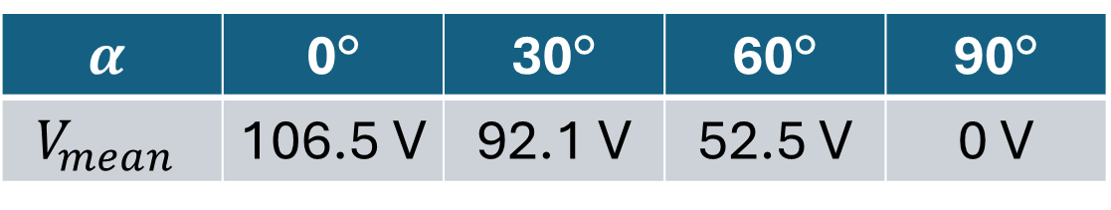

Bi-phase Half-wave (or Single-way) Rectifier with Inductive Load (R-L load)
$$α$$ | 0° | 30° | 60° | 90°
$$V_{mean}$$ | 106.5 V | 92.1 V | 52.5 V | 0 V
Thyristor rating:
Peak forward (or reverse) thyristor voltage =${2V}_{m}$
$$=2×120\sqrt{2}=340 V$$
$$I_{rms}=\frac{15}{\sqrt{2}}=10.6 A$$

Slide 14
Thanks for listening!

