Slide 1



Single-phase Bridge Rectifier
Lecture 10
Electrical Engineering Department
Power Electronics and Special Machine
By
Dr. Mustafa Fadel

Slide 2
Important Notice
Note to Students:
These lecture materials are provided as supplementary support to help clarify and reinforce the concepts discussed in the main course lectures. They are not a substitute for the official course materials or the primary references assigned. Students are encouraged to refer to the original sources and attend the main lectures to ensure full understanding of the subject.

Slide 3
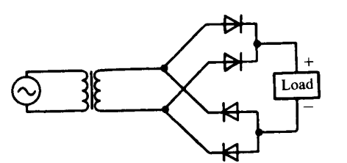
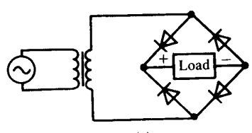
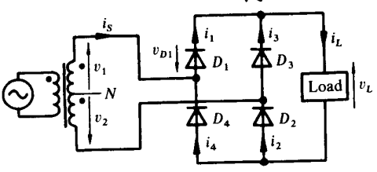
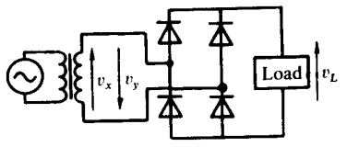
Uncontrolled Single-phase Bridge Rectifier (or Double-way) with Resistive Load (R load)
The circuit of uncontrolled single-phase bridge rectifier with Resistive Load (R load) is shown below

Slide 4
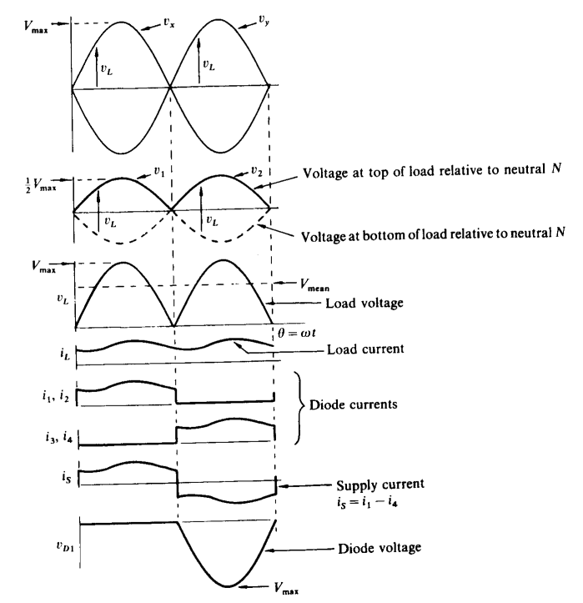
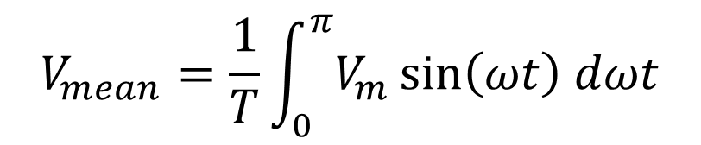
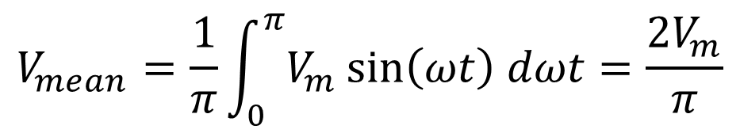
Uncontrolled Single-phase Bridge Rectifier (or Double-way) with Resistive Load (R load)
The waveforms of uncontrolled single-phase bridge rectifier with Resistive Load (R load) is shown:
The mean load voltage is
$$V_{mean}=\frac{1}{T}\int_{0}^{π}{V_{m}\sin\left(ωt\right) dωt}$$
$$V_{mean}=\frac{1}{π}\int_{0}^{π}{V_{m}\sin\left(ωt\right) dωt}=\frac{2V_{m}}{π}$$

Slide 5

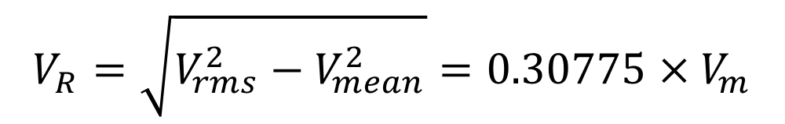

Uncontrolled Single-phase Bridge Rectifier (or Double-way) with Resistive Load (R load)
The mean load current is
The rms voltage is:
The voltage ripple is:
$$I_{mean}= \frac{{2V}_{m}}{R×π}$$
$$V_{rms}=\frac{V_{m}}{\sqrt{2}}$$
$$V_{R}=\sqrt{V_{rms}^{2}−V_{mean}^{2}}=0.30775{×V}_{m}$$

Slide 6
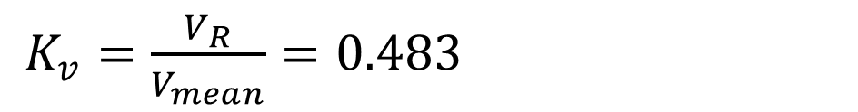
Uncontrolled Single-phase Bridge Rectifier (or Double-way) with Resistive Load (R load)
The ripple factor
Which is significantly less than the half wave rectifier (1.2)
$K_{v}=\frac{V_{R}}{V_{mean}}=0.483$

Slide 7
Uncontrolled Single-phase Bridge Rectifier (or Double-way) with Resistive Load (R load)
Example: A single-phase uncontrolled bridge rectifier is supplied from a 120 V (rms), 50 Hz AC source. The load is purely resistive, with R = 10 Ω. Assuming each diode to have voltage drop of 0.7 V. Determine:
The peak voltage (V_{m}) of the AC source.
The mean load voltage.
The mean output current.
The rectifier output power.

Slide 8
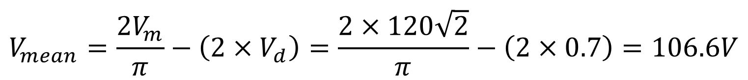

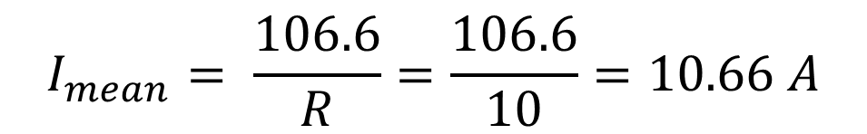
Uncontrolled Single-phase Bridge Rectifier (or Double-way) with Resistive Load (R load
Solution:
$V_{m}=V_{rms}×\sqrt{2}=120$ $\sqrt{2}$
$$V_{mean}=\frac{2V_{m}}{π}−\left(2×V_{d}\right)=\frac{2×120\sqrt{2}}{π}−\left(2×0.7\right)=106.6V$$
$$I_{mean}= \frac{106.6}{R}=\frac{106.6}{10}=10.66 A$$
$P_{out}=V_{mean}×I_{mean}=106.6×10.66=1136.356 W$

Slide 9
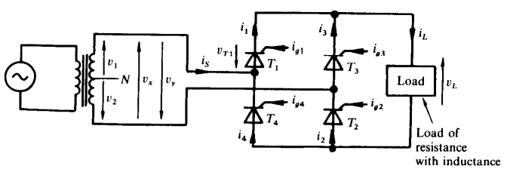
Fully Controlled Single-phase Bridge Rectifier (or Double-way) with Inductive Load (R-L load)
The circuit of fully controlled single-phase bridge rectifier with Inductive Load (R-L load) is shown below:

Slide 10
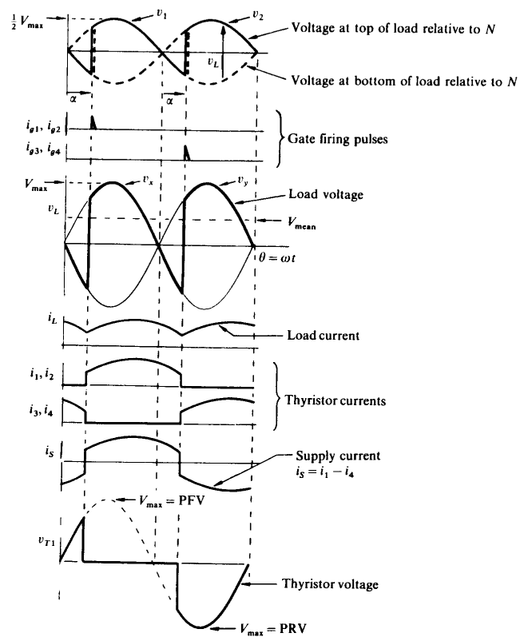
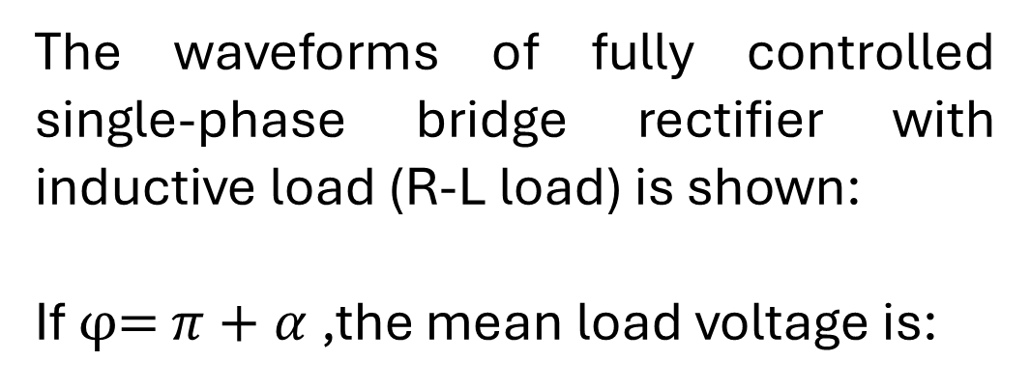
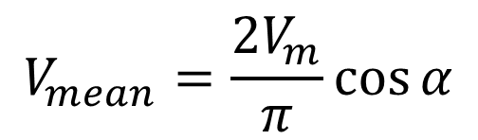
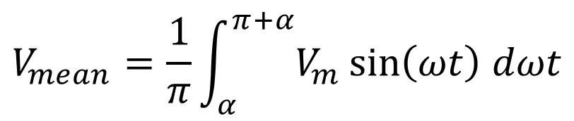
Fully Controlled Single-phase Bridge Rectifier (or Double-way) with Inductive Load (R-L load)
The waveforms of fully controlled single-phase bridge rectifier with inductive load (R-L load) is shown:
If φ= $π+α$,the mean load voltage is:
$$V_{mean}=\frac{1}{π}\int_{α}^{π+α}{V_{m}\sin\left(ωt\right) dωt}$$
$$V_{mean}=\frac{2V_{m}}{π}\cos{α}$$

Slide 11
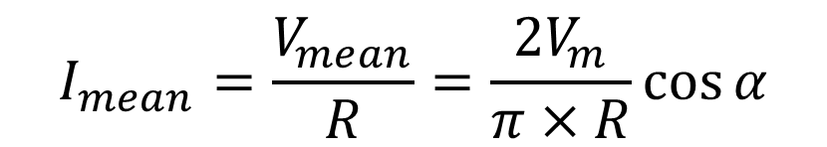
Fully Controlled Single-phase Bridge Rectifier (or Double-way) with Inductive Load (R-L load)
The mean load current is:
$$I_{mean}=\frac{V_{mean}}{R}=\frac{2V_{m}}{π×R}\cos{α}$$

Slide 12
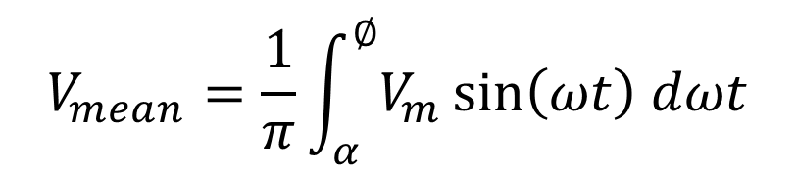
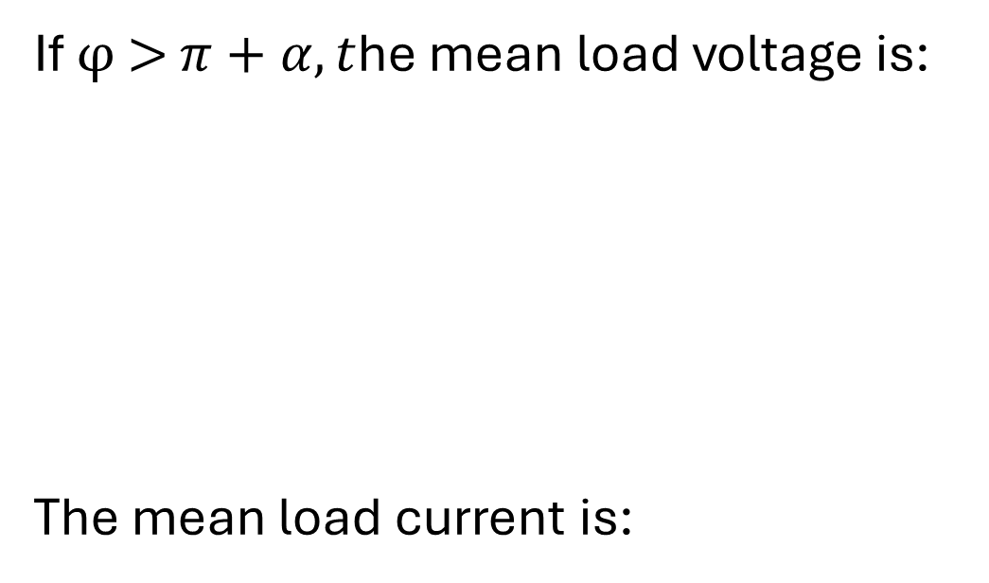
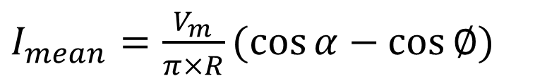
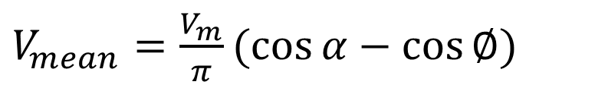
Fully Controlled Single-phase Bridge Rectifier (or Double-way) with Inductive Load (R-L load)
If φ > $π+α, t$he mean load voltage is:
The mean load current is:
$$V_{mean}=\frac{1}{π}\int_{α}^{∅}{V_{m}\sin\left(ωt\right) dωt}$$
$V_{mean}=\frac{V_{m}}{π}(cos{α}−$ $\cos{∅})$
$I_{mean}=\frac{V_{m}}{π×R}(cos{α}−$ $\cos{∅})$

Slide 13
Fully controlled Single-phase Bridge Rectifier (or Double-way) with Inductive Load (R-L load)
Example: A single-phase fully controlled bridge rectifier is supplied from a 120 V (rms), 50 Hz AC source. The load is inductive load. Determine the mean load voltage for firing angles of 0°, 45°, and 90°. Assuming each thyristor to have voltage drop of 1.5 V. Also, find the required peak voltage of each thyristor.

Slide 14
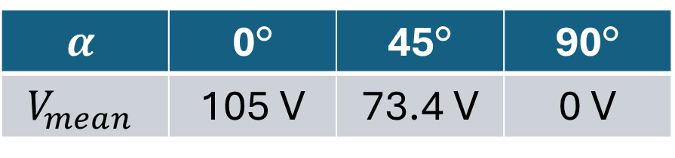

Fully controlled Single-phase Bridge Rectifier (or Double-way) with Inductive Load (R-L load)
Solution:
The peak voltage is:
$$V_{m}=120\sqrt{2}=170 V$$
$$α$$ | 0° | 45° | 90°
$$V_{mean}$$ | 105 V | 73.4 V | 0 V

Slide 15
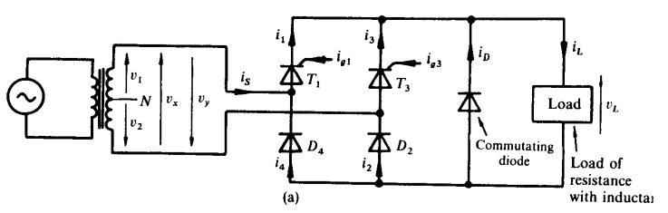
Half Controlled Single-phase Bridge Rectifier (or Double-way) with Inductive Load (R-L load) and freewheeling diode
The circuit of fully controlled single-phase bridge rectifier with Inductive Load (R-L load) and freewheeling diode is shown below:

Slide 16
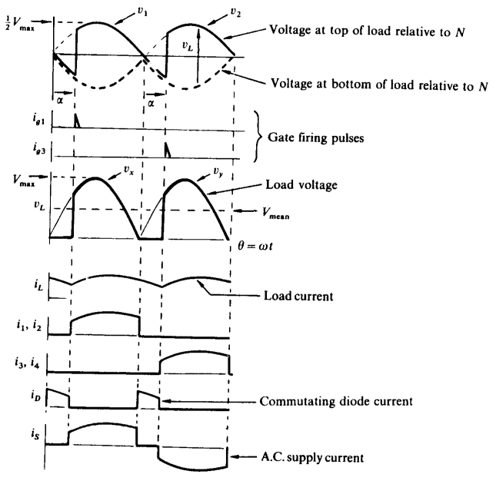
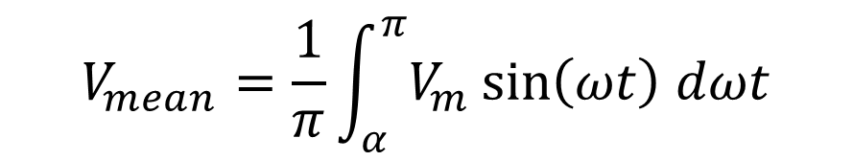

Half Controlled Single-phase Bridge Rectifier (or Double-way) with Inductive Load (R-L load) and freewheeling diode
The waveforms of fully controlled single-phase bridge rectifier with Inductive Load (R-L load) and freewheeling diode is shown below:
The mean load voltage:
$$V_{mean}=\frac{1}{π}\int_{α}^{π}{V_{m}\sin\left(ωt\right) dωt}$$
$$=\frac{V_{m}}{π}(1+cos{α)}$$

Slide 17
Half controlled Single-phase Bridge Rectifier (or Double-way) with Inductive Load (R-L load) and freewheeling diode
Example: A single-phase half controlled bridge rectifier is supplied from a 120 V (rms), 50 Hz AC source. Neglecting the voltage drop. Determine the mean load voltage for firing angles of 0°, 60°, 90° and 135 °. If the load is highly inductive taking 25 A, determine the required device rating.

Slide 18

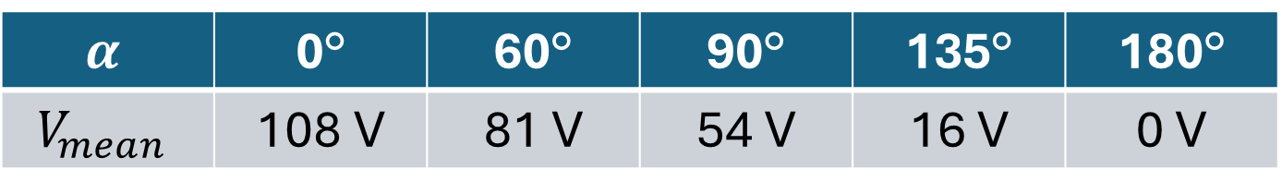

Half controlled Single-phase Bridge Rectifier (or Double-way) with Inductive Load (R-L load) and freewheeling diode
Solution:
$$α$$ | 0° | 60° | 90° | 135° | 180°
$$V_{mean}$$ | 108 V | 81 V | 54 V | 16 V | 0 V
The peak voltage is:
$$V_{m}=120\sqrt{2}=170 V$$
The current rating is:
$$I_{rms}=\frac{25}{\sqrt{2}}=17.7 A$$

Slide 19
Thanks for listening!

