Slide 1



Three-phase Rectifiers
Lecture 11
Electrical Engineering Department
Power Electronics and Special Machine
By
Dr. Mustafa Fadel

Slide 2
Important Notice
Note to Students:
These lecture materials are provided as supplementary support to help clarify and reinforce the concepts discussed in the main course lectures. They are not a substitute for the official course materials or the primary references assigned. Students are encouraged to refer to the original sources and attend the main lectures to ensure full understanding of the subject.

Slide 3
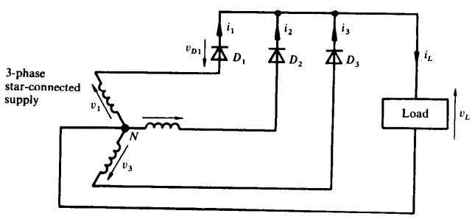
Uncontrolled Three-phase Half-wave Rectifier (or Single-way)
The circuit of three-phase half-wave rectifier feeding load is shown below

Slide 4
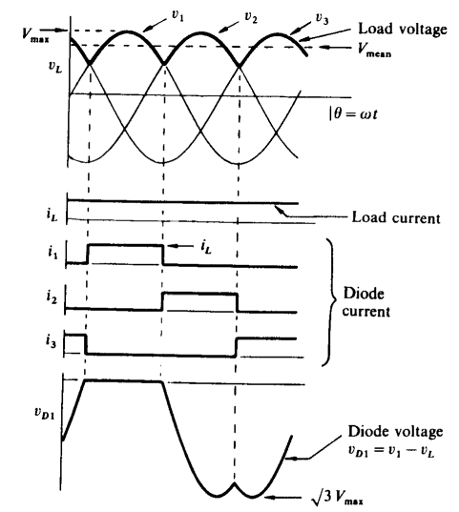

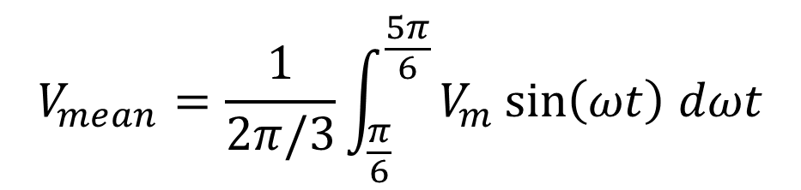
Uncontrolled Three-phase Half-wave Rectifier (or Single-way)
The waveforms of three-phase half-wave rectifier feeding load is shown:
The mean load voltage is
$$V_{mean}=\frac{1}{2π/3}\int_{\frac{π}{6}}^{\frac{5π}{6}}{V_{m}\sin\left(ωt\right) dωt}$$
$$V_{mean}=\frac{3\sqrt{3 }V_{m}}{2π}$$

Slide 5
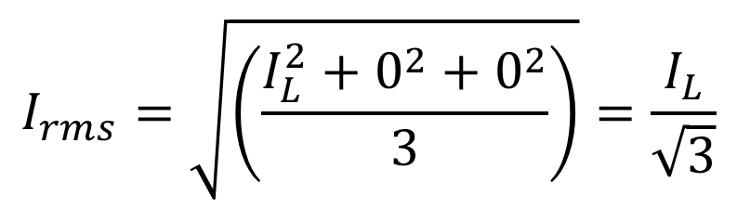

Uncontrolled Three-phase Half-wave Rectifier (or Single-way)
The RMS value of the diode current rating is as follows:
While the peak reverse voltage of each diode is equal to $\sqrt{3} V_{m}$
$$I_{rms}=\sqrt{\left(\frac{I_{L}^{2}+0^{2}+0^{2}}{3}\right)}=\frac{I_{L}}{\sqrt{3}}$$

Slide 6
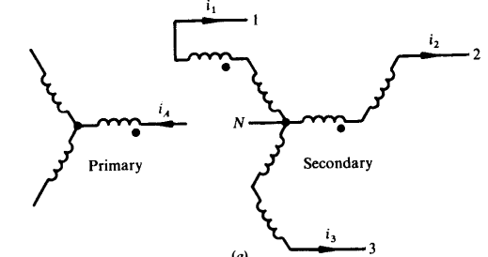
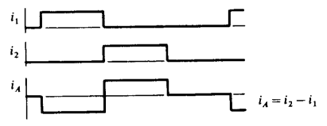
Uncontrolled Three-phase Half-wave Rectifier (or Single-way)
The unidirectional current in the star connection will cause DC magnetization to the transformer core and increases the iron losses. To avoid this, an interconnection-star (Zig-Zag) is used to remove any DC component MMF in the core

Slide 7
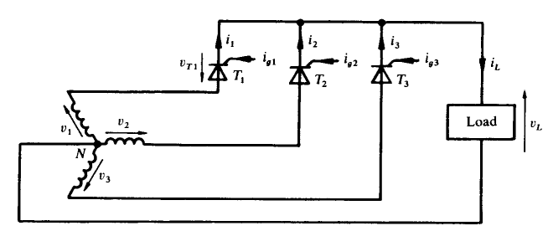
Controlled Three-phase Half-wave Rectifier
The circuit of controlled three-phase half-wave rectifier feeding load is shown below

Slide 8
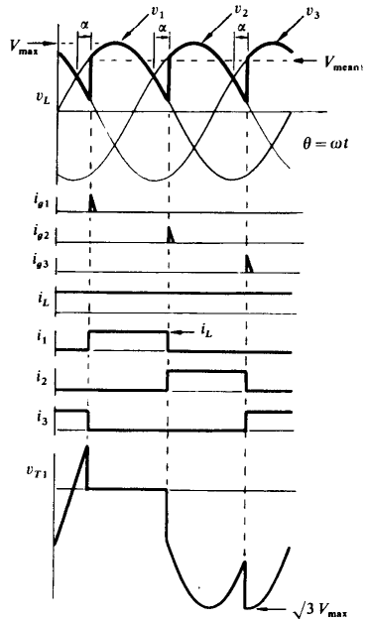
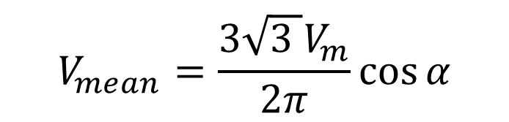
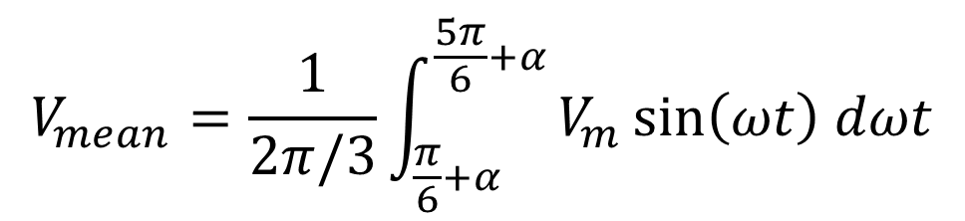
Controlled Three-phase Half-wave Rectifier
The waveforms of three-phase half-wave rectifier feeding load is shown:
The mean load voltage is
$$V_{mean}=\frac{1}{2π/3}\int_{\frac{π}{6}+α}^{\frac{5π}{6}+α}{V_{m}\sin\left(ωt\right) dωt}$$
$$V_{mean}=\frac{3\sqrt{3 }V_{m}}{2π}\cos{α}$$

Slide 9
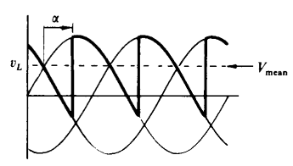
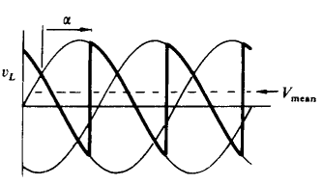
Controlled Three-phase Half-wave Rectifier
The waveforms of three-phase half-wave rectifier feeding load is shown:
The mean load voltage is
$$V_{mean}=\frac{1}{2π/3}\int_{\frac{π}{6}+α}^{\frac{5π}{6}+α}{V_{m}\sin\left(ωt\right) dωt}$$
$$V_{mean}=\frac{3\sqrt{3 }V_{m}}{2π}\cos{α}$$

Slide 10
Controlled Three-phase Half-wave Rectifier
Example: A three-phase half-wave controlled rectifier is supplied from a 150 V/phase, 50 Hz AC source. Determine the mean load voltage for firing delay angles of 0°, 30°, 60°, and 90° assuming each thyristor to have voltage drop of 1.5 V and continuous load current.

Slide 11
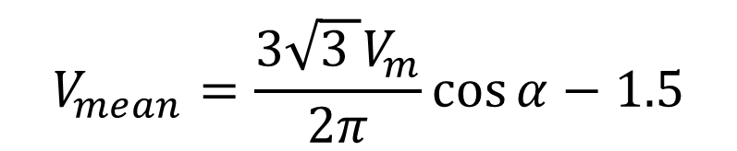
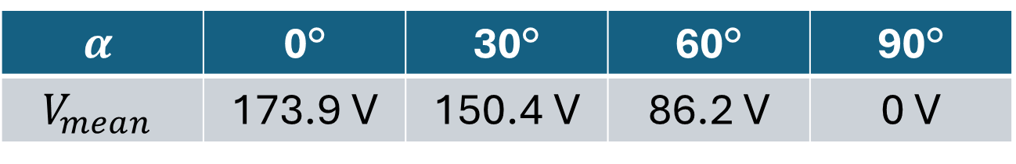
Controlled Three-phase Half-wave Rectifier
Solution:
$$V_{mean}=\frac{3\sqrt{3 }V_{m}}{2π}\cos{α}−1.5$$
$$α$$ | 0° | 30° | 60° | 90°
$$V_{mean}$$ | 173.9 V | 150.4 V | 86.2 V | 0 V

Slide 12
Thanks for listening!

