Slide 1



Three-phase Rectifiers
Lecture 12
Electrical Engineering Department
Power Electronics and Special Machine
By
Dr. Mustafa Fadel

Slide 2
Important Notice
Note to Students:
These lecture materials are provided as supplementary support to help clarify and reinforce the concepts discussed in the main course lectures. They are not a substitute for the official course materials or the primary references assigned. Students are encouraged to refer to the original sources and attend the main lectures to ensure full understanding of the subject.

Slide 3
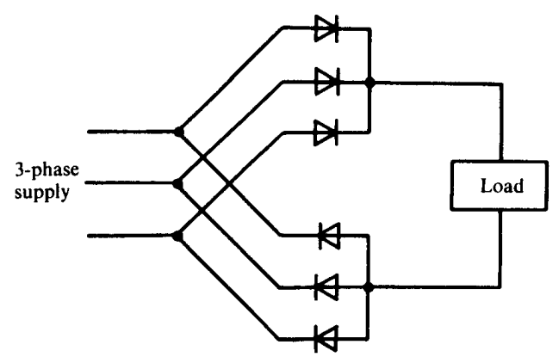
Uncontrolled Three-phase Bridge Rectifier(or Double-way)
The circuit of three-phase bridge rectifier feeding load is shown below

Slide 4
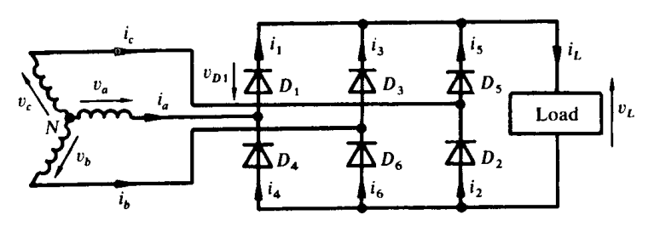
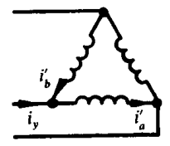
Uncontrolled Three-phase Bridge Rectifier(or Double-way)
Another representation for circuit of three-phase uncontrolled bridge rectifier feeding load is shown below:

Slide 5
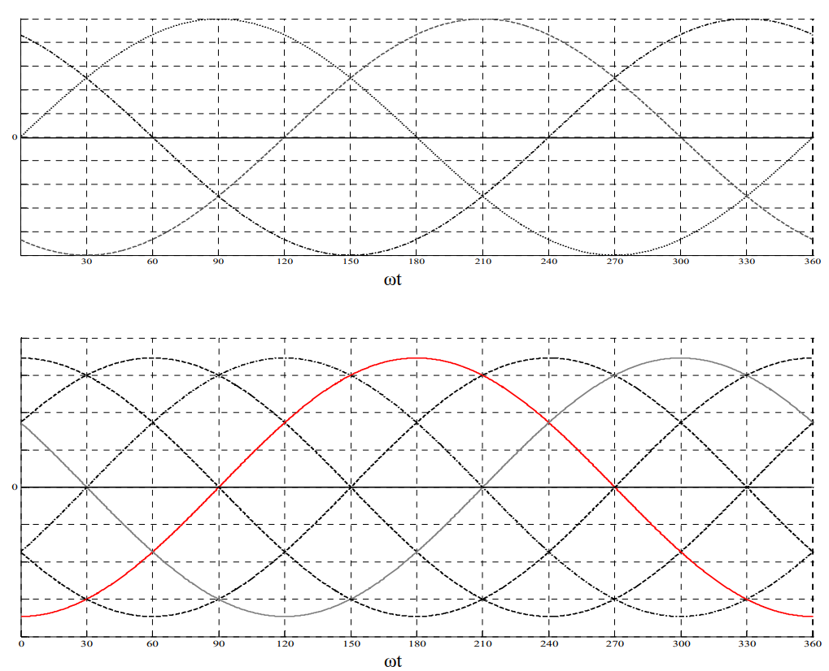
Uncontrolled Three-phase Bridge Rectifier(or Double-way)

Slide 6
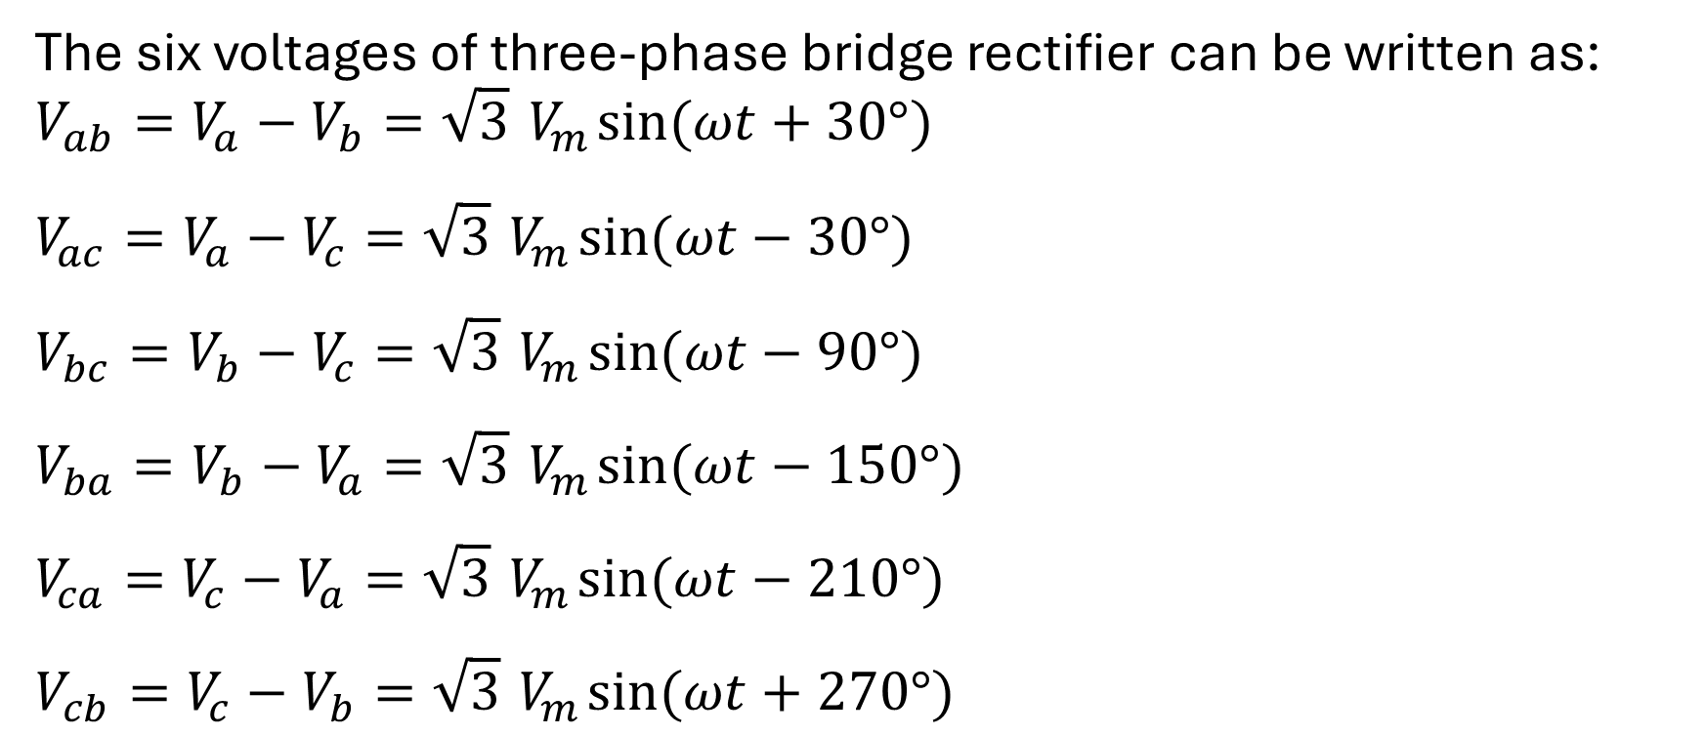
Uncontrolled Three-phase Bridge Rectifier(or Double-way)
The six voltages of three-phase bridge rectifier can be written as:
$$V_{ab}=V_{a}−V_{b}=\sqrt{3}{ V}_{m}\sin{(ωt+30°)}$$
$$V_{ac}=V_{a}−V_{c}=\sqrt{3}{ V}_{m}\sin{(ωt−30°)}$$
$$V_{bc}=V_{b}−V_{c}=\sqrt{3}{ V}_{m}\sin{(ωt−90°)}$$
$$V_{ba}=V_{b}−V_{a}=\sqrt{3}{ V}_{m}\sin{(ωt−150°)}$$
$$V_{ca}=V_{c}−V_{a}=\sqrt{3}{ V}_{m}\sin{(ωt−210°)}$$
$$V_{cb}=V_{c}−V_{b}=\sqrt{3}{ V}_{m}\sin{(ωt+270°)}$$

Slide 7
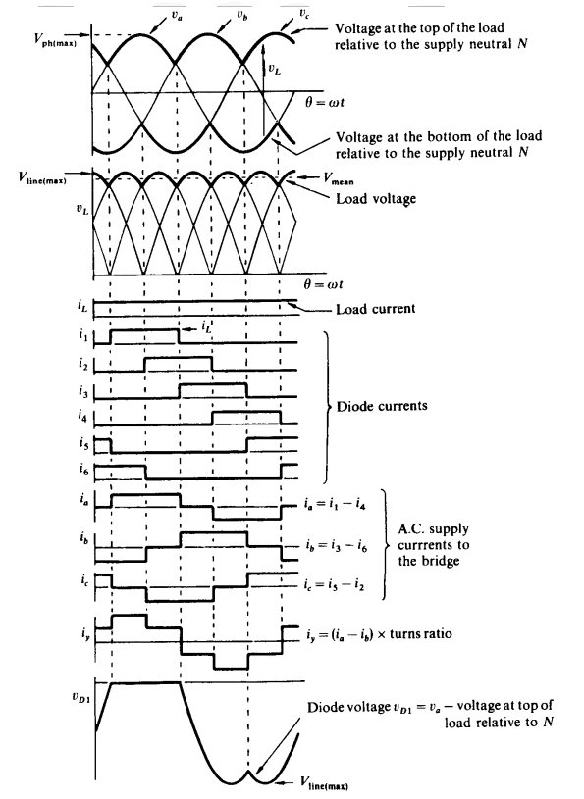
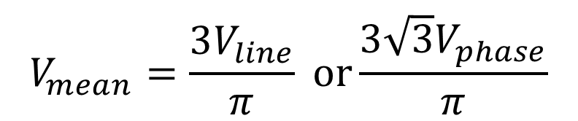
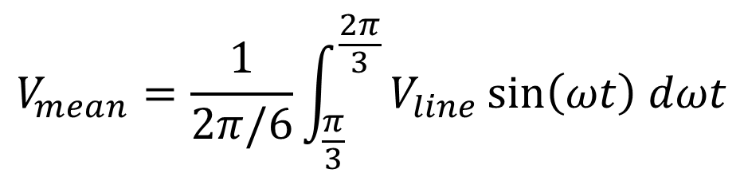
Uncontrolled Three-phase Bridge Rectifier(or Double-way)
The waveforms of three-phase full-wave rectifier feeding load is shown:
The mean load voltage is
$$V_{mean}=\frac{1}{2π/6}\int_{\frac{π}{3}}^{\frac{2π}{3}}{V_{line}\sin\left(ωt\right) dωt}$$
$$V_{mean}=\frac{3V_{line}}{π} or\frac{3\sqrt{3}V_{phase}}{π}$$

Slide 8
Uncontrolled Three-phase Bridge Rectifier(or Double-way)
Example: A three-phase bridge uncontrolled rectifier supplies a DC load of 300 V, 60 A from a 415 V, 3-phase AC supply via a delta-star transformer. Determine the required diode and transformer specification. Assume a diode voltage drop of 0.7 V and continuous load current.

Slide 9
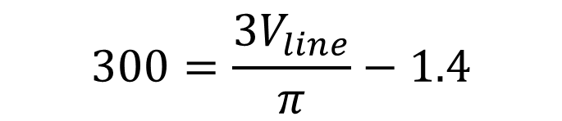
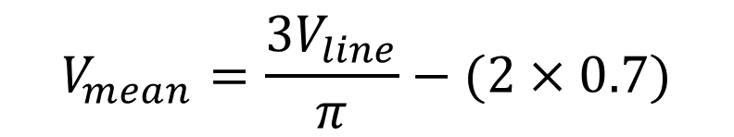
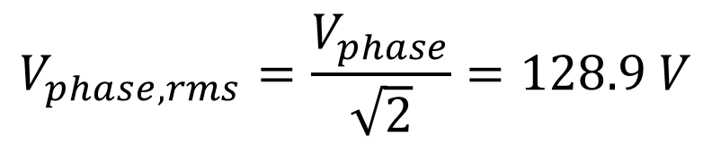
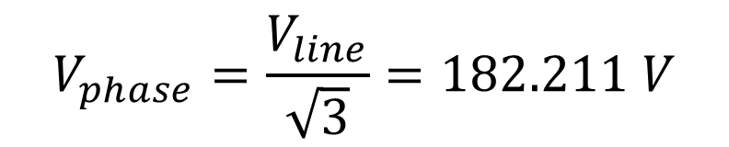

Uncontrolled Three-phase Bridge Rectifier(or Double-way)
Solution:
$$V_{mean}=\frac{3V_{line}}{π}−(2×0.7)$$
$$V_{phase,rms}=\frac{V_{phase}}{\sqrt{2}}=128.9 V$$
$$300=\frac{3V_{line}}{π}−1.4$$
$$V_{line}=315.6 V$$
$$V_{phase}=\frac{V_{line}}{\sqrt{3}}=182.211 V$$

Slide 10
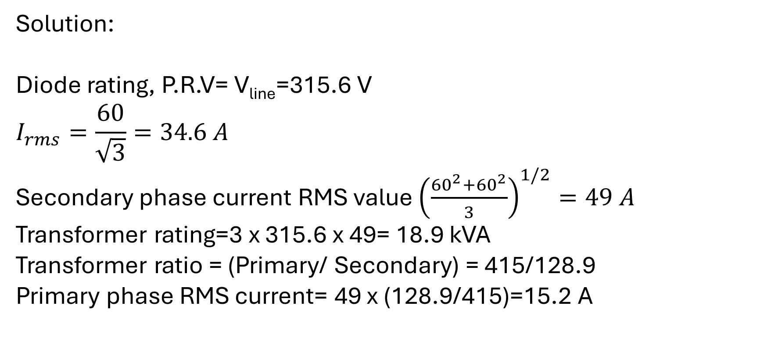
Uncontrolled Three-phase Bridge Rectifier(or Double-way)
Solution:
Diode rating, P.R.V= V_{line}=315.6 V
$$I_{rms}=\frac{60}{\sqrt{3}}=34.6 A$$
Secondary phase current RMS value ${\left(\frac{{60}^{2}+{60}^{2}}{3}\right)}^{1/2}=49 A$
Transformer rating=3 x 315.6 x 49= 18.9 kVA
Transformer ratio = (Primary/ Secondary) = 415/128.9
Primary phase RMS current= 49 x (128.9/415)=15.2 A

Slide 11
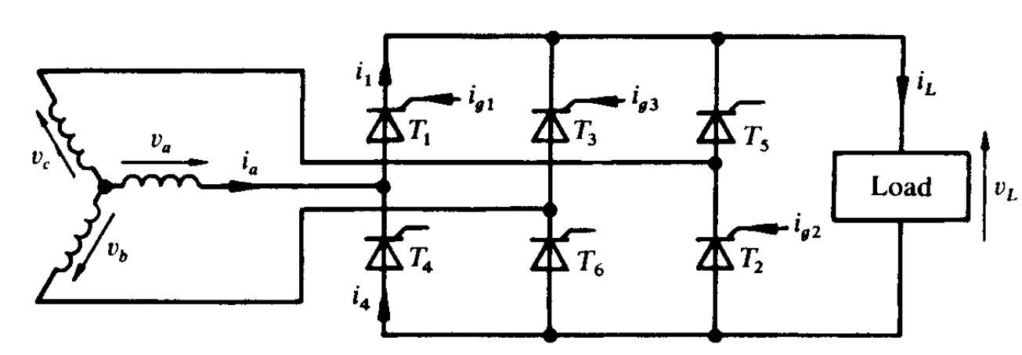
Fully Controlled Three-phase Bridge Rectifier
The circuit of three-phase fully controlled bridge rectifier feeding load is shown below:

Slide 12
Fully Controlled Three-phase Bridge Rectifier

Slide 13
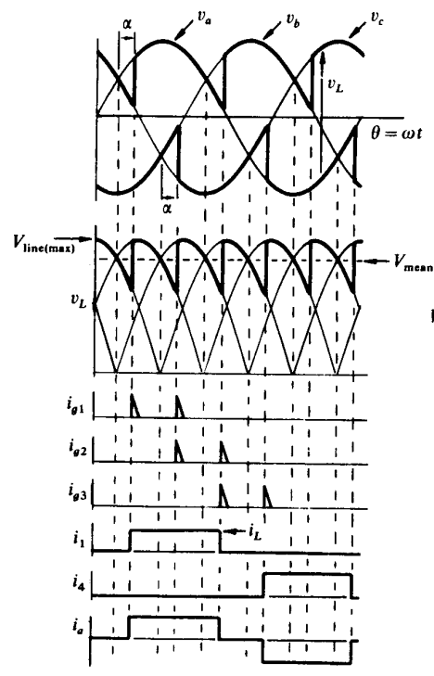
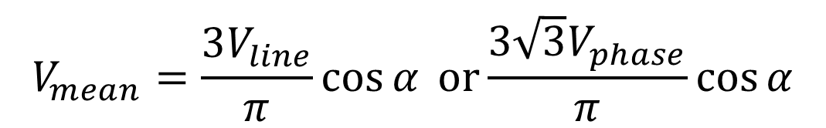
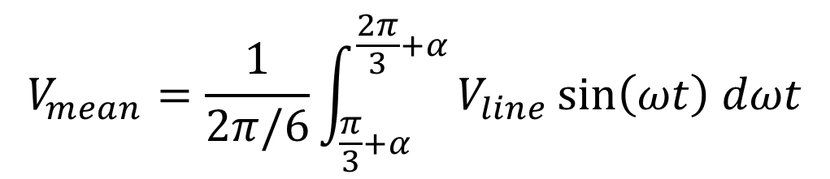
Fully Controlled Three-phase Bridge Rectifier
The waveforms of three-phase full-wave rectifier feeding load is shown:
The mean load voltage is
$$V_{mean}=\frac{1}{2π/6}\int_{\frac{π}{3}+α}^{\frac{2π}{3}+α}{V_{line}\sin\left(ωt\right) dωt}$$
$$V_{mean}=\frac{3V_{line}}{π}\cos{α} or\frac{3\sqrt{3}V_{phase}}{π}\cos{α}$$

Slide 14
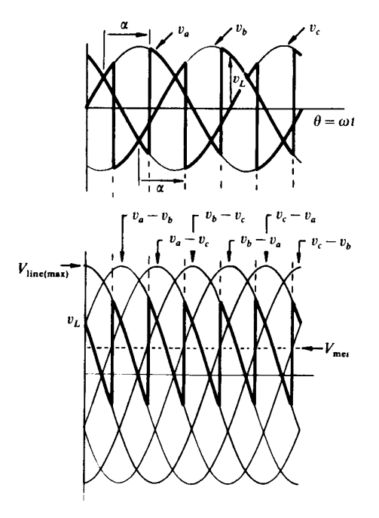
Fully Controlled Three-phase Bridge Rectifier
The waveforms of three-phase full-wave rectifier feeding load is shown:
The mean load voltage is
$$V_{mean}=\frac{1}{2π/6}\int_{\frac{π}{3}+α}^{\frac{2π}{3}+α}{V_{line}\sin\left(ωt\right) dωt}$$
$$V_{mean}=\frac{3V_{line}}{π}\cos{α} or\frac{3\sqrt{3}V_{phase}}{π}\cos{α}$$

Slide 15
Fully Controlled Three-phase Bridge Rectifier
Example: A fully-controlled three-phase rectifier bridge circuit is supplied by line voltage of 220 V. Assuming continuous load current and a thyristor voltage drop of 1.5 V, determine the mean load voltage at firing delay angles of 0°, 30°, 45°, 60°, and 90°. Plot the waveform of the thyristor voltage at a firing delay angle of 75°.

Slide 16
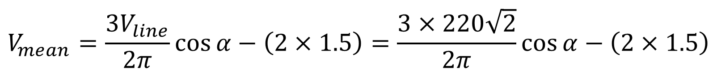
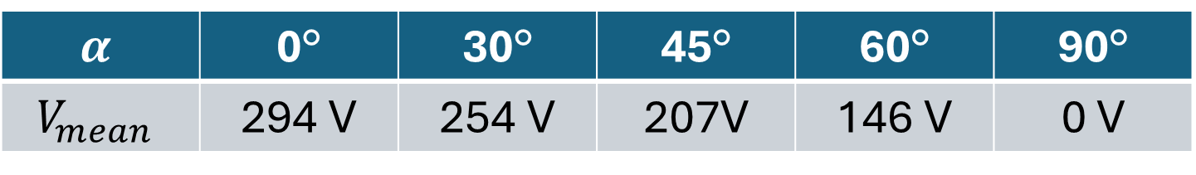
Fully Controlled Three-phase Bridge Rectifier
Solution:
$$V_{mean}=\frac{3V_{line}}{2π}\cos{α}−\left(2×1.5\right)=\frac{3×220\sqrt{2}}{2π}\cos{α}−\left(2×1.5\right)$$
$$α$$ | 0° | 30° | 45° | 60° | 90°
$$V_{mean}$$ | 294 V | 254 V | 207V | 146 V | 0 V

Slide 17
Fully Controlled Three-phase Bridge Rectifier
V_{o}
Solution: The voltage across thyristor T₁ is given by the phase-A source voltage Va​ minus the load voltage Vo,
i.e., V_{T1}=Va−Vo
V_{T1}

Slide 18
Thanks for listening!

