Slide 1
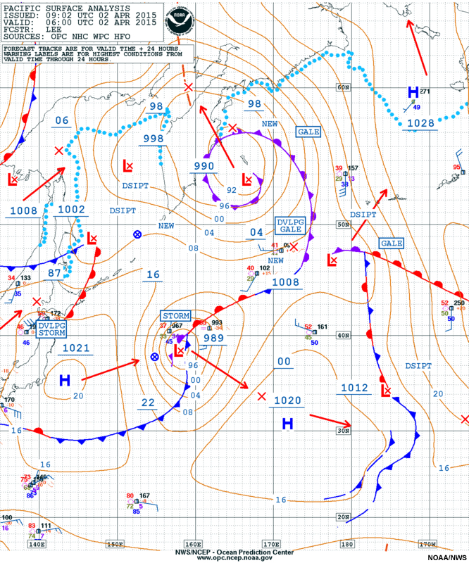
The Course of Synoptic Meteorology
Lecture 7
AL-MUSTANSIRIYAH UNIVERSITY
COLLEGE OF SCIENCES
ATMOSPHERIC SCIENCES DEPARTMENT
Dr. Sama Khalid Mohammed
SECOND CLASS

Slide 2
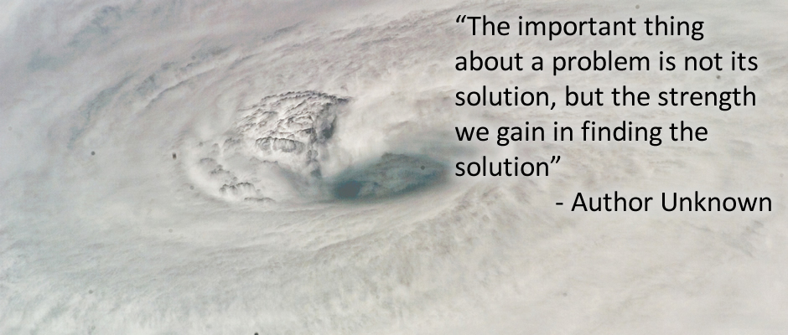

Slide 3
Polar Front Theory
Developed by Norwegian scientists (Bjerknes, Solberg, Bergeron)
Published shortly after WW I
Polar front theory of a developing wave cyclone
Working model of how a mid-latitude cyclone progresses through stages of birth, growth, decay.
Today the work has been modified to serve as a convenient way to describe the structure and weather associated with migratory storm systems.

Slide 4
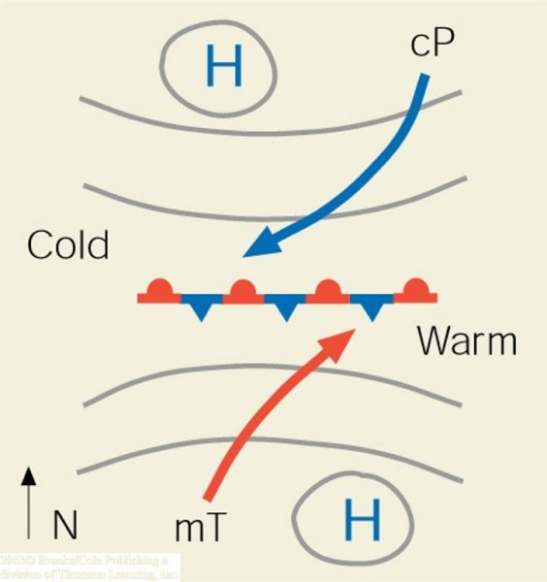
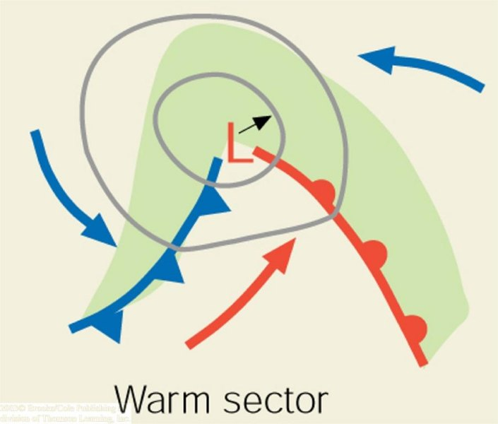
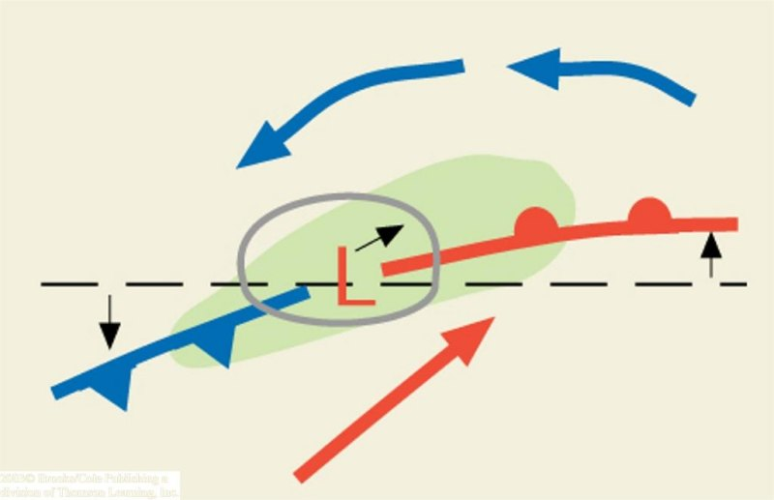
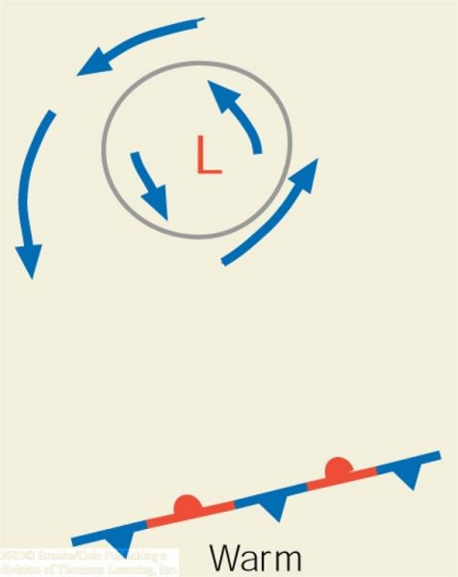
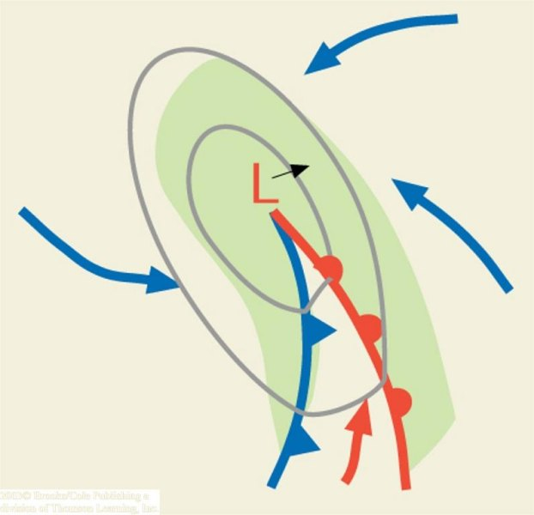
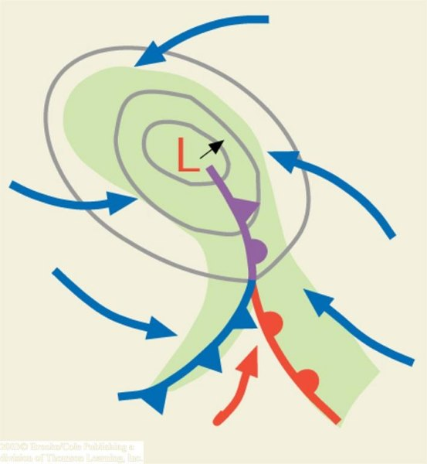
(a)
(b)
(c)
(d)
(e)
(f)

Slide 5
Step One
A segment of the polar front as a stationary front. (Trough of low pressure with higher pressure on both sides. Cold air to the North, warm air to the south. Parallel flow along the front.
This type of flow sets up a cyclonic wind shear.
HINT: if you place a pen between the palms of your hands and move your left hand toward your body; the pen turns counterclockwise, cyclonically.

Slide 6
Step Two
Under the right conditions a wavelike kink forms on the front. The wave that forms is known as a frontal wave. Wave cyclone – an extratropical cyclone that forms and moves along a front. The circulation of winds about the cyclone tends to produce a wavelike deformation on the front

Slide 7
Step Three
Steered by the winds aloft, the system typically moves east or northeastward and gradually becomes a fully developed open wave in 12 to 24 hours. Open wave – the stage of development of a wave cyclone where a cold front and a warm front exist, but no occluded front. The center of lowest pressure in the wave is located at the junction of two fronts.

Slide 8
Step Four
Central pressure is now lower, several isobars encircle the wave. The more tightly packed isobars create a stronger cyclonic flow, winds swirl counterclock-wise and inward toward the low’s center. Energy for the storm is derived rising warm air and sinking cold air transforming potential energy to kinetic energy (energy of motion). Condensation supplies energy in the form of latent heat. Converging surface winds produce an increase of kinetic energy. The cold front advances on the warm front…

Slide 9
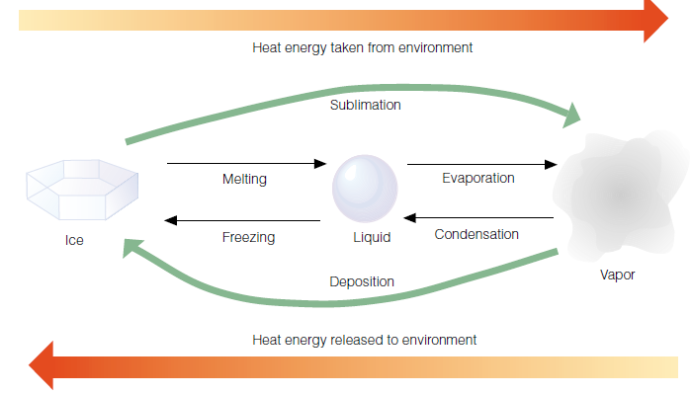

Slide 10
Step Five
As the open wave moves eastward, central pressures continue to decrease, and the winds blow more vigorously. The faster-moving cold front constantly inches closer to the warm front, squeezing the warm sector into a smaller area. Eventually the cold front overtakes the warm front and the system becomes occluded. The storm is usually most intense at this time, with clouds and precip covering a large area.

Slide 11
Step Six
The intense storm from step five gradually dissipates, because cold air now lies on both sides of the cyclone. Without the supply of energy provided by the rising warm, moist air, the old storm system dies out and gradually disappears. Occasionally, however a new wave will form on the westward end of the trailing cold front.
The entire life cycle of a wave cyclone can last from a few days to over a week.

Slide 12
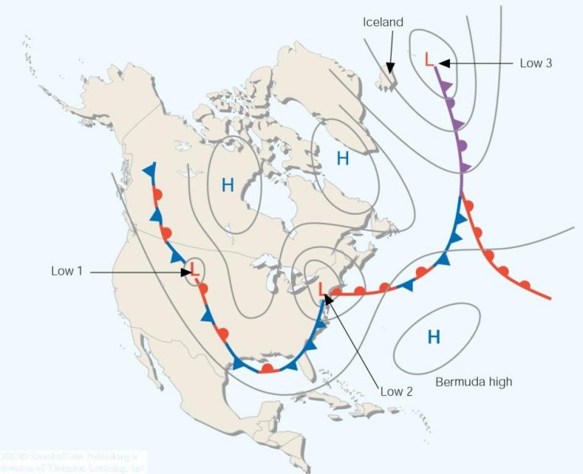
A series of wave cyclones (a "family" of cyclones) forming along
the polar front

Slide 13
Developing Mid-Latitude Cyclones and Anticyclones
Mid-latitude cyclones are "deep" pressure systems extending from the surface to tropopause level
Convergence – The piling up of air or the atmospheric condition that exists when the wind cause a horizontal net inflow of air into a specified region
Divergence – the spreading out of air or the atmospheric condition that exists when the winds cause a horizontal net outflow of air from a specific region
Developing surface storm systems are deep lows that usually intensify with height. Therefore, a surface low pressure area will appear on an upper level chart as either a closed low or a trough.

Slide 14
Suppose the upper-level low is directly above the surface low. Notice that only at the surface (because of friction) do the winds blow inward toward the low’s center.
As these winds converge (flow together), the air “piles up.” This piling up of air, called convergence, causes air density to increase directly above the surface low. This increase in mass causes surface pressures to rise; gradually, the low fills and the surface low dissipates.
The same reasoning can be applied to surface anticyclones. Winds blow outward away from the center of a surface high. If a closed high or ridge lies directly over the surface anticyclone, divergence (the spreading out of air) at the surface will remove air from the column directly above the high. Surface pressures fall and the system weakens.

Slide 15
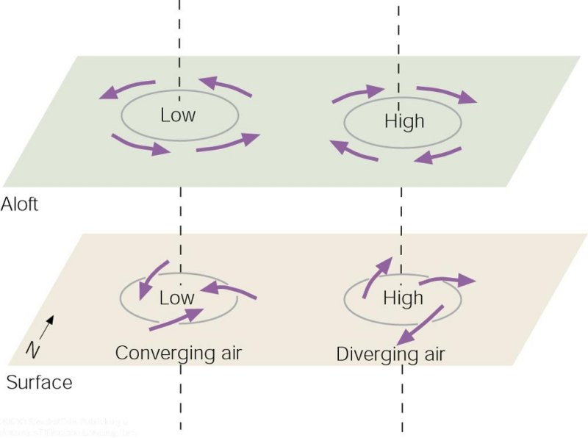
A low that is not supported by some divergence aloft will dissipate
Same is true for a high pressure system; divergence at the surface needs some support from convergence aloft to survive
If lows and highs aloft were always directly above lows and highs at the surface, the surface systems would quickly dissipate.

Slide 16
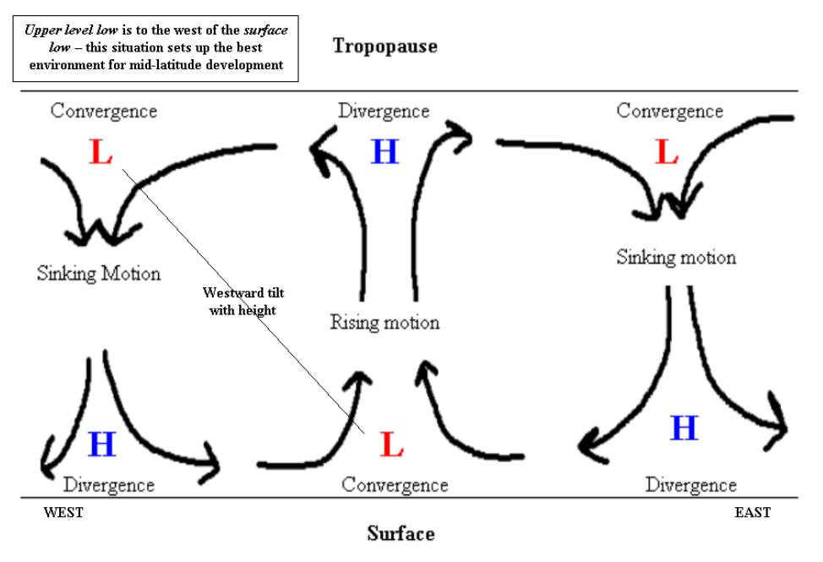

Slide 17
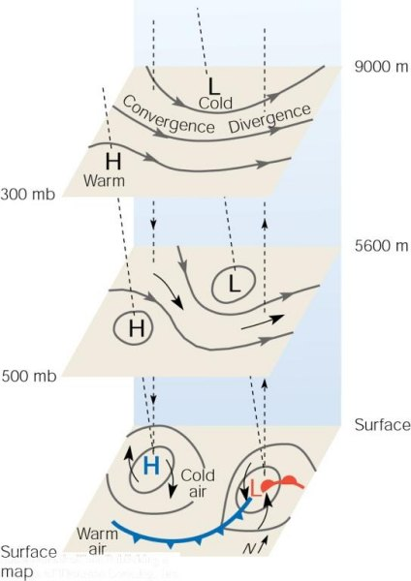
The upper-level low MUST be located north and west of the surface low - i.e., the area of low pressure must tilt to the northwest with height.
An area of divergence MUST be directly above the surface low
If divergence aloft > convergence at surface, will the low will deepen, intensifying the storm, or will it decay?
if divergence aloft < convergence at surface, will the low will deepen, or decay?

Slide 18
The upper-level high MUST be located south and west of the surface high - i.e., the area of high pressure must tilt to the southwest with height
An area of convergence MUST be directly above the surface high
if convergence aloft > divergence at surface, pressure at surface will increase and the high will build (intensify)
if convergence aloft < divergence at surface, pressure at surface will decrease and the high will decrease in intensity

Slide 19
Jet Streams and Developing Mid-latitude Cyclones
Jet streams play an additional part in the formation of surface mid-latitude cyclones and anticyclones.
When the polar jet stream flows in a wavy west to east pattern, deep troughs and ridges exist in the flow aloft.
Jet maxima or jet streaks produce regions of strong convergence and divergence along the flanks of the jet.

Slide 20
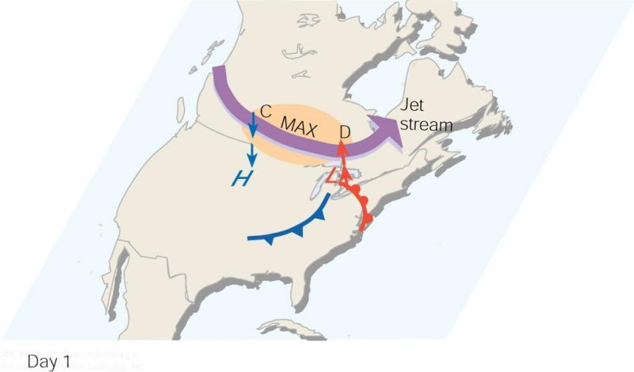
As the polar jet stream and its area of maximum winds (the jet streak, or MAX). Swings over a developing mid-latitude cyclone, an area of divergence (D) draws warm surface air upward, and an area of convergence (C) allows cold air to sink. The jet stream removes air above the surface storm, which causes surface pressures to drop and the storm to intensify.

Slide 21
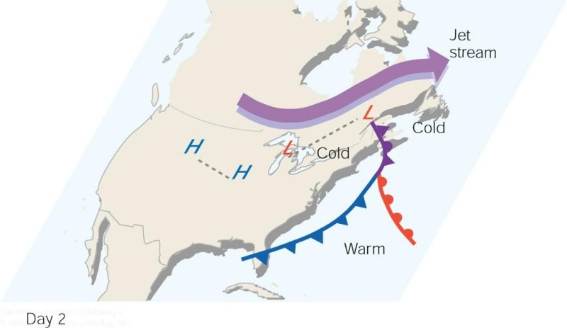
When the surface storm moves northeastward and occludes, it no longer has the upper-level support of diverging air, and the surface storm gradually dies out.

Slide 22
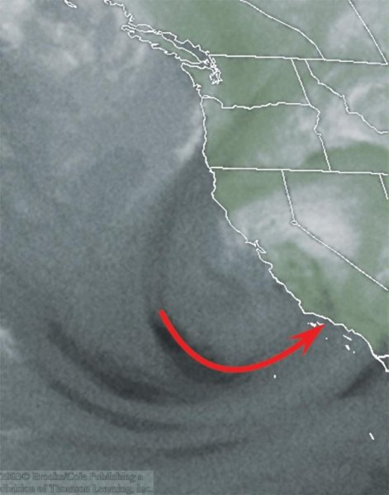
Water vapor satellite image showing a jet streak (heavy arrow) situated off the coast of Southern California.

Slide 23
Upper level Support
Upper air support – For a storm to intensify an upper level counterpart – a trough of low pressure that lies to the west of the surface low is necessary.
At the same time, the PFJ must form into waves and swing slightly south of the developing storm. When these conditions exist, zones of convergence and divergence along with rising and sinking air provide energy conversions for the storms growth.

Slide 24
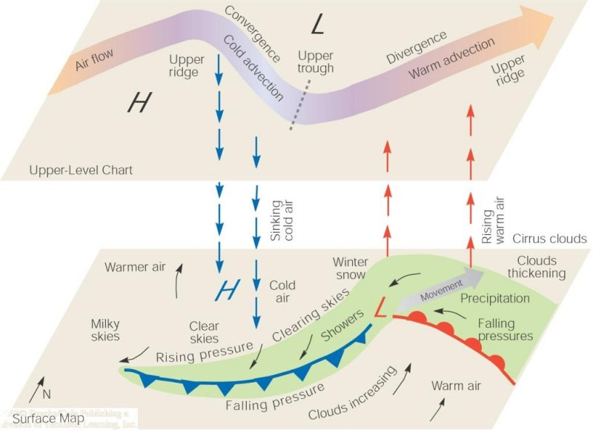
Summary of clouds, weather, and vertical motions associated with a developing wave cyclone.

Slide 25
Long waves and Short Waves
Long waves – a wave in the major belt of westerlies characterized by a long length (thousands of km) and significant amplitude. Rossby Waves
Short Waves – a small wave that moves around longwaves in the same direction as the air flow in the middle and upper troposphere. Shortwave troughs

Slide 26
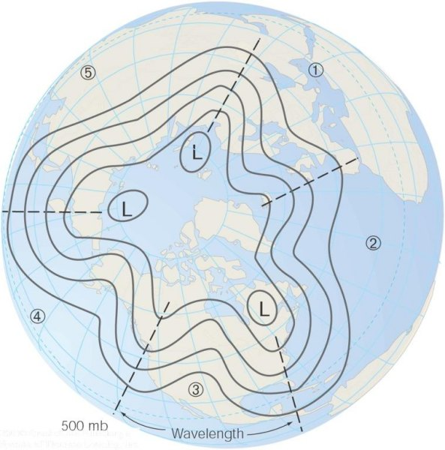
A 500-mb map of the Northern Hemisphere from a polar perspective shows five longwaves encircling the globe. Note that the wavelength of wave number 3 is greater than the width of the United States. Solid lines are contours. Dashed lines show the position of longwave troughs.

Slide 27
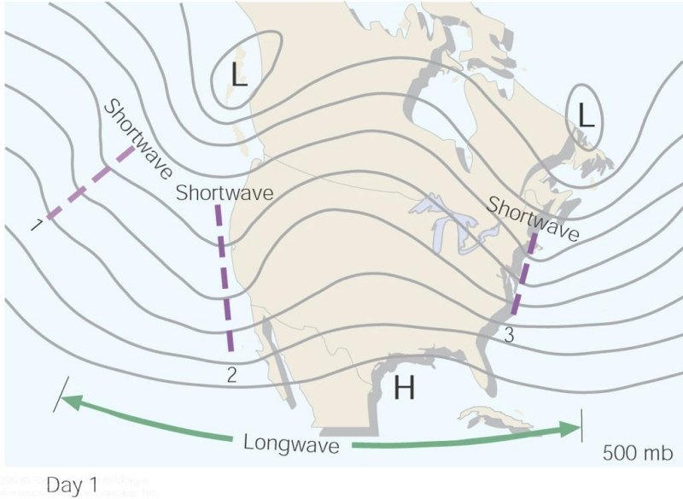
Upper-air chart showing a longwave with three shortwaves (heavy dashed lines) embedded in the flow.

Slide 28
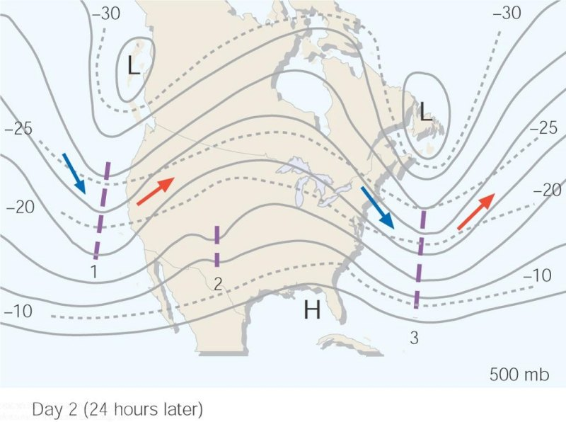
Twenty-four hours later the shortwaves have moved rapidly around the longwave. Notice that the shortwaves labeled 1 and 3 tend to deepen the longwave trough, while shortwave 2 has weakened as it moves into a ridge. Notice also that as the longwave deepens in diagram, its length actually shortens. Dashed lines are isotherms in °C. Solid lines are contours. Blue arrows indicate cold advection and red arrows warm advection.

Slide 29
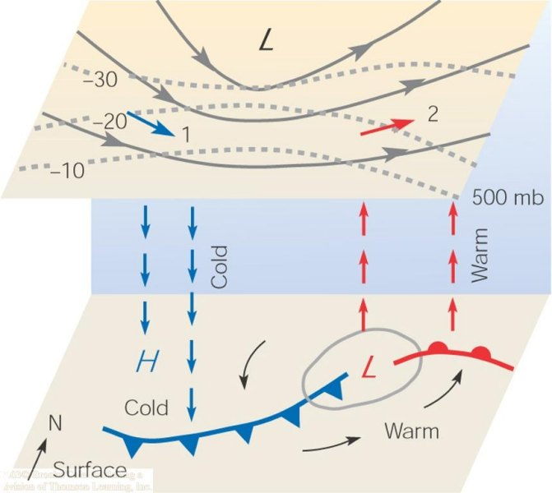
A shortwave (not shown) disturbs the flow aloft, initiating temperature advection. The upper trough intensifies and provides the necessary vertical motions (as shown by vertical arrows) for the development of the surface cyclone.

Slide 30
What happens when it all comes together just right!
Storm of the Century
Approx. 270 people killed, 48 at sea, three times greater than the death toll for Hurricanes Hugo and Andrew
Asheville airport closed for three days. Every airport on east coast was closed for some period of time
160 people rescued at sea
Mount Mitchell- 50 inches of snow 14 ft drifts
Myrtle Beach had 90 mph winds
Temperature reached 2°F in Asheville

Slide 31
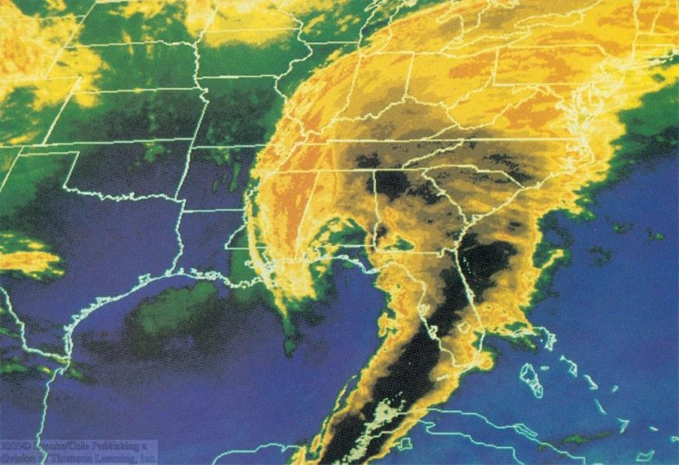
A color-enhanced infrared satellite picture that shows a developing wave cyclone at 2 A.M. (EST) on March 13, 1993. The darkest shades represent clouds with the coldest and highest tops. The dark cloud band moving through Florida represents a line of severe thunderstorms. Notice that the cloud pattern is in the shape of a comma.

Slide 32
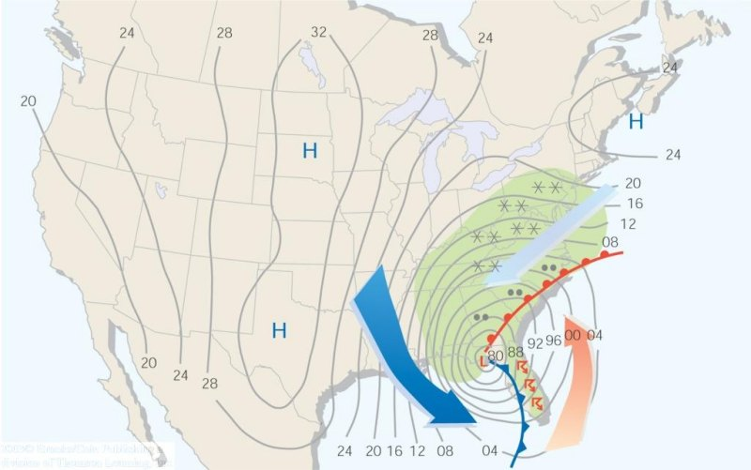
Surface weather map for 4 A.M. (EST) on March 13, 1993. Lines on the map are isobars. To obtain the proper pressure in millibars, place a 9 before those readings of 96 or lower, and place a 10 before those readings of 00 or higher. Green shaded areas are receiving precipitation. (The large orange arrow represents warm humid air and the warm conveyor belt. The light blue arrow represents cold moist air and the cold conveyor belt; the dark blue arrow represents cold dry air and the dry conveyor belt.)

Slide 33
Storm of the Century
The development of a wave cyclone into the ferocious storm of March, 1993. A small wave in the western Gulf of Mexico intensifies into a deep open-wave cyclone over Florida. It moves northeastward and becomes occluded over Virginia where its central pressure drops to 960 mb (28.35 in.). As the occluded storm continues its northeastward movement, it gradually fills. The number next to the storm is central pressure in millibars. Arrows show direction of movement. Time is Eastern Standard Time (EST).

