Slide 1
Mustansiriyah University
College of science
Biology Dept.
Zoology
4th class
Zoonoses lab. (6)

Slide 2
A} Intestinal ------------------1) E. histolytica
2) G. lamblia
3) Cryptosporidium
B} Urogenital Tract------------- Trichomonas vaginalis
C} Blood and Tissue--------------- 1) Plasmodium
2) Toxoplasma
3) Trypanosoma

Slide 3
TOXOPLASMOSIS
TOXOPLASMOSIS :-It is an infection caused by the parasite
Toxoplasma Gondii.
The protozoan Toxoplasmosis gondii, is a coccidian, intracellular parasite responsible for zoonotic infections in man and other mammals

Slide 4
A disease of the blood and lymphatic system.
Cats are a critical part of the life cycle.
It is usually acquired by eating undercooked meats but can also be acquired by contact with cat feces.
Primary problem is a congenital infection of fetus, resulting in either a stillbirth or a child with severe brain damage or vision problems.
The normal final host is cat and relatives in the family.

Slide 5
Life Cycle: Two phases
Intestinal and extra intestinal
1} Oocysts- Only members of the cat family shed oocysts
2} Trophozoites- Tachyzoites are the actively proliferating
trophozoites, which are observed during the acute stage of infection.
3} Tissue cysts (bradyzoites): Tissue cysts are found most commonly in the brain and in skeletal and cardiac muscle but can occur in any organ.

Slide 6
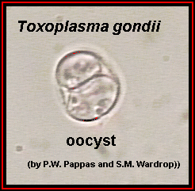
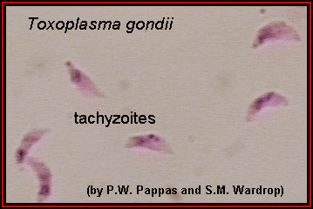
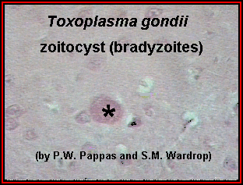
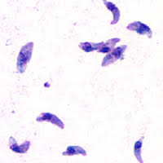
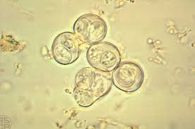
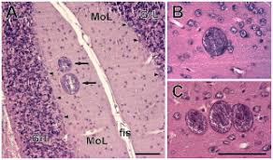
Oocysts
{cat}
Trophozoites-
Tissue cysts

Slide 7
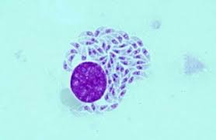
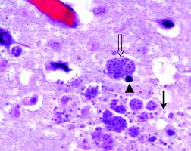
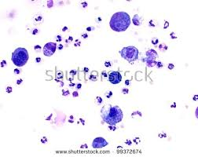
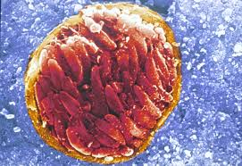
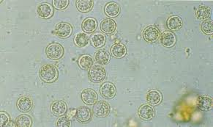

Slide 8
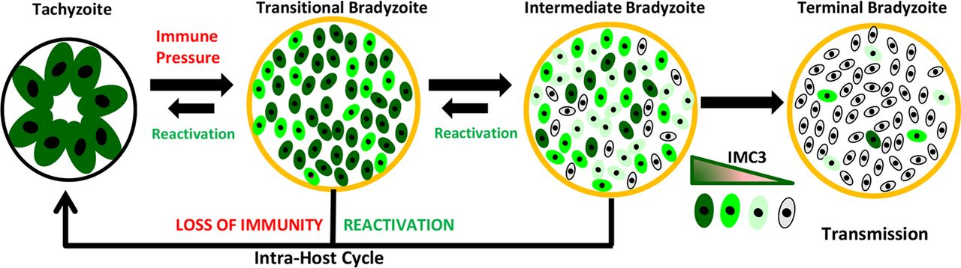

Slide 9
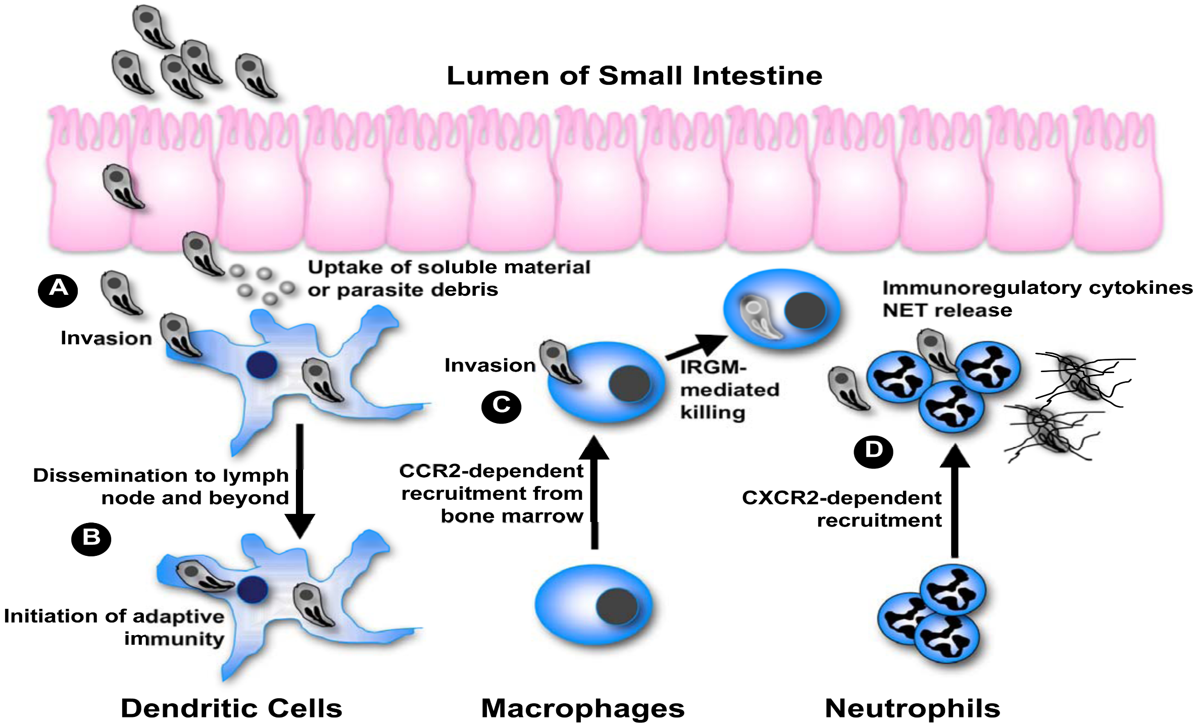

Slide 11
Sporozoite
Tachyzoite

Slide 12
Signs and Symptoms:
Fever
Sore throat
Sore muscles
Tiredness
Swollen glands
Temporary blurred vision or loss of vision

Slide 13
Development in Cat:-Organisms ( either sporozoites from Oocysts or Bradyzoites from tisse cysts ) invade the muscle cells of cats small intestine. oocysts develop exit from the host cells into the gut lumen of the cat and
pass out via feces
Structure of Sporozoites:-
In each Oocysts two sporocysts form and in about 48 hours four sporozoites form within sporocyst.
The Oocyst with its each Sporozoites when ingested can
either repeat its sexual cycle in a Cat

Slide 14
Events on Development in man :-
When man ingests Oocysts with eight Sporozoites excreted in Cats feces, can establish an infection and reproduces Asexually
In humans Oocysts open in duodenum and releases eight
Sporozoites which pass through the gut wall.
Circulate in body and invade various cells.

Slide 15
Implications on Human Health
In Humans produces
Congenital Toxoplasmosis
Post natal Toxoplasmosis

Slide 17
Diagnosis:
Serological tests
Polymerase chain reaction (PCR)
Histological demonstration of the parasite and or its antigens (i.e. immunoperoxidase stain)
Isolation of the organism

Slide 18
GIARDIA LAMBLIA
Giardiasis is an infection that occurs in the intestinal region of the body, primarily targeting the stomach and small intestine.
Mainly caused by Giardia lamblia also known as Giardia intestinalis
Most commonly found in the mucosa of the small intestine that are lined with enterocytes, the simple columnar epithelial cells.
Spreads through contact with infected people, eating contaminated food & water.
Pet dogs & cats also frequently contract Giardiasis.

Slide 20
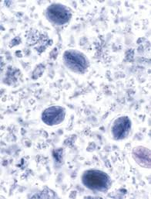
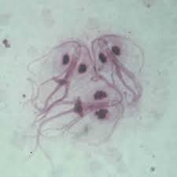

Slide 21
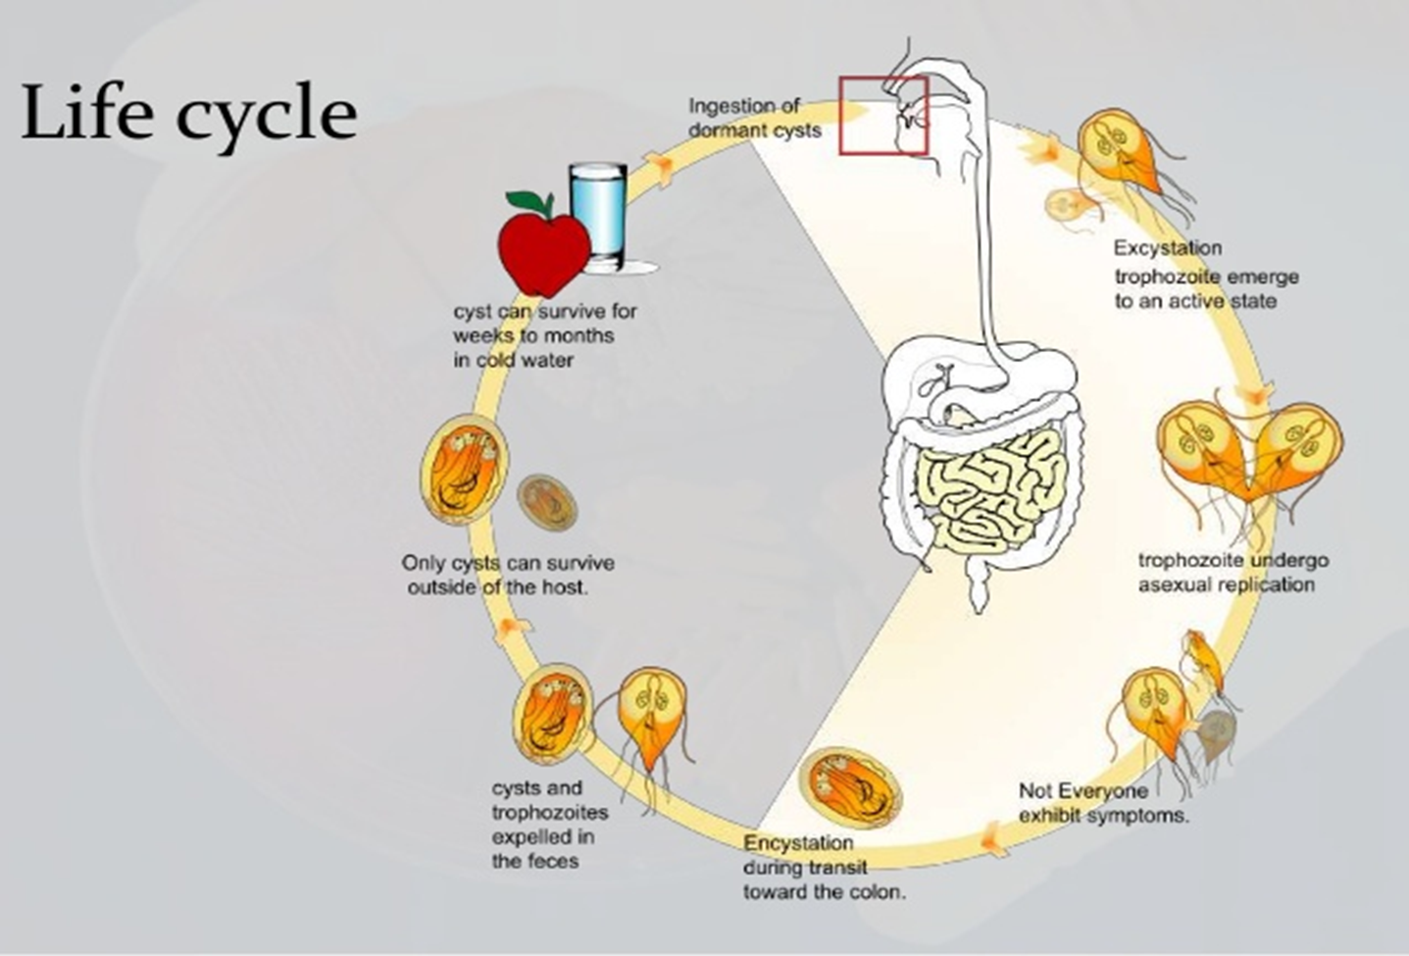

Slide 22
MORPHOLOGY
Two stages:
1} Trophozoite
2} cyst

Slide 23
Symptoms
Incubation period: 1-25 days
Most infections asymptomatic
Symptoms of clinical disease
Mild to severe gastrointestinal signs
Sudden onset diarrhea
Foul-smelling stools
Abdominal cramps
Bloating, flatulence
Nausea, fatigue
Weight loss

Slide 24
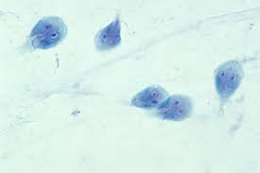
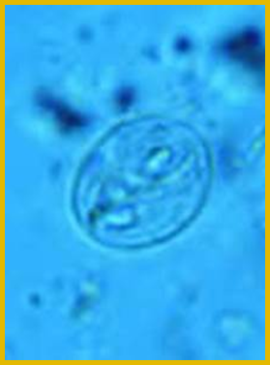
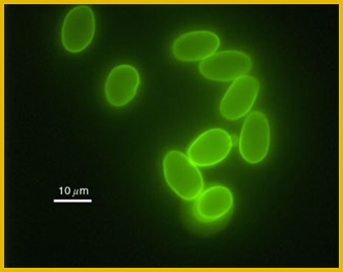
Diagnosis
1 } Direct observation in feces
Trophozoites
“Tear drop” shape
Two nuclei and tumbling mobility
Cysts
Approximately 13 microns long
Oval, with 2-4 nuclei
2} Immunofluorescence
3} ELISA, PCR

Slide 25
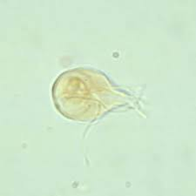
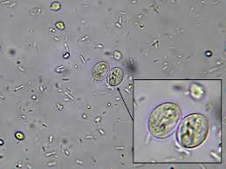
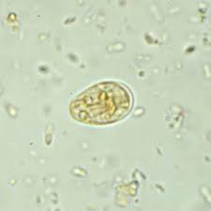
Trophozoites
Cysts
Cysts

