Slide 1
Mustansiriyah University
College of science
Biology Dept.
Zoology
4th class
Zoonoses lab. (8)

Slide 2
TOXOCARİASİS
Members of the genus Toxocara are zoonotic intestinal nematodes (roundworms) that mature in various mammals, including some domesticated species. the family Toxocaridae, superfamily Ascaridoidea
Parasitized animals can shed large numbers of eggs in the feces, infecting people (particularly children) who ingest these eggs in contaminated soil, or on hands or objects.
Although Toxocara eggs do not complete their maturation in humans, the
developing larvae can migrate through the body for a time. In some cases, they cause symptoms ranging from mild, vague discomfort to ocular disturbances, blindness and neurological syndromes

Slide 3
Etiology
Recognized species include Toxocara canis, T. cati, T. malaysiensis and T.
vitulorum, which have domesticated animals as their definitive hosts, which mature and shed eggs in wild animals.
Adult Toxocara can cause intestinal illnesses in their definitive hosts, while larvae migrating through the tissues can affect both definitive and paratenic hosts.
In paratenic hosts, toxocariasis is often called larva migrans.
Visceral larva migrans is a general term used to indicate the presence of larvae in various internal organs, while larvae in the eye are termed ocular larva migrans.
Larvae in the brain are sometimes called cerebral larva migrans.

Slide 4
Definitive hosts: Dogs, domestic cat, wild canids and hyaenids Cats

Slide 5
Transmission
Transmission of Toxocara to humans is usually through ingestion of infective eggs.
T. canis can lay around 200,000 eggs per day, These eggs are passed in cat or dog feces, but the defecation habits of dogs cause T. canis transmission to be more common than that of T. cati.
Both Toxocara canis and Toxocara cati eggs require a several week incubation period in moist,humid, weather, outside a host before becoming infective, so fresh eggs cannot cause toxocariasis.

Slide 6
Transmission
Many objects & surfaces can become contaminated with infectious eggs. Flies that feed on feces can spread Toxocara eggs to surfaces or foods. Young children who put contaminated objects in their mouths or eat dirt are at risk of developing symptoms. Humans can also contaminate foods by not washing their hands before eating.
Humans are not the only accidental hosts of Toxocara. Eating undercooked rabbit, chicken,or sheep can lead to infection;

Slide 7
Incubation period
The incubation period for Toxocara canis and cati eggs depends on temperature and moisture.
T. canis females, specifically, are capable of producing up to 200,000 eggs a day that require 2-6 weeks minimum up to a couple months before full development into the infectious stage.
Under ideal summer conditions, eggs can mature to the infective stage after two weeks outside of a host. Provided sufficient oxygen and moisture availability,Toxocara eggs can remain infectious for years
However, the second stage of larvae development poses strict vulnerabilities to certain environmental elements. High temperatures and low moisture levels will quickly degrade the larvae during this stage of growth.

Slide 10
Diagnostic Tests
Finding Toxocara larvae within a patient is the only definitive diagnosis for toxocariasis; however, biopsies to look for second stage larvae in humans are generally not very effective.
PCR, ELISA, and serological testing are more commonly used to diagnose Toxocara infection. Serological tests are dependent on the number of larvae within the patient, and are unfortunately not very specific.

Slide 11
Visceral Larva Migrans Larva

Slide 12
Ocular Larva Migrans

Slide 13
Worms develop to the adult stage in the small intestine aboout 60 to 90 days after the larvae hatch.
T . Cati
T . Canis

Slide 14
Adult Toxocariasis From Small Intestine

Slide 15
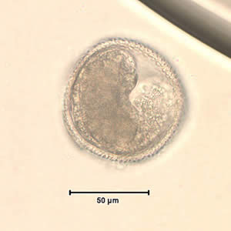
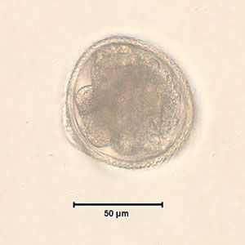
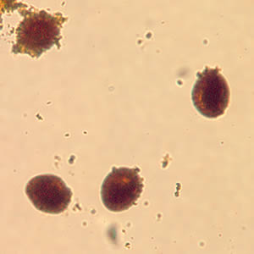
Toxocara sp. egg teased from an adult worm. The worm was never identified, but the egg size is most consistent with T. cati
toxocara sp. egg teased from an adult worm. The worm was never identified, but the egg size is most consistent with T. cati.
Toxocara sp. eggs teased from an adult worm and stained with iodine, magnification at 100×..

Slide 16
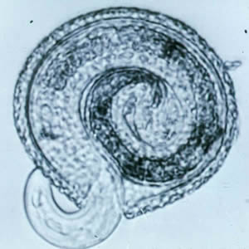
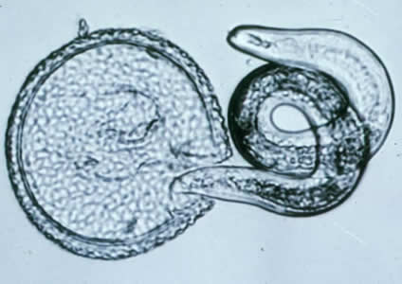
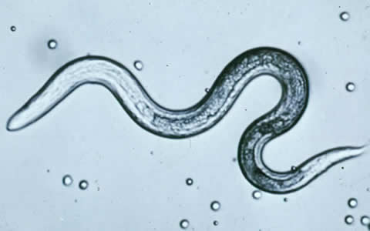
Toxocara canis larva
beginning to hatch.
T. canis larva hatching
C: T. canis larva.

Slide 17
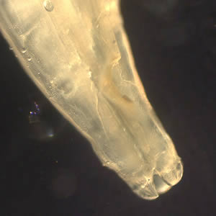
Close-up of the anterior end of Toxocara sp., showing the three lips characteristic of a scarid worms

Slide 18
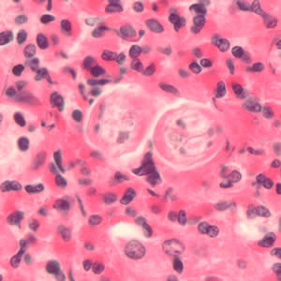
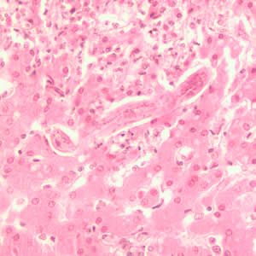
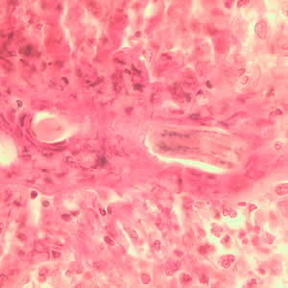
Longitudinal section of a Toxocara sp. larva in lung tissue stained with H&E.
Cross-section of Toxocara sp. larvae in liver tissue stained with hematoxylin and eosin (H&E).
Longitudinal section of a Toxocara sp. larva in liver tissue stained with H&E.

