Slide 1
AL-Mustansiriyah University College of science Biology Dept. Zoology 4th class
Laboratory Technique LAB.
(5)
NAME :

Slide 2
Cell Counting
is a general name for various methods for the quantification of cells in molecular biology & medicine.
Why to count ?
Certain experiments require an exact number of cells to be used.
2. A lot of kits for molecular biology have the amount of reagents for a certain number of cells
3. Experiments of proliferation and survival ( Usually toxicity studies).
For examples:
WBC count, Sperm , RBC

Slide 3
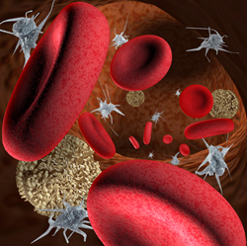
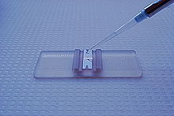
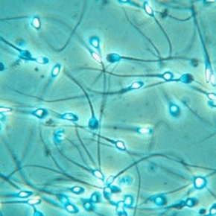
Hemacytometers
Hemacytometers → a accuracy-made slide for performing
manual cell counts with the aid of a
microscope.
Hemacytometers are used when……
1. Automated cell counters and hematology analyzers are unavailable
2. Blood cell counts are extremely low
3. To get a cell count for body fluids (spinal fluid, joint
fluid, semen counts, and other bodily fluids)

Slide 4
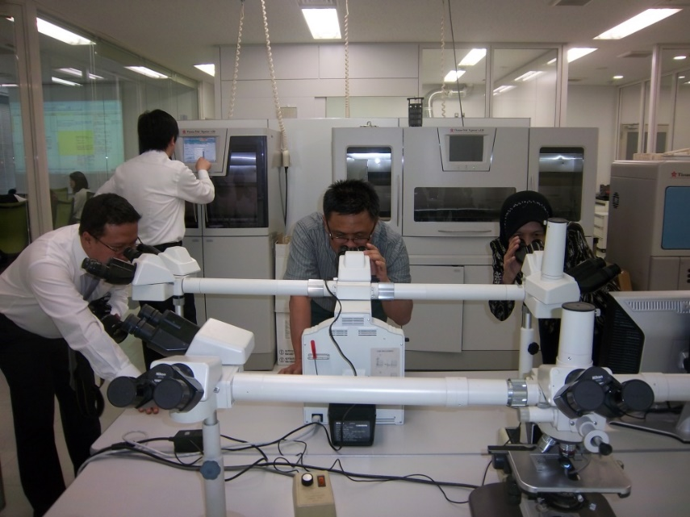
Counting Micro-organisms
A single tiny drop of nutrient broth incubated overnight may contain 5 000 000 cells – this is a lot to count.
1cm³ may contain 10⁸ cells.
In order to estimate numbers it is necessary to dilute the sample.

Slide 5
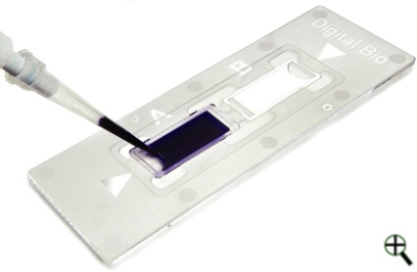
Hemacytometers
The hemacytometer is a counting chamber that contains two microscopically ruled areas marked off by lines.
Glass hemacytometers are made of heavy glass with two counting areas.
The chamber areas are covered with a coverglass and placed under the microscope for visual examination.
The chamber depth in the Neubauer-type hemacytometer is 0.1 mm.
A glass hemacytometer is reusable if disinfected between each use.
Disposable hemacytometers can also be purchased.
Instead of reusing these the coverglass is plastic and can only be used once.

Slide 6
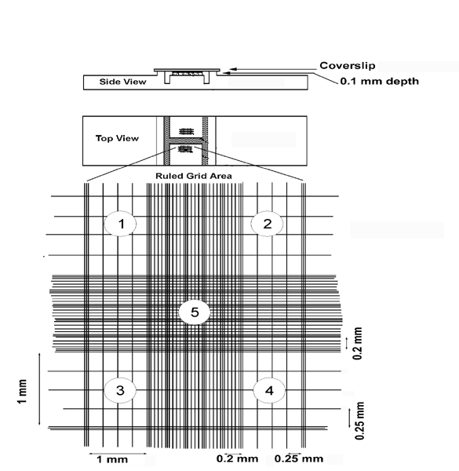
Hemacytometers
The hemacytometer contains two identical ruled areas that each have etched lines with squares of specific dimensions.
In the Neubauer-type hemacytometer, the total lined area on each side is made of a large square (3 X 3 mm).
This large square is divided into nine equal squares each 1 mm².
The total area of all the squares is 9 mm².
When the coverglass is put in place and fluid is added, the fluid volume in the area can be calculated.

Slide 7
WBC Count
The area used for counting WBCs is determined by how the sample of blood or fluid is diluted.
Usually if there are a few cells the entire chamber is counted to determine the most accurate number of WBCs.
If there are more than a few cells the 4 outer squares numbered 1-4 on the diagram are counted.
Different diluting kits are available to help in the dilution ratio and saline can be used.

Slide 8
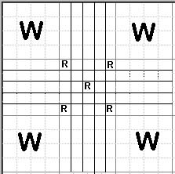
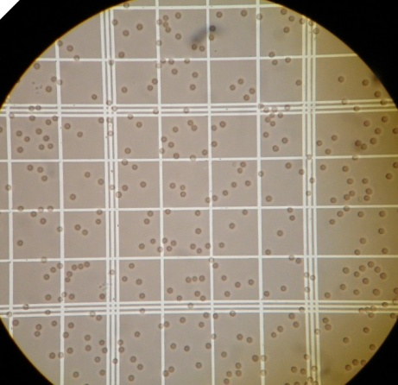
Performing a Manual WBC Count
First determine if the liquid needs to be diluted.
If it does follow the instructions for each diluting kit.
Load the hemacytometer.
Leave the hemacytometer for a few minutes to allow the cells to settle.
Use the microscope (10 X) to locate the WBC counting area.
You may have to lower the light on the microscope to visualize the WBCS.

Slide 9
Performing a Manual WBC Count
Cells touching the upper or left border of the squares are counted.
Cells touching the lower or right border of the square are not counted.
Each side of the chamber should be counted and an average of the two should be taken.
To calculate the cells if all 9 squares are counted you use the equation…..
# of cells X dilution = # cells / microliter
9 X 0.1
To calculate the cells in the 4 outer squares use the following equation…..
# of cells X dilution = # cells / microliter
4 X 0.1

Slide 10
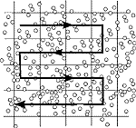
Counting Rule
Do not count cells touching
Bottom line
Right line

Slide 11
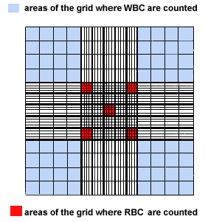
RBC Count & PLT Count
The large center square is used for RBC and PLT counts.
The center square is divided into 25 smaller squares, which are each subdivided into 16 squares.
Only 5 of the 25 squares are used to count red blood cells.
These 5 are usually the 4 outer squares and the inner most center square.
The entire large center square is used to count platelets.

Slide 12
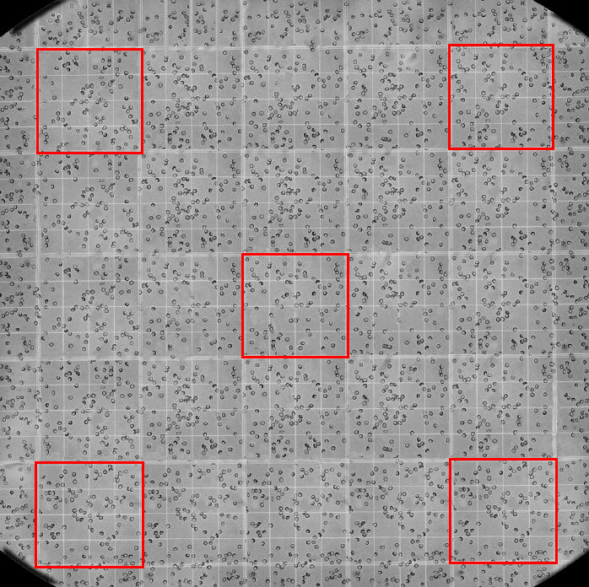
RBC Count & PLT Count
First determine if the liquid needs to be diluted.
If it does follow the instructions for each diluting kit.
Load the hemacytometer.
Leave the hemacytometer for a few minutes to allow the cells to settle.
Use the microscope (10 X) to locate the RBC counting areas.
The higher power (40 X) objective needs to be rotated into place to visualize the RBCs.

Slide 13
RBC Count & PLT Count
RBCs are much smaller than the before mentioned WBCs.
The cells touching either the top or left boundaries of the squares are included but the lower or right boundaries are not counted.
The following equation is used for the RBCs…..
# cells X dilution = # cells / microliter
5 X 0.004

