Slide 1
AL-Mustansiriyah University College of science Biology Dept. Zoology 4th class
Laboratory Technique LAB.
(6)
NAME :

Slide 2
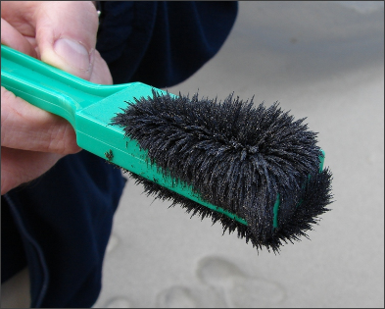
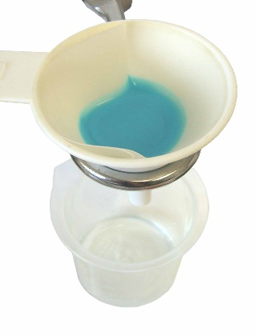
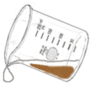
Purpose
The main purpose of this lab is to give you experience with techniques for separating different kinds of matter based on their physical properties.

Slide 3
Separation
Substances vary widely in their physical properties, so there are also a variety of separation techniques. a brief list includes:
distillation, filtration, magnetic, chromatography, evaporation, decanting, and extraction.

Slide 4
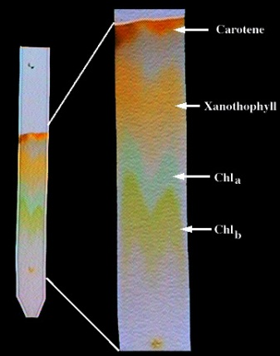
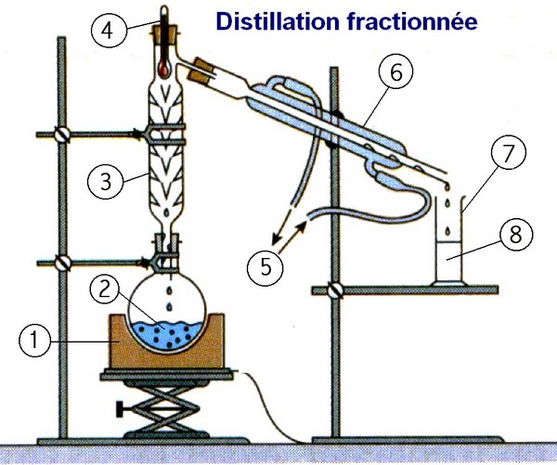
Various Methods for Separating
the Components of a Mixture
Chromatography: separating components of a mixture that have differing adsorptive tendencies on a stationary phase as the mixture is passed over or through the stationary phase .
Chromatography of plant pigments
Distillation: Separation through vaporization of a liquid from a solid, or another liquid, followed by vapor condensation.
Distillation is used in many different industries including chemical, brewery and pharmaceutical.

Slide 5
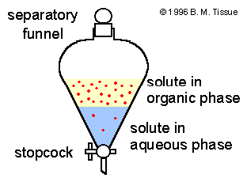
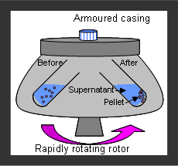
Extraction: removing a substance from a solid or liquid mixture by adding a solvent in which the substance is more soluble.
Centrifugation: removing a substance from a solution by means of a centrifuge.

Slide 6
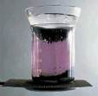
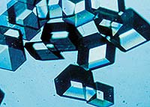
Crystallization: forming a crystalline solid by decreasing its solubility as a result of cooling the solution, evaporating the solvent, or adding a solvent in which the solid is less soluble such that solid crystals form.
Sublimation
of
Iodine
Sublimation: vaporizing a solid and subsequently condensing its vapor.
Crystals of insulin grown in space let scientists determine the vital enzyme's structure and linkages with much higher resolution than Earth-grown crystals.
mineral aquamarine
Notes:
Carotene
Xanthophyll
Chlorophyll B
Chlorophyll A

Slide 7
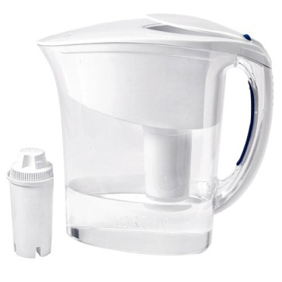
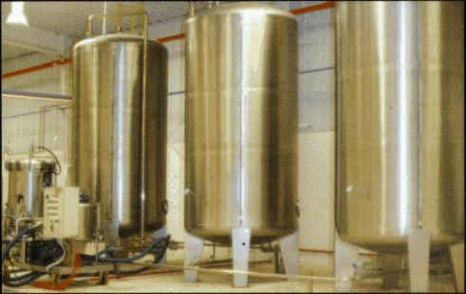
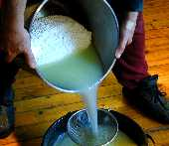
Filtration: removing a solid substance from a liquid by passing the suspension through a filter.
Crude oil filtration
(vacuum filtration)
Gravity
Filtration
Decantation: a process for separating the liquid component of a solid—liquid mixture from the solid by pouring.
Decanting whey
from the curds
in cheese making.
Decanting
a solvent
from a solute.

Slide 8
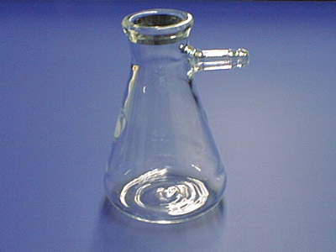
Side arm or filtration flask
A filtration flask looks like a flask with a short side arm.
The "arm" is designed to connect the flask to a vacuum source.
When sealed on the top with a stopper or a Büchner funnel, the vacuum flask will maintain a reduced pressure.

Slide 9
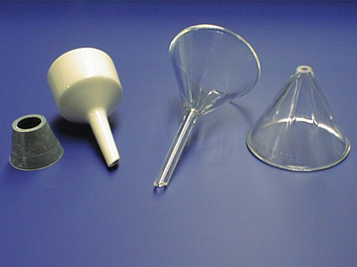
Stemmed Funnel
Büchner Funnel
Stemless Funnel
A Büchner funnel is the white porcelain funnel. It requires an adaptor or rubber stopper with a hole in it to connect it to the top of a filtration flask.
A Büchner funnel is used exclusively for vacuum filtrations.

