Slide 1
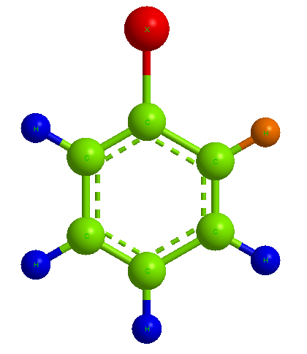
Aryl halides
Dr. Talat R. Al-Ramadhany

Slide 2
Aryl halides (Ar-x)
Aryl halides are organic compounds containing halogen atom attached to an aromatic ring. They have the general formula ArX, where (Ar-) is phenyl or substituted phenyl and (x) is F, Cl, Br, I.

Slide 3
Chlorobenzene
m-Bromonitrobenzene
p-Iodophenol
o-Chlorobenzoic acid

Slide 4
An aryl halide is not just any halogen compound containing an aromatic ring. Benzyl chloride, for example, is not an aryl halide; its halogen is not attached to the aromatic ring, in structure and properties it is simply a substituted alkyl halide.
Benzyl chloride
A vinyl halide

Slide 5
Physical properties:
Aryl halides are insoluble in water but soluble in organic solvents.
Para-isomer has a melting point about (70-100ºC) degree higher than ortho- or meta- isomers.
Para- isomer is more symmetrical which fits better into a crystalline lattice and the higher m.p.
Because of the strong intracrystalline forces, p- Isomer is less soluble in a given solvent than ortho-isomer.

Slide 6
Preparation of aryl halide compounds:
Direct halogenations of aromatic compounds:
Example:

Slide 7
From aryl diazonium salts

Slide 8
Sandmeyer reaction
Replacement of the diazonium group by Cl, or Br is carried out by mixing the solution of the freshly prepared diazonium salt with cuprous chloride or cuprous bromide at room temperature.

Slide 9
From arylthallium compounds
Aryl iodides can be prepared by simple treatment of arylthallium with iodine. The thallation route has the advantages of speed, high yield, and orientation control.
For iodides
only

Slide 10
The preparation of aryl halides from diazonium salts is more important than direct halogenation for several reasons:
First of all, fluorides and iodides, which can seldom be prepared by direct halogenation, can be obtained from the diazonium salts.
Second, where direct halogenation yields a mixture of ortho- and para- isomers; the ortho isomer, at least, is difficult to obtain pure. On the other hand, the ortho and para isomers of corresponding nitro compounds, from which the diazonium salts ultimately come, can often be separated by fractional distillation.

Slide 11
Low reactivity of aryl and vinyl halides:

Slide 13
The low reactivity attributed to two factors:
Delocalization of electrons by resonance.
Differences in σ bond energies due to differences in hybridization of carbon.
I
II
III
IV

Slide 14
Reactions of aryl halides:
Formation of Grignard reagents

Slide 16
2. Electrophilic Aromatic Substitution (EAS)

Slide 17
Nucleophilic aromatic substitution:
(Ar-) must contain strongly electron withdrawing groups
ortho and/or para to the X.

Slide 20
Nucleophilic aromatic substitution.
When the ring is not activated toward bimolecular displacement

Slide 22
Analysis of aryl halides
► Insoluble in cold sulfuric acid.
► Inertness toward bromine in carbon tetrachloride
(CCl₄) and toward permanganate solution (KMnO₄).
► Formation of orange to red colors when treated
with chloroform and aluminum chloride.
► dissolution in cold fuming sulfuric acid, but at a
slower rate than that of benzene.

