Slide 1
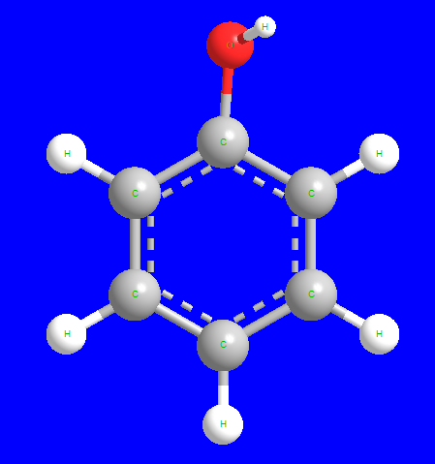
Phenols (Ar-OH)

Slide 2
I. Structure and nomenclature:
Phenols are compounds of the general formula Ar-OH, where Ar- is phenyl, substituted phenyl, or one of the other aryl groups.
Phenols differ from alcohols in having the -OH group attached directly to an aromatic ring. Hydroxybenzene, the simplest member of the phenols, is generally referred to as phenol.

Slide 3
Phenol Benzylalcohol
−OH is directly linked −OH is not directly linked
to the aromatic ring carbon to the aromatic ring carbon

Slide 5
II. Physical properties:
The simplest Phenols are liquid or low-melting solids.
Phenols have high boiling points.
Phenol itself is somewhat soluble in water
most other Phenols are essentially insoluble in water.
Phenols are colorless, but they easily oxidized by atmospheric air and become colored compounds.

Slide 6
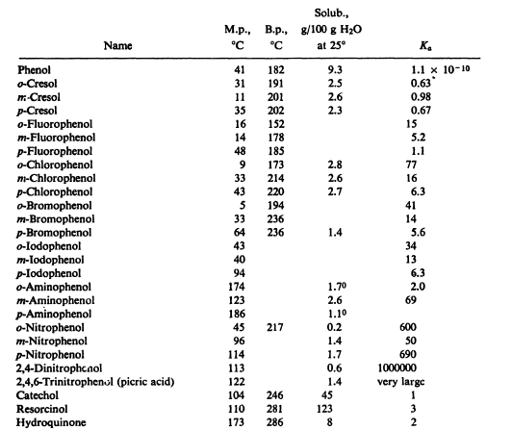

Slide 7
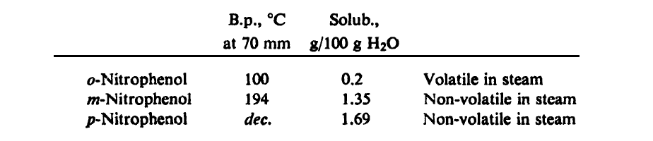
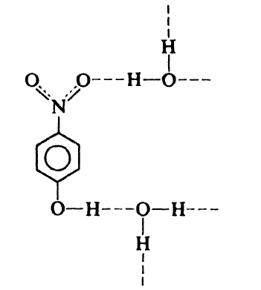
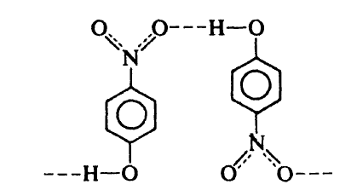
m- and p- isomers have higher boiling point because of the intermolecular hydrogen bonding and their solubility in water is due to the hydrogen bonding with water.

Slide 8
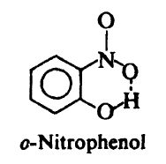
For o-nitrophenol, the –NO₂ and –OH groups are closed to each other and they form intramolecular hydrogen bonding (within a single molecule). Therefore o-nitrophenol does not have the low volatility of an associated liquid, cannot form hydrogen bonding with water, therefore it have lower solubility in water.

Slide 9
III. Acidity of Phenols:
Phenols are fairly acidic compounds, and in this respect differ markedly from alcohols, which are even more weakly acidic than water.
Carboxylic acid > Phenol > Water > Alcohol
Aqueous hydroxides convert Phenols into their salts; aqueous mineral acids convert salts back into the free Phenols.

Slide 10
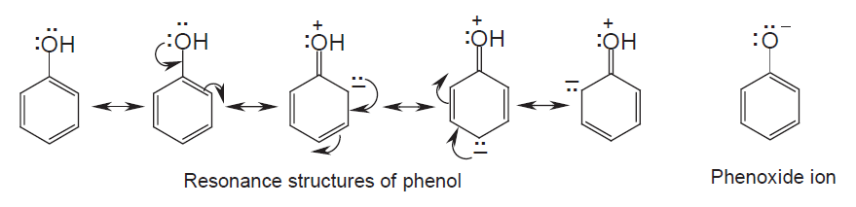
The acidity of phenols is mainly due to an electrical charge distribution in phenols that causes the -OH oxygen to be more positive. As a result, the proton is held less strongly, and phenols can easily give this loosely held proton away to form a phenoxide ion as outlined below.

Slide 11
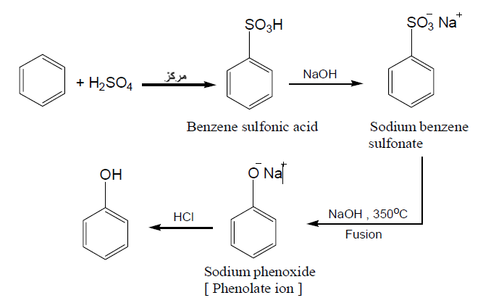
Industrial sours of Phenols:
Conc.
i.

Slide 12
Dow process, in which Chlorobenzene is allowed to react the aqueous sodium hydroxide at a temperature of about 360ºC.

Slide 13
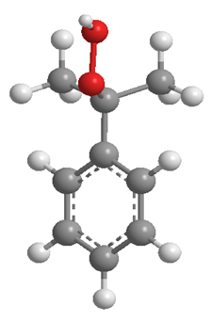
Oxidation of Cumene: Cumene is converted by air oxidation into cumene hydroperoxide, which is converted by aqueous acid into Phenol and acetone.

Slide 14
Preparation of Phenols in the laboratory
Hydrolysis of diazonium salts

Slide 15
Oxidation of arylthallium compounds
This method has two advantages over the diazonium route:
The speed and high yield.
Orientation control in the thallation step.

Slide 16
Alkaline hydrolysis of aryl halides

Slide 18
Reaction of Phenols
There are two type of reaction:
Reaction of (O–H) bond.
Reaction of aromatic ring
(Electrophilic Aromatic Substitution).

Slide 19
Reaction of (O–H) bond.
Acidity, salt formation.

Slide 20
Ether formation (Williamson Synthesis)
Phenols are converted into ethers by reaction in alkaline solution with alkyl halides.

Slide 22
Aryl halide must be containing strong electron-withdrawing group to form corresponding ether.

Slide 23
Ester formation
Phenols are usually converted into their esters by the reaction with carboxylic acids, acid chlorides or anhydrides.
Phenol Benzoyl chloride Phenyl benzoate

Slide 24
(Fries rearrangement)
When esters of Phenols are heated with aluminum chloride, the acyl group migrates from the Phenolic oxygen to an ortho or para position of the ring and yield a ketone. This reaction is called the Fries rearrangement, is often used to prepare phenolic ketones.

Slide 25
B. Reaction of aromatic ring
(Electrophilic Aromatic Substitution).
Halogenation (Bromination)
Treatment of Phenols with aqueous solution of bromine results in replacement of every hydrogen ortho or para to the –OH group

Slide 26
If halogenation is carried out in a solvent of low polarity:

Slide 27
Some group can replace by bromine

Slide 28
Sulfonation:

Slide 29
Nitration:

Slide 30
Friedel-Crafts alkylation
Alkyl phenols can be prepared by Friedel-Crafts alkylation of Phenols, but the yields are often poor.

Slide 31
Phenolic ketones can be made by direct Friedel-Crafts acylation of Phenols, they are more often prepared in two steps by means of the Fries rearrangement.

Slide 32
Nitrosation:
Nitrous acid converts Phenols into nitrosophenols

Slide 33
Synthesis of Phenolic acids (Kolbe reaction):
Treatment of the salts of a Phenol with carbon dioxide brings about substitution of the carboxyl group, -COOH, for hydrogen of the ring. This reaction is known as the Kolbe reaction; its most important application is in the conversion of Phenol into o-Hydroxybenzoic acid, known as salicylic acid.

Slide 34
7) Synthesis of Phenolic aldehydes (Reimer-Tiemann reaction):
Treatment of Phenol with chloroform and aqueous hydroxide introduces an aldehyde group, –CHO, into the aromatic ring, generally ortho to the –OH. This reaction is known as the Reimer-Tiemann reaction.

