Slide 1
Routine- & Special stool culture Sadeq Kaabi
بسم الله الرحمن الرحيم
Fourth grade
First semester
2018-2019
Diagnostic Medical Microbiology-Laboratory Manual

Slide 2
Enteric infections and their significance
Enteric bacterial infections, causing diarrhoea, dysentery, and enteric fevers, are important health problems throughout the world. Diarrhoeal infections are second only to cardiovascular diseases as a cause of death.
Diarrhea kills 2,195 children every day—more than AIDS, malaria, and measles combined.
Diarrheal diseases account for 1 in 9 child deaths worldwide, making diarrhea the second leading cause of death among children under the age of 5

Slide 3
What are enteric bacteria?
Functional definition: Gram negative facultatively anaerobic rods
Coliforms: enteric bacteria that ferment lactose to produce acid and gas

Slide 4
Enteric Bacteria
Enteric bacteria: secretory or watery diarrhea
Vibrio cholerae
ETECs (Enterotoxigenic E. coli)
EPECs (Enteropathogenic E. coli)

Slide 5
Enteric Bacteria
Invasive/Tissue Damaging Enteric pathogens: Bloody diarrhea and dysentery
EIECs (Enteroinvasive E. coli)
Shigella spp (produces Shiga toxin)
Salmonella spp-- found in undercooked chicken eggs and dairy products
EHECs (Enterohemmorhagic E. coli)—found in undercooked hamburger etc produces Shiga- like toxin
Example:: E. coli O157:H7

Slide 6
Enteric Bacteria
Slow bacterial Infection Pathogens
Helicobacter pylori
Causes gastric and duodenal ulcers
ulcers are caused by localized non-specific immune response and by the fact that the bacteria produce cytotoxins
Causes cancer : Gastric carcinoma
Found associated with the pyloric region of the stomach where it colonizes stomach for decades and causes a persistent low grade inflammation of the stomach

Slide 7
Helicobacter pylori —why doesn’t it get killed by stomach acids?
H. pylori goes to region of stomach (pyloric region) where the pH of the stomach is relatively higher
(It can sense pH and actively swim to the region that has a higher pH)
H. pylori produces urease which breaks urea down into ammonia, this further increases the pH of the stomach

Slide 8
Non-invasive bacteria that colonize the small intestines
Vibrio cholerae and ETECs
produces a toxin in the small intestines
do not invade cells but reside on the surface of cells of the small intestines
EPECS
do not produce toxins
changes the microvilli of the small intestines

Slide 9
Vibrio cholerae and ETECs
Makes contact with intestinal epithelial cells such they don’t get swept out by peristaltic movements of the intestines
These bacteria have proteins at the end of their pili called adhesins
The adhesins allow the bacteria to interact with glycoproteins and glycolipids on the surface of the intestinal epithelial cells
Once established at cell surface the bacteria produce toxins that enter the cell and destroy the ionic balance of the cell

Slide 10
Vibrio and ETEC toxins
Vibrio cholerae produces cholera toxin and ETECS produce “cholera like toxin”
Toxin has two components
A subunit is actual toxin
B subunit is delivery component
The B subunits bind to epithelial cell surfaces and delivers the A subunit into the cell
Once inside the cell the A subunit is activated and destroys ionic balance of cells

Slide 11
EPECS do not produce toxin but produce enzymes that change the surface of the microvilli of the small intestinal epithelial cells.
EPECS make contact with cells via bundle forming pili
They then produce enzymes that are secreted to the inside of the cell
The enzymes cause the actin underlying the microvilli to undergo actin rearrangements
Such rearrangements lead to a pedestal formation at apical surface of cells
This effaces the microvilli and prevents readsorption of water into the cell

Slide 12
EHECs
EHECs cause hemorrhagic colitis and hemolyic uremic syndrome (HUS)
HUS can cause renal failure
We come in contact with EHECs when
we eat undercooked hamburger—only 50 organisms required to cause disease or when the groundwater becomes contaminated near cattle farms
EHECs are resistant to stomach acids
EHECs travel to the colon where they attach to the surface of colonic epithelial cells and multiply

Slide 13
EHECs, Shiga like toxin and HUS
Shiga like toxin can travel in the blood stream where they reach the kidneys
They kill kidney epithelial cells
The dead cells plug up the small vessels in the kidneys leading to HUS (hemolytic uremic syndrome.
This can lead to kidney failure

Slide 14
Intracellular pathogens—Salmonella spp
Salmonella typhimurium causes gastro-enteritis and a bloody diarrhea in humans
S. typhimurium can be found in chickens, eggs, poultry products and milk
Salmonella typhi causes typhoid fever and travels to the spleen, liver, kidneys and gallbladder
Salmonella typhi can reside in the gallbladder of asymptomatic people, these people are carriers of the disease as they constantly shed the bacteria into the environment

Slide 15
Clinical significance of Shigella spp.
Shigella spp. cause a wide spectrum of clinical diseases, which vary from asymptomatic infections to diarrhoea without fever to severe dysentery.
Symptoms consist of abdominal cramps, ineffectual and painful straining to pass stool (tenesmus- زحير), and frequent, small-volume, bloodstained inflammatory discharge. Shigella spp. are the main cause of bacillary dysentery followed by enteroinvasive and enterohaemorrhagic E. coli. Many cases present as mild illnesses that require no specific treatment. However, for severe dysentery or when secondary spread is likely, antimicrobial therapy after susceptibility testing is indicated as resistance towards commonly used antimicrobials is high in many countries.
Four groups of Shigella organisms, with a total of 39 serotypes and subtypes, are recognized. Group A (S. dysenteriae) , group B (S.
flexneri), and group C (S. boydii) contain multiple serotypes; there is only one serotype for group D (S. sonnei). S. dysenteriae and S. flexneri are the most commonly isolated Shigella species in developing countries, while S. sonnei is the most commonly isolated species in developed countries.

Slide 16
Clinical significance of Salmonellae
The nomenclature and classification of the salmonellae have changed several times and are still under discussion. According to present nomenclature, all Salmonella species belong to a single genus which is subdivided in six subgroups (also called subspecies), including the former genus Arizona. Subgroup 1 corresponds to the typical salmonellae and includes among others: Salmonella typhi, S. paratyphi A, S. enteritidis, S. typhimurium, S. choleraesuis. This subgroup contains more than 2000 serotypes, which can be differentiated by their antigenic formula (O, H and Vi antigens). Serotypes in subgroup 1 continue to be named as if they were real species: Salmonella subgroup 1 serotype typhimurium is simply called S. typhimurium. More than 99% of human salmonella isolates belong to subgroup 1.

Slide 17
Clinical significance of Escherichia coli
At least six different classes of diarrhoea-producing Escherichia coli have
been identified: enteropathogenic E. coli (EPEC), enterotoxigenic E. coli
(ETEC), enterohaemorrhagic or verotoxin-producing E. coli (EHEC or VTEC), enteroinvasive E. coli (EIEC), enteroadhesive E. coli (EAEC), and enteroaggregative E. coli (EAggEC). Four of them are common causes of diarrhoeal disease in developing countries. However, identification of these strains requires serological assays, toxicity assays in cell culture, pathogenicity studies in animals and gene-probe techniques that are beyond the capacity of intermediate-level clinical laboratories.

Slide 18
Clinical significance of Vibrio cholerae
Cholera is a typical example of a toxigenic infection. All the symptoms can be attributed to the intestinal fluid loss caused by an enterotoxin released by Vibrio cholerae in the intestine. The stool is voluminous and watery, and contains no inflammatory cells. The main objective of treatment is fluid replacement and antimicrobials have only a secondary role.
V. cholerae spreads very rapidly. It can be divided into several serotypes on the basis of variation in the somatic O antigen, and serotype O1 exists in two biological variants termed “classical” and “El Tor”.
Until 1992, only V. cholera serogroup O1 (classical or El Tor) was known to produce epidemic cholera, and other serogroups were thought to cause sporadic cholera and extraintestinal infections. However, in 1992 a large outbreak of cholera appeared on the east coast of India and quickly spread to neighbouring countries. This epidemic was caused by a previously unrecognized serogroup of V. cholerae O139 Bengal.

Slide 19
Clinical significance of Aeromonas spp.
And other vibrios
V. parahaemolyticus and several other species of Vibrio (V. fluvialis, V. hollisae, V. mimicus) and Aeromonas (A. hydrophila, A. sobria, A. caviae) cause food poisoning or gastroenteritis in persons who eat raw or undercooked seafood.
Gastrointestinal disease in children is usually an acute, severe illness, whereas that in adults tends to be chronic diarrhea. Severe Aeromonas gastroenteritis resembles shigellosis, with blood and leukocytes in the stool. Acute diarrheal disease is self-limited, and only supportive care is indicated in affected patients.

Slide 20
Clostridium difficile –Associated Diarrhea
Toxins produced by Clostridium difficile strains in the GI tract cause pseudomembranous colitis, typically after antibiotic use. Symptoms are diarrhea, sometimes bloody, rarely progressing to sepsis and acute abdomen. Diagnosis is by identifying C. difficile toxin in stool. Treatment is with oral metronidazole, vancomycin, or fidaxomicin.

Slide 21
Clinical significance of Campylobacter jejuni
Campylobacter infections are among the most common bacterial infections in humans. They produce both diarrheal and systemic illnesses. In industrialized regions, enteric Campylobacter infections produce an inflammatory, sometimes bloody, diarrhea or dysentery syndrome.

Slide 22
Other enteric pathogens:
Pleisomonas shigelloids, Bacillus subtlis,
Staphylococcus aureus
Many bacterial species may be the causative agent of food poisoning like Staphylococcus aureus, Bacillus subtilis, and Pleisiomonas shigelloides, and many others of family Enterobacteriaceae.
These pathogens produces enterotoxin that result in diarrhea, and other symptoms of food of food poisoning.

Slide 23
Routine Stool Culture
Aim of the test
Detect bacterial pathogenic organisms in the stool; only for Salmonella spp. or Shigella spp.
Types of specimen
Stool, rectal swab in fecal transport system or Duodenal or sigmoid aspirate.
Who will collect the specimen
The patient, If stool is unobtainable, nursing staff or physician will collect fecal swab or aspiration by physician.
Quantity of specimen
The specimen should contain at least 5 g of feces.

Slide 24
Gastrointestinal Tract Infections
Common pathogens | Commensals flora
Helicobacter pylori | Enterobacteriaceae other than the common pathogens
Salmonella spp. | Bacteroides spp
E. coli O157:H7 | Streptococcus spp
Staphylococcus aureus | Lactobacilli
Campylobacter spp. | Pseudomonas spp.
Vibrio cholerae | Coagulase negative staphylococci
Yersinia enterocolitica | Bacteroides spp.
Clostridium difficile | Clostridium spp.
Shigella spp. | Peptostreptococcus spp.
 | Bifidobacterium spp.
 | Eubacterium spp.
Notes:
Cefsoludin-irgasan-novobiocin (CIN) agar selective media for Y. enterocolitica after 48 hours “bulls eyes” colony appearance
FORMULA in grams per liter purified filtered water
Gelatin Peptone17,0
Casein Peptone1,5
Meat Peptone1,5
Yeast Extract2,0
D-Mannitol20,0
Sodium Desoxycholate0,5
Sodium Cholate0,5
Sodium Pyruvate2,0
Magnesium Sulfate0,01
Sodium Chloride1,0
Neutral Red0,03
Crystal Violet0,001
Irgasan0,004
Agar13,5
Supplements
Cefsulodin0,015
Novobiocin0,0025
pH 7.4 +/- 0,2 at 25º C

Slide 25
Specimen Collection and Handling
Pass the stool into a clean, dry, plastic disposable container ·
DO NOT MIX URINE OR WATER WITH THE STOOL SPECIMEN.
Formed or semi-formed stool: Use the spork provided in the cap of the vial to pick a portion of the stool equivalent to the size of a navy bean and MIX it into transport media in the vial. Any blood or mucous should be included.
Liquid stool: Add approximately ½ to 1 teaspoon of fluid to the bottle and MIX into the transport media. DO NOT let the specimen sit on top of the media.
Rectal swabs: Insert the swabs into the transport media.
Tighten cap completely. A leaking specimen unsuitable for testing.
Clean the outside of the vial with rubbing alcohol or soap and water if it is soiled.
Check to make sure the patient name and date of collection are still readable.

Slide 26
Criteria of specimen rejection
specimen contaminated with urine, residual soap, or disinfectants.
Specimens received in grossly leaking transport containers, Diapers, dry specimens.
specimens submitted in fixative or additives.
Specimen | Collection |  | Time and Temp
 | Guidelines | Device and or minimum vol. | Transport | Storage
Stool Routine culture | Pass directly into clean dry container. Transport to microbiology laboratory within 1h of collection. | Sterile, leak proof, wide-mouth container | Unpreserved ≤ 2h,RT | ≤ 24h, ,4ċ

Slide 27
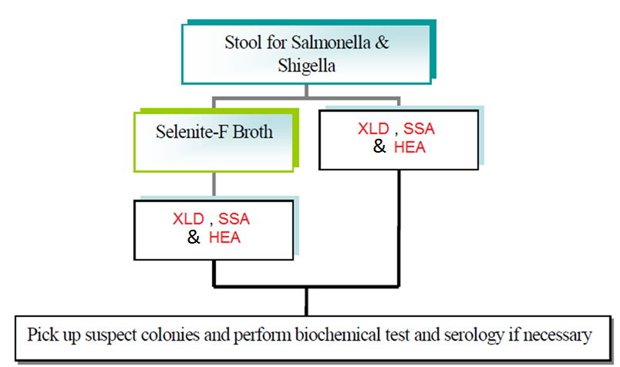
Specimen Processing

Slide 28
Xylose lysine Deoxycholate (XLD)
A selective and differential medium for the recovery of Salmonella and Shigella species.
Ingredients :
Lactose...................0.75 % | Sodium Chloride
Sucrose...................0.75% | Yeast Extract
Xylose.....................0.35% | Sodium Deoxycholate
L-Lysine....................0.5% | Ferric Ammonium Citrate
Agar..........................1.35% | Sodium Thiosulfate
Phenol Red
Final pH 7.4 ± 0.2 at 25°C

Slide 29
Xylose lysine Deoxycholate (XLD) Principle...
Sodium desoxycholate inhibits contaminating Gram-positive flora.
Xylose is fermented by practically all coliforms bacteria and Salmonella, except for Shigella which are thus differentiated from the other species.
After exhausting xylose, Salmonella decarboxylate lysine (via lysine decarboxylase) to cadaverine, causing the pH to rise.
Colonies of Salmonella resemble those of Shigella in the medium having become basic.
Phenol red is the pH indicator.
The addition of lactose and sucrose to the medium enable coliform bacteria to decarboxylate lysine and thereby produce excess acidity, making the indicator turn yellow, favoring their differentiation.
Sodium thiosulfate and Ferric ammonium citrate allow the detection of the H₂S producing bacteria.

Slide 30
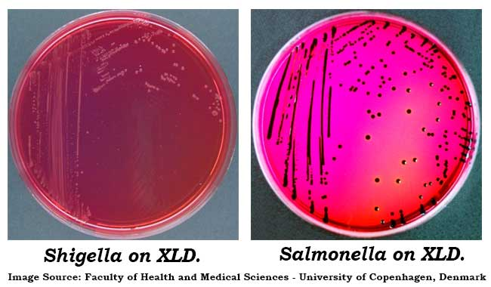

Slide 31
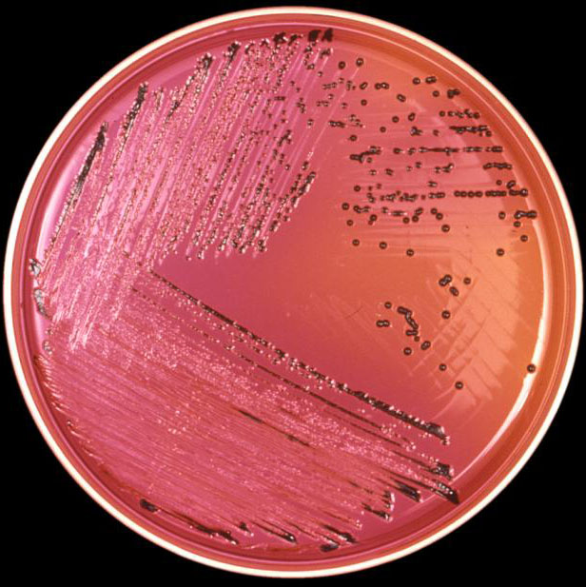
Salmonella on (XLD)

Slide 32
Salmonella-Shigella Agar(SSA)
This agar is for isolating Salmonella & Shigella species, These are the type of infectious organisms that are recovered from stool specimens.
Ingredients :
Beef Extract | Brilliant Green
Pancreatic Digest of Casein | Bile Salts
Peptic Digest of Animal Tissue | Sodium Citrate
Lactose................. 1% | Sodium Thiosulfate
Agar........................1.35% | Ferric Citrate
Neutral Red
Final pH 7.0 ± 0.2 at 25°C

Slide 33
Salmonella-Shigella Agar(SSA) Principle…
There are four main ingredients in this agar:
Lactose – to show lactose fermenters or non-lactose fermenters.
Bile Salts, Sodium Citrate and Brilliant Green- inhibit Gram-positive bacteria, most coliform bacteria.
Sodium thiosulfate and Ferric citrate allow the detection of the H₂S producing bacteria such as Proteus and some strains of Salmonella, as they produce colonies with black centers
Neutral Red is the pH indicator.
E. coli & Klebsiella pneumoniae are two gram negative organisms that will ferment the lactose and exhibit reddish/pink colonies on this agar.
Salmonella & Shigella species are non-lactose fermenters that will not produce any color on this media, so they will look like they are colorless.
Salmonella will be the organism that will produce Hydrogen Sulfide in the middle of the colony it produces on this agar.

Slide 34
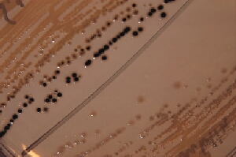
Salmonella and Shigella on (SSA)

Slide 35
Hektoen Enteric Agar (HEA)
Hektoen Enteric Agar is used for the isolation and cultivation of gram-negative enteric microorganisms, especially salmonella and shigella.
Ingredients :
Beef Extract | Bile Salts
Pancreatic Digest of Casein | Acid Fuchsin
Peptic Digest of Animal Tissue | Sodium Thiosulfate
Lactose................. 1.2% | Ferric Citrate
Sucrose................. 1.2% | Sodium Chloride
Salicin................... 0.2% | Agar........................1.35%
Bromthymol Blue
Final pH 7.5 ± 0.2 at 25°C

Slide 36
Hektoen Enteric Agar (HEA) Principle…
Bile Salts and Acid Fuchsin inhibit Gram-positive organisms.
Lactose, Sucrose, and Salicin are fermentable carbohydrates.
Ferric Ammonium Citrate, a source of iron, allows production of hydrogen sulfide (H₂S) present from Sodium Thiosulfate. H2S-positive colonies have black centers.
Bromothymol Blue and Acid Fuchsin are added as the pH indicator. The indicator bromothymol blue changes its color to yellow and acid fuchsin would changes color from yellow to orange- red when acid is formed.
Appearance of Colonies | Microorganisms
Green, moist, flat, transparent | Shigella, Providencia
Blue-green, with or without a black centre | Salmonella, Proteus
Green to bluish, flat, irregular edge | Pseudomonas
Orange-red surrounded by a zone of precipitate. | Coliform bacteria

Slide 37
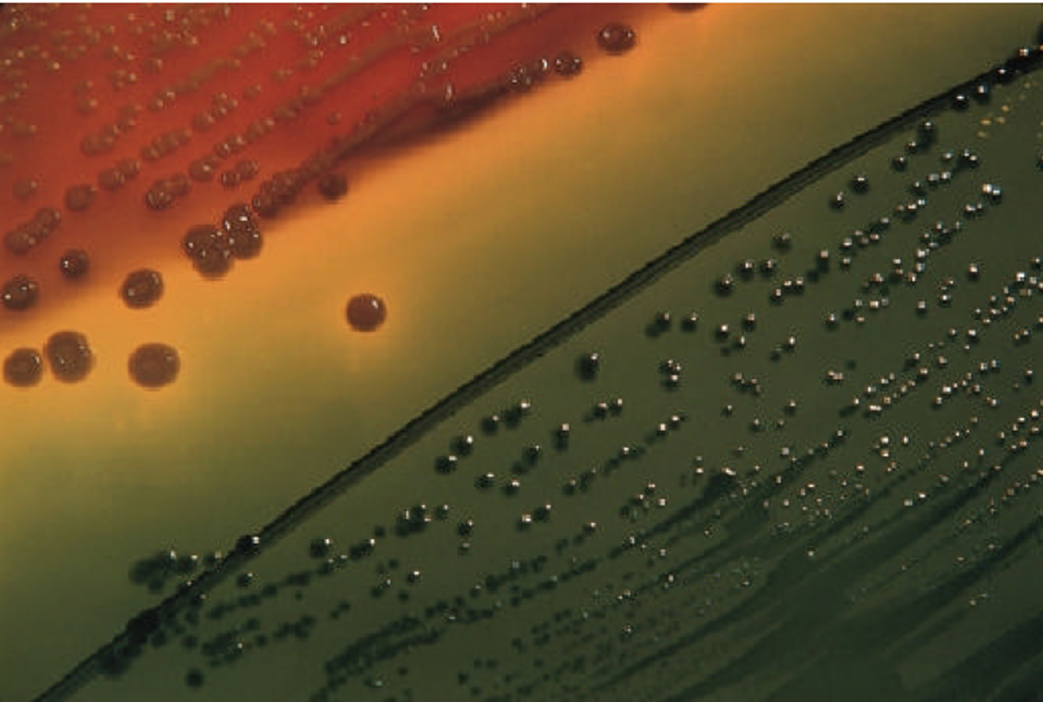
Shigella and Coliforms on (HEA)

Slide 38
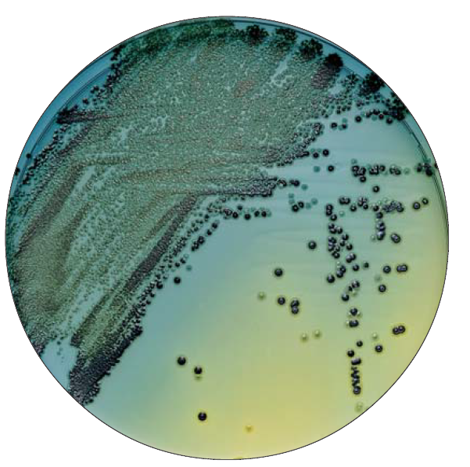
Salmonella and Shigella on (HEA)

Slide 39
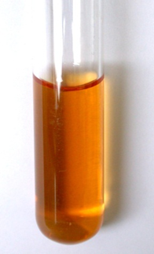
Selenite F broth
Selenite F broth is an enrichment medium for the isolation of salmonella species and some shigella species from faecal or urine specimens.
Ingredients :
Sodium hydrogen Selenite | Disodium hydrogen phosphate
Peptone | sodium dihydrogen phosphate
Lactose
Final pH 7.0 ± 0.2 at 25°C
Sodium Selenite inhibits the growth of Gram-positive bacteria and many Gram-negative bacteria, whereas the salmonellae are not affected.
Sodium selenite is highly toxic at near-neutral pH.
Buffer salts are present to help maintain the pH which may rise as the toxicity decreases . A rise in pH decreases selective activity of Selenite.
A fermentable carbohydrate ( lactose) is also present to provide acid to neutralize the alkali produced when the selenite is reduced by bacteria.

Slide 40
Additional Information
Notes
In enteric fever caused by Salmonella typhi, S. choleraesuis, or S.enteritidis, blood culture may be positive before stool cultures, and blood cultures are indicated early; urine cultures may also be helpful.
Stool samples should be examined and cultured as soon as possible after collection.
As the stool specimen cools, the drop in pH will inhibit the growth of most Shigella spp. and some Salmonella spp.
Gram Negative (GN) broth is selective enrichment medium used for the cultivation of enteric pathogens including Shigella and salmonella It is especially useful when the salmonella or Shigella are present in low numbers.
Notes:
SPECIMEN: For the diagnosis of enteric fever, specimens include, blood, feces
and urine for culture may be used depending on the course of illness.
A. Blood: Organisms can usually be detected in 75-90% of patients during the first 10
days of infection and in about 30% of patients during the 3rd. week.
B. Feces: Organisms can usually be isolated from 40-50% of patients during the third
week.
C. Urine: Organism, can usually be detected from about 25% of patients after the
second week of infection.
D. Serum: Is used for the detection of serum antibodies (Widal test).

Slide 41
Additional Information continue…..
Tetrathionate Broth, with added iodine-iodide solution, is used as a selective enrichment medium for the isolation of Salmonella.
One gram of stool is transported to tube of selenite F broth and a loop is streak on at least two of stool cultures media,( we recommended both HEA and XLD to be used, because SSA may inhibit some strains of salmonella or shigella) and incubated at 37ċ, after the overnight incubation subculture from selenite F broth onto a fresh plate of XLD and HEA at least.

Slide 42
Post Specimen Processing
Interfering factors:
Patient on antibiotic therapy.
Improper sample collection.
Result reporting:
A positive report will be issued only in case salmonella or shigella were isolated, otherwise, a negative report will be issued.
Turn around time:
Isolation of a possible pathogen can be expected after 2-4 days.
Negative culture will be reported out 2 days after the receipt of the specimen as No Enteric Pathogens Isolated.

Slide 43
Special Stool Culture 1.Vibrio colerae
بسم الله الرحمن الرحيم
Fourth grade
First semester
2018-2019
Diagnostic Medical Microbiology-Laboratory Manual

Slide 44
Stool Culture, Vibrio cholera
Aim of the test
To isolate Vibrio cholera from stool specimen and perform antibiotic sensitivity testing.
Pre-Specimen processing
See under stool culture, routine. ( Rice water stool ).
Specimen processing
Media
Alkaline peptone water.
TCBS (Thiosulfate Citrate Bile salt Sucrose Agar).

Slide 45
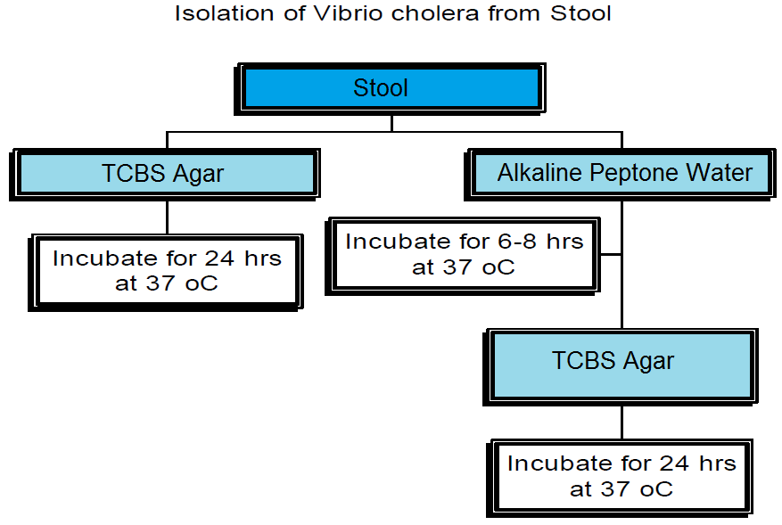
Specimen Processing
Pick typical yellow colonies from TCBS Agar and perform API 20 E SYSTEM

Slide 46
Thiosulfate Citrate Bile salt Sucrose (TCBS )Agar
Thiosulfate-Citrate-bile Salts-Sucrose agar or TCBS agar is a type of selective agar culture plate that is used in microbiology labs to isolate Vibrio spp.,Vibrios grow well at 35-37°C on media containing one percent sodium chloride and a very high pH (8.5-9.5). Halophilic vibrios require sodium chloride for optimum growth and metabolic activity.
Ingredients :
Yeast Extract | Peptone | Sodium Chloride ...1.0%
Sucrose | Sodium Thiosulfate | Ferric Citrate
Sodium Citrate | Agar.................1.5% | Bile salts
Bromothymol Blue | Thymol Blue
Final pH 8.6 ± 0.2 at 25°C

Slide 47
Thiosulfate Citrate Bile salt Sucrose (TCBS )Agar
Principle :
TCBS Agar contains a complementary source of plant and animal proteins, One percent Sodium Chloride, Sodium thiosulphate source of sulfur (in combination with Ferric citrate, detects hydrogen sulphide production)., and yeast extract, all of which allow optimum growth. The Bile Salts in the media inhibit the growth of gram-positive microbes.
The presence of Sucrose allows for the differentiation of those vibrios, which can utilize sucrose with the aid of Bromthymol blue, and Thymol blue pH indicators.
The high pH ( 8.6 pH )of TCBS Agar suppresses other intestinal flora while allowing uninhibited growth of vibrios.

Slide 48
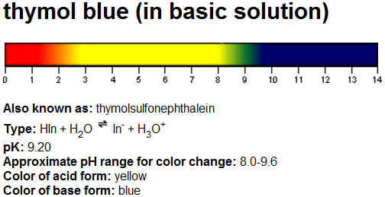
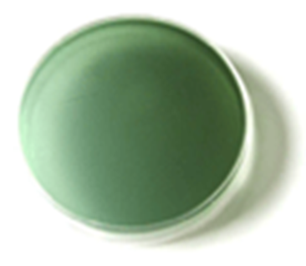
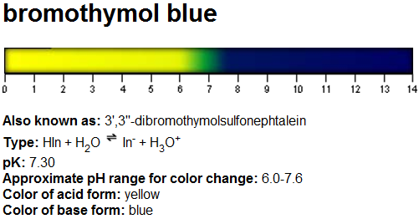
(TCBS Agar pH indicators)

Slide 49
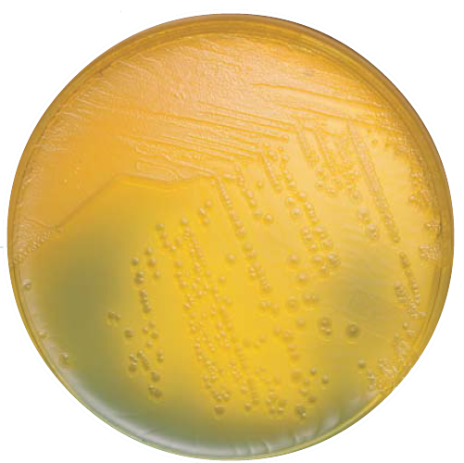
Vibrio cholerae on (TCBS) Agar
V. cholerae ........................... Large yellow colonies
Notes:
Luciferase

Slide 50
Alkaline Peptone Water
Alkaline Peptone Water is used for the enrichment of Vibrio cholerae and Vibrio species from food, water, feces and clinical studies.
Clinical materials containing small numbers of Vibrio should be inoculated into an enrichment medium prior to plating onto a selective medium, such as TCBS Agar.
Ingredients :
Peptone | Sodium Chloride ...1.0%
Final pH 8.6 ± 0.2 at 25ºC

Slide 51
Alkaline Peptone Water
Principle:
Alkaline Peptone Water is a suitable enrichment broth for Vibrios.
The relatively high pH of the medium (approximately 8.6) provides a favorable environment for the growth of vibrios.
It is claimed that raising the medium’s pH leads the medium’s alkalinity to inhibit most of the unwanted flora background, leaving the viability of the Vibrio species intact.
Growth in tubes is indicated by turbidity compared to an uninoculated control.
Additional steps are recommended, like plating onto a selective and non-selective media for isolation and morphology, and biochemical and serological studies for identification.

Slide 52
Post Specimen Processing
Interfering factors:
Patient on antibiotic therapy.
Improper sample collection.
Result reporting:
A positive report will be issued only in case Vibrio cholerae were isolated, otherwise, a negative report will be issued.
Turn around time:
Isolation of a possible pathogen can be expected after 4-5 days.
Negative culture will be reported out 2-3 days after the receipt of the specimen .

Slide 53
Special Stool Culture 2. E. coli O157:H7
بسم الله الرحمن الرحيم
Fourth grade
First semester
2018-2019
Diagnostic Medical Microbiology-Laboratory Manual

Slide 54
Stool Culture,E. coli O157:H7
Aim of the test
Detect E. coli O157:H7 from stool specimen or rectal swab and perform sensitivity test.
The Latex test will demonstrate by slide agglutination, E. coli strains possessing the somatic O157 antigen and Flagella H7 antigen.

Slide 55
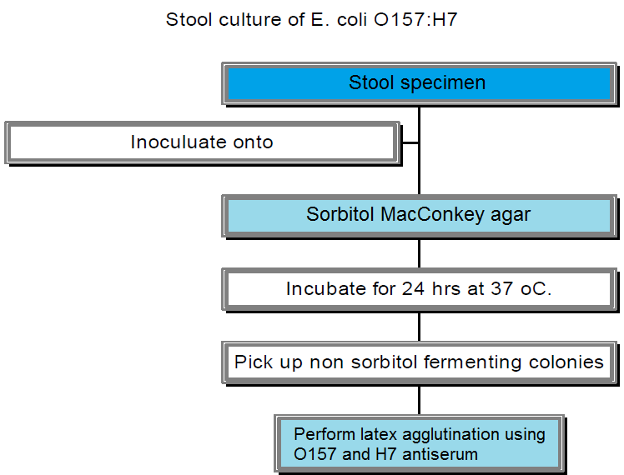
Specimen Processing

Slide 56
Sorbitol MacConkey (SMAC) Agar
This is a selective and differential medium for the isolation of Escherichia coli O157:H7.
Ingredients :
Casein peptone | Sodium Chloride
Meat peptone | Crystal violet
Sorbitol ………….1.0% | Neutral red
Bile salts | Agar..........................1.2%
Final pH 7.4 ± 0.2 at 25°C

Slide 57
Sorbitol MacConkey (SMAC) Agar Principle…
This medium contains Sorbitol instead of lactose and it is recommended for the detection of E. coli 0157:H7 which ferments lactose but does not ferment Sorbitol and hence produce colorless to pale yellow colonies in the presence of Neutral red pH indicator.
Sorbitol fermenting strains of E. coli produce pink-red colonies, The red color is due to production of acid from sorbitol, in the presence of Neutral red pH indicator which change into pink when the pH of the medium drops below 6.8.
It’s also contain Crystal violet and Bile salts to inhibit gram positive bacteria.

Slide 58
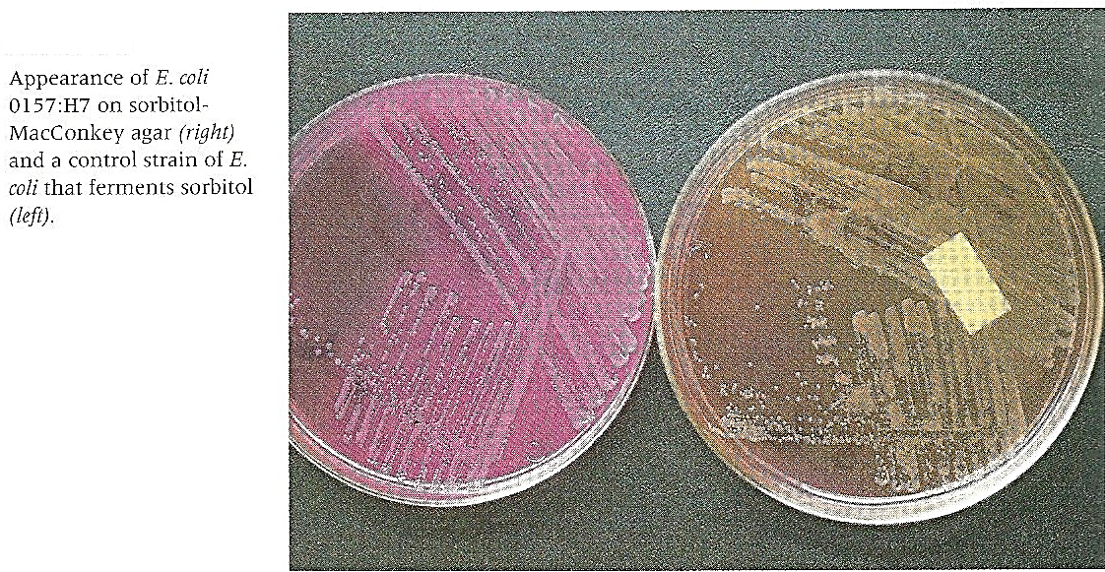
Sorbitol MacConkey (SMAC) Agar

Slide 59
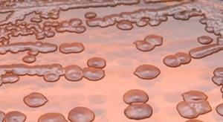
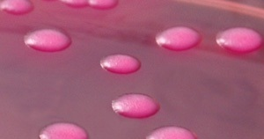
Sorbitol MacConkey (SMAC) Agar
Escherichia coli O157:H7 colonies growing on MacConkey Agar with Sorbitol Incubated aerobically for 24 hours at 37 deg. C.
Escherichia coli colonies growing on MacConkey Agar with Sorbitol Incubated aerobically for 24 hours at 37 deg. C.

Slide 60
E. coli O157 LATEX TEST
Principle of the Test Procedure:
Latex particles are coated with an antiserum against E. coli O157 antigen. When the coated latex particles are mixed with fresh colonies of E. coli serotype O157 the bacteria will bind to the antiserum, causing the latex particles to visibly agglutinate (positive reaction). Bacteria which are not O157 serotype will not bind to the antiserum and will not result in agglutination (negative reaction).
Test Procedure:
Allow all reagents to come to room temperature before use. The E.coli O157 Latex Reagent and Negative Control Latex Reagent must be tested with the Positive Control Antigen prior to running test specimens. The E. coli O157 Latex Reagent must show positive agglutination and the Negative Control Latex Reagent must show no agglutination within two minutes. This indicates that the reagents retain their activity.

Slide 61
Test Procedure
Test material may be obtained by culturing clinical specimens and using either:
Non-sorbitol fermenting colonies (NSFC) from Sorbitol MacConkey agar medium.
Subculture of NSFC from non-selective agar medium.
Select suitable colonies from the agar medium surface.
Re-suspend the colonies in 0.2 ml normal saline in a culture tube.
Place one drop of E.coli O157 Latex Reagent on to a test circle on one of the test cards provided. Using a sterile pasteur pipette add one drop of the test specimen (colony suspension) to the test circle, then mix with the Latex Reagent using one of the mixing sticks provided.

Slide 62
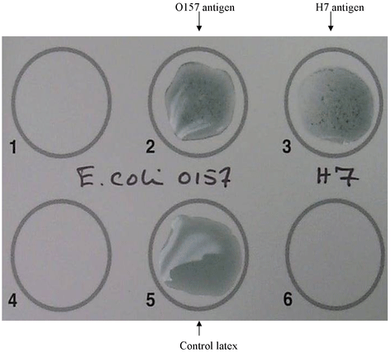
Test Procedure continue ……
Rock the card gently and examine for agglutination for up to two minutes.
Isolates that give a positive result with the test latex must be tested further by repeating the procedure using the Negative Control Latex Reagent.

Slide 63
Quality Control
The E. coli O157 Latex Reagent and Negative Control Latex Reagent must be tested with the Positive Control before running the test isolates. There must be agglutination with the E. coli O157 Latex Reagent within two minutes and no agglutination with the Negative Control Latex Reagent.
Latex Reagent latex particles coated with purified rabbit IgG that reacts with E. coli serogroup O157. Latex particles.
Positive Control suspension containing E. coli serotype O157:H7 antigen.
Negative Control suspension not containing E. coli serotype O157:H7 antigen.

Slide 64
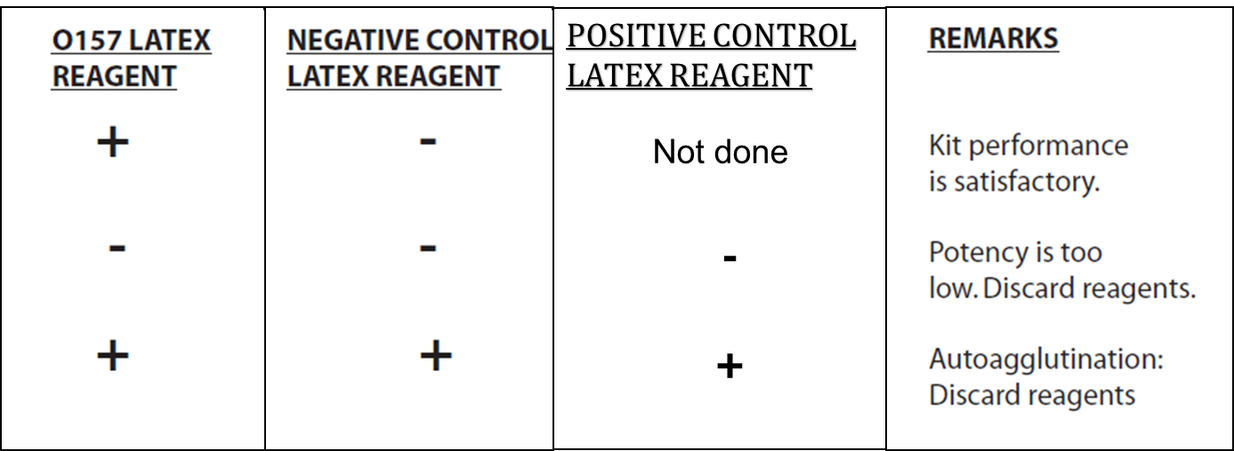
Interpretation of the Results
1. The following table shows how the results obtained with the E. coli O157 Latex Reagents and the E. coli O157 Positive Control should be interpreted:

Slide 65
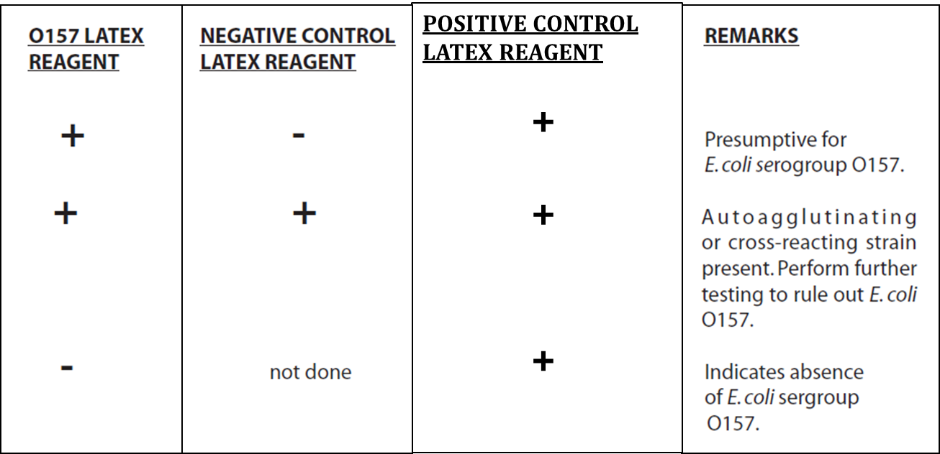
Interpretation of the Results
2. Agglutination of latex reagents with test specimen is interpreted as shown below:

Slide 66
Post Specimen Processing
Interfering factors:
Patient on antibiotic therapy.
Improper sample collection.
Result reporting:
A positive report will be issued only in case E. coli O157:H7 were isolated, otherwise, a negative report will be issued.
Turn around time:
Isolation of a possible pathogen can be expected after 2-4 days.
Negative culture will be reported out 2 days after the receipt of the specimen .

Slide 67
End of Lecture

