Slide 1
Applications of biosynthesis nanoparticles in Medicine
Lec.4

Slide 2
Nanomedicine
Nanomedicine is defined as the application of nanotechnology to health, and is virtually synonymous with Nanobiotechnology.
quantitative detection devices for early diagnosis and for therapy monitoring will have a wide influence in patient management, in improving patient’s quality of life and in lowering mortality rates, in diseases like cancer and Alzheimer’s disease.

Slide 3
Antimicrobial application of nanoparticles
-Antibacterial Effects of Nanoparticles.
- Antifungul.
- Antiviral.
- Anti-itch Treatment, Eczema, Foot Treatment.
- Germ Free Products, Germicide Products.

Slide 4
Automated diagnosis
Diagnosis is essentially a problem of pattern recognition: an object (in this case, the disease) must be inferred from a collection of features.
the practical possibility depends on the availability of extremely powerful processors, based on chips having the very high degree of integration enabled by nanoscale components on the chips.

Slide 6
Biosensors
An alternative approach is to develop sensors so tiny that they can be semi permanently implanted inside the body, where they can continuously monitor their surroundings.
New fields of nanotechnology are both components of the biosensor are excellent candidates for the application of nanotechnology.

Slide 7
Imaging and labeling biological samples

Slide 8
Applications of novel drug delivery system for herbal formulations
Great advances have been made on development of novel drug delivery systems (NDDS) for plant bioactive and extracts.
Novel herbal formulations like:
polymeric nanoparticles,
nanocapsules,
liposomes,
phytosomes,
nanoemulsions,
microsphere,
have been reported using bioactive and plant extracts.

Slide 9
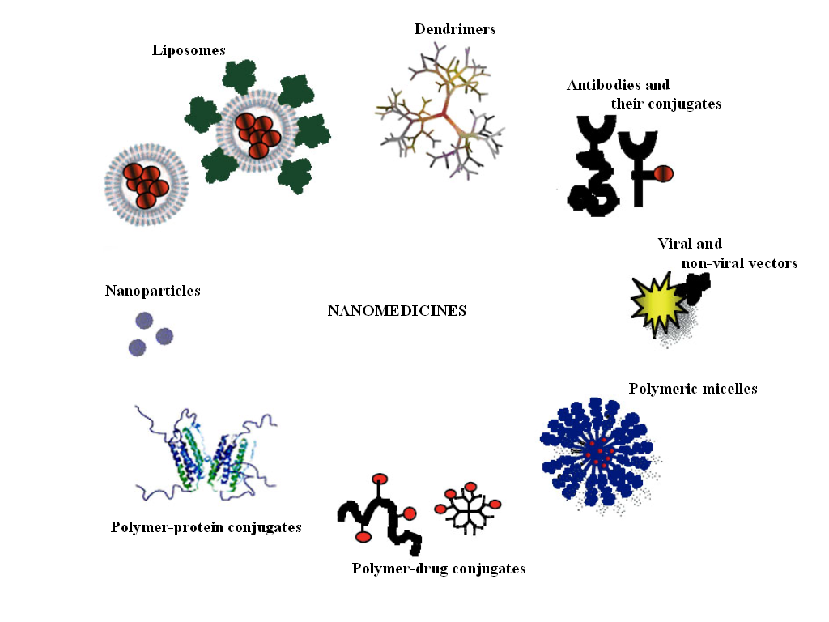
NANOSCALE DRUG DELIVERY VEHICLE

Slide 10
Novel formulations are reported to have
remarkable advantages over conventional
formulations of plant actives and extracts which include: enhancement of solubility,
bioavailability,
protection from toxicity,
enhancement of pharmacological activity, enhancement of stability,
and protection from physical and chemical degradation.

Slide 12
LIPOSOMES FOR ANTIMICROBIAL DRUG DELIVERY
Liposomes are spherical lipid vesicles with a bilayered membrane structure consisting of amphiphilic lipid molecules.
After extensive studies on their fundamental properties including lipid polymorphisms, lipid-protein and lipid-drug interactions,

Slide 13
and mechanisms of liposome disposition in 1980s, the application potential of liposomes as a drug delivery vehicle was thoroughly recognized and started being transferred to practice.

Slide 14
In 1995, Doxil (doxorubicin liposomes) became the first liposomal delivery system approved by the Food and Drug Administration (FDA) to treat AIDS.
Liposomal drug delivery system can be made of either natural or synthetic lipids.

Slide 15
Schematic illustration of four nanoparticle platforms for antimicrobial drug delivery: (a) liposome, (b) polymeric nanoparticle, (c) solid lipid nanoparticle, and (d) dendrimer. Black circles represent hydrophobic drugs; black squares represent hydrophilic drugs; and black triangles represent either hydrophobic or hydrophilic drugs

Slide 16
Nano robotics
are the technology of creating machines of robots at or close to the nanometer scale.
Using special bacterium-sized "assembler“ devices, nanotechnology would permit on a programmable basis exact control of molecular structures.

Slide 17
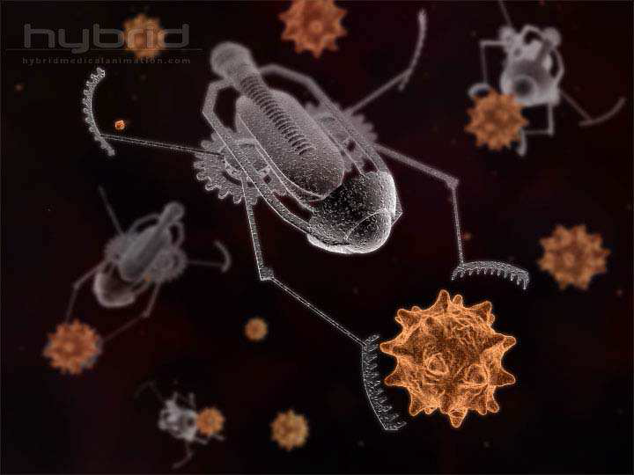

Slide 18
Nanotechnology and Cancer
Nanotechnology has the potential to enable
cancer research
improve molecular imaging,
early detection,
prevention,
and treatment of cancer.

Slide 21
Prostheses and implants
Nanotechnology also has applications in tissue engineering to help a person who needs new bones, teeth, or other tissues. That technique based on biological nanostructures is workable.
Biomimetic nanostructures start with a predefined nanochemical or physical structure.

Slide 22
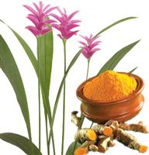
OPPORTUNITY FOR NANOTECHNOLOGY BASED TRADITIONAL MEDICINES
Curcumin
It is commonly used as spice and nutritional supplement,
Used as antioxidant, anti-inflammatory, antiviral, antibacterial, antifungal, anticancer activities and potentially acts against various malignant diseases, diabetes, allergies, arthritis and Alzheimer's disease etc.

Slide 23
Major problems associated with its use are its low solubility, bioavailability and stability.
Curcumin is reported to be unstable in the gut, and little amounts of curcumin that pass through the GI tract are rapidly degraded.
Nanotechnology has been successfully utilized here and has proven to be very effective in solving these problems.

Slide 24
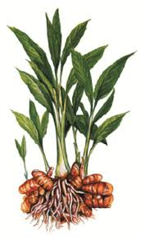
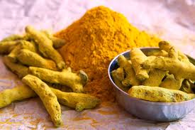
---- Contd ----
In vitro therapeutic efficacy of nano formulated
curcumin and free curcumin against a panel of
human pancreatic cancer cell lines showed comparable results.
Novel polymeric amphiphile conjugates with hydrophilic and hydrophobic segments showed minimal toxicity on HeLa cells.

Slide 25
Nanocrystal solid dispersion of curcumin, and nanoemulsion exhibited marked improvement in the dissolution behavior when compared with crystalline curcumin with significant improvement in pharmacokinetic behavior.

Slide 26
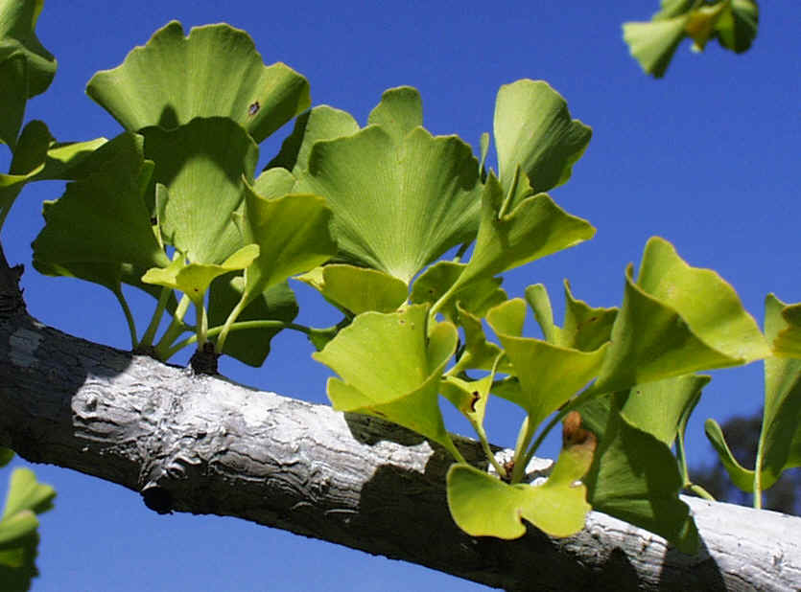
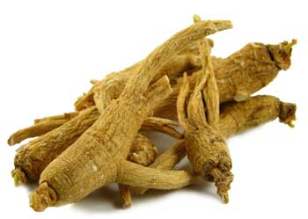
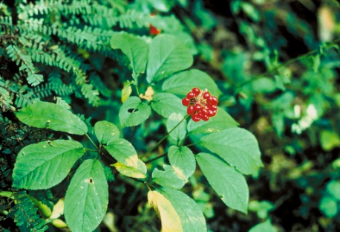
Ginkgo biloba
Ginseng
Sources: Grape seed, hawthorn, milk thistle, green tea, and ginseng.
Active Component: Flavonoid and terpenoids.
Drugs can be embedded or dissolved in nanoparticles and can also be adsorbed or coupled on the surface.
Encapsulating drugs within NPs can improve the solubility and pharmacokinetics of drugs.

Slide 27
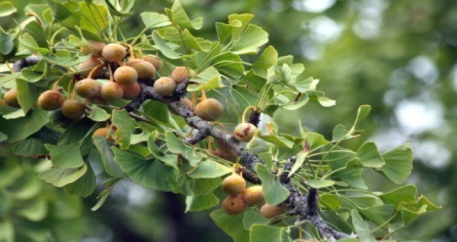
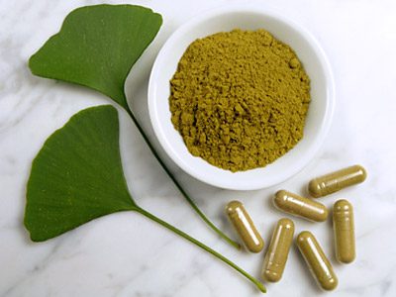
-- Contd. ---
The leaf extract of Ginko biloba L. has been widely used for brain cell activation properties. The nano sized G. biloba extract is expected to activate the brain cell and work on the treatment of Alzheimer's dimentia (like loss of memory, thinking, language, judgement and behaviour) better than pure extract.

Slide 28
The pharmacokinetic behavior and physicochemical factors related with delivery systems are considered to be primarily responsible for the improved targeting and therapeutic effectiveness; therefore, dealing with these factors during development of nano-herbal formulation can lead to more promising treatments for acute and chronic diseases.

