Slide 1
8th and 9th lectures in molecular biology
DNA REPLICATION -part 1 and 2
By Senior professor
Dr Sawsan sajid
Dr Nadal Abdulameer Ali

Slide 2
What is DNA replication ???
Before each cell division, new copies must be made of each of the many molecules that form the cell, including the duplication of all DNA molecules. DNA replication is the name given to this duplication process, which enables an organism’s genetic information — its genes — to be passed to the two daughter cells created when a cell divides.
DNA replication is the process of producing two identical copies from one original DNA molecule. This biological process occurs in all living organisms . It is the basis for biological inheritance. DNA is composed of two strands and each strand of the original DNA molecule serves as template for the production of the complementary strand, a process referred to as semiconservative replication.

Slide 3
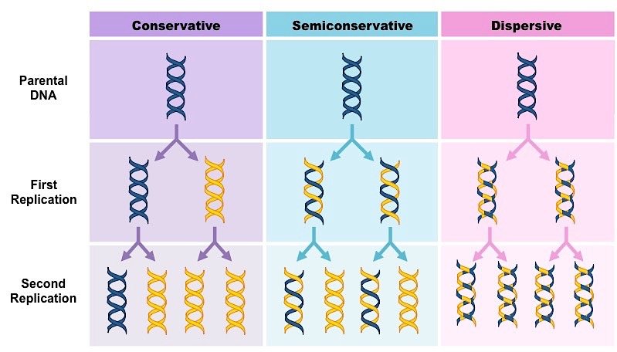
Semi conservative replication of DNA

Slide 4
the process followed by proofreading or error-checking mechanisms to ensure correct reading to the genetic code,. like all biological polymerization processes(Transcription and Translation), the process involve 3 stages :
1- Initiation 2-Elongation and 3- Termination.
Early studies of DNA replication mainly depend on the observation of Meselson and Stahl(1958) ,the British biochemist John Carnis (1963) and the Japanese scientist Reiji Okazaki (1968

Slide 5
Steps of DNA replication
1- Initiation: the process require replictor and intiator protein(DnaA protein ).
For a cell to divide, it must first replicate its DNA.This process is initiated at particular points in the DNA, known as replicator (200-300 bp) which contain specific area called "origin of replication ori c or Dna A box) ", which will opened by initiator proteins. In E. coli this protein is called DnaA protein ; in yeast, is called origin recognition complex. Sequences opened by initiator proteins tend to be "AT-rich" (rich in adenine and thymine bases), because A-T base pairs have two hydrogen bonds (rather than the three bond in a C-G pair).

Slide 6
Replication fork The replication fork is a structure that forms during DNA replication .Many enzymes are involved in the DNA replication fork in order to stabilize initiation step .
helicases, which break the hydrogen bonds holding the two DNA strands together. The resulting structure has two branching "prongs", each one made up of a single strand of DNA. These two strands serve as the template for the leading and lagging strands, which will be created as DNA polymerase matches complementary nucleotides to the templates; the templates may be properly referred to as the leading strand template and the lagging strand templates. SSBPs also required here
Single-Strand Binding (SSB) Proteins Bind to ssDNA and prevent the DNA double helix from re-annealing after DNA helicase unwinds it thus maintaining the strand separation

Slide 7
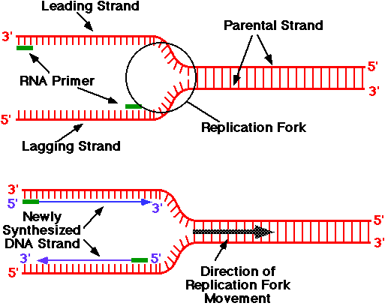

Slide 8
Once the origin has been recognized ,the initiators proteins (DnaA protein ) start forming the pre-replication complex, which unwind the double-stranded DNA . All known DNA replication systems require a free 3' hydroxyl group before synthesis can be initiated . use a primase enzyme (RNApolymerase) to synthesize a short RNA primer(10-20 bp) with a free 3′ OH group which is subsequently elongated by a DNA polymerase in this mechanism,

Slide 9
Prokaryotic and eukaryotic DNA replication is bidirectional
The experiment of John Cairns in 1963 demonstrated by autoradiography that the DNA of Escherichia coli is a single circular not linear molecule that is replicated from a point or moving locus forming the ( replicating fork) at which both new DNA strands are being synthesized. The movement of this fork is bidirectional in another world there are two moving forks, traveling in opposite directions around the chromosome forming θ theta shape (the Greek letter) which look like a bubble . it start from one point called ori c (origin of replication) and replication continue till reaching the opposite direction in one point called Ter i( from terminus). Also the shape is called the (A-butter fly replication) (
شكل يشبه حرف ثيتا الاغريقي او شكل الفراشه وهذا هو تضاعف كيرنس

Slide 10
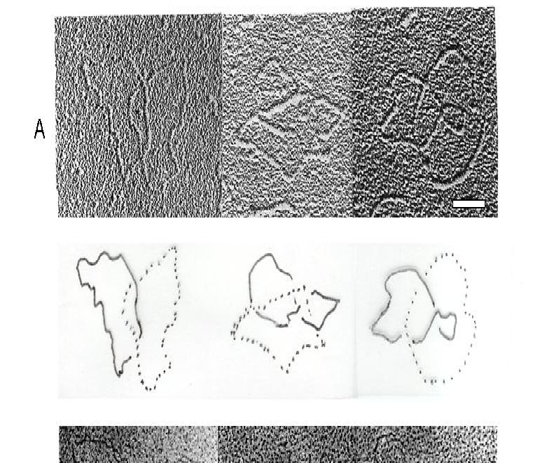
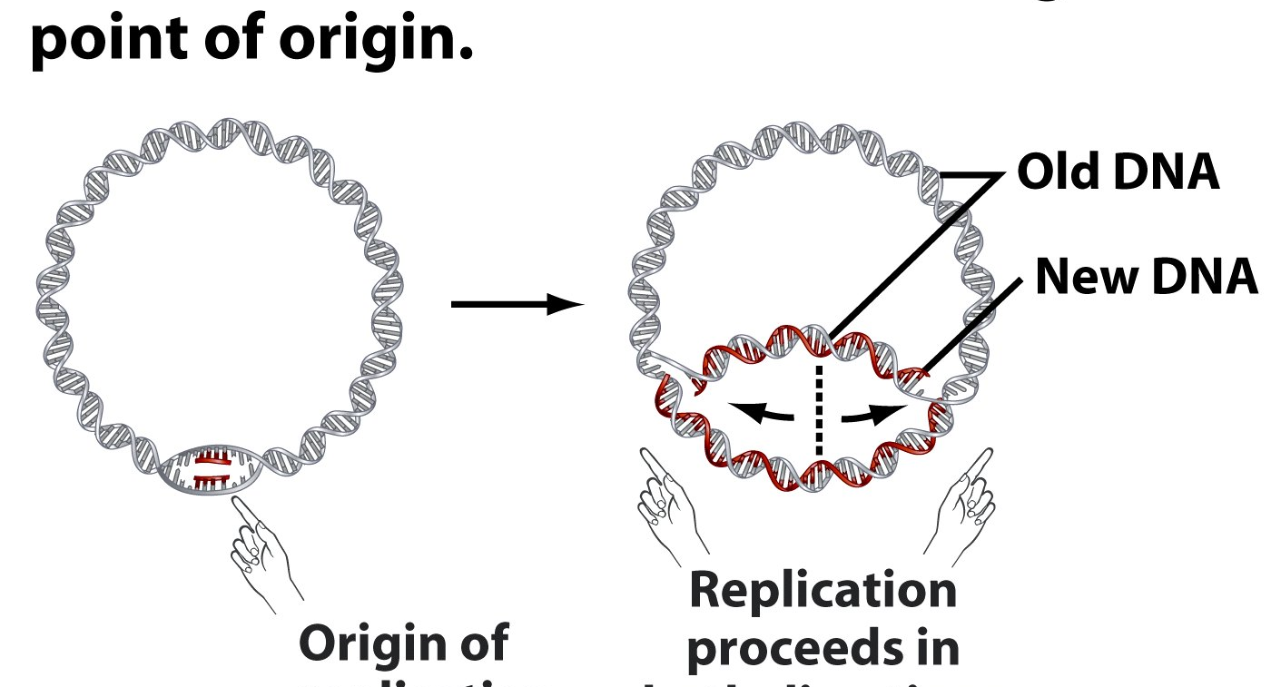

Slide 11
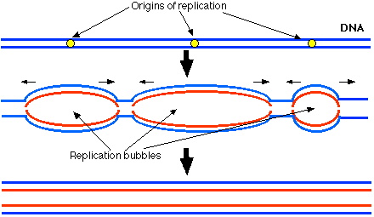
Replication in eukaryotic cell start from more than one ori c(each 300bp there is oric ) so multiple replication bubbles will form thus replication here is faster than prokaryotic cell

Slide 12
2- Elongation step
DNA is always synthesized in the 5' to 3' direction.
DNA Polymerase is an enzyme who synthesis new DNA strands
Even with the DNA template exposed, new DNA cannot be synthesized until a primer is constructed. Recall that all known DNA polymerases require a primer with a free 3′-hydroxyl group for DNA synthesis. How is this primer formed? An important clue came from the observation that RNA synthesis is essential for the initiation of DNA synthesis. In fact, RNA primes the synthesis of DNA by a specialized RNA polymerase called primase. Primase synthesizes a short stretch of RNA (~5 nucleotides) that is complementary to one of the template DNA strands. The primer is RNA rather than DNA because DNA polymerases cannot start chains de novo

Slide 13
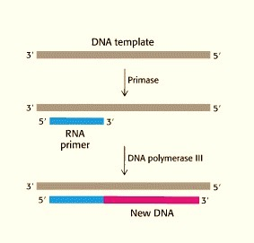
A new DNA strand is always
synthesized in a 5’ to 3’ manner,
thus the replication of both the
strands goes in two different ways.
Since the leading and lagging strand
templates are oriented in opposite directions
at the replication fork, a major issue is how to
achieve synthesis of nascent (new) lagging
strand DNA, whose direction of synthesis
is opposite to the direction of
the growing replication fork.

Slide 14
1- Leading strand
DNA polymerase III begins the synthesis of the leading strand by using the RNA primer formed by primase ( from 5’-3’direction or the same direction as the replication fork movement)
The leading strand is synthesized continuously by polymerase III, which does not release the template until replication has been completed.
This strand is formed as nucleotides are continuously added to the 3’ end of the strand after polymerase reads the original DNA template . Only one primer will require here . no Okazaki fragment are formed.

Slide 15
2- lagging strand:
However, all known DNA polymerases synthesize DNA in the 5′ → 3′ direction but not in the 3′ → 5′ direction.
How then does one of the daughter( lagging ) DNA strands appear to grow in the 3′ → 5′ direction?
A lagging strand is the strand which is synthesized in the 3’-5’ direction or opposite direction as to the movement of the replication fork. It grows or is synthesized away from the fork.
This why it is discontinuous; it is synthesized in short, separated segments. On the lagging strand template, a primase "reads" the template DNA and initiates synthesis of a short complementary RNA primer. A DNA polymerase III extends the primed segments, forming Okazaki fragments. DNA polymerase will add nucleotides in the 5' to 3' direction;

Slide 16
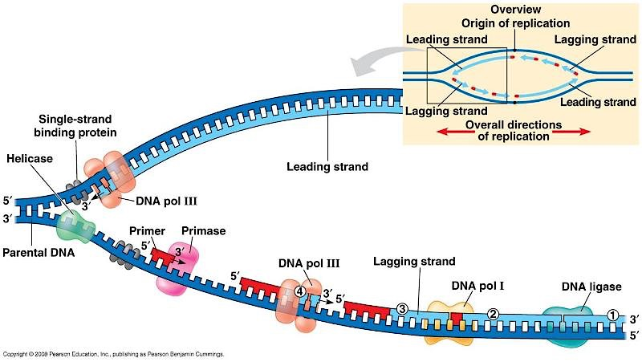

Slide 17
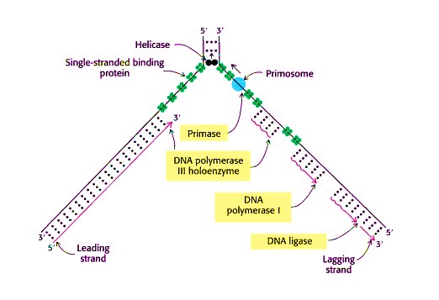

Slide 18
More than one primer will be necessary here and it will be removed later by the exonuclease activity of DNA polymerase (I) which will fill the gap between two adjacent Okazaki fragments. the final binding will done by the activity of ligase enzyme who will add a 3́ 5́ phospho diester bond continuously ; this is the reason why the synthesis of the lagging strand is more complicated than the leading strand.
DNA polymerase molecules are required for polymerization the two strands which run together in the same machine binding together but still the replication happened in opposite direction The polymerase involved in leading strand synthesis is DNA polymerase III(DNA Pol III) in prokaryotes and presumably Pol ε in yeasts. In human cells the leading and lagging strands are synthesized by Pol ε ابسلو
and Pol delta δ , respectively, within the nucleus and Pol γ in the mitochondria

Slide 19
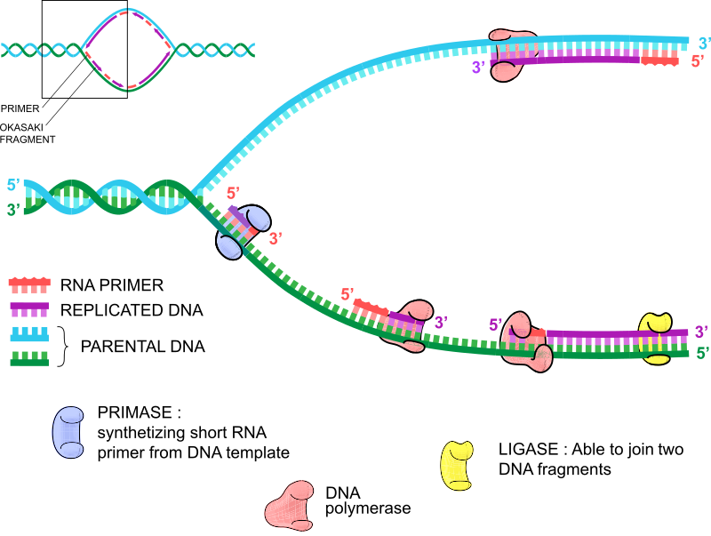

Slide 20
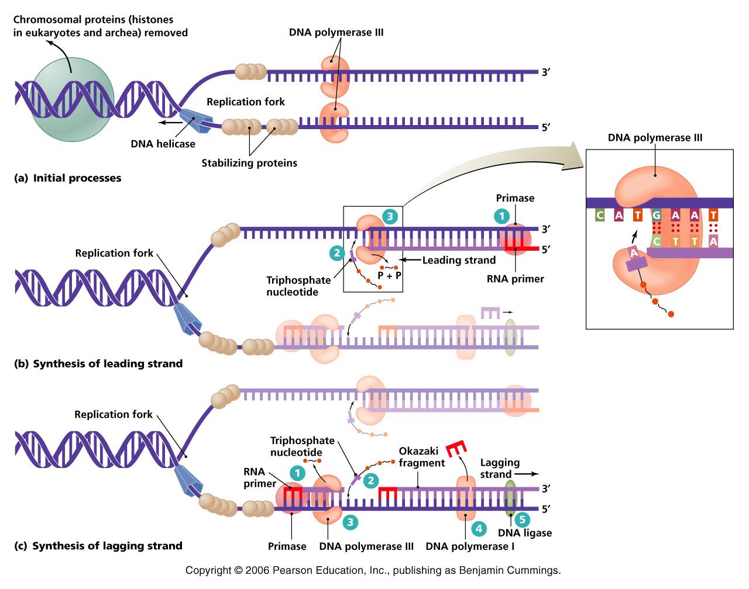
Enzymes involve in DNA replication

Slide 21
3-Termination
1-Termination requires that the progress of the DNA replication fork must stop or be blocked. Termination at a specific locus, when it occurs, involves the interaction between two components: (1) a termination site sequence in the DNA, and (2) a protein which binds to this sequence to physically stop DNA replication. In various bacterial species, this is named the DNA replication terminus site-binding protein, or Ter protein.
2-Because bacteria have circular chromosomes, termination of replication occurs when the two replication forks meet each other on the opposite end of the parental chromosome . As a result, the replication forks are constrained to always meet within the termination region of the chromosome.

Slide 22
3-Removes the primer (RNA fragments), by DNA polymerase I by 5'-3' exonuclease activity of polymerase I, and replaces the RNA nucleotides with DNA nucleotides. and fill the gaps.
4- When this is complete, a single nick on the leading strand and several nicks on the lagging strand can be found.
5- Ligase works to fill these nicks in, thus completing the newly replicated DNA molecule .
6- Topoisomerase IV will : separate the two complete daughter chromosome in to two chromosome
To form a continuous lagging strand of DNA, the RNA primers must eventually be removed from the Okazaki fragments and replaced with DNA. In E. coli, RNA primers are removed by the combined action of RNase H, an enzyme that degrades the RNA strand of RNA-DNA hybrids, and polymerase I.

Slide 23
Termination in Eukaryotic cell
Primer removal in eukaryotes is performed by RNase I that remove all the primer leaving only one nucleotide in the junction between 2 nucleotide and the remained one will removed by FenI enzyme.
Eukaryote cell initiate DNA replication at multiple points in the chromosome, so replication forks meet and terminate at many points in the chromosome; these are not known to be regulated in any particular way. Because eukaryotes have linear chromosomes, DNA replication is unable to reach the very end of the chromosomes, but ends at the Telomere region of repetitive DNA close to the end.

Slide 24
This shortens the telomere of the daughter DNA strand. Shortening of the telomeres is a normal process in Somatic cells. As a result, cells can only divide a certain number of times before the DNA loss prevents further division. Within the Germ cell line, which passes DNA to the next generation, Telomerase extends the repetitive sequences of the telomere region to prevent degradation. Telomerase can become mistakenly active in somatic cells, sometimes leading to Cancer formation. in the end of the replication the DNA will warp around the basic hiatons to form the chromatin

Slide 25
DNA Gyrase (and Topoisomerase IV) ; this is a specific type of topisomerase II convert relaxed form to super coiled
DNA Ligase Re-anneals the semi-conservative strands and joins Okazak’i Fragments of the lagging strand.
Primase Provides a starting point for DNA polymerase to begin synthesis of the new DNA strand.
Topoisomerase I : Relaxes the DNA from its super-coiled nature
Telomerase Lengthens telomeric DNA by adding repetitive nucleotide sequences to the ends of eukaryotic chromosomes

Slide 26
DNA Helicase Also known as helix destabilizing enzyme cases formation of Replication Fork due to broken hydrogen bonds
DNA Polymerase Builds a new duplex DNA strand by adding nucleotides in the 5' to 3' direction. performs proof-reading and error correction.
DNA clamp: A protein (unit from polymerase which prevents DNA polymerase III from dissociating from the DNA parent strand.
Single-Strand Binding (SSB) Proteins Bind to ssDNA and prevent the DNA double helix from re-annealing after DNA helicase unwinds it thus maintaining the strand separation

Slide 27
Types of DNA polymerase in Prokaryotic cell
Types of enzyme | Initiation activity | Polymerization 5́́→3́ | Exonuclease activity 3́→5́ | Exonuclease activity 5́́→3́
DNA polymerase I | - | + | + | +
DNA polymerase II | - | + | + | -
DNA polymerase III | - | + | + | -

Slide 28
Types of DNA polymerase in Eukaryotic cell
The DNA polymerases of eukaryotes are in general less understood than the DNA polymerases of prokaryotes, Eukaryotic cells have at least five major nuclear DNA polymerases: αالفا ,βبيتا ,γ, كاما δ , دلتا εكاما . ابسلون is found in mitochondria, although it is encoded by a nuclear gene. Plant chloroplasts also contain their own DNA polymerase that appears to be similar to γ
Pol α polymerase: it is the only enzyme has primase activity beside DNA polymerase so it is self- primed it will form short primer 12-20 nts called the initiator RNA iRNA)
Pol α is a heterotetramer composed of two primase subunits and two polymerase subunits. The primase subunits initiate DNA replication by synthesizing short (7–12 ribonucleotides) RNA primers, which are then extended by polymerase α (Pellegrini, 2012)

Slide 29
Pol β polymerase: excision repair and it is not highly active and is not very processive.
Pol γ polymerase: polymerization the mitochondrial DNA beside repairing by its exonuclease activity 3́→5́
Polδ delta and ε ابسلون polymerase :polymerization lagging (δ)and leading (ε) strand respectively 5 ́→3́. In eukaryotes, the low-processivity initiating enzyme, Pol α, has intrinsic primase activity. The high-processivity extension enzymes are Pol δ and Pol ε.

Slide 30
Some important and basic information
Primase: in fact is RNA polymerase thus the formed primer is RNA rather than DNA and it will removed latter by DNA polymerase I
Topoisomerase I: will break the 3́́ 5́ phosphodiester bond converting super coiled to relax form which opposite to ligase
Helicase : will break hydrogen bond between the two strand
Movement of replication fork 5́ →3́́ which is the same

Slide 31
The DNA replication machinery ماكنة تضاعف الدنا
The Replisome is composed of the following:
2 DNA Pol III enzymes molecules , each has a core subunits composed from 3 sub units α, ε and θ subunits.
the α subunit has the polymerase activity.
the ε subunit has 3'→5' exonuclease activity.
the θ subunit stimulates the ε subunit's proofreading.
2 β units which act as sliding clamps(مثبت المتزحلق (keeping the polymerase bound to the DNA template .
2 τ units which acts to dimerism two of the core enzymes (α, ε, and θ subunits).
)

Slide 32
The gamma γ complex which acts as a clamp loader (مثبت الحامل او المقود) for the lagging strand helping the two β subunits to form one unit and bind to DNA. The γ unit is made up of 5 subunits which include 3 γ subunits, 1 δ subunit , and 1 δ' subunit . The δ is involved in copying of the lagging strand. Beside that there are Χ and Ψ which complete the complex and bind to γ
DNA polymerase III synthesizes base pairs at a rate of around 1000 nucleotides per second. DNA Pol III activity begins after strand separation at the origin of replication. Because DNA synthesis cannot start replication , an RNA primer, complementary to part of the single-stranded DNA, is synthesized by primase (an RNA polymerase

Slide 33
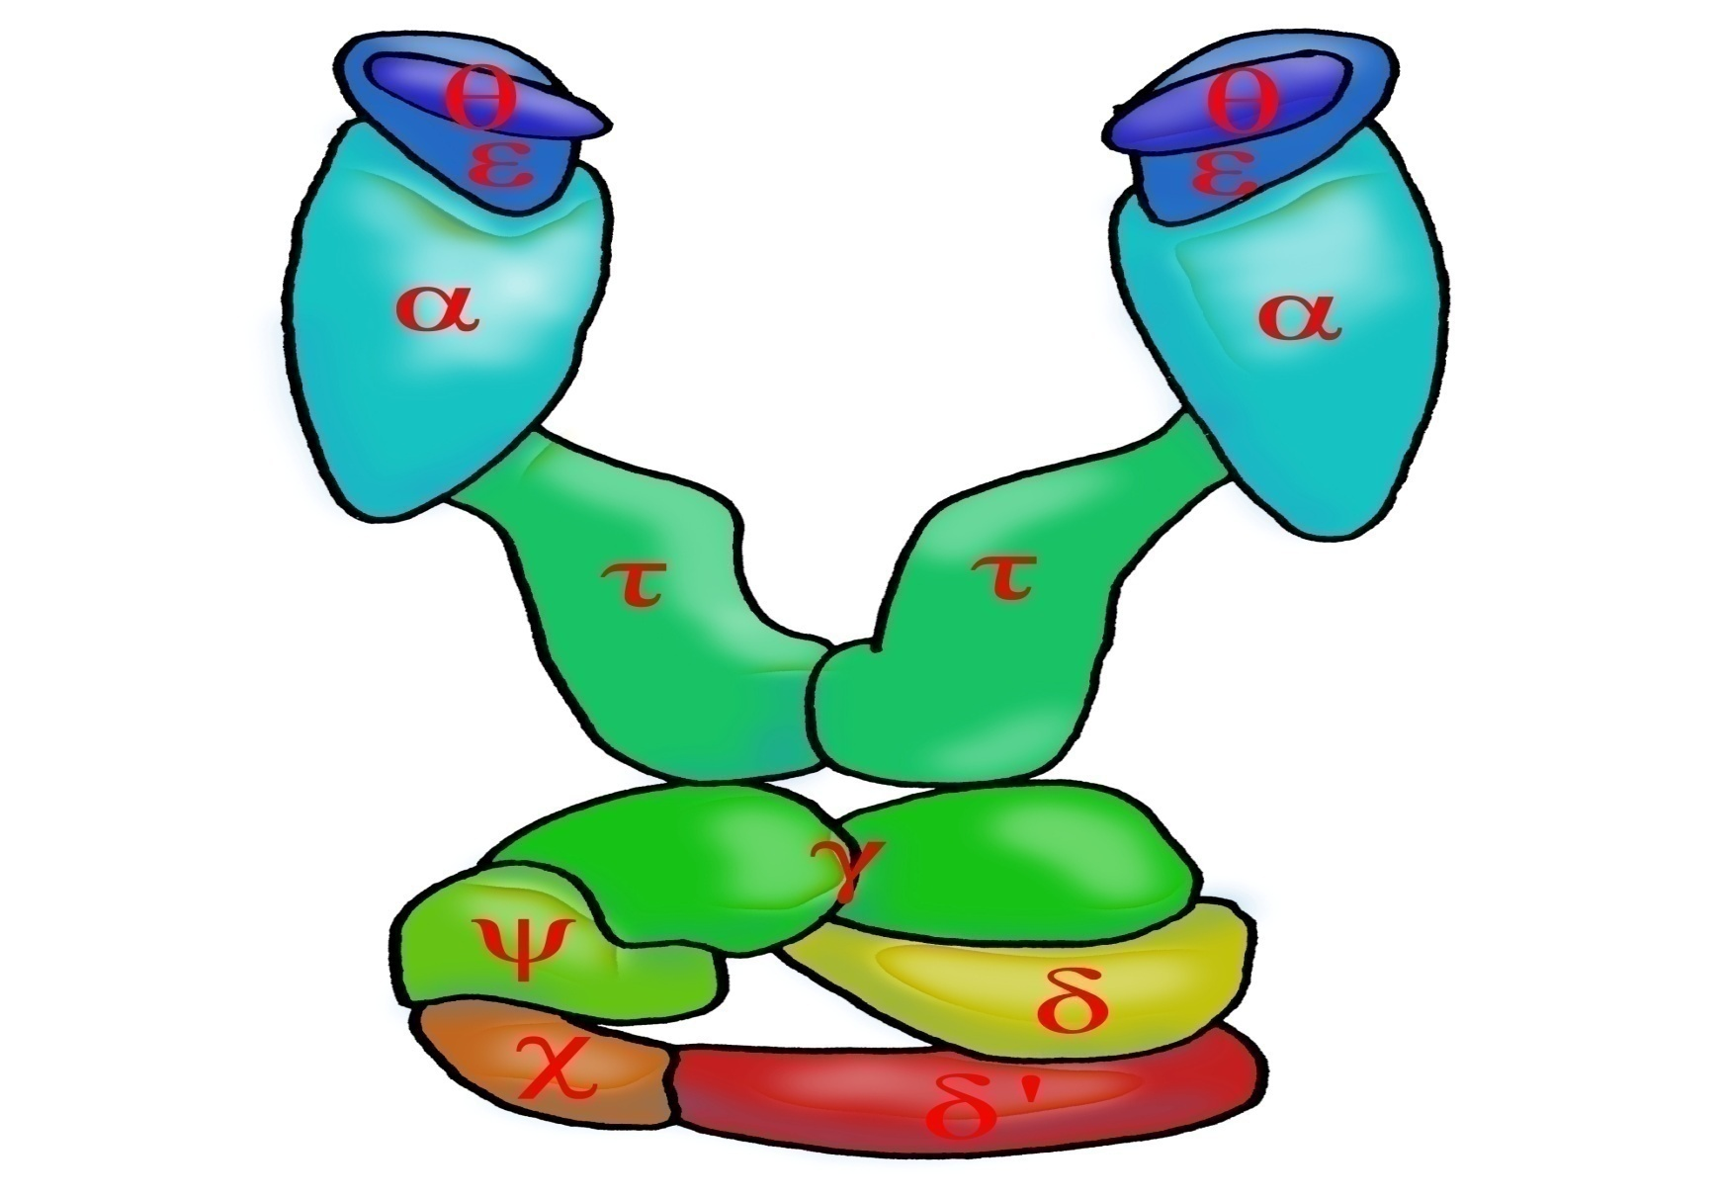
Structure and sub units of
2 DNA polymerase III(replisome)

Slide 34
DNA COULD BE SYNTHESISED IN LAB
The dream become true for synthesizing part of the genome in lab after 3 decade from discovering DNA polymerase enzyme precisely in 1983 by Kary mullis who found a genius way to amplify (تكثير ) any part of the genomic DNA by PCR process (polymerase chain reaction) the process requires the following:
Template DNA (genomic animal or plant cell , plasmid, cosmid, bacterial/yeast colony, etc.)
primers :usually forward and reverse DNA primers(17-25bp) forwarded from 5 ́→ OH 3́ with free end thus DNA polymerase will use this end to add nucleotide to the newly formed strand .in nature this segment is synthesized by primase enzyme (RNA rather than DNA as will discussed latter)
buffer for DNA polymerase enzyme
To enhance enzyme activity we add MgCl₂ or MgSO4.
dNTPs :The four type is used (dATP, d TTP, d GTP, d CTP) .
Taq DNA polymerase: heat stable enzyme is used here . Cos of its stability in heat during denarturation step (95Cº)

Slide 35
Polymerase chain reaction
Researchers commonly replicate DNA in vitro using the polymerase chain reaction (PCR). PCR uses a pair of primers to span a target region in template DNA, and then polymerizes partner strands in each direction from these primers using a thermostable Taq DNA polymerase. Repeating this process through multiple cycles produces amplification of the targeted DNA region. At the start of each cycle, the mixture of template and primers is heated, separating the newly synthesized molecule and template. Then, as the mixture cools, both of these become templates for annealing of new primers, and the polymerase extends from these. As a result, the number of copies of the target region doubles each round, increasing exponentially

Slide 36
Properties of Taq DNA polymerase
Taq polymerase is a thermostable DNA polymerase named after the thermophilic bacterium Thermus aquaticus from which it was originally isolated by Thomas D. Brock. It is often abbreviated to "Taq Pol" and is frequently used in polymerase chain reaction(PCR), a method for greatly amplifying short segments of DNA .
T. aquaticus is a bacterium that lives in hot springs and hydrothermal vents, and Taq polymerase was identified as an enzyme able to withstand the protein-denaturing conditions (high temperature) required during PCR.Therefore
it replaced the DNA polymerase from E. coli originally used in PCR.Taq's optimum temperature for activity is 75–80°C, with a half-life of greater than 2 hours at 92.5°C , and can replicate a 1000 base pair strand of DNA in less than 10 seconds at 72°C. One of Taq's drawbacks is its relatively low replication fidelity It lacks a 3' to 5' exonuclease proofreading activity, and has an error rate measured at about 1 in 9,000 nucleotides
[ Some thermostable DNA polymerases have been isolated from other thermophilic bacteria and archaea, such as vent and Pfu DNA polymerase, possessing a proofreading activity, and are being used instead of (or in combination with) Taq for high-fidelity amplification.

