Slide 1
LAB: 6 PART 2 Enterobacteriaceae

Slide 2
Escherichia coli
General characteristics
1-Gram negative bacteria (red)
2- Coccobacilli
3- Facultative anaerobes
4-Motile
5-Non spore forming
6- Capsule -ve ( microcapsule)
7-Catalase positive ,,,Oxidase negative ,,,
8- Urease negative
9-Lactose fermenter ( pink colonies )(on MacConkey agar)

Slide 4
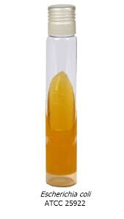
10-IMViC test: ++--
11-TSI test: Acid \Acid\ CO2+\H2S –
12- black colonies on (EMB agar) with green metallic sheen because high acid product

Slide 5
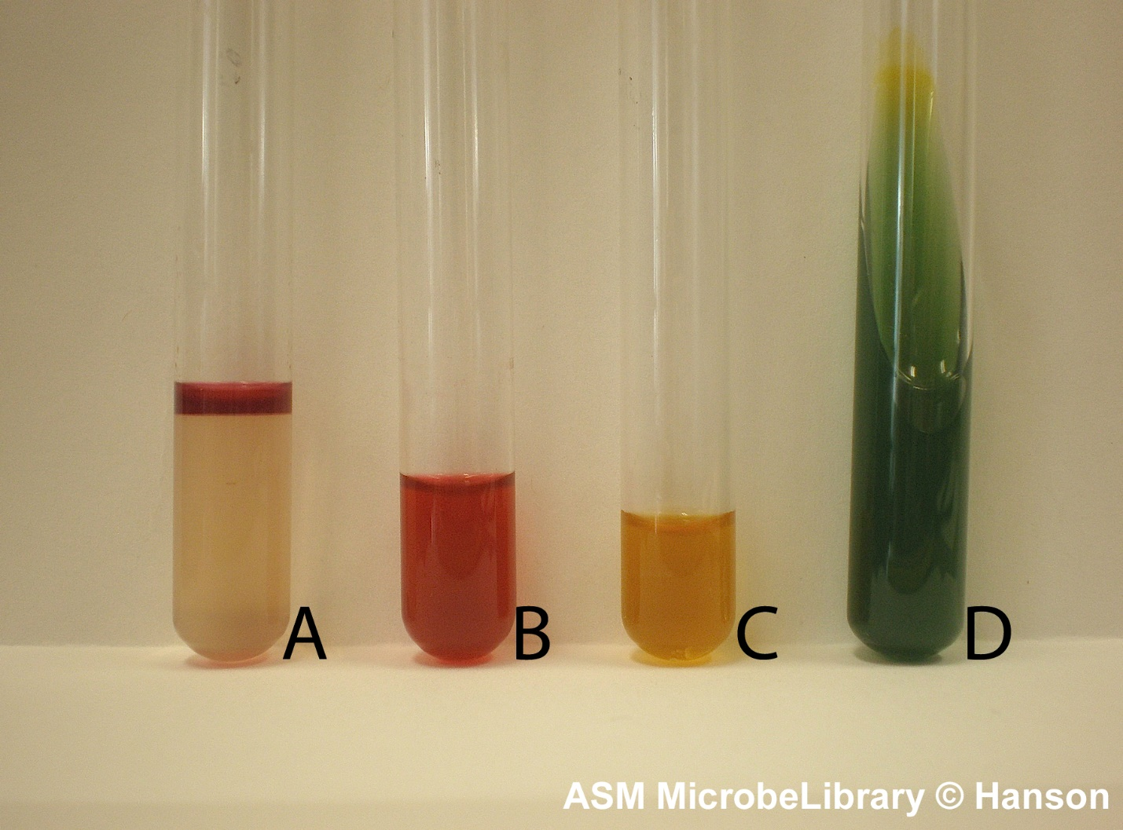

Slide 7
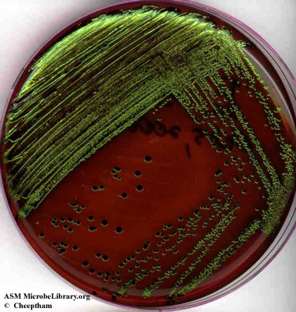

Slide 8
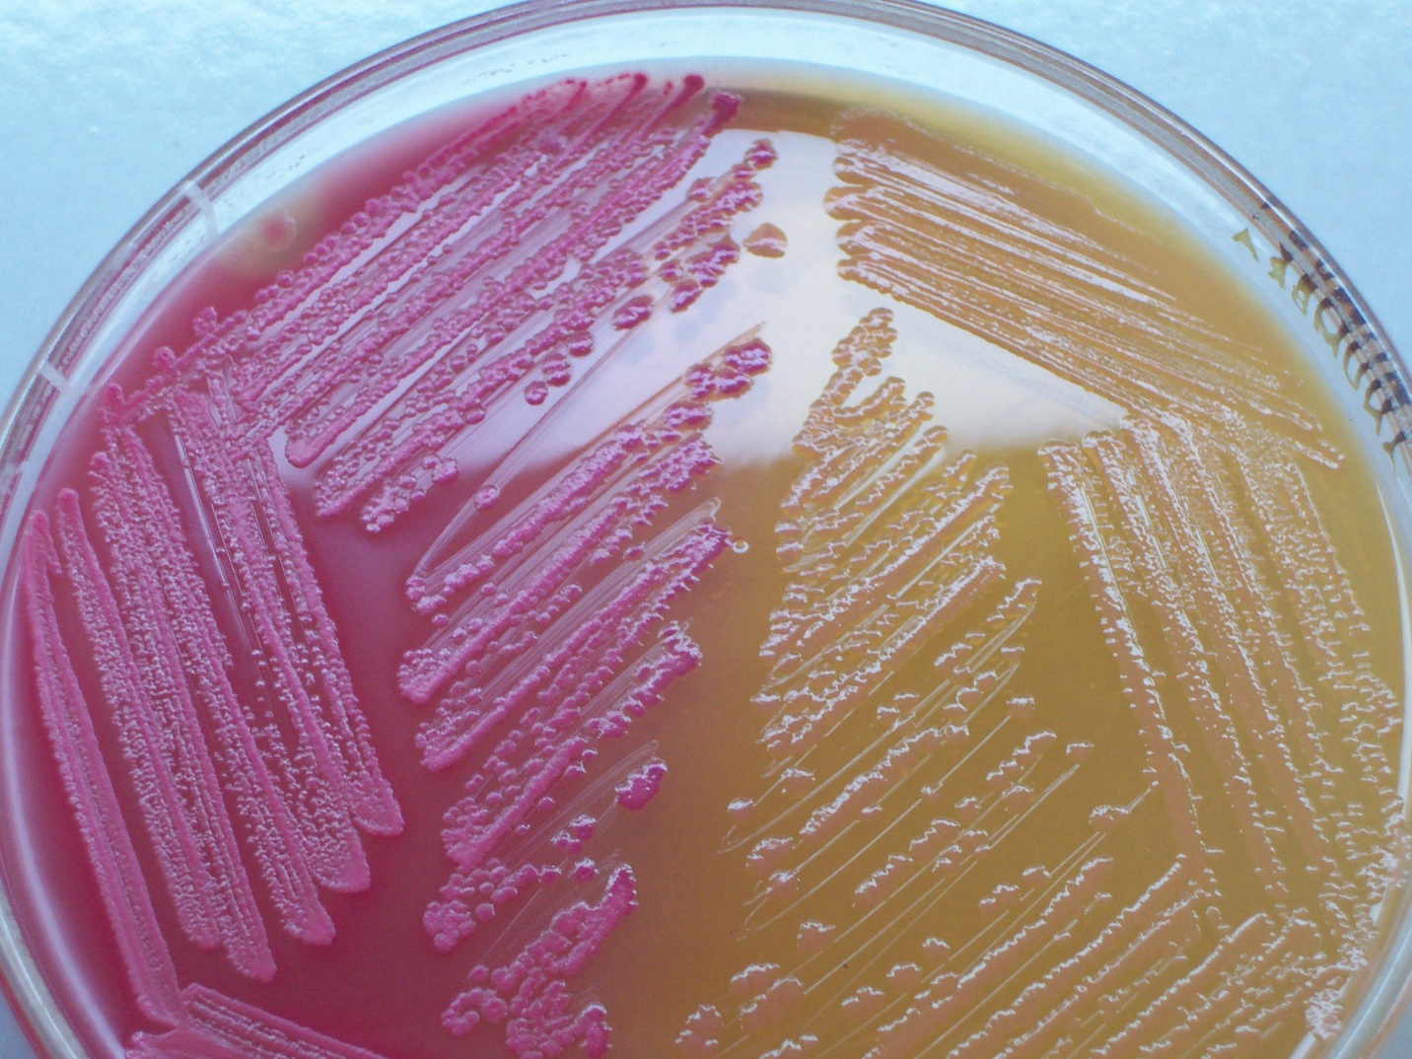

Slide 9
Klebsiella spp
General characteristics
1-Gram negative bacteria (red)
2- Coccobacilli
5-Facultative anaerobes
4- Non Motile
5-Non spore forming
Capsule +ve
7-Catalase positive ,,,Oxidase negative
8-Lactose fermenter (mucoid pink colonies )(on MacConkey agar)
9-Urease positive

Slide 10
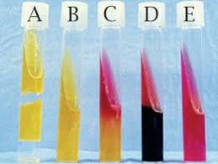
10-IMViC test: -,-,+,+
11-TSI test: Acid \Acid\ CO2+\H2S –
12- purple or pink mucoid colonies on (EMB agar) because low acid product

Slide 12
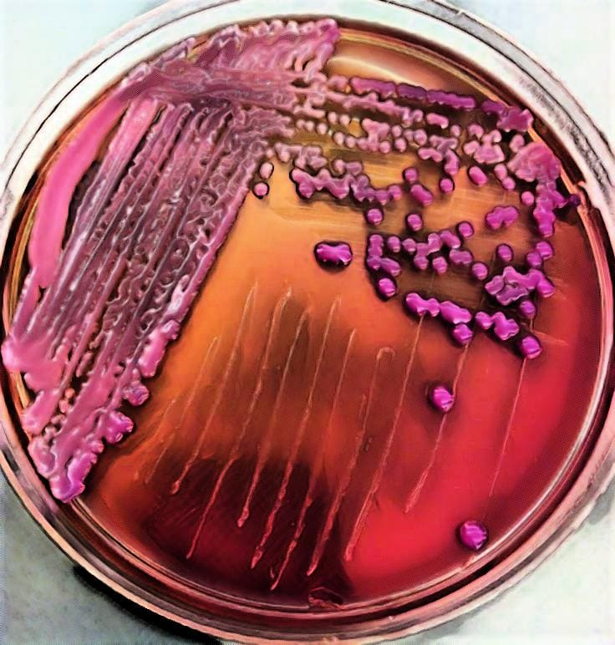

Slide 15
Enterobacter spp
General characteristics
1-Gram negative bacteria (red)
2- Coccobacilli
5-Facultative anaerobes
4- Motile +ve
5-Non spore forming
Capsule -ve
7-Catalase positive ,,,Oxidase negative
8-Lactose fermenter ( pink colonies )(on MacConkey agar)
9-Urease –ve

Slide 16
10-IMViC test: -,-,+,+
11-TSI test: Acid \Acid\ CO2+\H2S –
12- pink colonies on (EMB agar) because low acid product
Enterobacter ( Motile +ve ,,, Urease –ve )
Klebsiella ( Motile -ve ,,, Urease +ve )

Slide 17
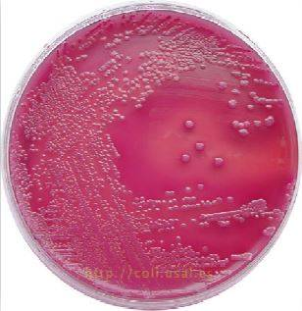

Slide 18
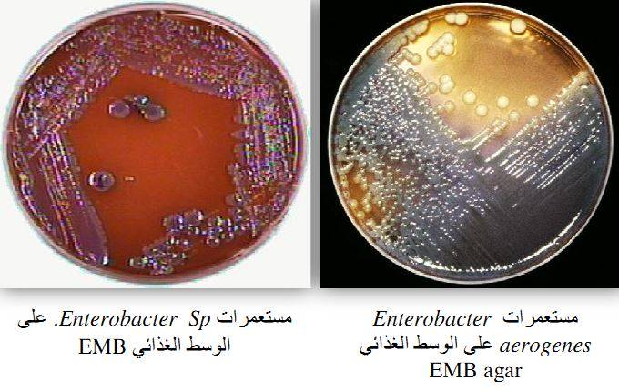

Slide 21
Proteus spp
1- Gram negative
2-Rod shape
3- Facultative anaerobes
4- pleomorphic
5- Motile +( peritrichous )
6-Capsule –ve
7- nonspore forming
8-Catalase +ve ,,Oxidase –ve ,,Urease +ve (very active )
9-Swarming +ve
10- H2S +ve (black sediment ).
11- non lactose fermenter (pale colonies ).

Slide 22
12-IMViC test v,+,-,v
13 - TSI test K\ A H2S + , CO2 +
14-Phenylalanine +ve
Proteus (swarming ,,H2S producer )
P.vulgaris (UTI,wound infection ) ,(Indole +ve ,maltose +ve)
P. mirabilis (UTI,wound infection , nosocomial infections) ,(Indole -ve ,maltose -ve)
P. rettgeri (gastroenteritis )
P. penneri (UTI,wound infection , nosocomial infections)

Slide 23
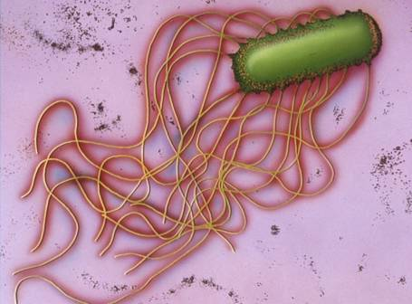

Slide 25
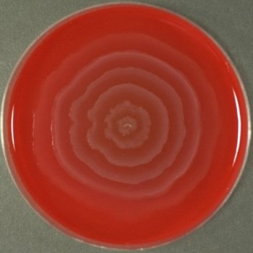
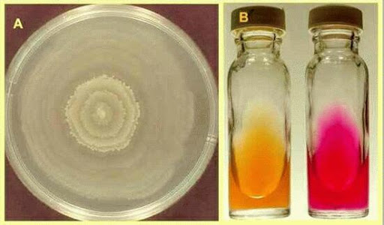
15-Blood hemolysis v \ Alpha & Beta

Slide 26
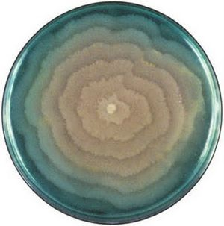

Slide 27
