Slide 1
semiconductors
Solid state physics
Lecture (3)
Prof. Dr. Wisam J. Aziz

Slide 2
Contents
Introduction
Types of semiconductors
Carrier concentration and Fermi level
Mass Action Law
Carrier – transport phenomena
Optical transition
Band to band transition
Applications of semiconductors

Slide 3
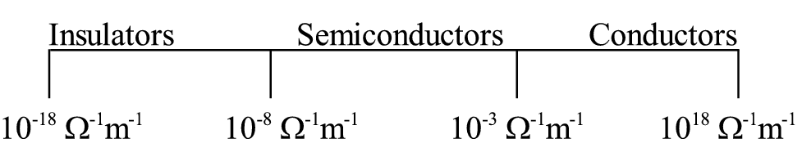
Introduction
A semiconductor is a material with an electrical conductivity that is intermediate between that of an insulator and a conductor.
A semiconductor behaves as an insulator at very low temperature, and has an appreciable electrical conductivity at room temperature although much lower conductivity than a conductor.
It’s called semiconductor because their ability to conduct electricity is small compared with the conductivity of metals
Two general classifications of semiconductors are the elemental semiconductor materials ,found in group IV of periodic table , and compound semiconductor materials formed from the group III and V group .

Slide 4
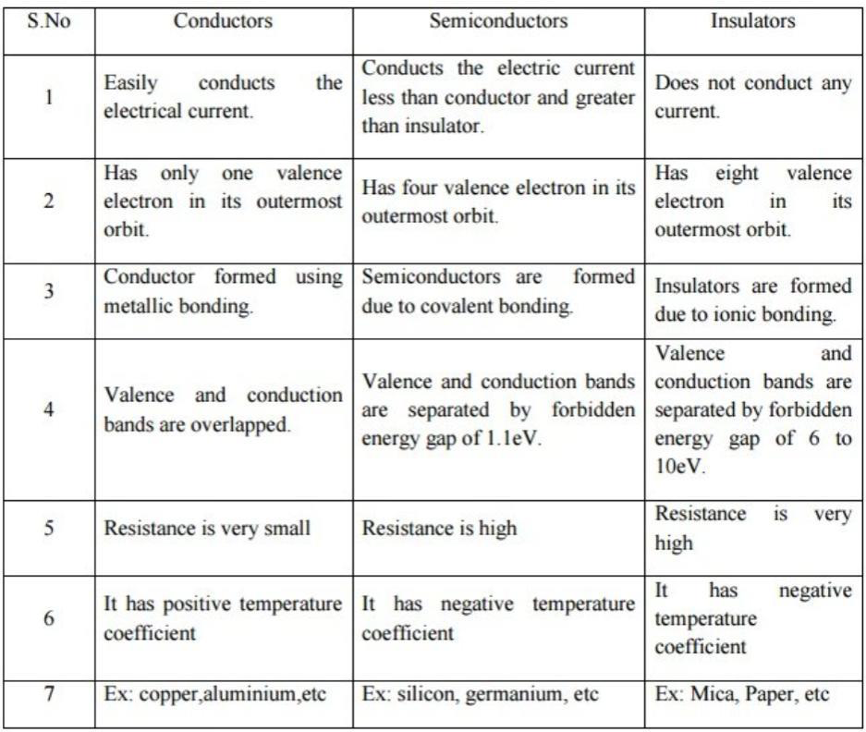
The difference between conductors, semiconductors, and insulators

Slide 5
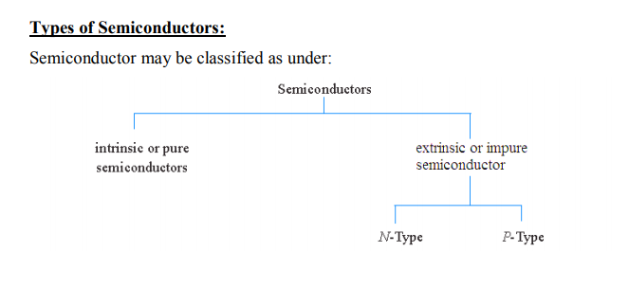

Slide 6
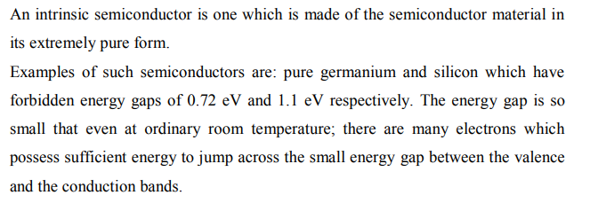
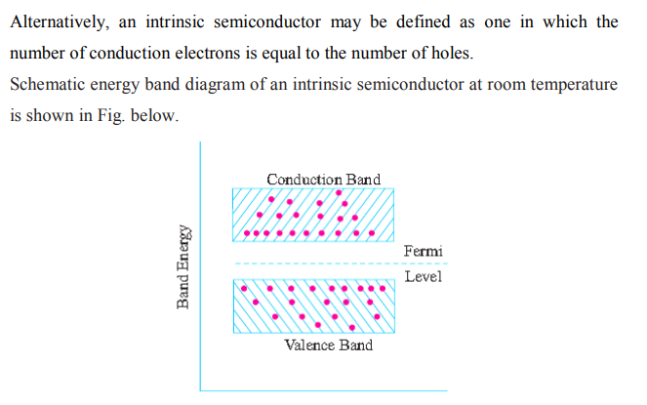
Intrinsic semiconductor
.

Slide 7
The difference between silicon and germanium
Silicon
Silicon is denoted by Si and its atomic number is 14
Semi-metallic
The atomic radius of silicon is less than the atomic radius of germanium
Conductivity of silicon Less than the conductivity of germanium
Silicon has no distribution Electrons in the d orbital
Germanium
Germanium It is denoted by Ge and its atomic number is 32
Semi-metallic
Be the atomic radius of germanium
Greater than the atomic radius of silicon
Germanium conductance Higher than the conductivity of silicon
Most of the silicon specifications are ten times less expensive than the equivalent germanium specification, plus Silicon conductors are widely used due to Can be used at higher temperatures than conductors Germanium

Slide 8
Extrinsic Semiconductor
Pure semiconductors have negligible conductivity at room temperature. To increase the conductivity of intrinsic semiconductor, some impurity is added. The resulting semiconductor is called impure or extrinsic semiconductor.
Impurities are added at the rate of ~ one atom per 10 to 10 semiconductor atoms. The purpose of adding impurity is to increase either the number of free electrons or holes in a semiconductor.
6
10

Slide 9
Extrinsic Semiconductor
Two types of impurity atoms are added to the semiconductor
Atoms containing 5
valance electrons
(Pentavalent impurity atoms)
Atoms containing 3
valance electrons
(Trivalent impurity atoms)
e.g. Al, B, In
e.g. P, As , Bi
N-type semiconductor
P-type semiconductor
Free electron
Hole

Slide 10
N – type semiconductor
This figure shows an n- type silicon , where subsititutional phosphorous atom with 5 valance electrons has replaced a silicon atom , and negative charged electron is donated to the lattice in the conduction band.
The phosphorous atom is called a donor .
Si
Si
Si
Si
P
Si
Si
Si
Si

Slide 11
P – type semiconductor
This figure shows that when a boron atom with 3 valance electrons substitute for a silicon atom , a positive- charged hole is created in the valance band .
And an additional electron will be accepted to form 4 covalent bonds around the boron.
This is p – type , and the boron is an accepter .
Si
Si
Si
Si
B
Si
Si
Si
Si

Slide 12
Carrier concentration and Fermi level
We first consider the intrinsic case without impurities added to the semiconductor. The number of electrons (occupied conduction-band levels) is given by the total number of states N(E) multiplied by the occupancy F(E), integrated over the conduction band:
The no. of electron is given by :
where N(E)dE : is the density of states (cm⁻³) in the energy range dE
F(E) : fermi - dirac distribution function
1

Slide 13


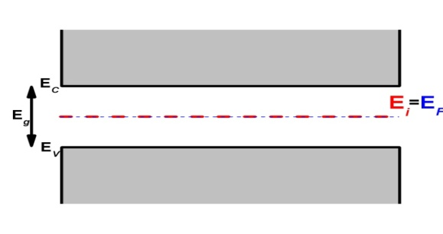
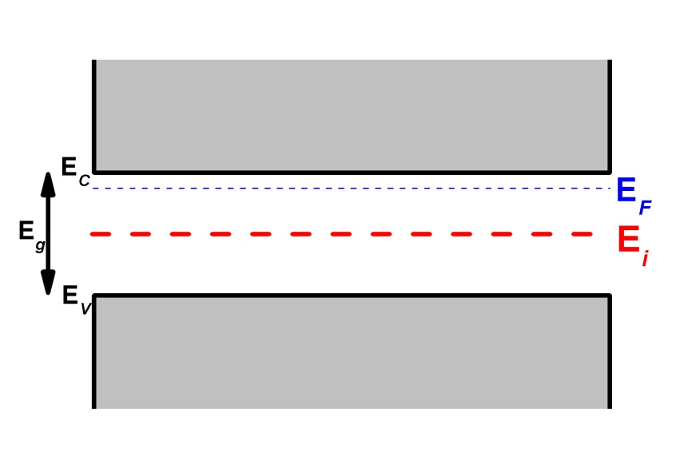
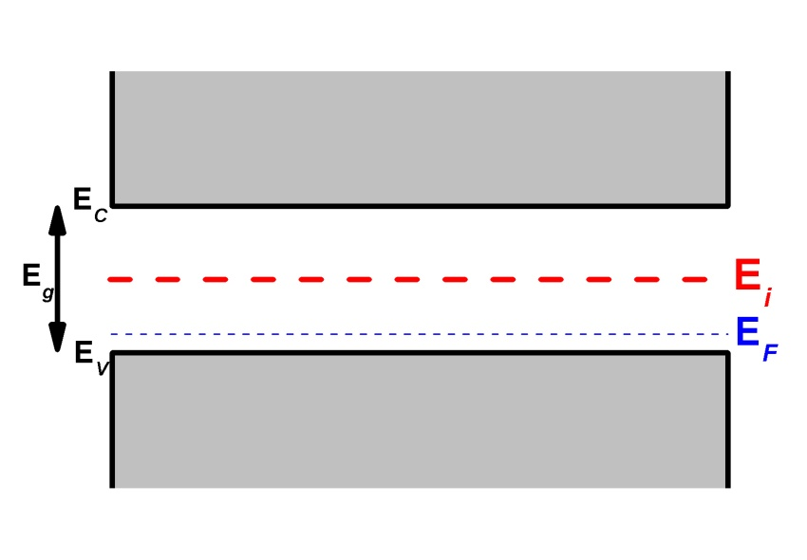
Intrinsic semiconductors
Where :
where N_{v} is the effective density of states in the valence band
Nc : the effective density of states in the condition band
Ec : energy of states in condition band
Ev : energy of states in valance band
K : boltazman constant
T : temperature
the concentration of electrons in the conduction band is
the concentration of holes in the valance band is
Extrinsic semiconductors
n-type
p-type

Slide 14
Fermi energy
Fermi energy or the Fermi level in solid and matter physics
The capacitor represents the highest energy level an electron occupies at a degree Absolute zero. At zero kelvin (absolute zero), no The electrons gain any heat energy that helps them move.
it begins by filling in the lowest energy levels in "clusters of atoms" first then the upper, the higher, forming a sea of ​​electrons called a sea Fermi.
The surface of this sea represents "Fermi energy".

Slide 15
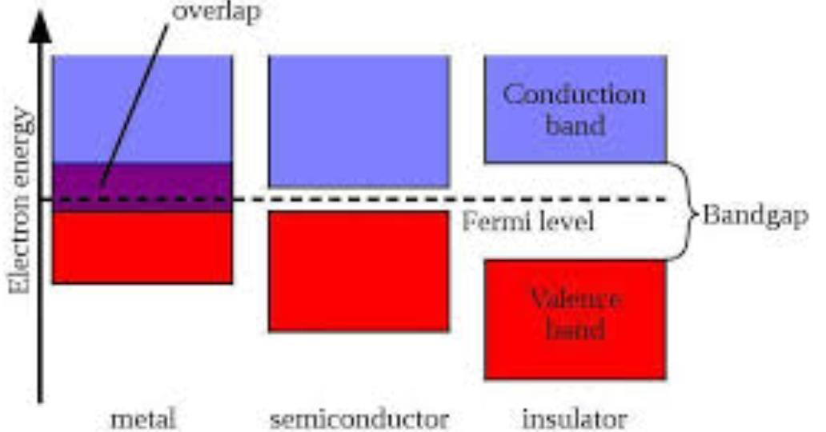
Fermi level

Slide 16
Mass Action Law
Addition of n-type impurities decreases the number of holes below a level. Similarly, the addition of p-type impurities decreases the number of electrons below a level.
It has been experimentally found that
“Under thermal equilibrium for any semiconductor, the product of no. of holes and the no. of electrons is constant and independent of amount of doping. This relation is known as mass action law”
where n = electron concentration, p = hole concentration
and n_{i} = intrinsic concentration

Slide 17



Carrier – transport phenomena
1- Drift and Mobility .
At low electric fields the drift velocity is proportional to the electric field strength 𝛆 and the proportionality
constant defined as mobility 𝝻 .
Since the mobility is controlled by scattering it can be also related to the mean free time 𝞽m . or mean free bath by
The last result use the relationship
Where : is the thermal velocity given by

Slide 18

For multiple scattering mechanics , the effective mean free time is derived from the individual mean free times of scattering events by
As the impurity concentration increases ( at room
temp. ) the mobility decrease also for larger , mobility decreases ; thus for given impurity concentration the electron mobilites for these semiconductor are larger than the hole mobilites
For lower impurity concentration the mobility is limited by phonon scattering and it decreases with temp .

Slide 19

Resistivity
For semiconductors with both electron and holes as carriers, the drift current under applied field is given by :
Where 𝞼 is the conductance
Where 𝝆 is the resistivity , if n >> p

Slide 20
Recombination, Generation, and Carrier Lifetimes
Whenever the thermal-equilibrium condition of a semiconductor system is disturbed
processes exist to restore the system to equilibrium.
These processes are recombination when and thermal generation when .

Slide 21
Figure below illustrates the band-to-band electron-hole recombination.
The energy of an electron in transition from the conduction band to the valence band is conserved by emission of a photon ( radiative process) or by transfer of the energy to another free electron or hole (Auger process). The former process is the inverse of direct optical absorption, and the latter is the inverse of impact ionization.
Band-to-band transitions are more probable for direct-band gap semiconductors which are more common among 111-V compounds. For this type of transition, the recombination rate is proportional to the product of electron and hole concentrations,
given by
The term called the recombination coefficient .

Slide 22
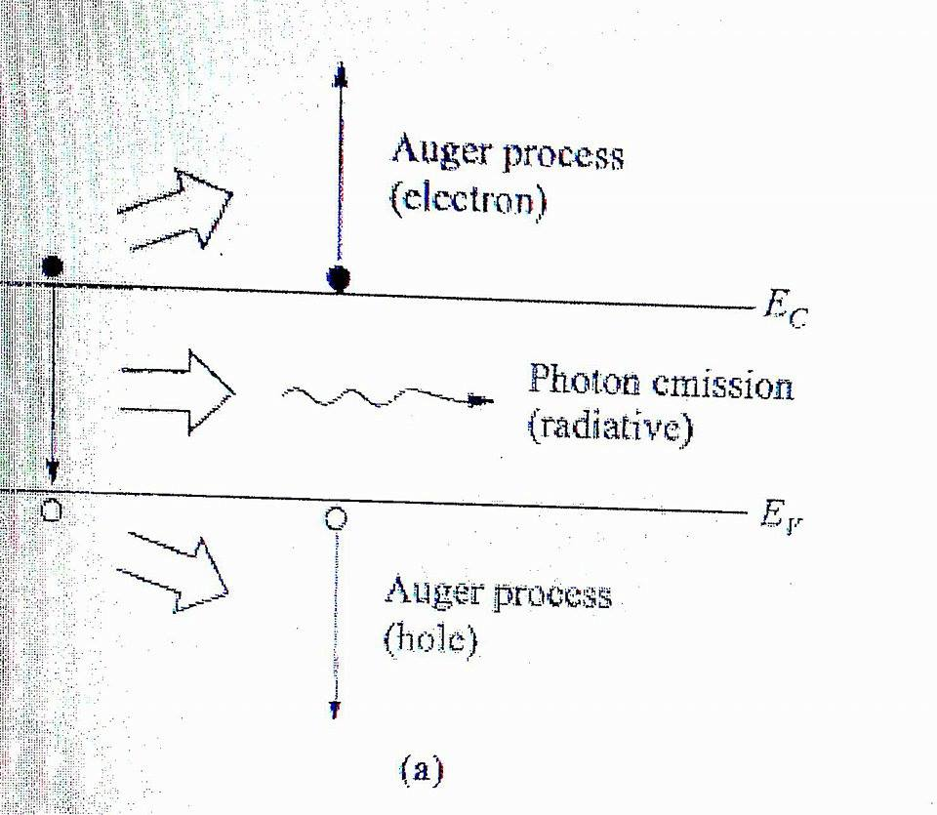
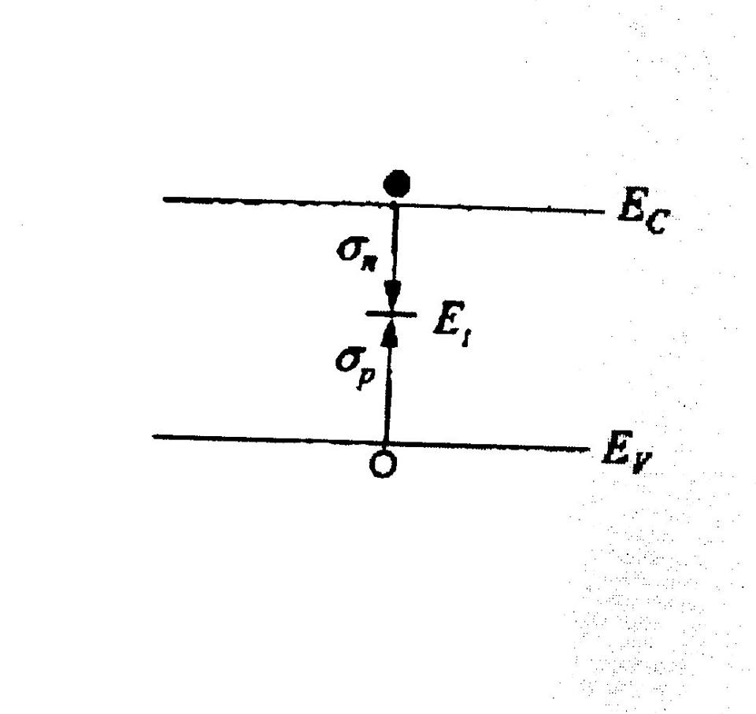
Recombination processes (the reverse are generation processes).
Band-to-band recombination. Energy is exchanged to a radiative or Auger process.
(b) Recombination through single-level traps (non radiative).

Slide 23
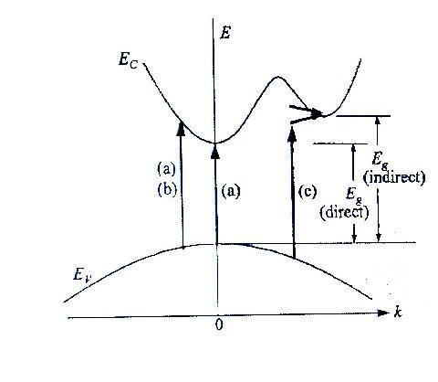
Optical transitions
(a) allowed
(b) forbidden direct transitions
(c) indirect transition involving phonon emission
(upper arrow) and phonon absorption (lower arrow).

Slide 24
Band to band transition
There are two transition (allowed and forbidden ) .
ــDirect transition :
Allowed direct transition can occur in all K values and γ=1/2 .
Forbidden direct transition can only occur at k≠0 and γ= 3/2 .
ــIndirect transition :
Phonons are involved in order to conserve momentum .
In these transition , phonons (with energy Ep) are either absorbed or emitted, and the absorption coefficient is modified to
γ= 2 & 3 for allowed and forbidden indirect transition , respectively .

Slide 25
Applications of semiconductors
A-In electronic devices
1-Computers, television and mobile devices
2-High brightness LEDs.
3-Imaging array sensors: Digital cameras.
4-Diode lasers.
5-Optical storage.
6-Robotics.
7-Medical Electronics.
8-Industrial Electronics.
9-Telecommunications.
10-Wireless Communication.
11-Global Positioning By Satellite (GPS).
12-Memories.
B-in solar cells
C-In telecommunications
D- Technical field

