Slide 1
Programming Agents with JADE for Multi-Agent Systems
Dr. abbas akram khorsheed 2020
Based on Jade, Java and Eclipse documentation

Slide 2

Content
Briefly about components
JADE overview
Setting up the Development Environment
  Installing JADE
  Installing Eclipse
  Setting Eclipse to work with JADE
Book Trading example

Slide 3

Components, Java
http://java.sun.com/
Java technology is a portfolio of products that are based on the power of networks and the idea that the same software should run on many different kinds of systems and devices.
The Java programming language lets you write powerful, enterprise-worthy programs that run in the browser, from the desktop, on a server, or on a consumer device.

Slide 4

Components, Eclipse
http://www.eclipse.org/
Eclipse is an open source community whose projects are focused on providing an extensible development platform and application frameworks for building software
Eclipse provides extensible tools and frameworks that span the software development lifecycle, including support for modeling, language development environments for Java, C/C++ and others, testing and performance, business intelligence, rich client applications and embedded development

Slide 5

Components, JADE
http://jade.tilab.com/
JADE (Java Agent DEvelopment Framework) is a software framework fully implemented in Java language.
It simplifies the implementation of multi-agent systems through a middle-ware that claims to comply with the FIPA specifications and through a set of tools that supports the debugging and deployment phase.

Slide 6
JADE overview
JADE is a middleware that facilitates the development of multi-agent systems. It includes
A runtime environment where JADE agents can “live” and that must be active on a given host before one or more agents can be executed on that host.
A library of classes that programmers have to/can use (directly or by specializing them) to develop their agents.
A suite of graphical tools that allows administrating and monitoring the activity of running agents.

Slide 7
Containers and Platforms
Each running instance of the JADE runtime environment is called a Container as it can contain several agents.
The set of active containers is called a Platform.
A single special Main container must always be active in a platform and all other containers register with it as soon as they start.

Slide 8
AMS
The AMS (Agent Management System) that provides
  the naming service (i.e. ensures that each agent in the platform has a unique name)
  represents the authority in the platform (for instance it is possible to create/kill agents on remote containers by requesting that to the AMS).

Slide 9
DF
The DF (Directory Facilitator) that provides a Yellow Pages service by means of which an agent can find other agents providing the services he requires in order to achieve his goals.

Slide 10
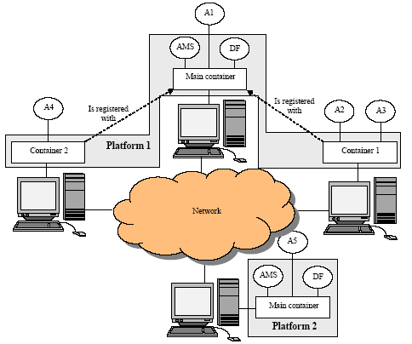
Sample architecture

Slide 11
JADE Requirements
The only software requirement to execute the system is the Java Run Time Environment version 1.4

Slide 12
Getting JADE
All the software is distributed under the LGPL license limitations and it can be downloaded from the JADE web /. Five compressed files are available:site http://jade.tilab.com
The source code of JADE
The source code of the examples
The documentation, including the javadoc of the JADE API and this programmer's guide
The binary of JADE, i.e. the jar files with all the Java classes
A full distribution with all the previous files

Slide 13
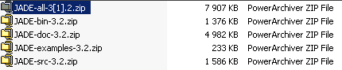
Installing JADE

Slide 14
Eclipse Requirements
You will need a Java runtime environment (JRE) to use Eclipse.

Slide 15
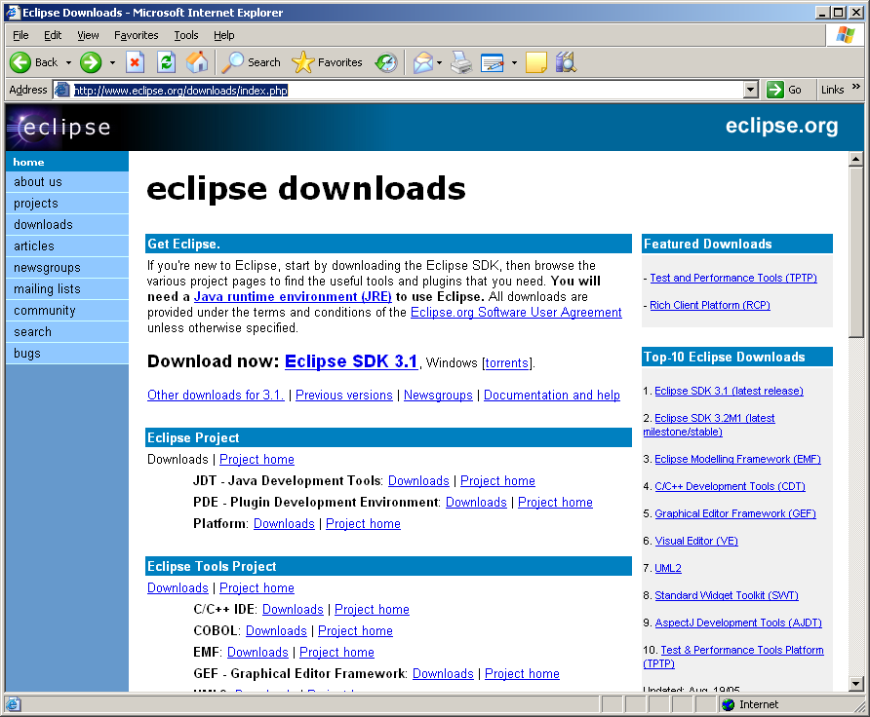
Getting Eclipse
download the Eclipse SDK
  http://www.eclipse.org/downloads/index.php

Slide 16
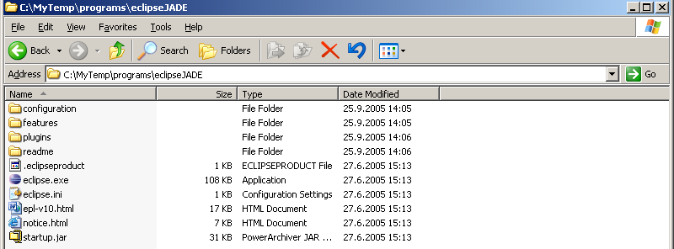
Installing Eclipse
Installing Eclipse

Slide 17

Running Eclipse
Run eclipse.exe

Slide 18
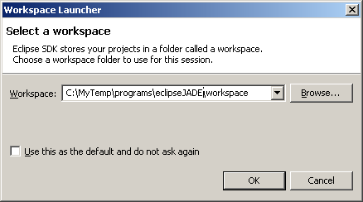
Running Eclipse. Workspace
Set arbitrary folder for the workspace

Slide 19
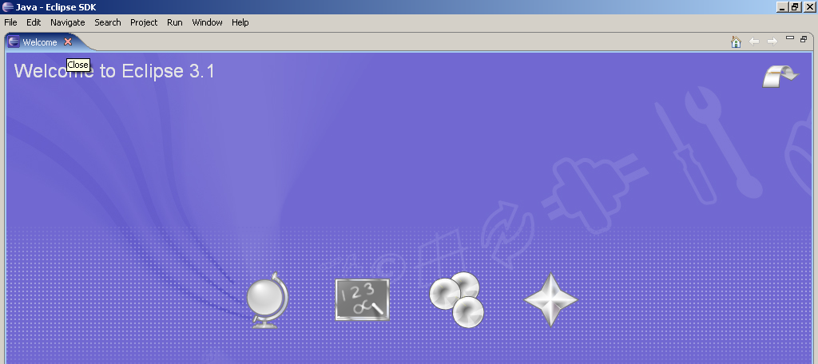
Running Eclipse. Close Welcome view
Close the welcome view

Slide 20
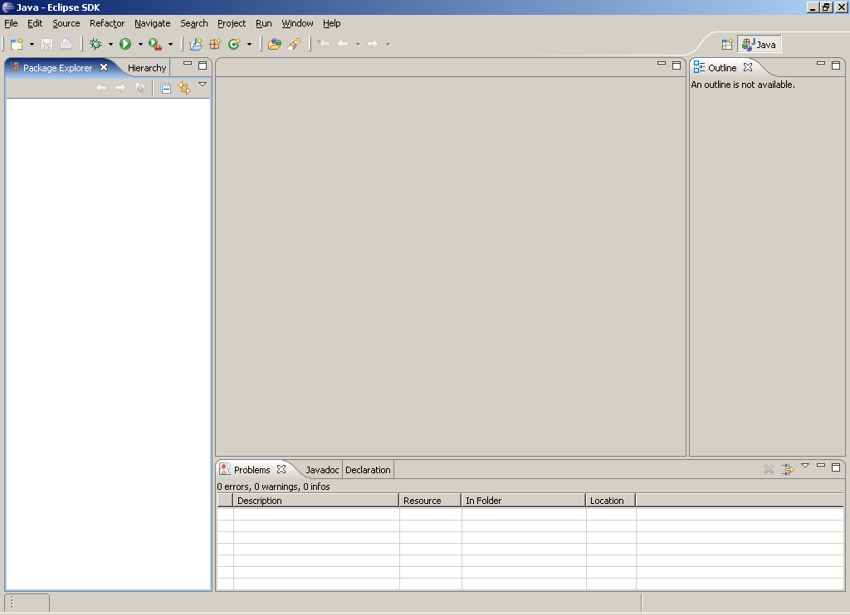
Running Eclipse
If you see this then you are ready

Slide 21
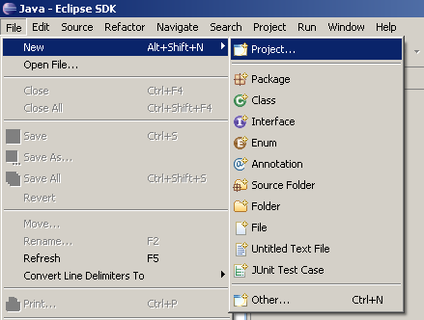
Creating a project in Eclipse

Slide 22
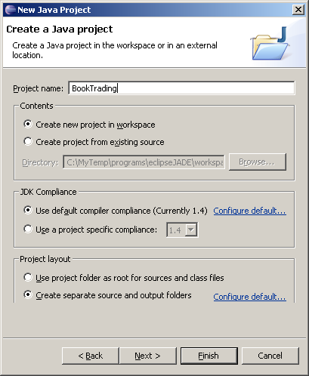
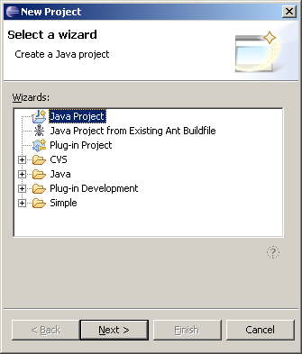
Creating a java project in Eclipse

Slide 23
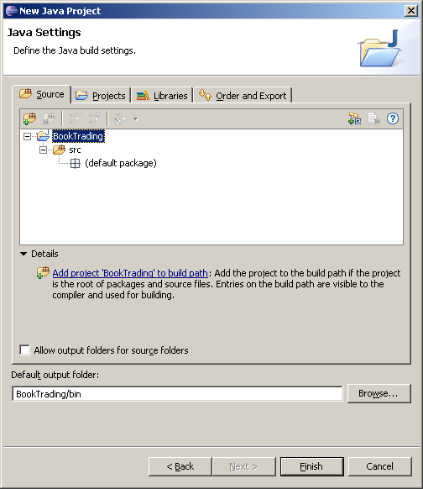
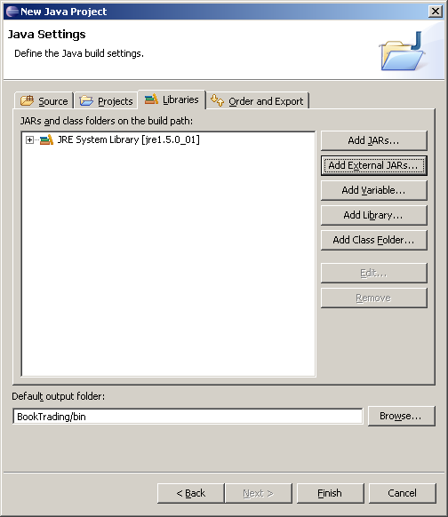
Adding JADE libs to the project

Slide 24
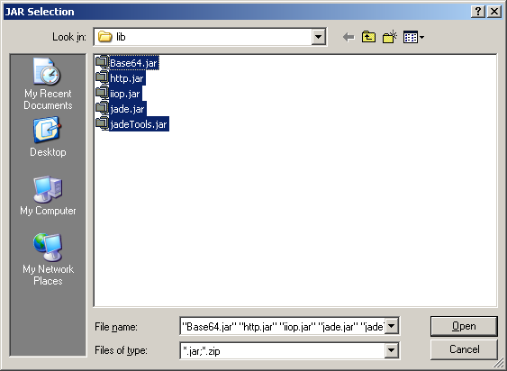
Adding JADE libs to the project

Slide 25
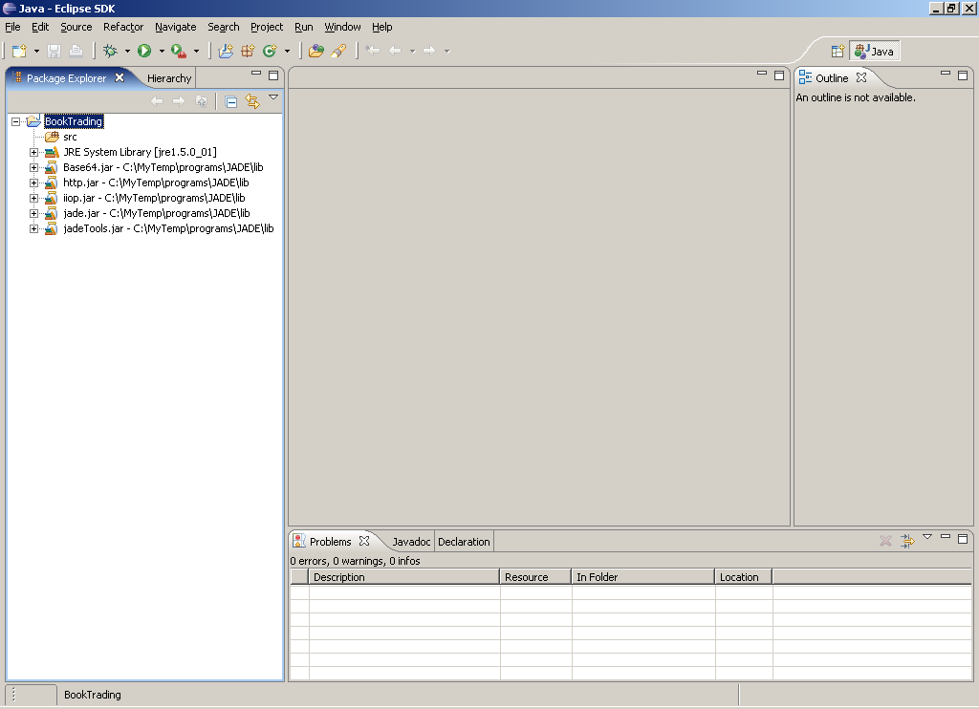
Development Environment is ready

Slide 26
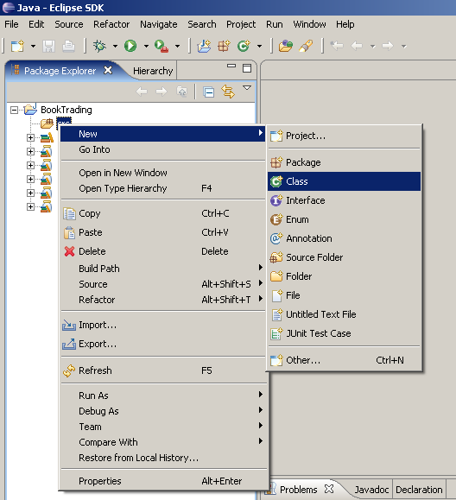
Testing Settings. Create TestAgent

Slide 27
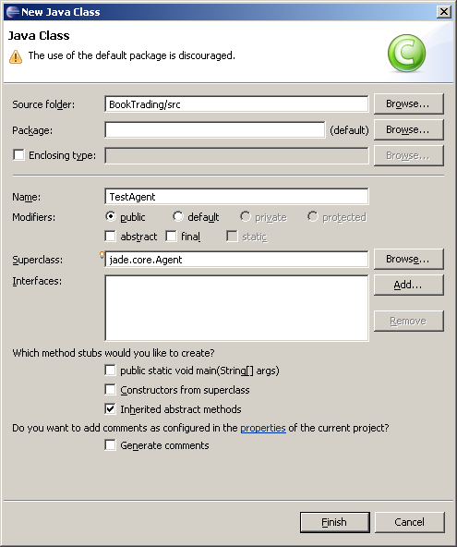
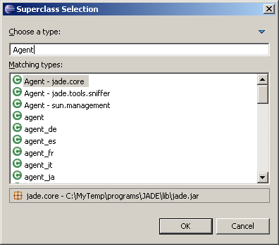
Create TestAgent

Slide 28
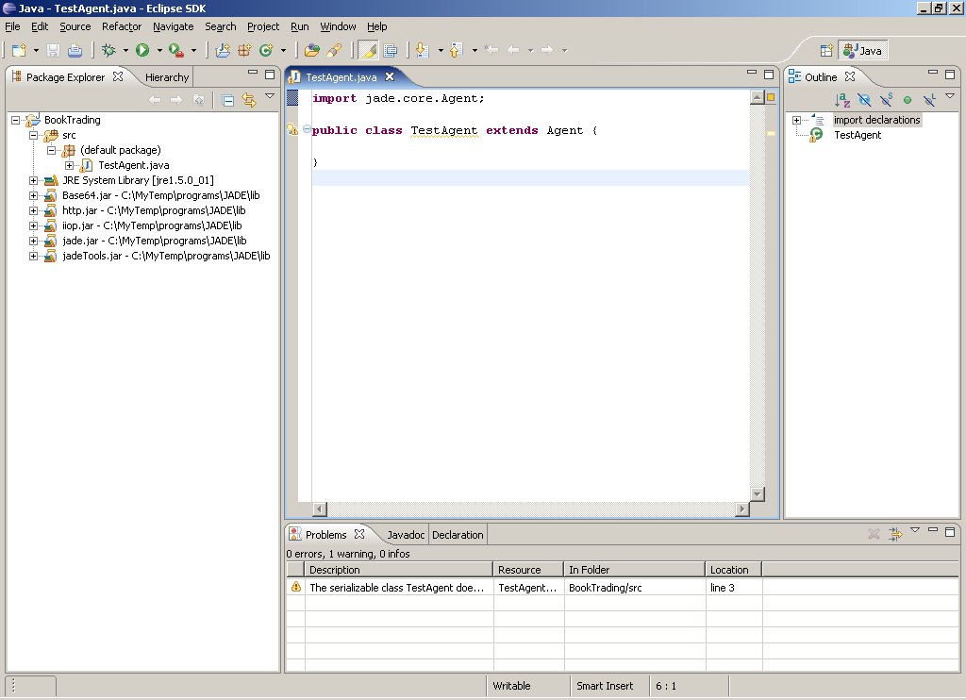
TestAgent is created

Slide 29
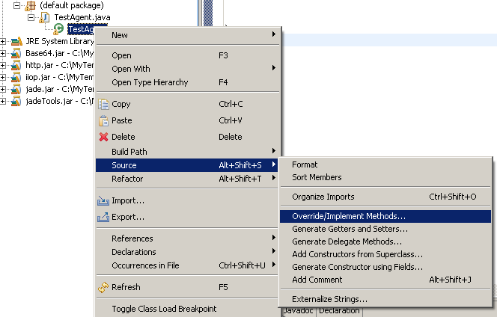
Method setup() to run TestAgent
The setup() method is intended to include agent initializations.

Slide 30
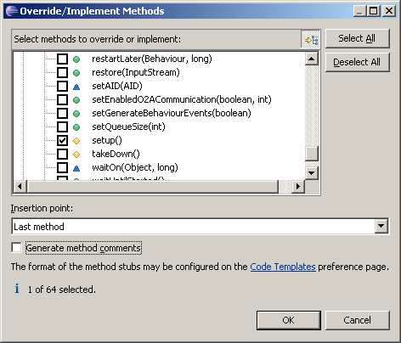
Override method setup()

Slide 31
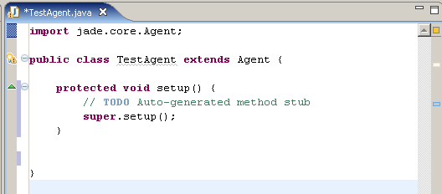
Result of overriding

Slide 32
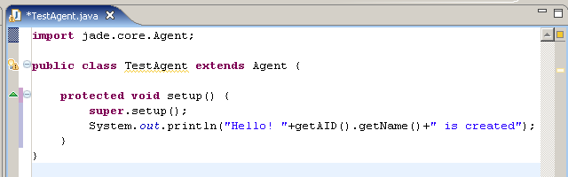
Print Hello message

Slide 33
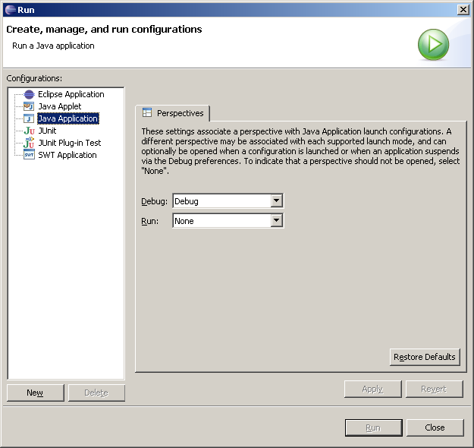
Create JADE configuration to run

Slide 34
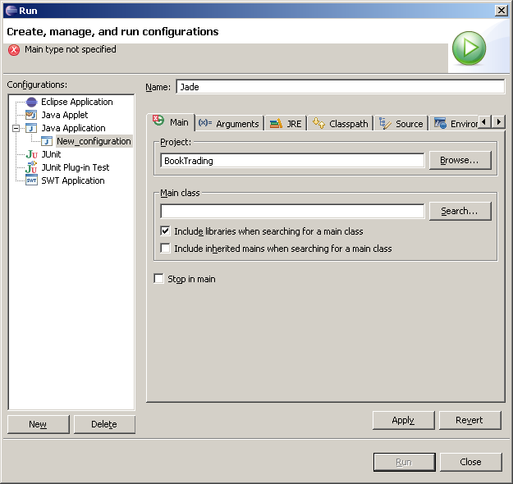
Create JADE configuration to run

Slide 35
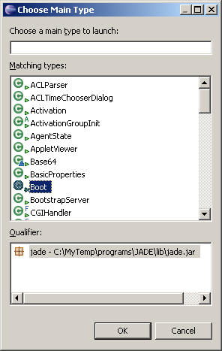
Create JADE configuration to run

Slide 36
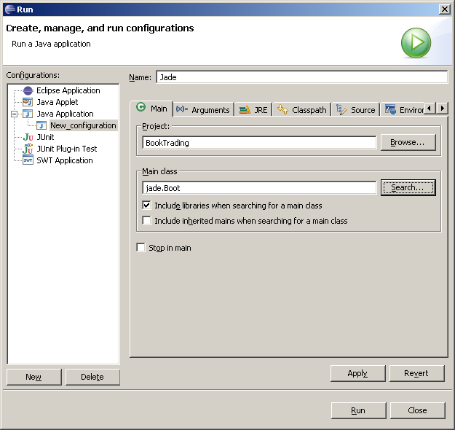
Create JADE configuration to run

Slide 37
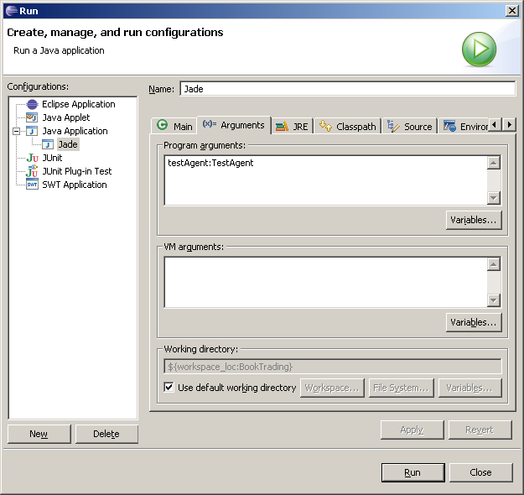
Create JADE configuration to run

Slide 38
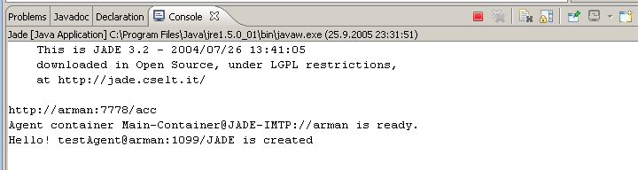
Result of Test

Slide 39
Book Trading Example
It shows how to create simple JADE agents and how to make them executing tasks and communicate between each other.
Some agents selling books and other agents buying books on behalf of their users.

Slide 40
Buyer Agent
Receives the title of the book to buy (the “target book”) as a command line argument
Periodically requests all known seller agents to provide an offer
As soon as an offer is received the buyer agent accepts it and issues a purchase order
If more than one seller agent provides an offer the buyer agent accepts the best one (lowest price)
Having bought the target book the buyer agent terminates

Slide 41
Seller Agent
Has a minimal GUI by means of which the user can insert new titles
Continuously wait for requests from buyer agents
When asked to provide an offer for a book they check if the requested book is in their catalogue and in this case reply with the price. Otherwise they refuse.
When they receive a purchase order they serve it and remove the requested book from their catalogue

Slide 42
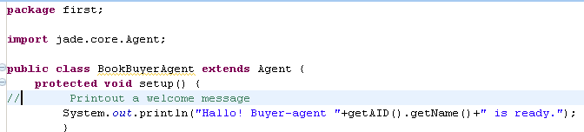
setup() method
The setup() method is intended to include agent initializations.

Slide 43
Agent identifiers
Each agent is identified by an “agent identifier” represented as an instance of the jade.core.AID class.
The getAID() method of the Agent class allows retrieving the agent identifier.
An AID object includes a globally unique name plus a number of addresses.
<nickname>@<platform-name>

Slide 44
Assigning name
The ISLString nickname = “Peter”;
AID id = new AID(nickname, AID.ISLOCALNAME);
OCALNAME constant indicates that the first parameter represents the nickname (local to the platform) and not the globally unique name of the agent.

Slide 45
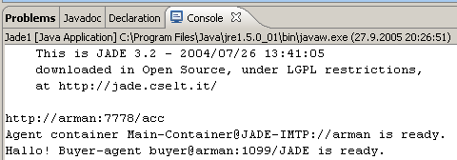
Running JADE
The first part of the above output is the JADE disclaimer
The indication that a container called “Main-Container” is ready completes the JADE runtime startup.
When the JADE runtime is up our agent is started and prints its welcome message
The platform name “arman:1099/JADE” is automatically assigned on the basis of the host and port we are running JADE on

Slide 46
Agent termination
Even if it does not have anything else to do after printing the welcome message, our agent is still running.
In order to make it terminate its doDelete() method must be called.
The takeDown() method is invoked just before an agent terminates and is intended to include agent clean-up operations.

Slide 47
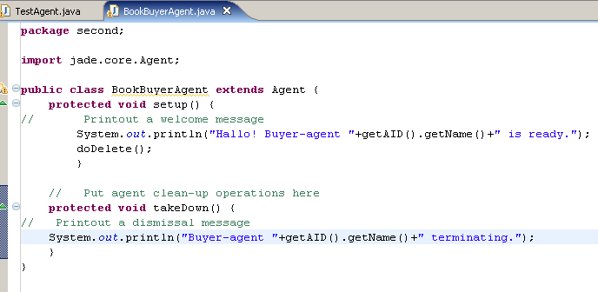
doDelete() and takeDown()

Slide 48
Passing arguments to an agent
Agents may get start-up arguments specified on the command line.
These arguments can be retrieved, as an array of Object, by means of the getArguments() method of the Agent class.
We want our BookBuyerAgent to get the title of the book to buy as a command line argument.

Slide 49
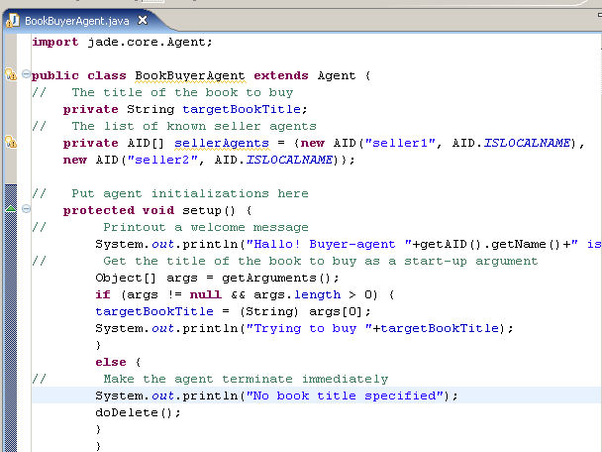
Taking target book as argument

Slide 50
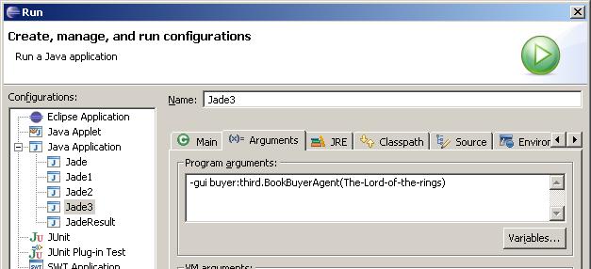
Passing book title

Slide 51
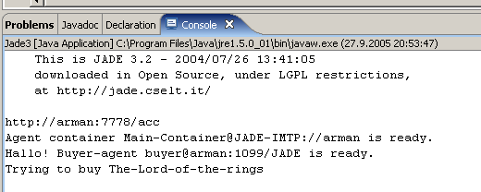
Trying to buy …

