Slide 1
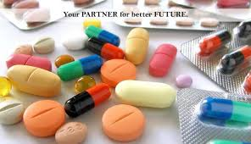
6th lecture in Antibiotics for biotechnology
Other Cell Wall Inhibitors rather than
Beta –Lactam Antibiotics
(VANCOMYCIN , CYCLOSERINE , BACITRACIN
Anti-tuberculosis agent )
Prepared by
Dr. Sawsan Sajid AL- Jubori

Slide 2
1-VANCOMYCIN Source: Streptomyces orientalis
Inhibit 2nd stage of peptidoglycan synthesis by:
a. binding directly to D-alanyl-D-alanine → block transpeptidase binding
b. inhibiting bacterial transglycosylase
It represent the drug of choice to treat S. aureus (MRSA) & S. epidermidis infection resistant to penicillinase-resistant PEN . Treatment of pseudomembranous colitis caused by Clostridium difficile; Common side effects include pain in the area of injection& allergic reactions. Occasionally problems with hearing
  2-CYCLOSERINE second line drug in the treatment of TB
Inhibit 2 enzymes → D-alanine-D-alanine synthetase and alanine racemase → catalyze cell wall synthesis
inhibit 1st stage of peptidoglycan synthesis

Slide 3
3- BACITRACIN
  Source :produced by the bacteria Bacillus licheniformis
  Action : Prevent dephosphorylation of the phospholipid that carries the peptidoglycan subunit across the membrane → block regeneration of the lipid carrier & inhibit cell wall synthesis
  Too toxic for systemic use →thus it is used for treating superficial skin infections and in clinical laboratory purposes
  4- Anti- tuberculosis agents (used with Rifampicin as a combination to treat TB.
4-1 : ISONIAZID It a chemical compound specifically Inhibit mycolic acid synthesis the main components of TB cell wall
4-2: ETHAMBUTOL
  as with the previous component it Interferes with synthesis of arabino galactan in the cell wall of TB

Slide 4
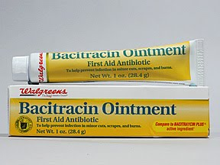
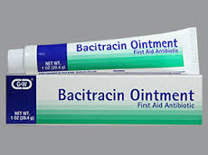
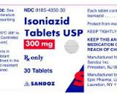
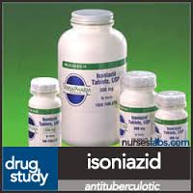
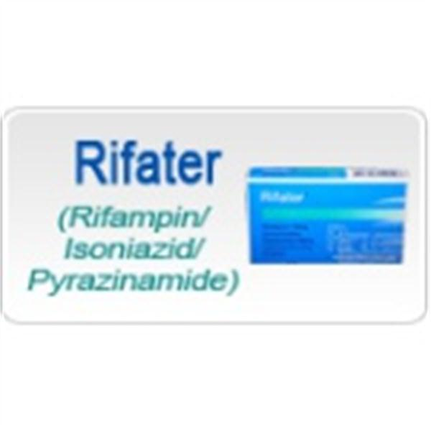
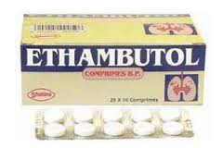
Bacitracin as ointment
Anti –tuberculosis
Isoniazide and ethambutol tablet
Riftar : the new combination to treat TB
Rifampicin and isoniazid and pyrazinamide

Slide 5
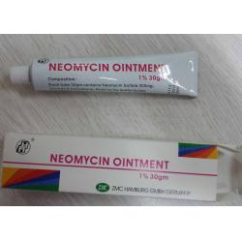
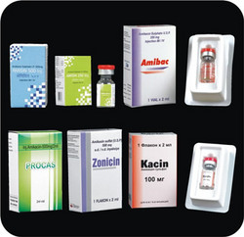
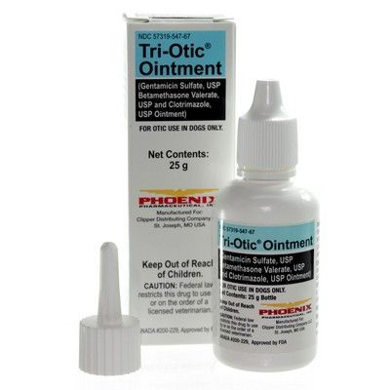
Antibiotics inhibit protein synthesis
1- Aminoglycoside group
Because its poorly absorbed through gut thus there are only ointment & injections (with some exceptions).

Slide 6
History and principles : Aminoglycosides was discovered by Selman Waksman (1944) and his coworkers searching for an agent against TB. They discovered streptomycin which is produced by Actinomycete mould, Streptomyces griseus and is active against M. Tuberculosis Aminoglycosides group contain many antibiotics some of them that are derived from Streptomyces genus are named with the suffix mycin whereas those that are derived from Micromonospora are named with the suffix micin
Antibiotics with -mycin (Streptomyces spp)
Streptomycin ( Dihydro streptomycin)
Neomycin and Paromomycin
Kanamycin ( Amikacin Arbekacin Be-kanamycin)
Tobramycin
Spectinomycin
Antibiotics with -micin (Micromonospora spp)
Gentamicin# Netilmicin Sisomicin
Verdamicin
Astromicin

Slide 7
The source and year of isolation of the aminoglycosides
Aminoglycoside year Source organism
Streptomycin 1944 Streptomyces griseus
Neomycin 1949 Streptomyces fradiae
Kanamycin 1957 Streptomyces kanamyceticus
Paromomycin 1959 Streptomyces rimosus
Spectinomycin 1962 Streptomyces spectabilis
Gentamicin 1963 Micromonospora purpurea
Tobramycin 1967 Streptomyces tenebrarius
Sisomicin 1970 Micromonospora inyoensis
Amikacin 1972 Semisynthetic derivative of kanamycin
Netilmicin 1975 Semisynthetic derivative of sisomicin
Arbekacin 1990 Semisynthetic derivative of kanamycin

Slide 8
General characters and properties of aminoglycoside group
1-The chemical structures of aminoglycosides are similarare made up of amino groups (−NH₂) attached to glycosides (derivatives ofsugar).
2- All of them are organic alkalis with a high dissociation and low lipid diffusion, and do not easily transport across membranes.
3-Their antimicrobial mechanisms are similar inhibiting the synthesis of proteins Bactericidal action . As a result the bacterial cell dies
4--The aminoglycosides are poorly absorbed from the gastrointestinal tract and therefore are given parenterally, via intramuscular or intravenous injection, or topically, via application to the skin وOral administration(neomycin) can be used for gut decontamination (e.g., in hepatic encephalopathyفقط النيوميسين يستعمل لتنظيف المعي عند اجراء العلميات الجراحية
5-Aminoglycosides are selectively active against oxygen-dependent (aerobic), gram-negative bacterial cells, since these cells possess the chemical characteristics that attract aminoglycosides and the specific transport mechanisms that facilitate the uptake of the drugs into the cells it depend on the self promoted uptake pathway to enter gr-ve cell envelop and this system require energy (ATP) through 3 phases which only exist in arobic M.O . non of the anaerobic are susceptible to these drug الاهوائية غير مستجيبة لهذه المضادات
6-Nephrotoxicity سمية للكلية (impairment of kidney function) and ototoxicity سمية للعصب السمعي الثامن (impairment of hearing and balance) are the most common side effect

Slide 9
Mode of Action موجودة سابقا
Aminoglycosides binds to specific 30S-subunit ribosomal proteins. Protein synthesis is inhibited by them in at least three ways:
①They block the formation of initiation 70S ribosomal mRNA complex;
②They induce misreading of mRNA causes incorporation of incorrect amino acids into peptide resulting in a nonfunctional or abnormal protein synthesis .
③ They inhibit the combination of the releasing factor with the site A on ribosome prevent the synthesized peptide chain releasing from the 70S ribosomal mRNA complex and the 70S ribosomal mRNA complex dissociating into 30S and 50S subunits.
4- Inhibition of ribosomal translocation i.e., movement of the peptidyl-tRNA from the A- to the P-site—has also been suggested

Slide 10
Aminoglycosides: Spectrum of Activity
Gram-Negative Aerobes (not streptomycin) enteric bacilli, E.coli, klebsiella, proteus, enterobacter are highly susceptible;
Pseudomonas aeruginosa is susceptible to some aminoglycosides (e.g. gentamicin, amikacin, netilmicin, and sisomicin), in particular tobramycin.
Gram-Positive Aerobes staphylococci, including penicillin-resistant S.aureus
Mycobacteria M.tuberculosis - streptomycin, amikacin ,kanamycin
Aminoglycosides are useful primarily in infections involving aerobic, Gram-negative bacteria, such as Pseudomonas, Acinetobacter, and Enterobacter. In addition, someMycobacteria, including the bacteria that cause tuberculosis, Streptomycin was the first effective drug in the treatment of tuberculosis, Amikacin is The most frequent used aminoglycosides for serious infections such as septicemia, complicated intra abdominal infections, complicated urinary tract infections, and nosocomial respiratory tract infections. aminoglycosides have been used in conjunction with beta-lactam antibiotics in streptococcal infections for their synergistic effects, in particular in endocarditis

Slide 11
Mode of resistance : موجودة سابقا محاضرة 3
1-Decrease uptake into bacterial cell membrane permeability or increase efflux pump .
2- Mutations to ribosome A site or to ribosomal protein
3- Methylation of ribosome particularly at A 1408 which dramatically reduces the binding affinity for most aminoglycosides by methyltransferases. This mechanism is essential for aminoglycoside –producing microorganism to protect them from been victm to their own toxic product .
4- The production of aminoglycoside modifying enzymes the determinants of these enzymes located at plasmid , transposones and integrons.
Aminoglycosides Adverse Effects:
① Nephrotoxicit – Aminoglycosides are mainly excreted by glomerular filtration and can be stored up in kidney. It can cause acute renal insufficiency and tubular necrosis. – Neomycin is the most nephrotoxic drug, streptomycin is the least one.
② Ototoxicity – the cranial nerve damage - cochlea and ear vestibule toxicity; irreversible vestibular: dizziness, vertigo, ataxia auditory: tinnitus, decreased hearing – neomycin, kanamycin, and amikacin are the most ototoxic drugs, Streptomycin and gentamicin are the most vestibul otoxic. Netilmicin is the least ototoxic.
③ Neuromuscular junction blockade may take place at high doses or in combination with curariform drugs .
④ Hypersensitivity reactions skin rash, fever, eosinophilia and anaphylactic shock can be seen though infrequently.

Slide 12
Streptomycin :The first antibiotic discovered in the early 1940s & The first drug was really effective against tuberculosis in combination with isoniazid and rifampicin, although it is less commonly used in the treatment of this disease today. In spite of it is broad-spectrum antibiotic, actively against a range of Gram-positive and negative bacteria, but still its use is limited due to several problems, first poorly absorption from the gastrointestinal tract as with other membrane of this group. Second side effects like deafness, owing to irreversible injury to the eighth cranial nerve, and may also cause kidney damage , and third, long duration treatment causes emergence of bacterial resistance to this antibiotic Streptomycin has been displaced by gentamicin for treatment of Gram negative infections, Streptomycin is preferred for treatment of and tularemia and plague طاعون and is often used (with a tetracycline)for severe Brucellosis حمى مالطا
Neomycin. Neomycin has the same antibacterial spectrum as kanamycin and sharing similar properties . Parenterally has not been used because of its toxicity, deafness has also followed topical use over large areas of skin, injection into cavities such as joint. Neomycin also can cause severe damage to hearing and renal function)

Slide 13
Gentamicin(Garamicin) .Gentamicin is one of the few heat-stable antibiotics that remain active even after autoclaving, which makes it particularly useful in the preparation of some microbiological growth media, It is useful for treatment of many hospital-acquired infections caused by Gram negative bacteria bacilli which confer resistance to gentamicin are often susceptible to amikacin or to one of the third generation cephalosporins, the fourth generation cefepime, or to other β-lactam group including Carbapenems which including imipenem or meropenem . Gentamicin is also used in combination with penicillin G, ampicillin or vancomycin for treatment of endocarditis caused by pathogenic enterococci
used to treat many types of bacterial infections including bone infections , blood and soft tissue , endocarditis , pelvic inflammatory disease , meningitis , pneumonia , urinary tract infections, Topical formulations may be used in burns or for infections of the outside of the eye..
Tobramycin : similar to gentamicin but with greater activity against P. aeruginosa but with less activity against Serratia . is usually given by injection and are valuable in the treatment of septicemia caused by Gram negative organism, respiratory infections ,while it may given topically as eye drops to treat Pseudomonas eye infections

Slide 14
Kanamycin : is a water-soluble broad-spectrum antibiotic . It is active against some Gram negative bacilli except Pseudomonas . Resistance toward kanamycin is common beside it’s more toxic than gentamicin or tobramycin, they it replaced with gentamicin, tobramycin or amikacin. Kanamycin could be used with other drugs for treatment of tuberculosis , and orally administrated kanamycin are used to eliminate bowel flora before intestinal surgery
Amikacin (Amikin) : a semi-synthetic aminoglycoside derived from kanamycin often effective in treating infections caused by Gram negative strains which are resistant to gentamicin and tobramycin, including some strains of P.aeruginosa and Acinetobacter . It is generally reserved for treatment of serious infections caused by amikacin-susceptible Gram negative bacteria known or suspected to be resistant to the other aminoglycosides It has also been used concurrently with other drugs for treating mycobacterial infections. It is usually given by injection and is used in the treatment of bone infections (osteomyelitis), Cystic fibrosis and in combination with vancomycin to treat endocarditis

