Slide 1
8- Icon Operations
To change the arrangement of icons on the desktop do the following:
1 - Right Click the desktop
2- Click Sort by
3- Select one of the 4 options to arrange
icons from sub-menu

Slide 2
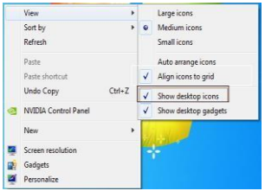
View/Hide Icons
Right Click the desktop
Click View
Check to see if Show desktop
icon has a check mark
4. If it does not, choose it .

Slide 3
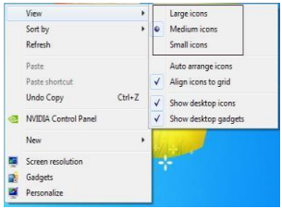
Change Icon size
Right Click the desktop
Click View
Show the required size

Slide 4
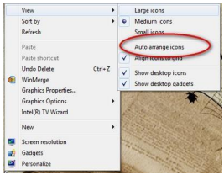
Auto Arrange Icon
1-Right Click the desktop
2- Click View
3- Check to see if Auto Arrange
has a check mark
4-If it does uncheck it

Slide 5
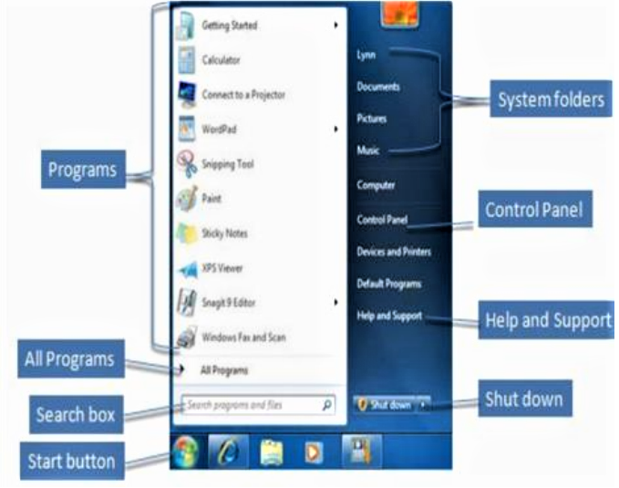
Start Menu Parts
The Start menu for Windows 7 consists of many Parts,
to show Use the Start menu to do these common activities
Start programs
Open commonly used folders
Search for files, folders, and programs
Adjust computer settings
Get help with the Windows operating system
Turn off the computer
Log off from Windows or switch to a different user account.

Slide 6
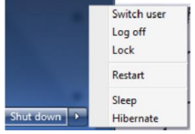
At the bottom of the right pane is the Shutdown button.
Click the Shutdown button to turn off your computer.
Clicking the arrow next to the Shutdown button displays a menu with additional options for switching users, logging off, restarting,
or shutting down.

Slide 7
Switch user:
If you have more than one user account on your
computer, Fast User Switching is an easy way for
another person to log on to the computer
without logging you off or closing your programs
and files.
Log off: When you log off from Windows, all of the programs you were using are closed, but the computer is not turned off.
Lock: Locking your PC is a good option if you’ll be back soon.
You'll have to enter your password when you come back, which helps keep your work more secure.

Slide 8
Restart:
The Restart button "reboots" your computer
(it is sometimes called "warm boot" or "soft boot.").
That means it saves your information to the hard
drive, turns off the computer for a moment, and
then turns it back on again
Sleep:
Clicking on Sleep puts your computer in a low-power state, but doesn't turn it off.
The main advantage is that it allows you to get back to work quickly, without having to wait for the computer to do a full reboot.

Slide 9
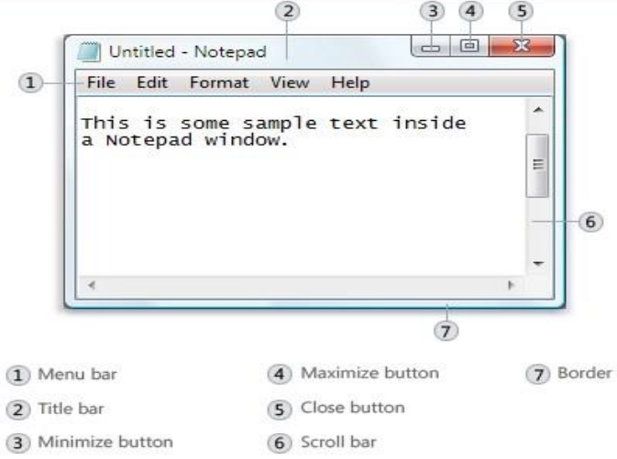
Parts of a window
1-Menu bar.
Contains items that you can click to make choices in a program.
2-Title bar.
Displays the name of the document and
program (or the folder name if you’re
working in a folder).
3-Minimize button to hide the window
4-Maximize button to enlarge it to
fill the whole screen
5-Close button to close it.

Slide 10
Changing the size of a window
1- To make a window fill the entire screen, click its Maximize button or double-click the window's title bar.
To return a maximized window to its former size, click its Restore button (this appears in place of the Maximize button).
Or, double-click the window's title bar. To resize a window (make it smaller or bigger), point to any of the window's borders or corners.
When the mouse pointer changes to a two headed arrow drag the border or corner to shrink or enlarge the window.

Slide 11
2-Hiding a window
Hiding a window is called minimizing it.
If you want to get a window out of the way temporarily without closing it, minimize it.
To minimize a window, click its Minimize button.
The window disappears from the desktop and is visible only as a button on the taskbar, the long horizontal bar at the bottom of your screen.
To make a minimized window appear again on the desktop, click its taskbar button.
The window appears exactly as it did before you minimized it.

Slide 12
3-Closing a window
Closing a window removes it from the desktop and taskbar.
If you're done with a program or document and don't need to return to it right away, close it.
To close a window, click its Close button.
If you close a document without saving any changes you made, a message appears that gives you the option to save your changes.

Slide 13
6-Scroll bar.
Let’s you scroll the contents of the window
to see information that is currently out of view.
7-Borders and corners.
You can drag these with your mouse pointer
to change the size of the window.

