Slide 1
الجامعة المستنصرية
كلية العلوم
قسم علوم الحاسوب
Part 3

Slide 2
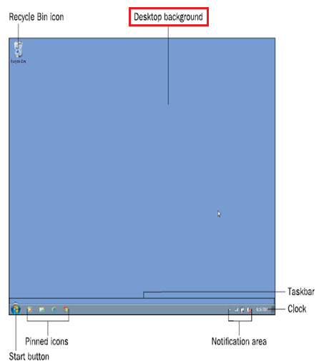
A Tour of Windows 7
The Windows 7 interface, called the desktop, is your starting point for most of the activities you perform in Windows 7.
From the desktop, you can:
Run programs.
Manage files.
Access the Internet.
Check the status of devices.
and more.

Slide 3
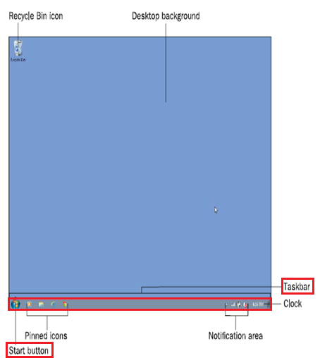
A Tour of Windows 7
The taskbar is the thin bar across the bottom of the screen. It is used to start programs and to manage the programs that are already running.
At the far-left end is the Start button.
The small graphics you see on the desktop are called icons.
An icon can sit on the desktop, as the Recycle Bin icon or it can be pinned to the taskbar for easy access.

Slide 4
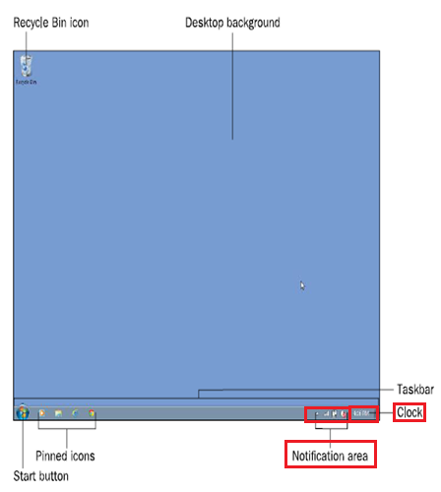
Four pinned icons appear to the right of the Start button.
The center of the taskbar is blank, but if any programs were running or windows open, buttons for those programs or windows would appear there.
some other icons are at the right end of the taskbar, but these aren’t pinned there.
That area is called the notification area (or system tray), and the icons there represent information from programs or system components that are running in the background, such as the:
Volume Control
Battery Meter.
At the far-right end of the taskbar is a clock.

Slide 5
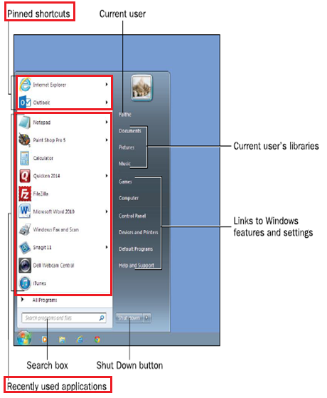
When you click the Start button, the Start menu opens, as shown in the figure below. It has two columns.
In the left column:
the top section contains pinned shortcuts to applications. By default, there might not be any pinned shortcuts here; the figure below shows pinned shortcuts for Internet Explorer and Outlook.
The bottom section of the left column contains shortcuts to recently or frequently used applications. This list changes depending on your usage.

Slide 6
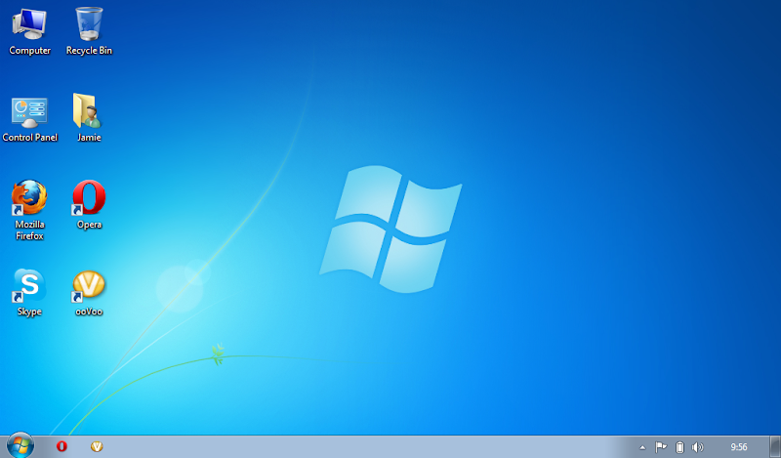
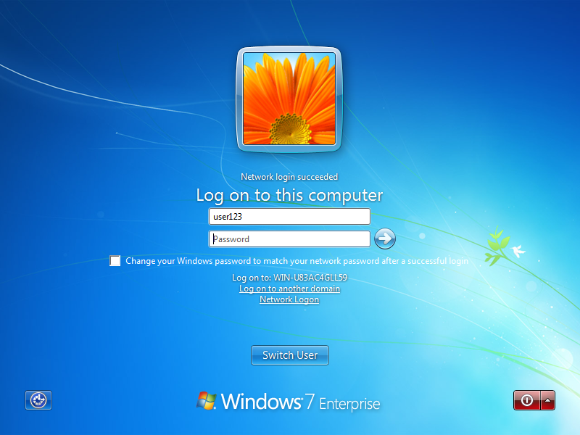
Starting Up and Shutting Down
When you turn on the computer’s power, Windows 7 loads automatically. Depending on the way your copy of Windows is configured, the desktop might appear automatically, or you might see a login screen At the login screen.
If your username appears with a password box under it, type the password and press Enter to log in.
If several different usernames appear, click your account to select it.

Slide 7
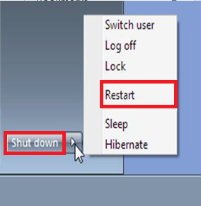
Starting Up and Shutting Down
When you Shut down the computer and then turn it back on again later, that’s called a cold boot because the computer’s circuitry has been off (and is therefore cold).
When you Restart the PC, Windows shuts down, but the computer’s power remains on, and Windows immediately restarts. Restarting is also called a warm boot because the computer stays on (warm) as it reboots.
To Restart Windows, choose Restart from the Shut Down button’s menu

Slide 8
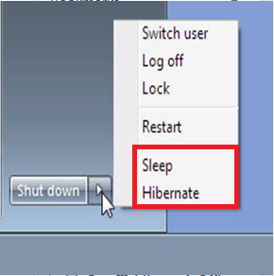
Placing the PC in a Low-Power Mode
Windows supports two special modes that you can place the computer in as an alternative to shutting down completely.
In each of these modes, when the computer resumes operation:
The desktop is just as you left it, including any open programs, windows, and files.
This saves you time because you don’t have to wait as long for Windows to start up as you normally would, and when it does start up, you don’t have to reopen the applications and windows you want to continue working with.

Slide 9
Sleep mode is a low-power state. It keeps the RAM powered, but shuts down all other components.
Hibernate mode is a no-power-needed state. It copies the contents of RAM to a reserved area on the hard drive, and then shuts the power down completely.
To wake up from Sleep mode, press any key on the keyboard.
To wake up from Hibernate mode, press the computer’s Power button.

Slide 10
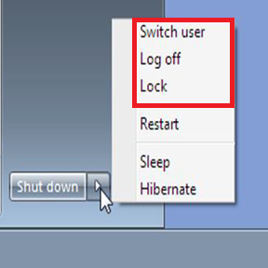
Logging Off and Switching Users
If another user wants to use the computer for a short time, the first user may not want to take the time to shut down all applications and data files that he or she is working on.
The Switch User command suspends the current user’s session but does not end it, and returns to the login screen. Another user can then log in.
When one user is finished, he or she can log off, which:
Shuts down any running programs.
Closes any open data files.
Unloads all personal settings for that user.
Returns to the login screen.
with all the available users listed.

Slide 11
If you are going to be away from your computer for a while, you might not want other people to be able to see what you were working on or snoop on your computer while you are gone.
You can use the Lock command. Locking preserves the current state of the computer but redisplays the login screen.
You must retype your password when you return to the computer to continue your session.

Slide 12
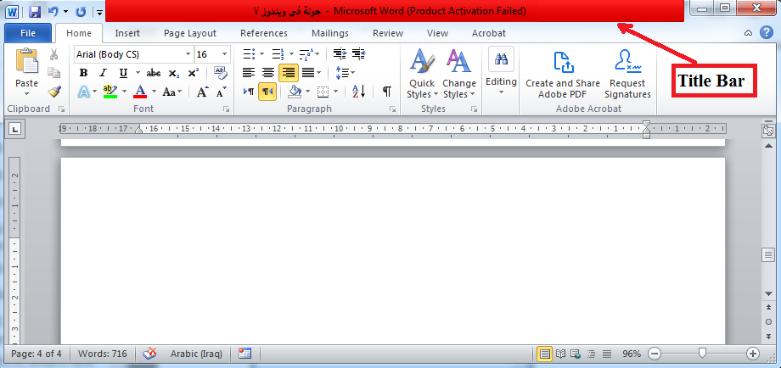
Manipulating a Window
Title bar: is the bar across the top of the window. If the window holds an application, it shows the application’s name. You can move a window around onscreen by dragging its title bar.
The buttons at the far-right end of the title bar control the window’s size.
Minimize: Hides the window by shrinking it down to a button on the taskbar.
Maximize: Enlarges the window to fill the entire screen. When a window is already maximized, this button changes to a Restore button

Slide 13
Close: Closes the window, exiting the application that was open in it
Each window has a border around its edges. You can position the mouse pointer over any part of the border and then drag to change the size of the window.
If you drag a corner of the border, you can resize in both dimensions at once.

Slide 14
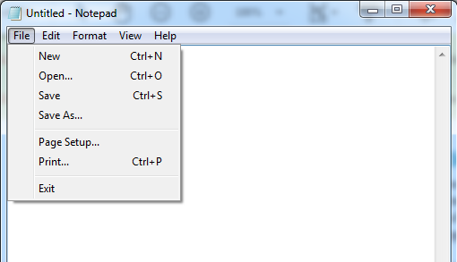
Navigating in an Application
Most Windows-based applications have one of two interfaces:
Menu interface.
Ribbon interface.
Menu interface: is typical of older applications and applications not developed by Microsoft.
Ribbon interface: is common in newer Microsoft applications.

Slide 15
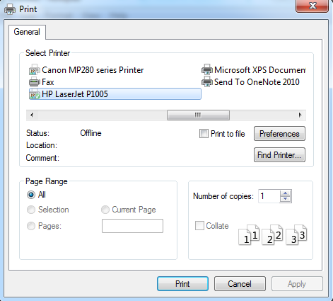
Menu-based interface: has a menu bar across the top of the screen, immediately below the title bar. You can click a menu name to open the menu, as shown in the figure below.
Notice that some commands have keyboard shortcuts listed next to them. You can press those keys instead of using the menu system if you prefer.
Notice also that some commands open dialog boxes, which are windows that prompt you for additional information.
For example, if you click the Print command, the Print dialog box opens, prompting you to enter print settings, as shown in the figure below.

Slide 16
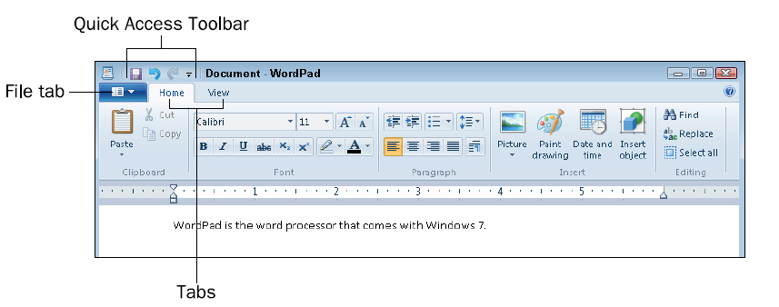
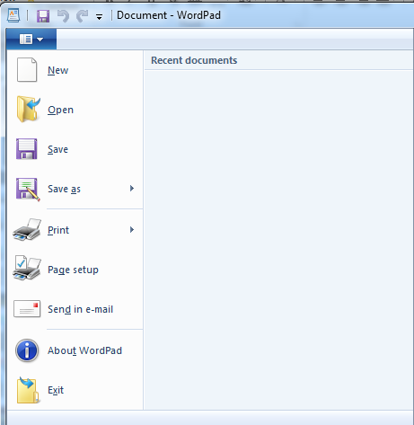
Ribbon-based applications: do not have a menu bar or toolbar. Instead, they have a tabbed Ribbon, which is somewhat like a large multi-page toolbar.
Each tab represents a different page of tools. Click a tab to access the buttons and other tools on that tab. the figure shows an app called WordPad.
It has two ordinary tabs, Home and View, containing commands you can select.
It also contains a File tab, which is the blue tab to the left of the other two. The File tab opens a File menu, which contains commands for saving, opening, closing, and printing files.
Microsoft Office programs use this same type of interface.

Slide 17
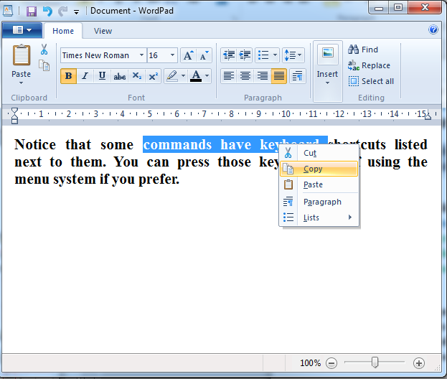
In most applications, both menu-based and Ribbon-based, you can right-click to open a shortcut menu (also called a context menu) and select commands from there. The shortcut menu’s content changes depending on what you right-click and what you are doing.
For example, if you right-click some text that you’ve selected, the shortcut menu contains commands to cut and copy it, as shown in the figure below.
To close an application, Close its window by
clicking the Close (X) button in the upper-right corner,
Open its File menu and choose Exit,
Press Alt+F4 when the application window is active.

Slide 18
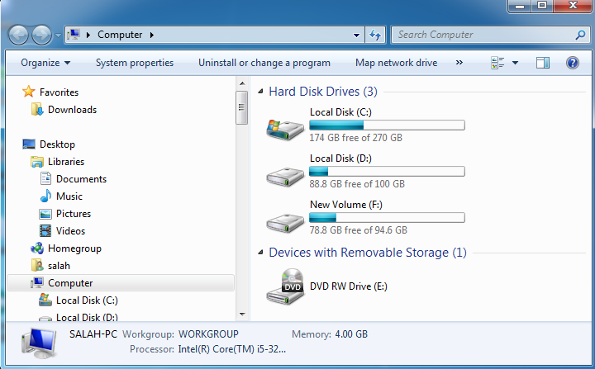
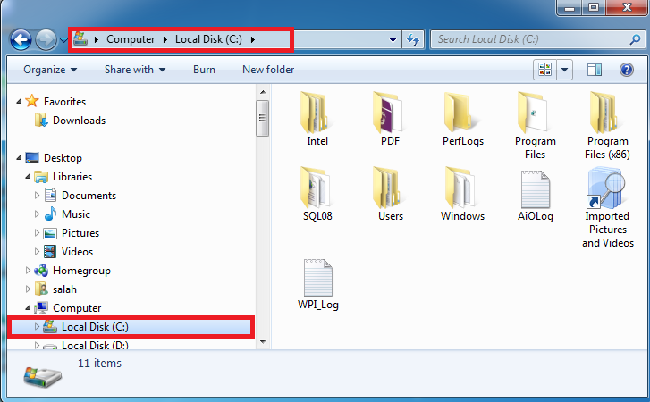
Managing Files
Computer’s file system consists of physical drives that contain volumes that have letters (with colons) assigned to them, like C: and D:.
Each volume can contain folders, and each folder can contain files.
In Windows 7, Windows Explorer is the tool for managing files. “Managing” is a pretty broad term, encompassing all the various operations you might perform on a file, including:
Moving.
Copying.
Renaming.
Deleting.
viewing its properties.

Slide 19
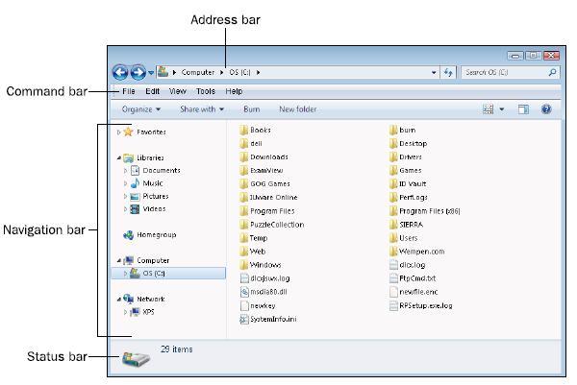
Understanding the Windows Explorer Interface
In many ways, Windows Explorer resembles any other window. It has a title bar, a menu bar, and window controls. It also has some extra features, though, that not every window has, shown in the figure below.
Navigation bar.
Command bar.
Address bar.
Status bar.
Search box

Slide 20
Navigation bar:
The pane on the left side of the Windows Explorer window contains links for displaying various locations, both on your local computer and on any networks you may be connected to.
2. Command bar:
This extra bar below the menu bar contains an Organize button that opens a menu, and also other commands, which change depending on what location you are viewing.
3. Address bar:
The address bar, which appears above the menu bar, shows the current path.
4. Status bar:
This bar appears at the bottom of the window, and reports information about the currently displayed or selected location or objects.
5. Search box:
To find a particular file or folder in Windows Explorer, you can type a part of its name in the Search box and press Enter.

Slide 21
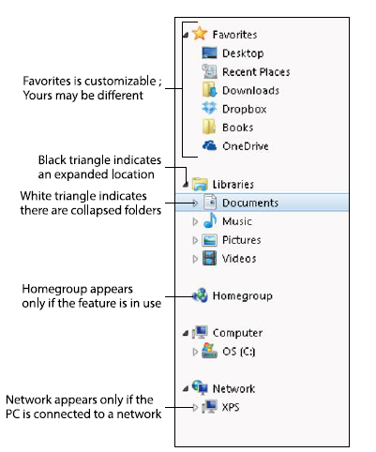
Navigating to Different Locations
When you open Windows Explorer, the location shown depends on how you opened it. For example, the Start menu has several links on it that all open different locations (Computer, Documents, Pictures, and Music). In addition, the Windows Explorer shortcut on the taskbar opens Windows Explorer to the Libraries window.
You can easily navigate to any location in Windows Explorer, so it doesn’t matter from which location you start.
One way to navigate to a different location is to click one of the links in the navigation pane (the left pane). The navigation pane contains these expandable sections, as shown in the figure below:

Slide 22
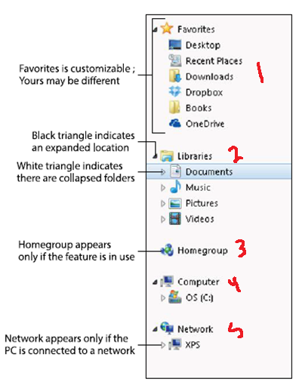
1- Favorites: Contains shortcuts for a few common locations, such as the desktop and Recent Places. You can also add your own location shortcuts here, for easy access to the locations you use the most.
2. Libraries: Contains shortcuts for the Documents, Music, Pictures, and Videos libraries for the logged-in user account.
3. Homegroup: If your computer is part of a homegroup, a link to it appears. A homegroup is a type of networking used in home and small business workgroup environments.
4. Computer: Contains a list of all the local volumes in an expandable folder tree.
5. Network: Contains shortcuts for browsing a network if you are connected to one.

Slide 23
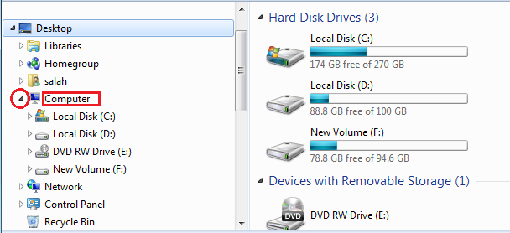
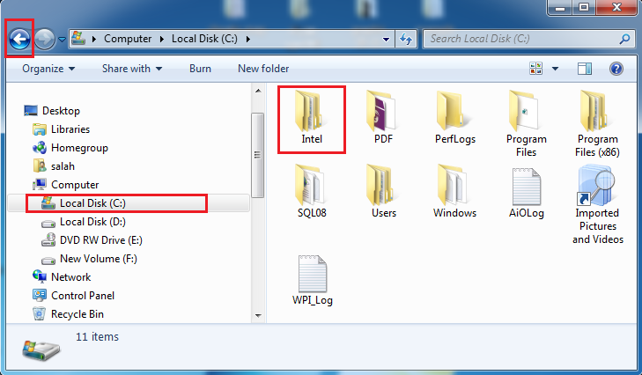
To expand a section, double-click its name, or point to it (so that a white triangle appears to its left) and then click the triangle to expand it. When a section is expanded in the folder tree, the triangle next to it appears black; click the black triangle to collapse the section again.
You can also navigate by double-clicking a folder in the main pane.
If you want to go back one step in your navigation, click the Back button in the upper-left corner. The Forward button next to it takes you one step forward again after you have used Back.

Slide 24
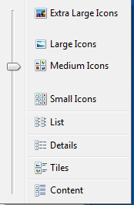
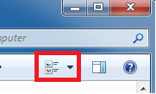
Changing the View of a Location
You can view the current location in the main pane in a number of different ways.
Click the Change Your View button to toggle through the available views.
Click the down arrow to the right of that button to open a menu of views and then click the one you want.
Drag the slider up or down to a different view. See the figure below.

Slide 25
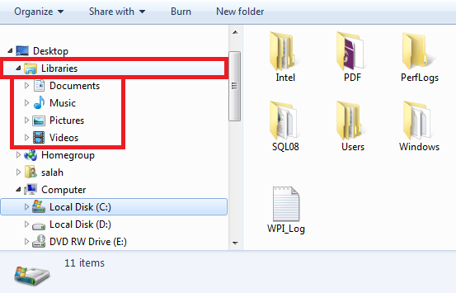
Understanding Libraries
A library is not a folder, although it looks like one. It is a virtual folder created by combining the contents of several different folders in one pane. The Library's feature enables you to work with the contents of many different locations at once, without worrying about where a particular file is actually stored.
Windows 7 comes with four libraries already set up for you: Documents, Music, Pictures, and Videos.
When you save a file to your Documents library, where is that file actually saved, if the library represents multiple locations? That depends on which folder is set up to be the save location.

Slide 26
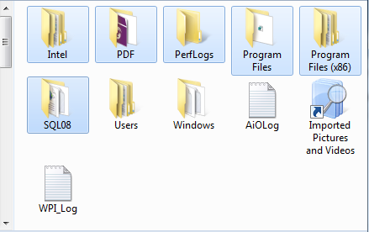
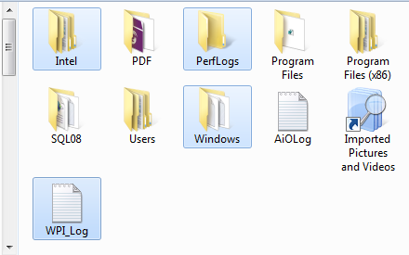
Selecting Files and Folders
Before you can issue a command that affects a file or folder (for example, to move or copy it),
If you are selecting only one file or folder, you must first select that file or folder by click on it.
If you want to act upon multiple files or folders at once, you must select them all before issuing the command.
When two or more files or folders are contiguous in the file listing, you can select them by clicking the first one and then holding down the Shift key while you click the last one. All the files between the two are also selected.
When the files you want are non-contiguous, hold down the Ctrl key and then click individually on each one.

Slide 27
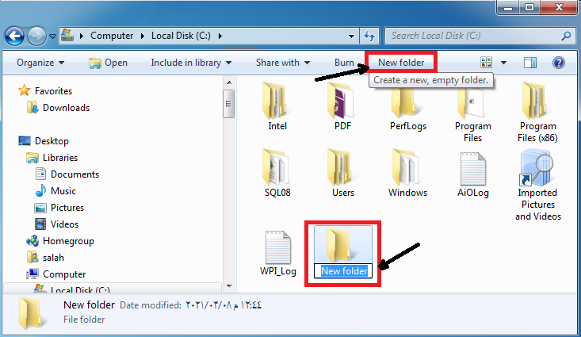
Creating New Folders
As you work in Windows, you may want to create new folders to organize your data.
For example, you might create a separate folder for each project you work on. You could create them in your My Documents folder, so that they show up in your Documents library, or in another other location on any volume to which you have access.
To create a new folder:
Click the New Folder button on the command bar in Windows Explorer.
2. A new folder appears with a generic name, with the name highlighted so you can easily change it.
3. Type the new name and press Enter.

Slide 28
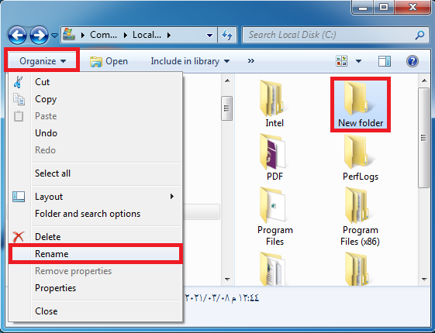
Renaming and Deleting Files and Folders
There are many different ways to rename a file or folder. You can do any of the following:
Select the file or folder and press F2 to make the name editable. Type the new name and press Enter.
Click the file or folder to select it and then click it again to move the insertion point into the name. Edit the name and press Enter.
Right-click the file or folder and click Rename. Edit the name and press Enter.
Select the file or folder and then open the File menu and choose Rename. Edit the name and press Enter.

Slide 29
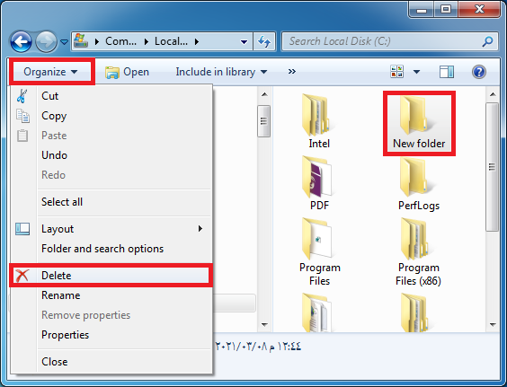
To delete a file or folder:
select it and then do any of the following:
Press the Delete key on the keyboard.
Right-click the file and folder and click Delete.
Open the File menu and click Delete.
Deleting a file sends it to the Recycle Bin, which is a temporary holding area for deleted content. You can retrieve a deleted file or folder from the Recycle Bin.

Slide 30
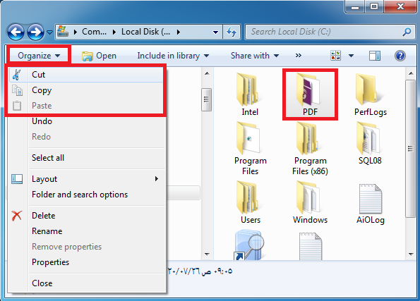
Moving and Copying Files and Folders
You can move and copy files and folders from and to any location. This enables you to transfer your data files from your hard drive to a removable drive such as a USB flash drive.
There are many ways to move and copy items.
You can use the Windows Clipboard,
drag and drop files from one location to another,
you can use the Move to Folder
Copy to Folder command in Windows Explorer.
Operation | Keyboard Method
Cut | Ctrl + X
Copy | Ctrl + C
Paste | Ctrl + V

Slide 31
The End

