Slide 2
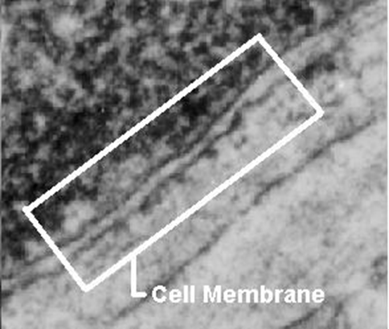
About Cell Membranes
All cells have a cell membrane
. Functions:
Controls what enters and exits the cell to maintain an internal balance called homeostasis
Provides protection and support for the cell

Slide 3
Types of Cellular Transport
Passive Transport
cell doesn’t use energy
Diffusion
Facilitated Diffusion
Osmosis
Active Transport
cell does use energy
Protein Pumps
Endocytosis
Exocytosis

Slide 4
Passive Transport
cell uses no energy
molecules move randomly
Molecules spread out from an area of high concentration to an area of low concentration.
(High→Low)
Three types:

Slide 5
3 Types of Passive Transport
Simple Diffusion
Facilitative Diffusion – diffusion with the help of transport proteins
Osmosis – diffusion of water

Slide 6
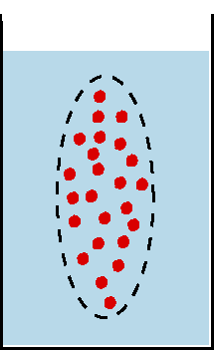
Passive Transport: 1. Diffusion
Simple Diffusion: random movement of particles from an area of high concentration to an area of low concentration.
(High to Low)
Diffusion continues until all molecules are evenly spaced (equilibrium is reached)-Note: molecules will still move around but stay spread out.

Slide 7
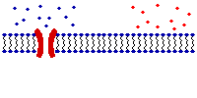
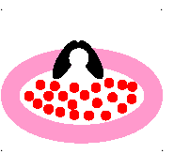
Passive Transport: 2. Facilitated Diffusion A B
Facilitated diffusion: diffusion of specific particles through transport proteins found in the membrane
Transport Proteins are specific – they “select” only certain molecules to cross the membrane
Transports larger or charged molecules
Facilitated diffusion (Channel Protein)
Diffusion (Lipid Bilayer)
Carrier Protein

Slide 8
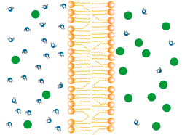
Passive Transport: 3. Osmosis
3.Osmosis: diffusion of water through a selectively permeable membrane
Water moves from high to low concentrations
Water moves freely through pores.
Solute (green) to large to move across.

Slide 9
Active Transport
cell uses energy
actively moves molecules to where they are needed
Movement from an area of low concentration to an area of high concentration
(Low → High)
Three Types:
1. Protein Pump. 2. Endocytosis. 3. Exocytosis.

