Slide 1
Republic of Iraq Ministry of Higher Education and Scientific Research Mustansiriyah University College of Science Department of Chemistry
Impact of Nanoparticles on the biochemical parameters in sera of patients with multiple sclerosis
Proposal
Submitted to Department of Chemistry/ College of Science/ Mustansiriyah University
By
Nada Nadhim Ahmed
B.Sc. University of Mustansiriyah (2013)
M.Sc. University of Mustansiriyah(2019)
Supervised by
Prof. Dr. Salwa Hameed Naser Al-Rubae'i Dr. Wafaa Mahdi Salih
2021-2020

Slide 2
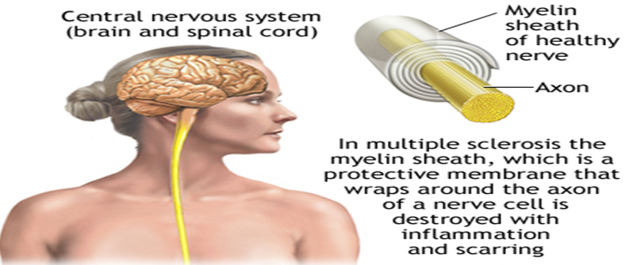
1. Introduction
1.1 Definition
Multiple sclerosis is a progressive autoimmune and inflammatory disease in which the immune cells of the body strike nervously in the CNS. It involves the gradual destruction of myelin in a genetically vulnerable patient due to an autoimmune response produced against self-antigens [1].
MS is a chronic, inflammatory white matter disease of the CNS the underlying cause of which remains uncertain, with a female to male ratio of 2:1–3:1[2].

Slide 3
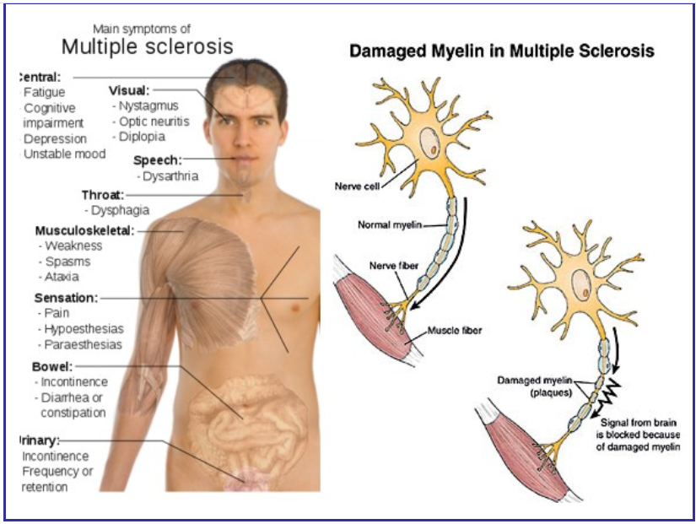
Figure 1: The Main Symptoms of Multiple [3]

Slide 4
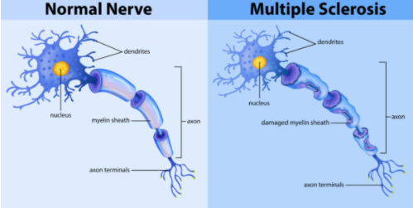

Slide 5
The cause of MS is not known, strong evidence suggests genetic and environmental factors (infectious agents) are involved in the initiation of this disease, in particular vitamin D or ultraviolet B light (UVB) exposure, Epstein–Barr virus (EBV) infection, obesity and smoking.

Slide 6
1.2 Pathology and Types
Neurologists agree that patients may be grouped into four major categories based on the course of disease [4][5].
.
Relapsing–remitting MS (RRMS): the most common form, affecting about 85% of MS patients. It is marked by flare-ups (relapses or exacerbations) of symptoms followed by periods of remission, when symptoms improve or disappear.
Secondary progressive MS (SPMS): may develop in some patients with relapsing–remitting disease. For many patients, treatment with disease-modifying agents helps delay such progression. The disease course continues to worsen with or without periods of remission or leveling off of symptom severity (plateaus).
Primary progressive MS (PPMS): affects approximately 10% of MS patients. Symptoms continue to worsen gradually from the beginning. There are no relapses or remissions, but there may be occasional plateaus. This form of MS is more resistant to the drugs typically used to treat the disease.
• Progressive-relapsing MS (PRMS): a rare form, affecting fewer than 5% of patients. It is progressive from the start, with intermittent flare-ups of worsening symptoms along the way. There are no periods of remission.

Slide 7
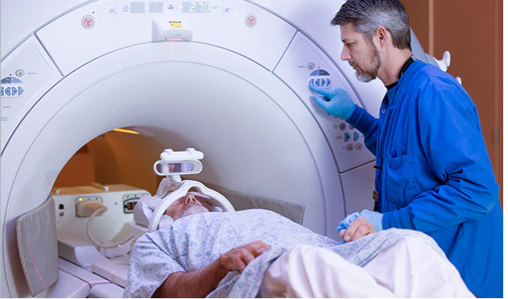
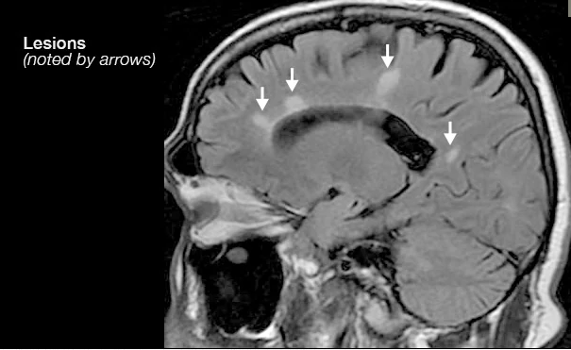
1.3 Diagnosis of Multiple sclerosis
Multiple sclerosis is typically diagnosed based on the presenting signs and symptoms, in combination with supporting medical imaging and laboratory testing [10]. It can be difficult to confirm, especially early on, since the signs and symptoms may be similar to those of other medical problems [6][7].
MRI which can reveal areas of MS (lesions) on your brain and spinal cord.

Slide 8
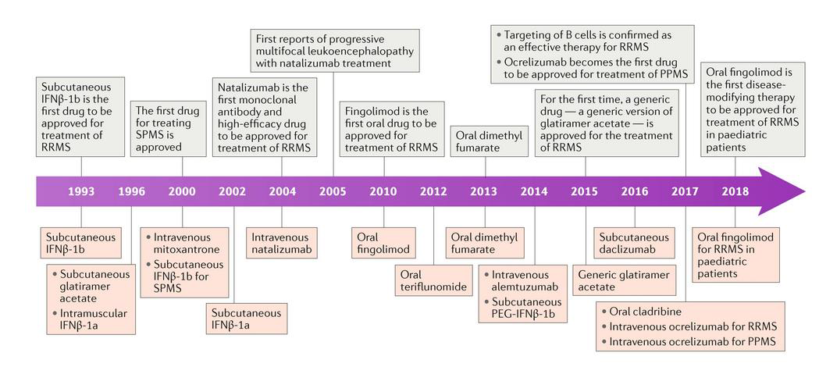
1.4 Treatment
There is no cure for multiple sclerosis. Treatment typically focuses on speeding recovery from attacks, slowing the progression of the disease and managing MS symptoms. Some people have such mild symptoms that no treatment is necessary. Figuer.2 shows the time line developments in the treatment of multiple sclerosis [8].

Slide 9
1.5 Biochemical Markers
1.5.1Vitamin D
Vitamin D is a group of fat-soluble secosteroids responsible for increasing intestinal absorption of calcium, magnesium, and phosphate, and many other biological effects. In humans, the most important compounds in this group are vitamin D3 (also known as cholecalciferol) and vitamin D2 (ergocalciferol) [9].
Low concentration of vitamin D in blood circulation seems to have a significant role on MS pathogenesis.
Vitamin D may be involved in myelination and remyelination at different levels.
Myelination is the process by which axons are wrapped in myelin. Remyelination of demyelinated lesions has been observed in the early stages of MS this is supported by neuroimaging findings [10].

Slide 10
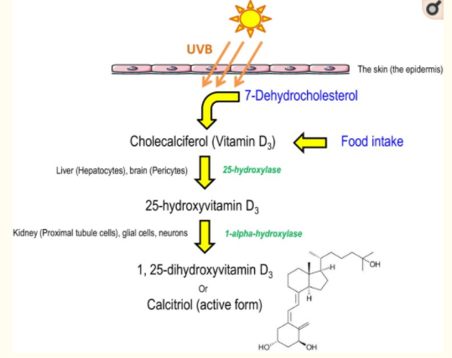
Figure: Schematic representation of calcitriol synthesis in humans. Cholecalciferol, from food intake or derived from 7-dehydrocholesterol after sun exposition, is converted to calcitriol, the active form, by two hydroxylation [11].

Slide 11
1.5.2 Vitamin D Receptor
The Vitamin D Receptor is a member of the nuclear receptor family of transcription factors, which is particularly expressed on macrophages, T cells, and B cells[12].
Vitamin D-VDR signaling regulates the expression of more than 900 genes involved in a wide array of physiological functions [19]. Therefore, VDR is considered a powerful modulator of pathophysiological mechanisms in several human diseases.
The effects of Vitamin D on the immune system are exerted by binding to the nuclear Vitamin D Receptor (VDR). Particular variants of the VDR gene are related to changes in vitamin D metabolism and function.
these results suggested that VDR may play an important role in the pathogenesis of MS [13].

Slide 12
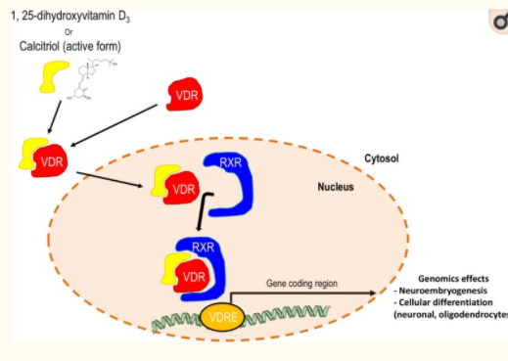
Figure: Schematic representation of the synergetic effects of calcitriol and the retinoid X receptor on the expression of genes with neuronal roles [11].

Slide 13
1.5.3 Cytochrome P450 Enzymes
1.5.3.1 CYP2D6 enzymes
Cytochromes P450 (CYPs) are a superfamily of enzymes containing heme as a cofactor that function as monooxygenases. In mammals, these proteins oxidize steroids, fatty acids, and xenobiotics, and are important for the clearance of various compounds, as well as for hormone synthesis and breakdown. In plants, these proteins are important for the biosynthesis of defensive compounds, fatty acids, and hormones.
Cytochrome P450 (CYP 450) is a hemeprotein that plays a key role in the metabolism of drugs .
The family of Cytochrome (CYP) P450 enzymes plays a key role in the metabolism of vitamin D [14].

Slide 14
Human CYPs are primarily membrane-associated proteins[19] located either in the inner membrane of mitochondria or in the endoplasmic reticulum of cells. CYPs metabolize thousands of endogenous and exogenous chemicals.
Cytochrome P450 enzymes are present in most tissues of the body, and play important roles in hormone synthesis and breakdown (including estrogen and testosterone synthesis and metabolism), cholesterol synthesis, and vitamin D metabolism. Cytochrome P450 enzymes also function to metabolize potentially toxic compounds [15].

Slide 15
CYP2D6 Cytochrome P450 2D6 (CYP2D6) is an enzyme that in humans is encoded by the CYP2D6 gene. CYP2D6 is primarily expressed in the liver. It is also highly expressed in areas of the central nervous system.
CYP2D6, a member of the cytochrome P450 mixed-function oxidase system, is one of the most important enzymes involved in the metabolism of xenobiotics in the body. In particular, CYP2D6 is responsible for the metabolism and elimination of approximately 25% of clinically used drugs, via the addition or removal of certain functional groups – specifically, hydroxylation.

Slide 16
1.5.4 Interferon beta (IFN-beta)
Interferons (IFNs) are a group of signaling proteins made and released by host cells in response to the presence of several viruses. a virus-infected cell will release interferons causing nearby cells to heighten their anti-viral defenses.
IFNs belong to the large class of proteins known as cytokines, molecules used for communication between cells to trigger the protective defenses of the immune system that help eradicate pathogens. Interferons are named for their ability to "interfere" with viral replication by protecting cells from virus infections.

Slide 17
Interferon beta is a cytokine in the interferon family used to treat multiple sclerosis (MS) . Interferon beta has not been shown to slow the advance of disability. Interferons are not a cure for MS (there is no known cure); the claim is that interferons may slow the progress of the disease if started early and continued for the duration of the disease [16].
Interferons were the first cytokines that were used for therapeutic purposes as natural forms or recombinant forms in humans. In recent years, the therapeutic effects of various interferons have been identified on the treatment of various diseases, including autoimmune diseases, MS, and their importance in well-established therapeutic programs.
Interferon beta (IFN-beta) is a commonly used disease modifying treatment for MS [17][18].

Slide 18
1.6 Gold Nanoparticles (GNPs)
Gold nanoparticles (GNPs), are one of the promising inorganic (NPs) that have attracted scientific and technological interests due to their ease of synthesis, chemical stability and excellent optical properties. These unique properties of GNPs, make them appealing tools for cancer diagnosis and treatment[19], drug delivery .
Most of invitro studies has indicated that these NPs are nontoxic for cells. Evaluation of GNPs cytotoxicity is essential because of broad spectrum application of GNPs in biomedical sciences [20].

Slide 19
1.7 Silver Nanoparticles (AgNPs
Silver Nanoparticles have been received the huge attention of the scientists due to their remarkable defense against various pathogenic microorganisms. The exceptional characteristics of Ag NPs have made them applicable in various fields like biomedical, drug delivery, water treatment, agricultural. It also has been achieved extensively in the drug delivery system for the treatments of cancer [21]

Slide 20
Synthesis of Nanoparticles
Physical method
Biological method
Chemical method
Top- down
Bottom-up

Slide 21
2. Aims of the Study
Nanotechnology has been considered as the impressive tool for treating neurological disease. This study aim to add a treatment suggestion to the MS diseases due to the limited therapeutic options available to many MS patients, through the following:
1. Synthesis of Ag and Au NPs, then characterization by applying different techniques including: XRD, SEM, TEM, AFM, UV-Visible and FTIR.
2. Determination the level of vitamin D, vitamin D receptor, CYP2D6 enzyme, and IFN-beta.
3. Estimate the association, if any, between the study parameters and MS disease to properly manage the treatment and diagnosis the disease in early stage.
4. Characterization after the binding of NPs with sera of MS patients.

Slide 22
3. Materials and Methods
3.1 Sample Collection
Five ml of blood will obtained from each patients and healthy person by vein puncture. A serum will be separated by the centrifuge at 1500xg and then serum will pooled in the sterile plastic tube and immediately stored at -20°C until use for use. Every sample will divide in to two aliquots. The first aliquot will be using for biochemical parameter determination and the other sample will be used nanotechnology parts on biochemical parameter and compare with control sample.
3.2 Inclusion Criteria: Male or female (negative pregnancy test) , 18 through 55 years of age inclusive and diagnosis of multiple sclerosis as defined by 2005 revised McDonald criteria.
3.3 Exclusion Criteria: immunodeficiency syndrome, history or presence of malignancy, a kn

Slide 23
3.4 Instruments
• ELISA Human Reader and washer
• Freezer (-20)
• Centrifuge
• Microscope
• UV-Visible Spectrophotometer
• X-ray Diffraction
• Scanning electron microscope (SEM)
• Transmission Electron microscope (TEM(
• FT-IR spectrophotometer
• Oven
• Magnetic stirrer
• Vortex Mixer
3.5 Materials
ELISA kit for detection of Multiple Sclerosis includes the following sera:-
o Vitamin D
o Vitamin D receptor
o CYP2D6 enzyme
o IFN-beta

Slide 24
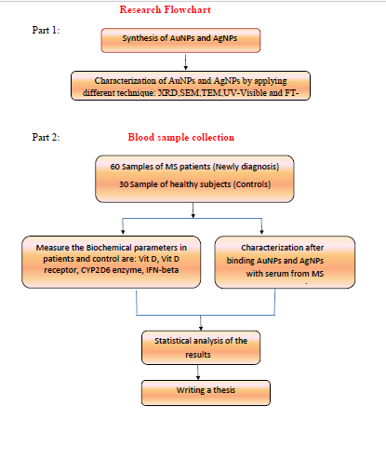

Slide 25
5. References
[1] J. Feige, T. Moser, L. Bieler, K. Schwenker, L. Hauer, and J. Sellner, “Vitamin D supplementation in multiple sclerosis: A critical analysis of potentials and threats,” Nutrients, vol. 12, no. 3, pp. 1–11, 2020, doi: 10.3390/nu12030783.
[2] R. Dobson and G. Giovannoni, “Multiple sclerosis – a review,” Eur. J. Neurol., vol. 26, no. 1, pp. 27–40, 2019, doi: 10.1111/ene.13819.
[3] C. O. Thompson AJ, Baranzini SE, Geurts J, Hemmer B, “Multiple sclerosis.,” vol. 391(10130), pp. 1622–1636, 2018.
[4] A. Khosravi, B. Javan, M. A. Tabatabaiefar, H. Ebadi, D. Fathi, and M. Shahbazi, “Association of interleukin-1 gene cluster polymorphisms and haplotypes with multiple sclerosis in an Iranian population,” J. Neuroimmunol., vol. 288, pp. 114–119, 2015.
[5] S. S. Balkhi and Z. Hojati, “The comparison between the mutated HuIFN-β 27-101 and the wild type interferon β: The comprehensive in silico study to evaluate the effect of mutations on IFN-β,” Adv. Pharm. Bull., vol. 9, no. 4, pp. 640–648, 2019, doi: 10.15171/apb.2019.074.
[6] M. T. Wallin et al., “The prevalence of MS in the United States: a population-based estimate using health claims data,” Neurology, vol. 92, no. 10, pp. e1029--e1040, 2019.
[7] G. Macaron and D. Ontaneda, “Diagnosis and Management of Progressive
Multiple Sclerosis,” Biomedicines, vol. 7, no. 3, p. 56, 2019, doi: 10.3390/biomedicines7030056.

Slide 26
[8] M. Tintore, A. Vidal-Jordana, and J. Sastre-Garriga, “Treatment of multiple sclerosis—success from bench to bedside,” Nat. Rev. Neurol., vol. 15, no. 1, pp. 53–58, 2019.
[9] J. Smolders, Ø. Torkildsen, W. Camu, and T. Holmøy, “An update on vitamin d and disease activity in Multiple sclerosis,” CNS Drugs, pp. 1–13, 2019.
[10] Matías-Guíu J, Oreja-Guevara C, Matias-Guiu JA, Gomez-Pinedo U. Vitamina D y remielinización en laesclerosis múltiple. Neurología. 2018;33:177—186.
[1] P. A. Faye et al., “Focus on 1,25-dihydroxyvitamin D3 in the peripheral nervous system,” Front. Neurosci., vol. 13, no. APR, pp. 1–16, 2019, doi: 10.3389/fnins.2019.00348.
[12] D. Saccone, F. Asani, and L. Bornman, “Regulation of the vitamin D receptor gene by environment, genetics and epigenetics,” Gene, vol. 561, no. 2, pp. 171–180, 2015.
[13] D. Imani, B. Razi, M. Motallebnezhad, and R. Rezaei, “Association between vitamin D receptor (VDR) polymorphisms and the risk of multiple sclerosis (MS): An updated meta-analysis,” BMC Neurol., vol. 19, no. 1, pp. 1–17, 2019, doi: 10.1186/s12883-019-1577-y.
[14] C. Taylor, I. Crosby, V. Yip, P. Maguire, M. Pirmohamed, and R. M. Turner, “A review of the important role of cyp2d6 in pharmacogenomics,” Genes (Basel)., vol. 11, no. 11, pp. 1–23, 2020, doi: 10.3390/genes11111295.

Slide 27
[15] I. S. Williams, L. Gatchie, S. B. Bharate, and B. Chaudhuri, “Biotransformation, Using Recombinant CYP450-Expressing Baker’s Yeast Cells, Identifies a Novel CYP2D6. 10A122V Variant Which Is a Superior Metabolizer of Codeine to Morphine Than the Wild-Type Enzyme,” ACS omega, vol. 3, no. 8, pp. 8903–8912, 2018.
[16] and A.-M. Y. Young Hee Choi, “乳鼠心肌提取 HHS Public Access,” Physiol. Behav., vol. 176, no. 3, pp. 139–148, 2019, doi: 10.1016/j.immuni.2019.03.025.Shared.
[17] S. January, “Elsevier has created a COVID-19 resource centre with free information in English and Mandarin on the novel coronavirus COVID-19,” COVID-19 Resour. Cent. is hosted Elsevier Connect. company’s public news Inf., 2020.
[18] M. Rosaria, E. Uleri, C. Caglioti, and A. Dolei, “Since January 2020 Elsevier has created a COVID-19 resource centre with free information in English and Mandarin on the novel coronavirus COVID- 19 . The COVID-19 resource centre is hosted on Elsevier Connect , the company ’ s public news and information ,” no. January, 2020.
[19] L. T. Curtis, C. G. England, M. Wu, J. Lowengrub, and H. B. Frieboes, “An interdisciplinary computational/experimental approach to Evaluate drug-loaded gold nanoparticle tumor cytotoxicity,” Nanomedicine, vol. 11, no. 3, pp. 197–216, 2016, doi: 10.2217/nnm.15.195.
[20] H. N. Verma, P. Singh, and R. M. Chavan, “Gold nanoparticle: Synthesis and
characterization,” Vet. World, vol. 7, no. 2, pp. 72–77, 2014, doi: 10.14202/vetworld.2014.72-77.

Slide 28
[21] K. S. Siddiqi, A. Husen, and R. A. K. Rao, “A review on biosynthesis of silver nanoparticles and their biocidal properties,” J. Nanobiotechnology, vol. 16, no. 1, 2018, doi: 10.1186/s12951-018-0334-5.

