Slide 1
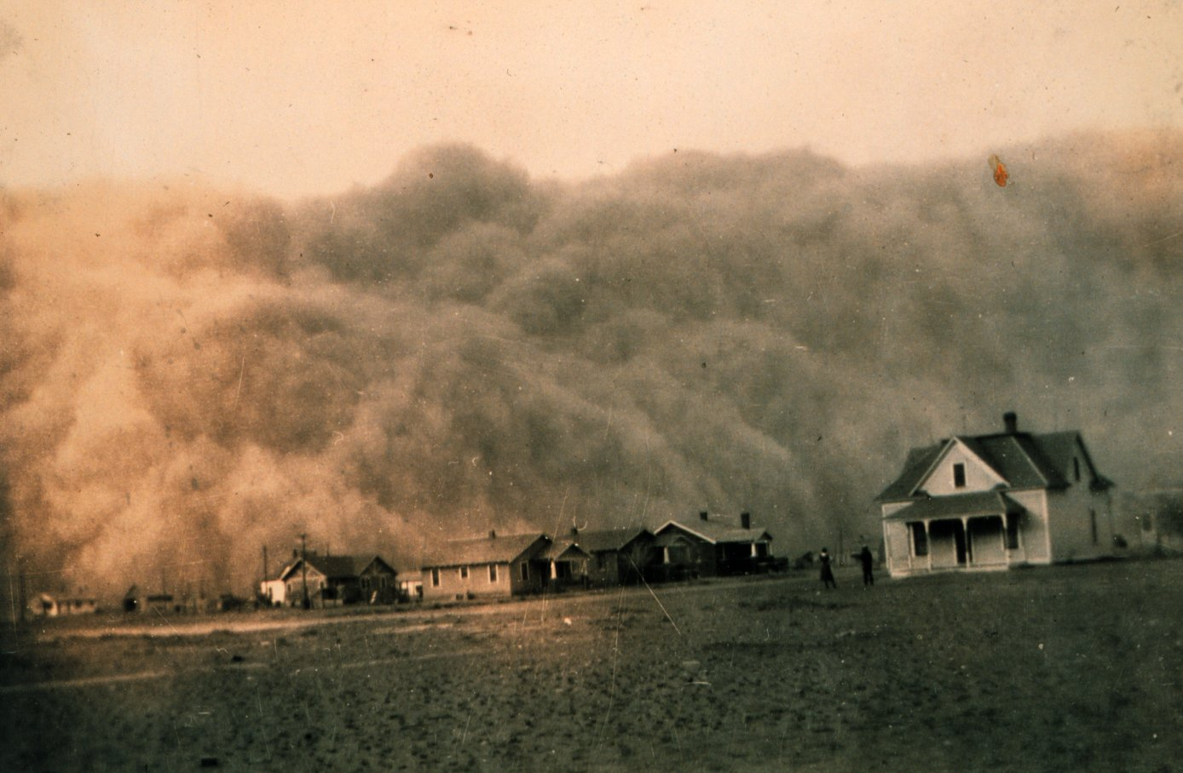
“The Dust storms”
Dr.Taghreed Ali
Atmospheric Science department
Collage of science
Al-Mustansiriyah University

Slide 2
What do you already know?
What is “The dust”?
What is the storm?

Slide 3


What is DUST?
Dust is earth , pollen or any other matter in finely powdered particles that can be blown in the air

Slide 4
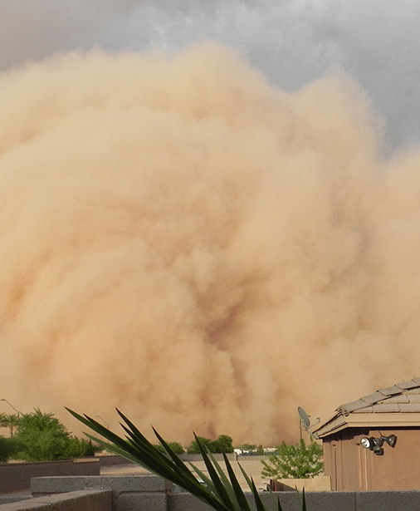
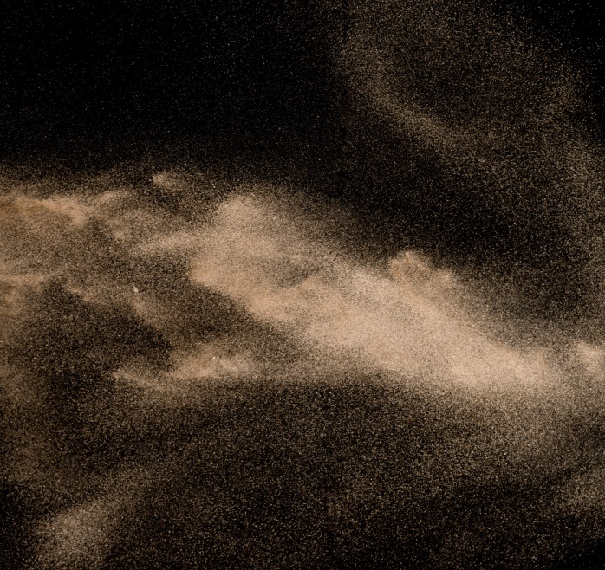
the dust storm
A dust storm is a meteorological phenomenon when dust is raised from the ground by strong winds.
Its common on the great plains of Arabia, North America, in the Gobi desert of Mangolia, the Taklamakan Desert of Northwest China, the Sahara desert of North Africa, and other arid and semi arid regions of the world.
PRESENTATION

Slide 5
The dust storm definition
Generally, “a dust storm is defined to be a windstorm that sweeps clouds of dust across
an extensive area.” or “A windstorm that lifts up clouds of dust or sand especially in an
arid region”.
For meteorological purposes, however, such
a windstorm can only be reported as a dust
storm if wind speed becomes 22 knots (40.7km) or more and surface visibility reduces to less
than one kilometer. For reporting of a dust
storm both of these conditions are to be
satisfied. If any one or both of the
conditions are not satisfied, than the
phenomenon may not be reported as a dust
storm. In that case, it may be reported as
blowing/drifting dust or sand / dust in
suspension and etc. depending upon the
prevailing weather conditions. Front of a
dust storm especially in case of a severe
storm may appear like a ‘wall of dust’

Slide 6
Factors
Temperature
Soil
Wind

Slide 7
The cause of formation
The weather situations in favor of forming strong wind or severe wind, the source
distribution of sand & dust and air unsteadiness condition are the major reasons of
forming dust storms or strong dust storms. Severe wind is the dynamical force of a dust
storm, while the source of sand and dust is the substance foundation of a dust storm.
Unsteady thermal conditions benefit to enhance wind power level and advance the
convection developing, which carry more dust and sand and blow them higher.

Slide 9
Effect of the dust storm
Reduce visibility
Erosion
Climate change
Soil Composition
Health:
Allergies
Intoxication
Dry skin
Breathing problems

Slide 10
What to do in case of dust storm
01
Stay indoors
Cover mouth and nose
02
03
If driving reduce speed or pull over
Lock all open areas in the house
04

Slide 11
What can we do?
Here a few of the steps we can do to stop the dust storms :
Plant some trees
Invest in the deserts
check your air conditioner
build more buildings

Slide 12
THANK YOU
Any Questions?

