Slide 1


Slide 2


جمع وتصبير الحشرات بأستخدام أهم الوسائل المعتمدة عالميا في المتاحف
Methods of Collecting and preservation insects by using the most important methods approved in museums
Presented by
أ.د معن عبد العزيز ا.م .د نسرين نوري م. زيد ناجي

Slide 3
Locating Insects
•on plants (leaves, flowers, bark)
•in decaying matter
•under rocks, leaf litter
•in homes, garages, sheds
•in food or clothing
•in/on water
•on animals

Slide 4
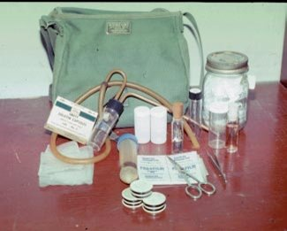
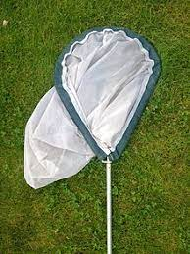
Goals of sample collection
As a hobby.
Measure biodiversity.
Detect changes in water quality.
Acquire material for biological, physiological, ecological and molecular studies.
Because of the incredible diversity of insects, we must select an appropriate tool and an appropriate way for collection.

Slide 5
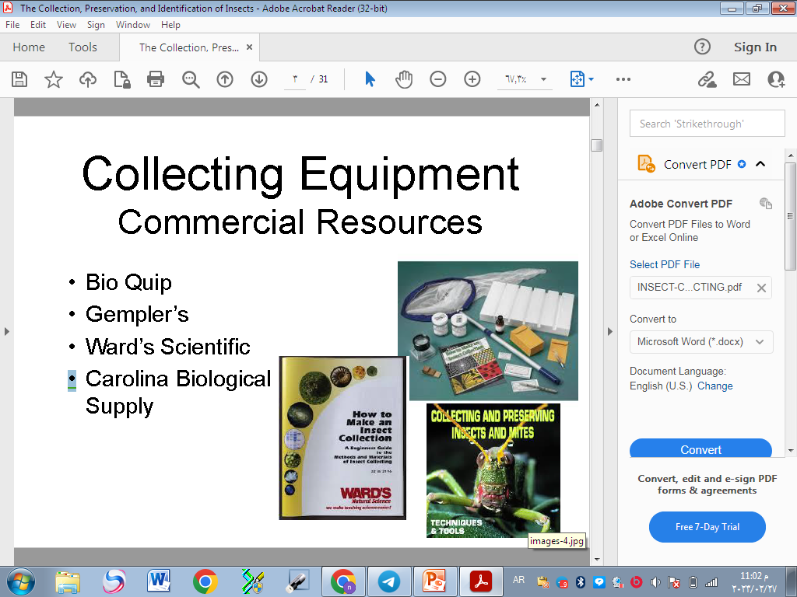
Equipment and Collecting Methods
  Equipment or appropriate tool
  Forceps, Vials containing alcohol or other preservatives
  Killing jars, Small boxes for storing specimens after their removal from killing jars.
  aspirators.
  Notebook
  A strong knife, hand lens
  A small, fine brush for picking up minute specimens.

Slide 6
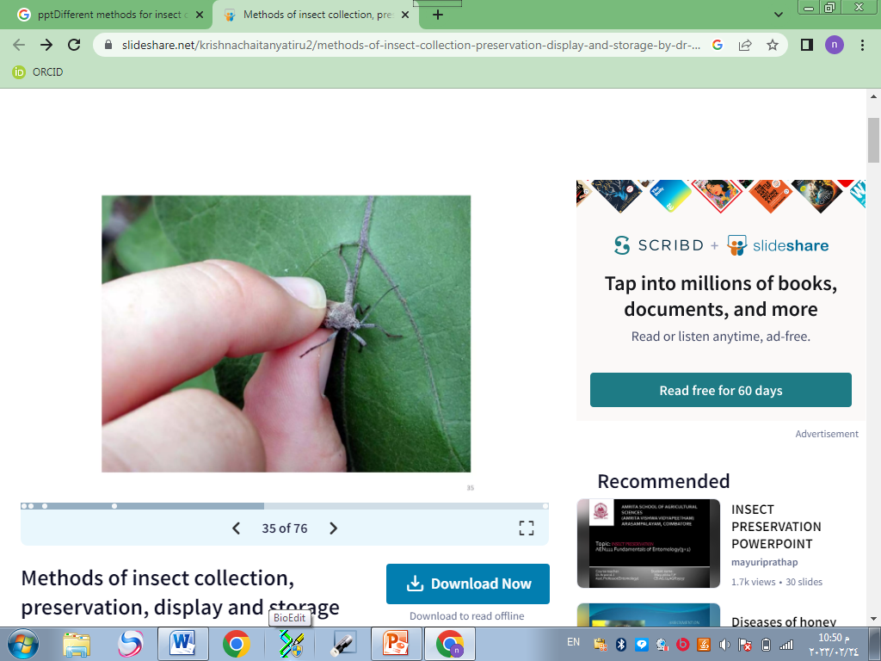
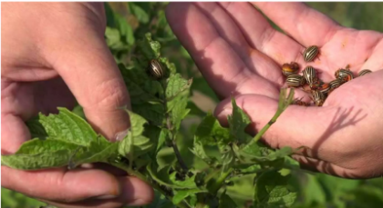
Method or appropriate way:
1-picking up insects by hand
This method is simple and sometimes effective, with large terrestrial insects, Such as cockroaches where they are picked by hand and put it in a bottle.

Slide 7
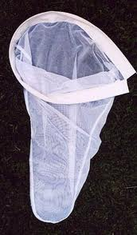
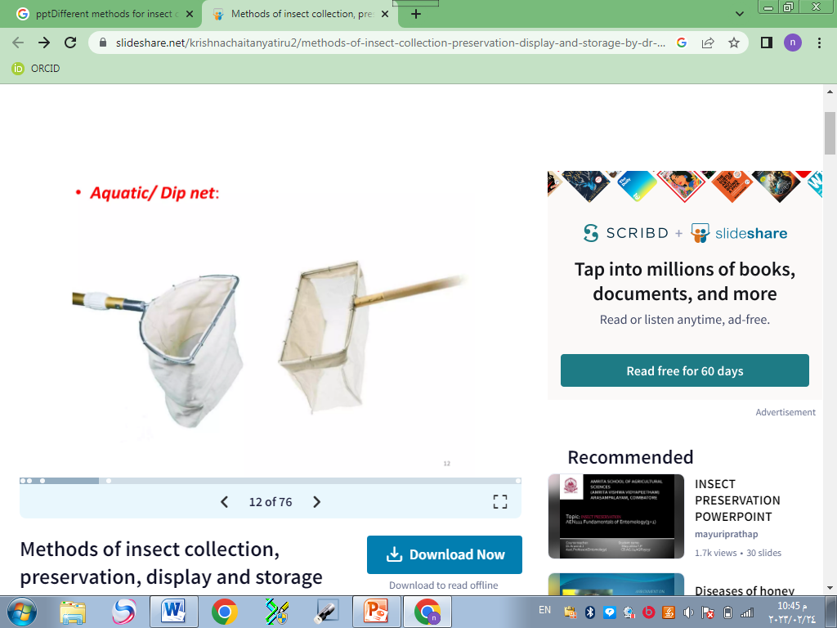
2-Collecting Nets
Collecting nets come in three basic forms:
Aerial nets
is designed especially for collecting
butterflies and other flying insects. Both the bag and handle are relatively lightweight
Aquatic nets
are used for gathering insects from
water.

Slide 8
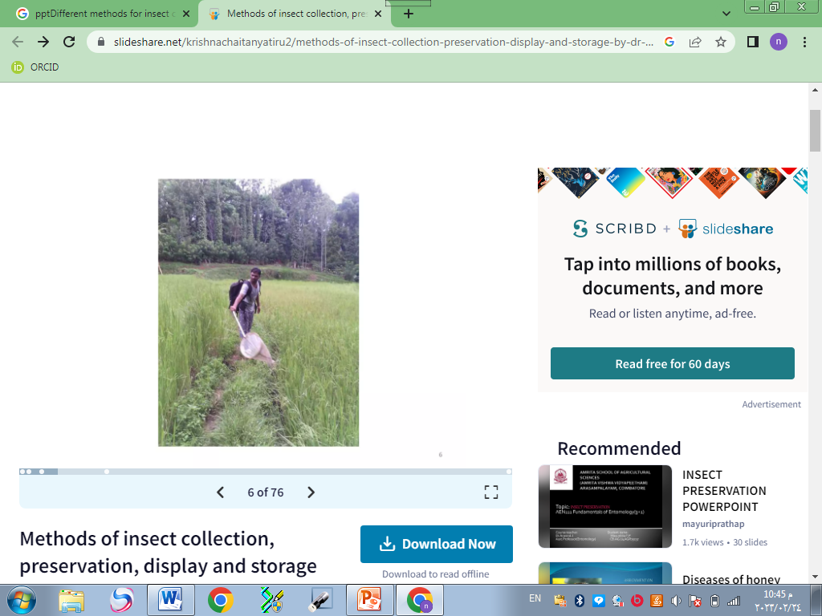
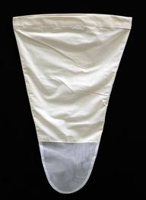
Sweeping Nets:
Made of thick fabric used in the compilation of most types of insects on crops such as wheat and clover ring, potatoes, herbs and grasses.

Slide 9
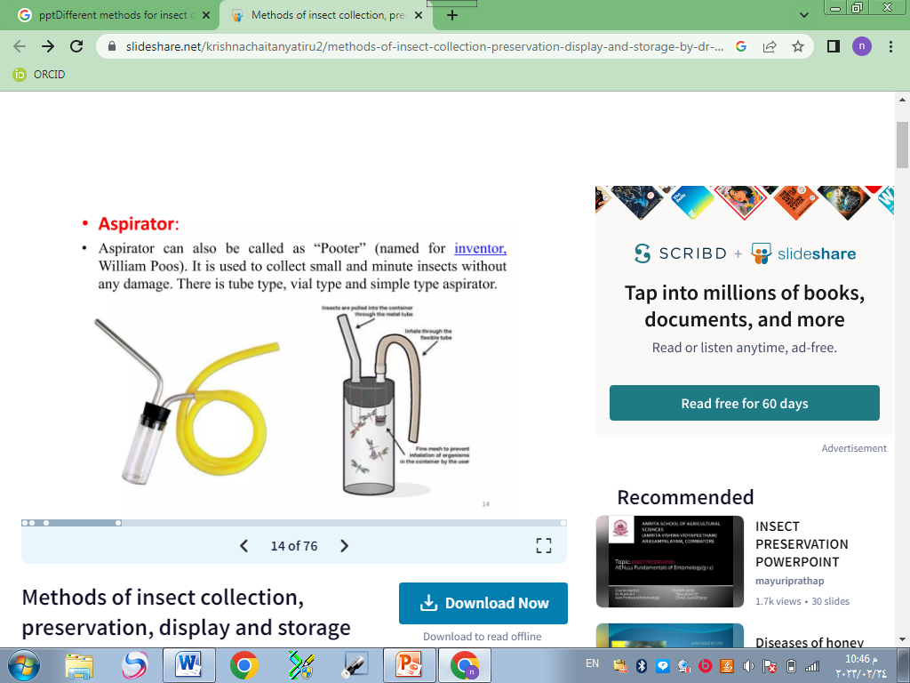
3- aspirator
is effective device for collecting small insects. The following materials are

Slide 10
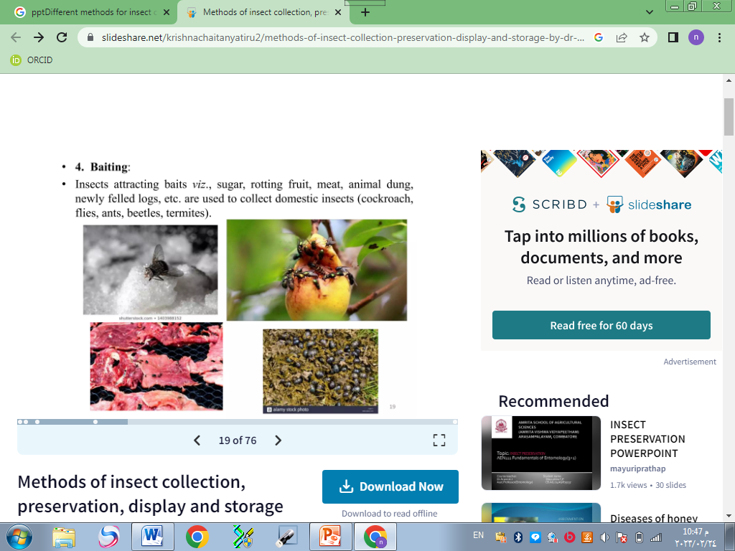
4- Traps
A- Baiting traps

Slide 11
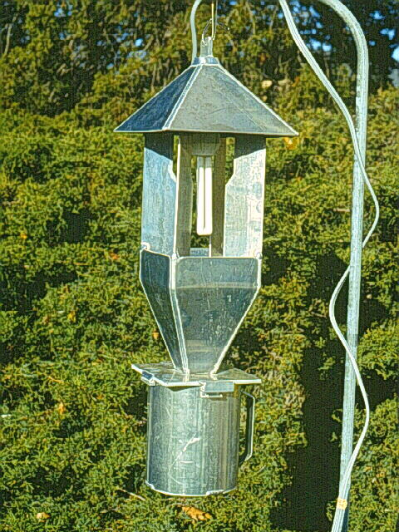
B- light traps
With light traps, advantage is taken of the attraction of many insects to a light source which increasingly active at night

Slide 12
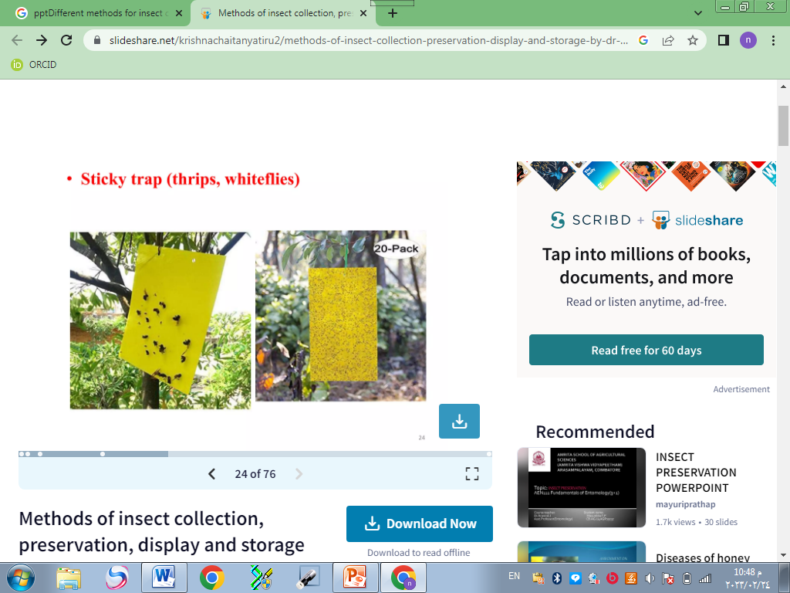
C- Sticky traps
using in the collection of insects active at night and day, a sheet coated with an adhesive, and placed on the pillar to the desired height then, stud and identify the insects stuck

Slide 13
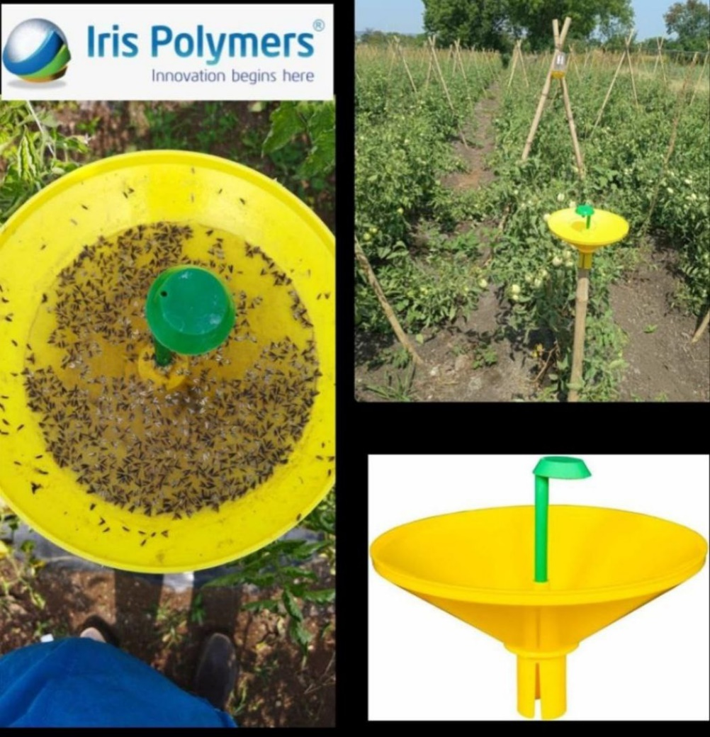
D- Water traps
using to collect many kinds of insects such as flies, which is a time painted from the inside in yellow or white to attract insects to it.

Slide 14
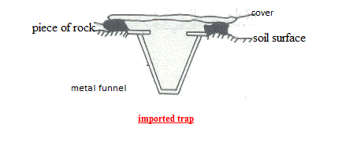
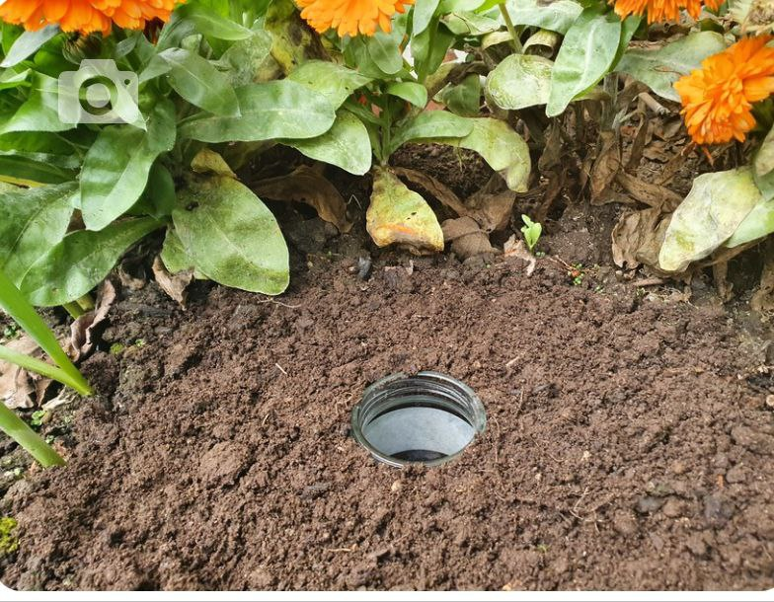
E- Pitfall Traps
This method is used in the compilation of terrestrial insects such as ants beetles. This traps are composed of glass container or plastics with a wide mouth jar and drown in a hole under the surface of the soil

Slide 15
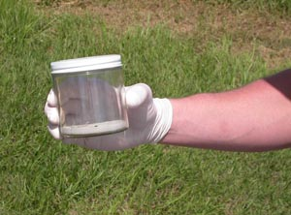
killing insect
After collecting living insects, put in jars.
These bottles have different sizes and tight lid, chemicals are added to kill insects.
The most important chemicals used to kill insects chloroform and ethyl acetate.

Slide 16
Preservation insect
Dry preservation:
used with insect have a hard outer cover to dry in good condition. Then kept Samples in special boxes made ​​of wood with tightly closed.
labeled.
Avoid placing specimens collected at different times or places in the same container The process of pinning the insect immediately after killing and before the dry stick a pin vertically in the thorax, so that leaves about 4 / 1 pin along the top body

Slide 17
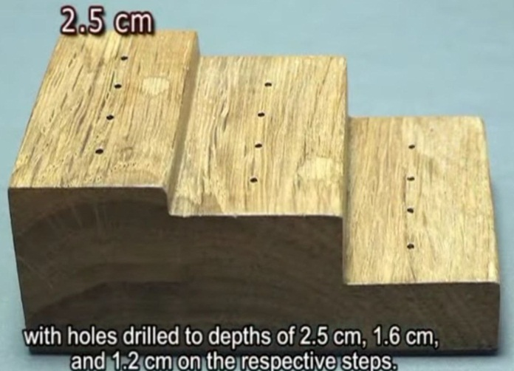
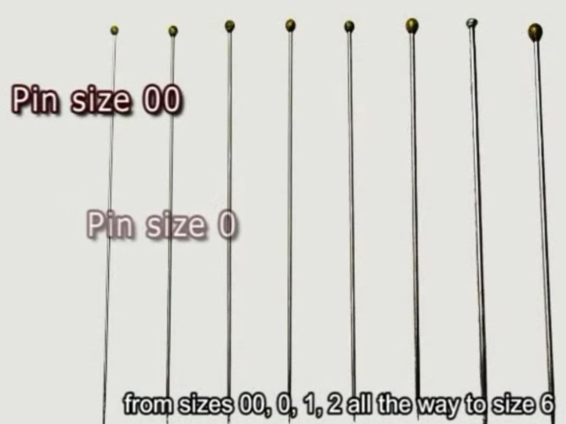
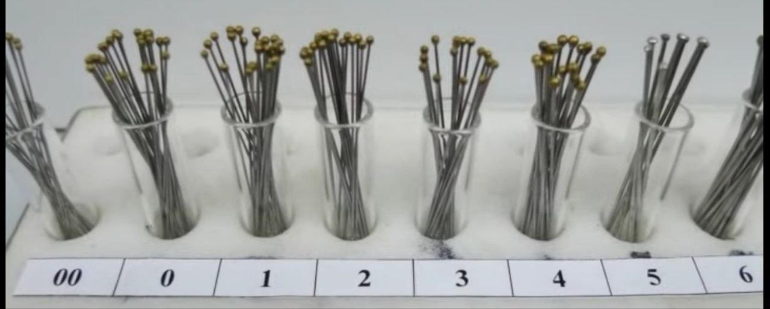
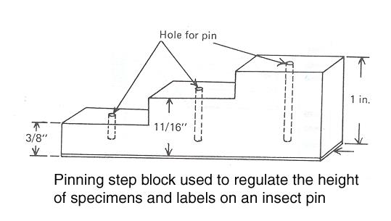
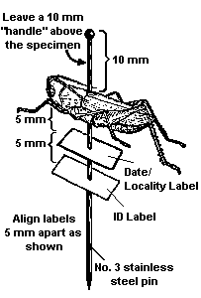
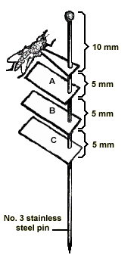

Slide 18
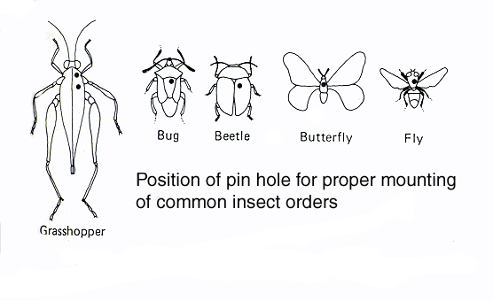
Insect Pin Positioning

Slide 19
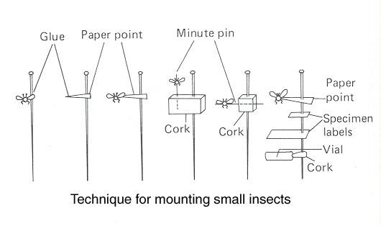

Slide 20
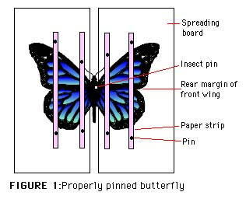

Slide 21
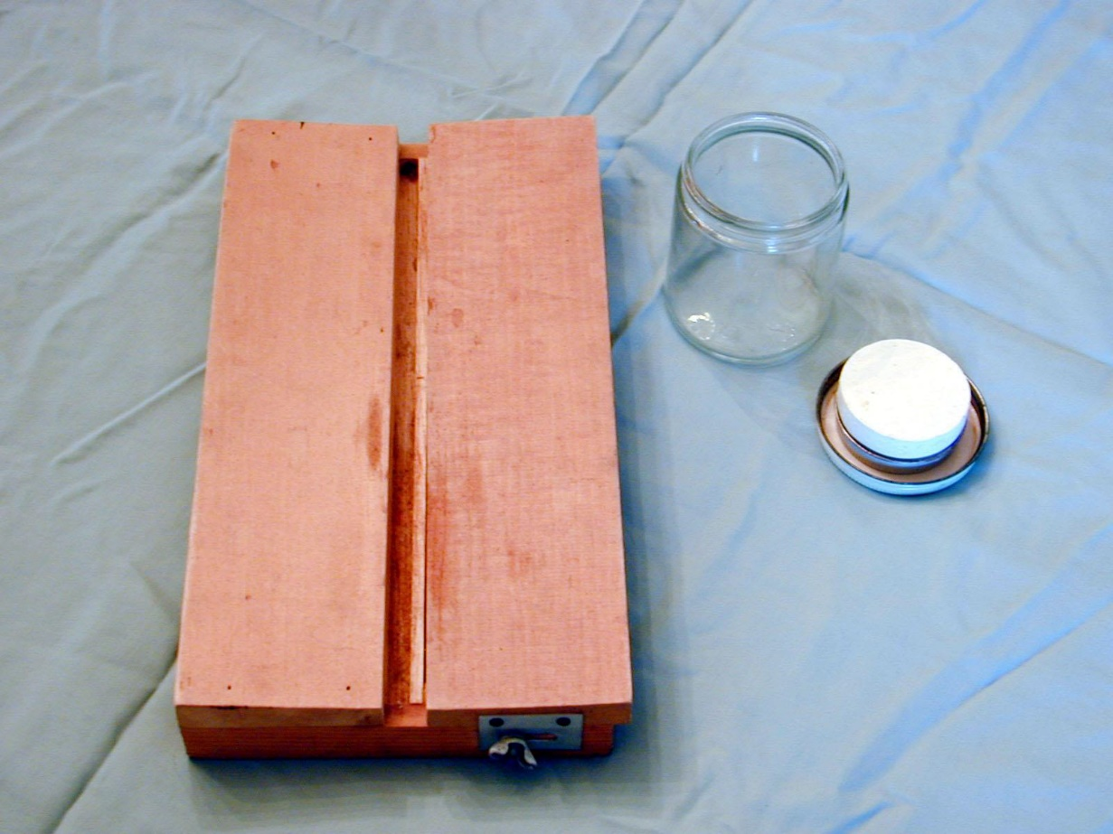
Wing Spreading Board

Slide 22
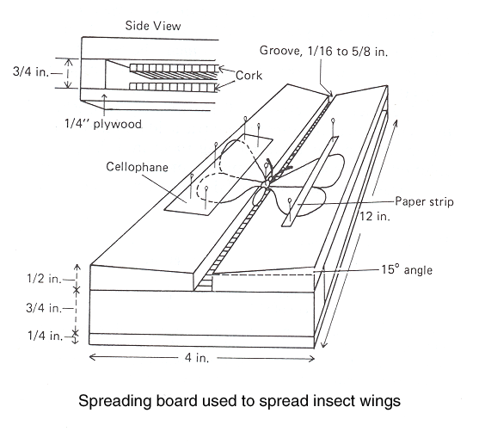

Slide 23
A Good Specimen Needs Data
Upper label: Gives collection location of specimen
•State and County
•Nearest town, road or other easily identifiable feature (GPS if available)
•Date collected (5 Dec.1980 or XII-5-1980)
•Collector’s name
(An additional label may note how the specimen was collected (i.e.in, on, under), host data)
Lower label: Scientific name

Slide 24
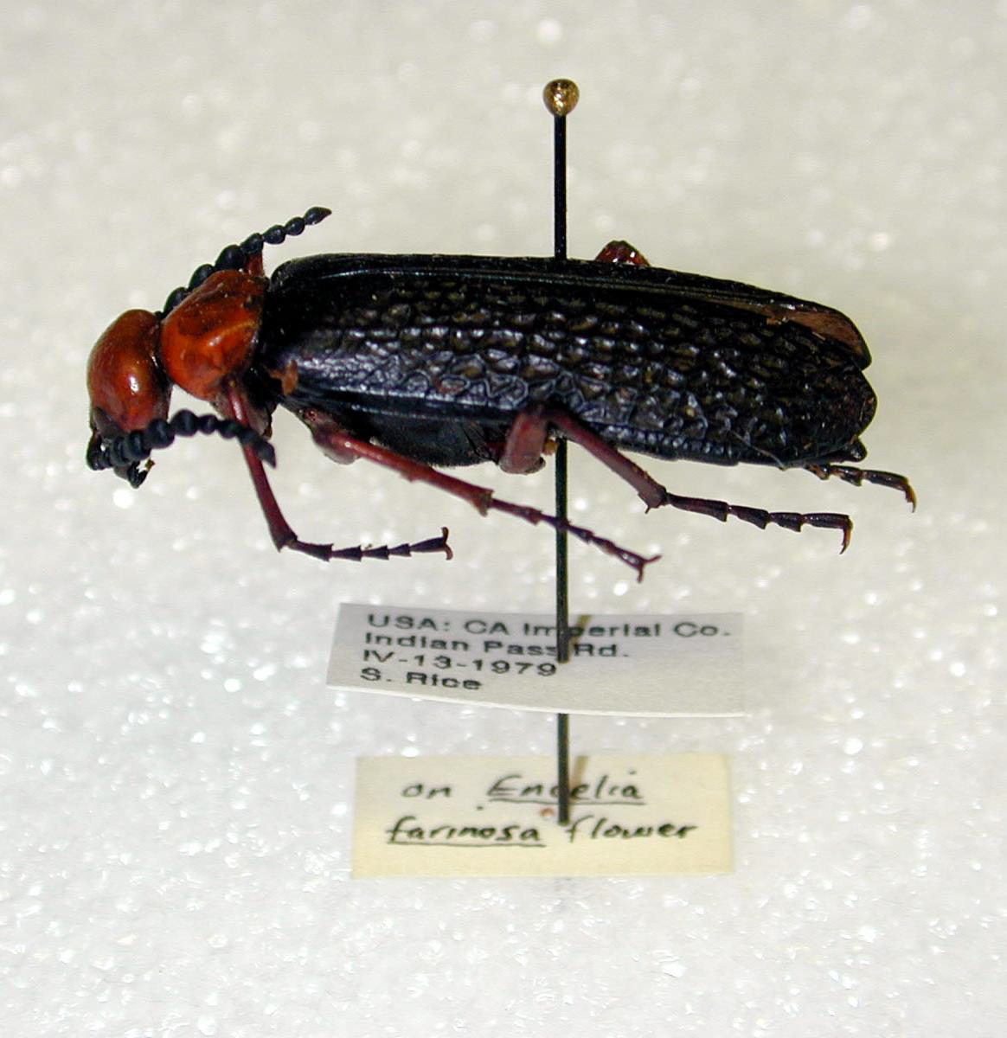

Slide 25
Packaging Insects for Shipment
•Send samples frozen, chilled, or stored in alcohol (postal regulations are significant for items shipped in flammable fluids)
•Special packaging for dried/pinned specimens
•Send specimens of various life stages

Slide 26
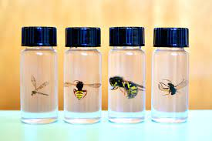
Liquid Preservation
used to save the insects that are difficult to maintain dry, or the insect collected by light traps in large numbers.

Slide 27
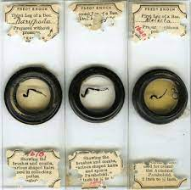
Save by microscopic slides
used in the maintenance of very small insects which are placed in a liquid then carry on slides Such as fleas, aphid
Most species have soft bodies
save some parts of the body such as insect legs, antennae, wings and mouth parts

Slide 28
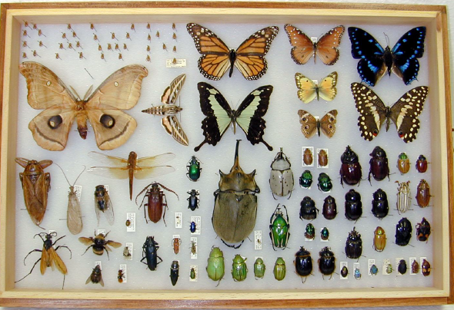

Slide 29
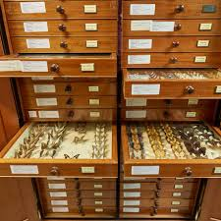

Slide 30
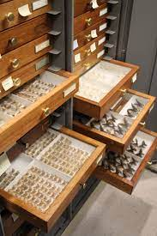
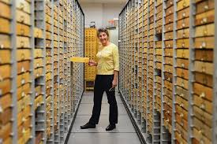

Slide 31


