Slide 1
Thyroid gland and disorders
By
Aisha Abd Al-Fatah Essa

Slide 2
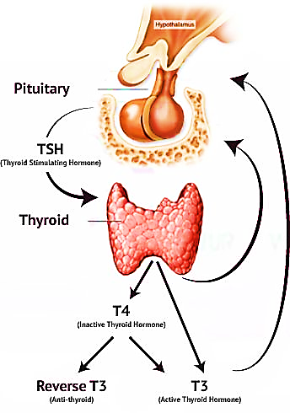
Thyroid gland is one of the largest organs in the body .
formed from a midline anlage in the pharyngeal floor consisting of foregut endoderm cells that are committed to a thyroid fate (Rousset et al., 2015).

Slide 3
The thyroid gland is a butterfly-shaped organ and is composed of two cone-like lobes or wings, lobus dexter (right lobe) and lobus sinister (left lobe), connected via the isthmus (Yalçin and Ozan, 2006).
Thyroid gland is encircled by fibrous sheath. It is consists of follicles lined by cuboidal epithelial cells.

Slide 4
These cells are enclosed by a jelly- like iodine- containing material named colloid which involves the stores of thyroid hormones (Sandra, 2001).
The function of thyroid glands is production of thyroid hormones known as triiodothyronine (T3) and thyroxin (T4) (Irizarry, 2014).
The body metabolism, blood pressure, heart
rate, and temperature of the body are controlled by thyroid hormones (Huether, 2007).

Slide 5
Thyroid stimulating hormone (TSH) is encouraged release and production of thyroid hormones. Thyroid hormones are important for the regulation of membrane transport, cellular metabolism, and normal development of tissues cell structure (Cheng et al., 2010).
Thyroid gland is essential for normal growth and maturation of skeletal system (Mariani and Berens, 2012). Other functions of thyroid gland are differentiation, control of oxygen consumption and the basal metabolic rate (BMR) in the body (Mader, 2004).

Slide 6
Thyroid gland is essential for normal growth and maturation of skeletal system (Mariani and Berens, 2012). Other functions of thyroid gland are differentiation, control of oxygen consumption and the basal metabolic rate (BMR) in the body (Mader, 2004).
Imbalance in production of thyroid hormones start from disorder of the thyroid gland itself, the hypothalamus, which normalize the pituitary gland by TRH or the pituitary gland, which produced TSH (Surks,2004).

Slide 7
Thyroxin is the major form of thyroid hormone in the blood which has a longer half-life than T3. The percentage of T4 to T3 released into the blood is approximately 2 to 1. T4 is converted to the active T3 (three to four times more potent than T4) within cells by deiodinases (Roshni et al., 2013). The T3 is more biologically active than T4 due to its higher affinity to thyroid receptor (Castanho and Poian, 2015).

Slide 8
The major regulator of thyroid hormone is TRH (Fox, 2004). Also, release and production of thyroid hormones is stimulated by TSH. Thyroid hormones reduce the synthesis of TSH maintaining an enough quantity of T4 and T3. Secretion of TSH is controlled by negative feedback of T4 and T3 on the hypothalamus and pituitary (Guyton and Hall, 2006).

Slide 9
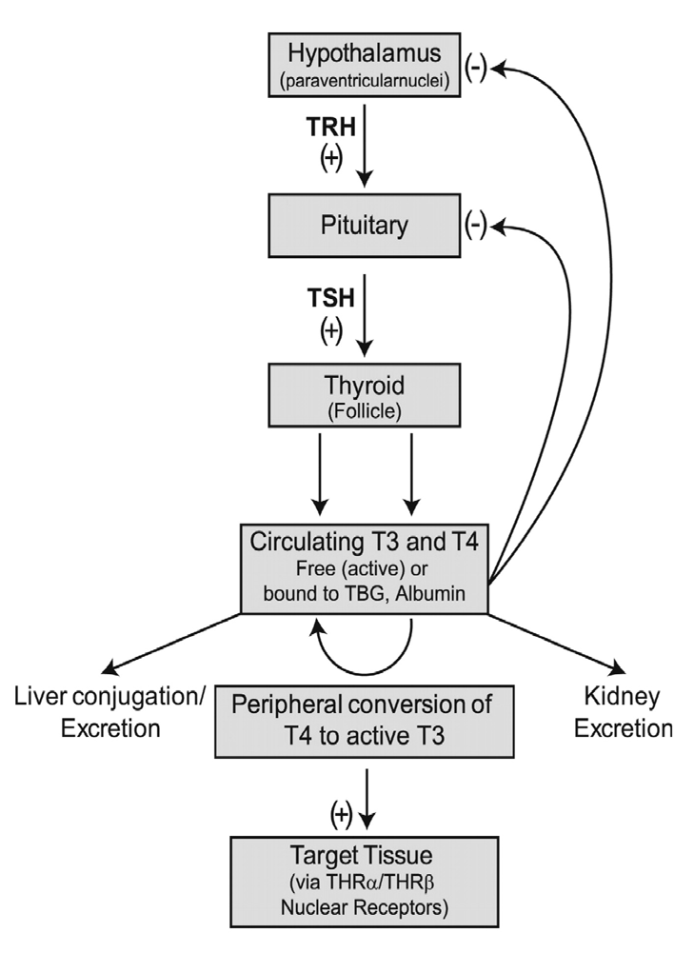
Figure (1-3): The mechanism of negative feedback loop of circulating
thyroid hormone concentrations (Kansagra and Willis, 2010).

Slide 10
Imbalance in production of thyroid hormones start from disorder of the thyroid gland itself, the hypothalamus, which normalize the pituitary gland by TRH or the pituitary gland, which produced TSH (Surks,2004).

Slide 11
Thyroid disorders
Hyperthyroidism which is the situation that occurs due to extreme production of thyroid hormones by the thyroid gland.
Hypothyroidism is a condition resulting from deficiency in thyroid hormones discharge and action.

Slide 12
Thank you

