Slide 1
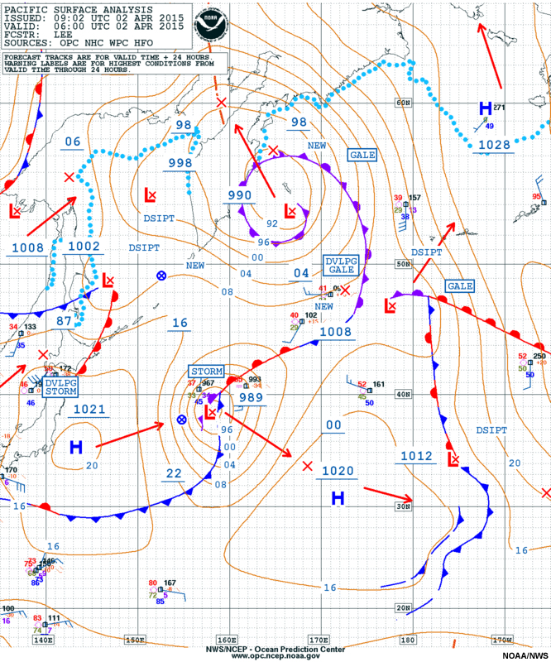
The Course of Synoptic Meteorology
Lecture 5
AL-MUSTANSIRIYAH UNIVERSITY
COLLEGE OF SCIENCES
ATMOSPHERIC SCIENCES DEPARTMENT
2024-2025
Dr. hussain abodi
SECOND STAGE

Slide 2
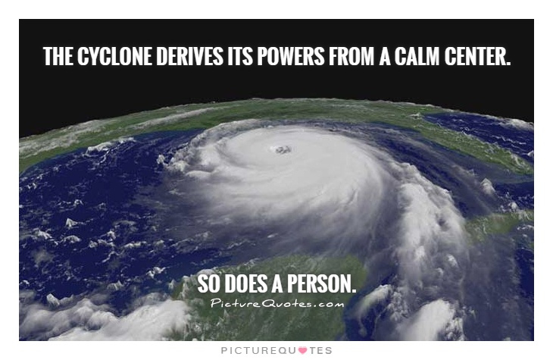
Welcome Students In The Sixth Lecture ☺

Slide 3
Polar Front Theory
Developed by Norwegian scientists (Bjerknes, Solberg, Bergeron)
Published shortly after WW I
Polar front theory of a developing wave cyclone
Working model of how a mid-latitude cyclone progresses through stages of birth, growth, decay.
Today the work has been modified to serve as a convenient way to describe the structure and weather associated with migratory storm systems.

Slide 4
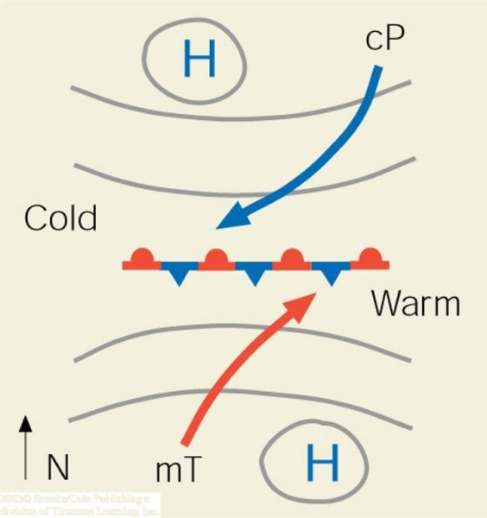
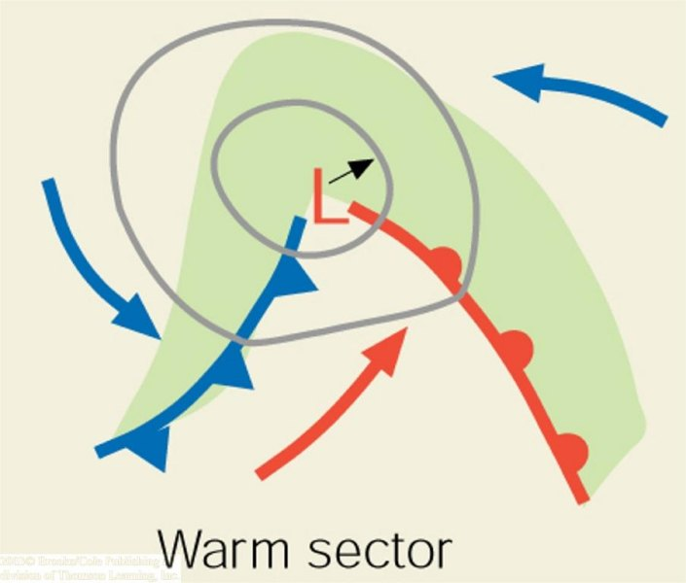
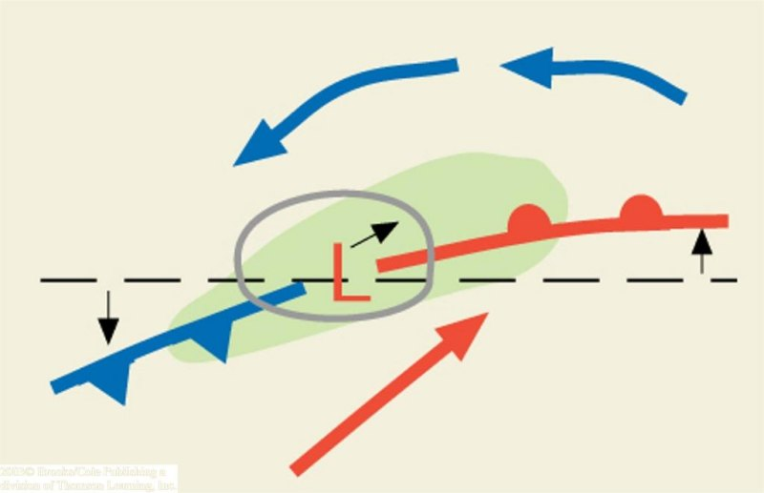
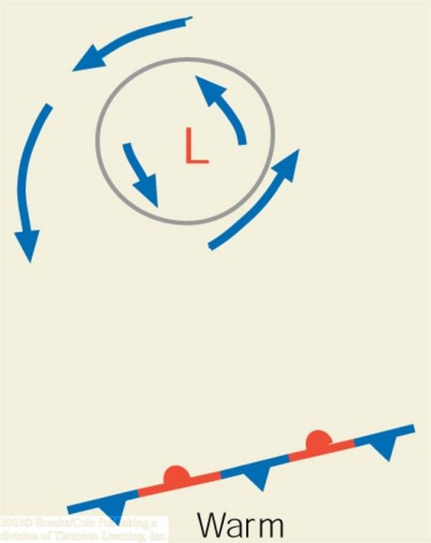
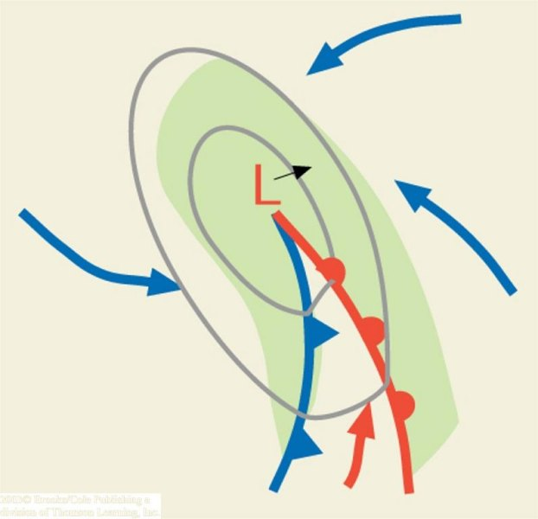
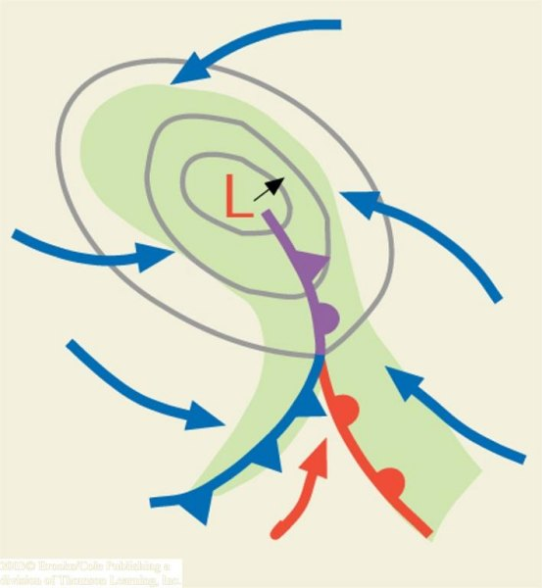
(a)
(b)
(c)
(d)
(e)
(f)

Slide 5
Step One
HINT: if you place a pen between the palms of your hands and move your left hand toward your body; the pen turns counterclockwise, cyclonically.
A segment of the polar front as a stationary front. (Trough of low pressure with higher pressure on both sides. Cold air to the North, warm air to the south. Parallel flow along the front. This type of flow sets up a cyclonic wind shear.
Wind shear is a change in wind speed and/or direction over a short distance (either horizontally or vertically) and is most often associated with strong temperature inversions or density gradients. Wind shear can occur at high or low altitude. For low latitude, the low-level wind shear occur when the temperature difference across the front at the surface is (5ºC) or more, and the front is moving at a speed of at least 30 knots

Slide 6
Step Two
Under the right conditions a wavelike kink (turn) forms on the front. The wave that forms is known as a frontal wave. Wave cyclone – an extratropical cyclone that forms and moves along a front. The circulation of winds about the cyclone tends to produce a wavelike deformation on the front

Slide 7
Step Three
Steered by the winds aloft, the system typically moves east or northeastward and gradually becomes a fully developed open wave in 12 to 24 hours. Open wave – the stage of development of a wave cyclone where a cold front and a warm front exist, but no occluded front. The center of lowest pressure in the wave is located at the junction of two fronts.

Slide 8
Step Four
Central pressure is now lower, several isobars encircle the wave. The more tightly packed isobars create a stronger cyclonic flow, winds swirl counterclock-wise and inward toward the low’s center. Energy for the storm is derived rising warm air and sinking cold air transforming potential energy to kinetic energy (energy of motion). Condensation supplies energy in the form of latent heat. Converging surface winds produce an increase of kinetic energy. The cold front advances on the warm front…

Slide 9
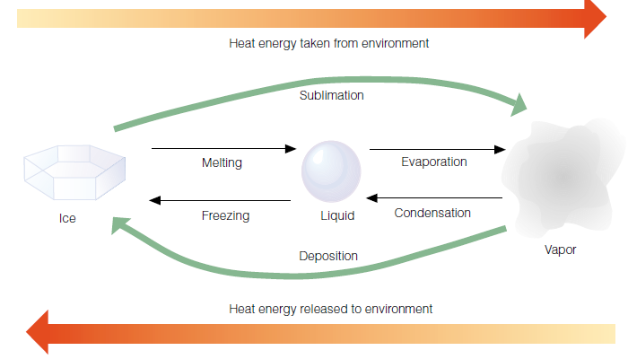

Slide 10
Step Five
As the open wave moves eastward, central pressures continue to decrease, and the winds blow more vigorously. The faster-moving cold front constantly inches closer to the warm front, squeezing the warm sector into a smaller area. Eventually the cold front overtakes the warm front and the system becomes occluded. The storm is usually most intense at this time, with clouds and precipetation covering a large area.

Slide 11
Step Six
The intense storm from step five gradually dissipates, because cold air now lies on both sides of the cyclone. Without the supply of energy provided by the rising warm, moist air, the old storm system dies out and gradually disappears. Occasionally, however a new wave will form on the westward end of the trailing cold front.
The entire life cycle of a wave cyclone can last from a few days to over a week.

Slide 12
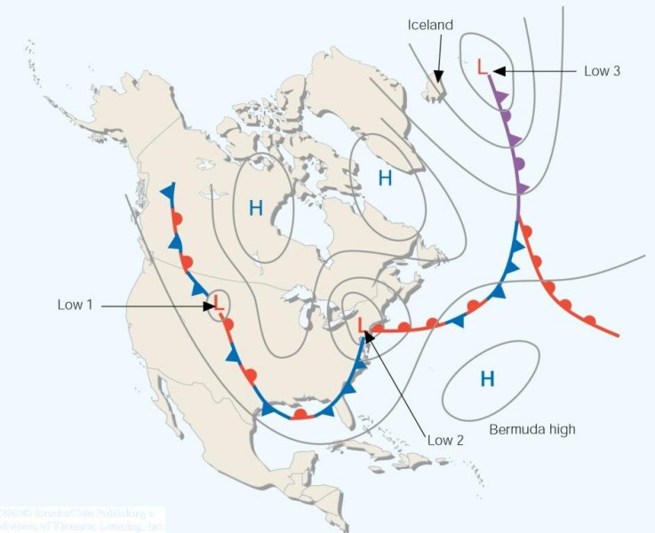
A series of wave cyclones (a "family" of cyclones) forming along
the polar front

Slide 13
Developing Mid-Latitude Cyclones and Anticyclones
Mid-latitude cyclones are "deep" pressure systems extending from the surface to tropopause level
Developing surface storm systems are deep lows that usually intensify with height. Therefore, a surface low pressure area will appear on an upper level chart as either a closed low or a trough.

Slide 14
