Slide 1
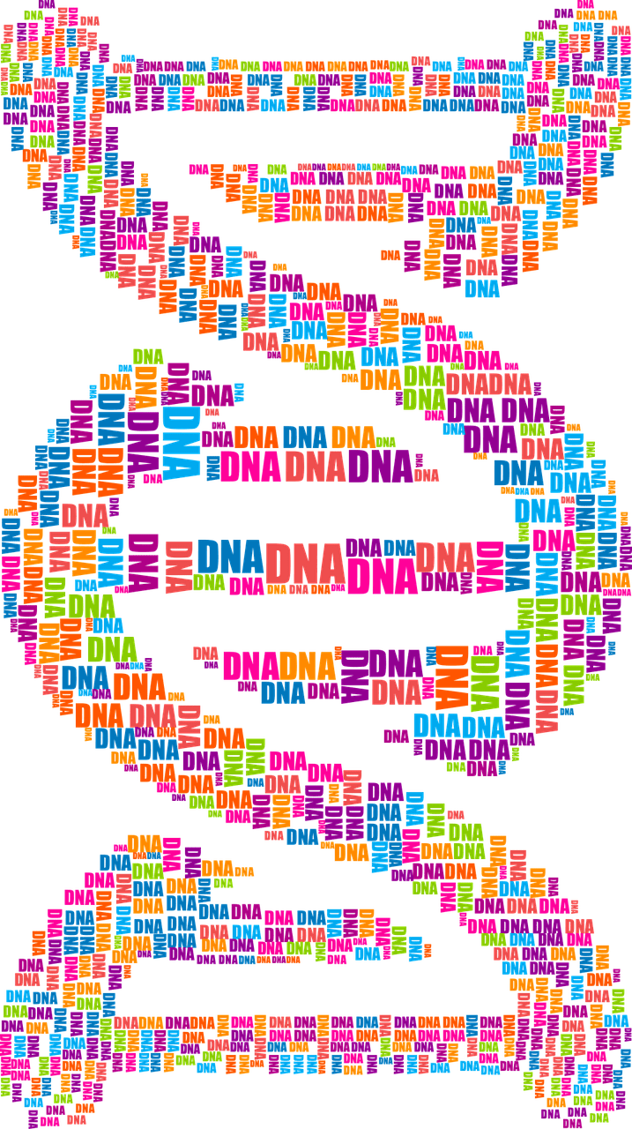
Molecular Biology
Lecture 2
DNA & RNA
Basic structure and roles

Slide 2
Types of Extrachromosomal DNA
The Nucleic Acids (DNA & RNA):
DNA (Deoxyribonucleic acid) is the most important molecule in living cells and contains all the information that the cell need to live and to propagate itself, with RNA (Ribonucleic acid), they maintain the cell through gene expression.
Nearly all of the DNA present in eukaryotic cells can be found in the cell nucleus (chromosomes), but also there are other amounts are present out of chromosomes, while in the prokaryotic cells (such as bacteria), DNA is found in cytoplasm.
1
Plasmid DNA
2
Chloroplast DNA
3
Mitochondrial DNA

Slide 3
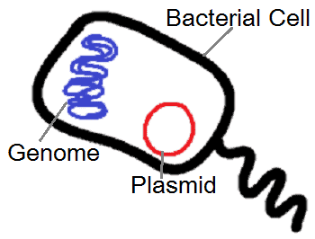
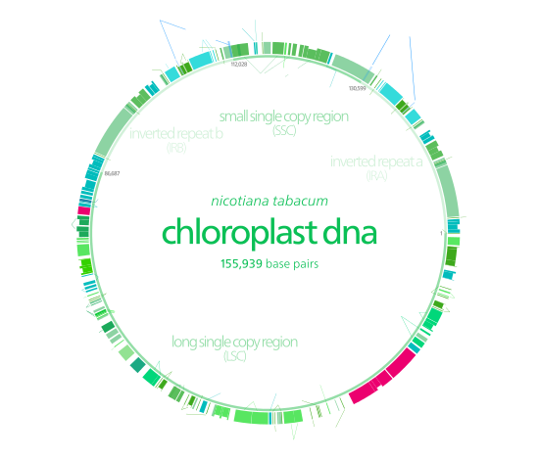
1: Plasmid DNA.
It is a double stranded super helix DNA (extra chromosomal genetic material) usually found in bacterial cytoplasm. Plasmid are not confined to bacteria but they have been isolated from yeast, protozoa and plants
2: Chloroplast DNA.
Chloroplasts are organelles that conduct photosynthesis, where the photosynthetic pigment chlorophyll captures the energy from sunlight, converts it, and stores it in the energy-storage molecules ATP and NADPH while freeing oxygen from water in plant and algal cells.
Chloroplast DNA is present inside chloroplast responsible for its activity.

Slide 4
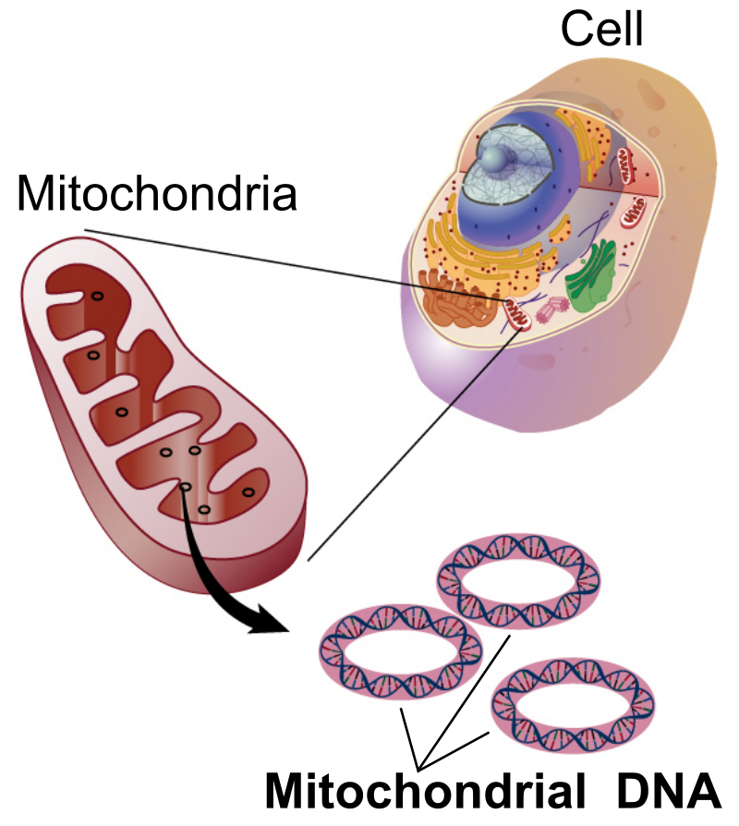
3: Mitochondrial DNA (myDNA or mDNA).
It is the DNA located in organelles called mitochondria, which found in eukaryotic cells and acts in convert chemical energy from food into a form that cells can use which is adenosine triphosphate (ATP).
In humans, mitochondrial DNA can be assessed as the smallest chromosome coding for only 37 genes and containing only about 16,600 base pairs. Human mitochondrial DNA was the first significant part of the human genome to be sequenced.

Slide 5
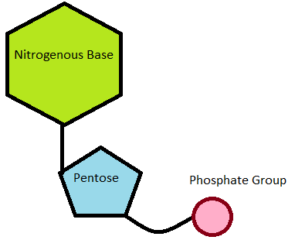
Basic Structure of Nucleic Acids.
A Nucleic Acid is a polymer consisting of nucleotides (the main structural units in nucleic acid) each nucleotide has the 3 following components:
The Nucleotide
1
pentose
(five carbon sugar)
2
Nitrogen base
Purines or Pyrimidines
3
Phosphate group

Slide 6
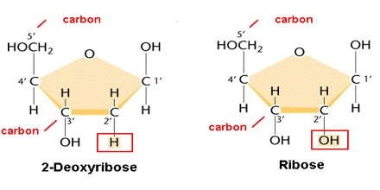
1
Pentose (five carbon sugar)
Both ribose and deoxyribose sugar are essential components of nucleotides, and are found in both RNA and DNA, respectively. The sugars found in nucleic acids are pentose sugars (has five carbon atoms).
Ribose, found in RNA, is a "normal" sugar, with one oxygen atom attached to each carbon atom, while Deoxyribose, found in DNA, is a modified sugar, lacking one oxygen atom (hence the name "deoxy").

Slide 7
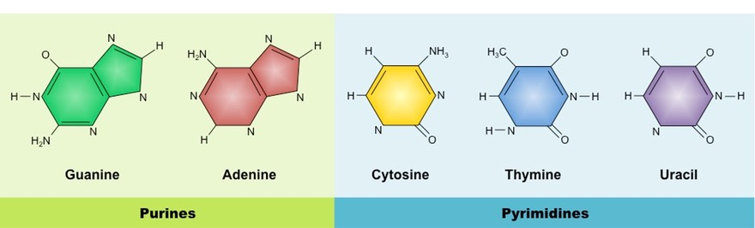
2
nitrogenous base
A nitrogenous base is an organic molecule that contains the element nitrogen and play an important role as building blocks of both DNA and RNA. Nitrogenous bases are typically classified into two groups; pyrimidines (which consist of one ring and contains cytosine C, thymine T and uracil U ) and purines (which consist of two ring and contains adenine A and guanine G ). Uracil is found only in RNA, while thymine is found only in DNA.
Found in DNA & RNA
Found in DNA & RNA
Found in DNA & RNA
Found in DNA
Found in RNA

Slide 8
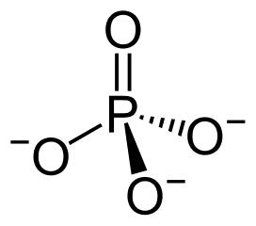
3
Phosphate group
Phosphate, chemical formula PO43-, is a chemical compound made up of one phosphorus and four oxygen atoms. When it is attached to a molecule containing carbon, it is called a phosphate group. It is found in the genetic material DNA and RNA and is also in molecules such as adenosine triphosphate (ATP) that provide energy to cells.
A phosphate group (phosphoric acid) attached to the 5⁻ carbon
atom of the sugar by a phosphoester bond, this phosphate group is responsible for the strong negative charge of nucleic acid

Slide 9
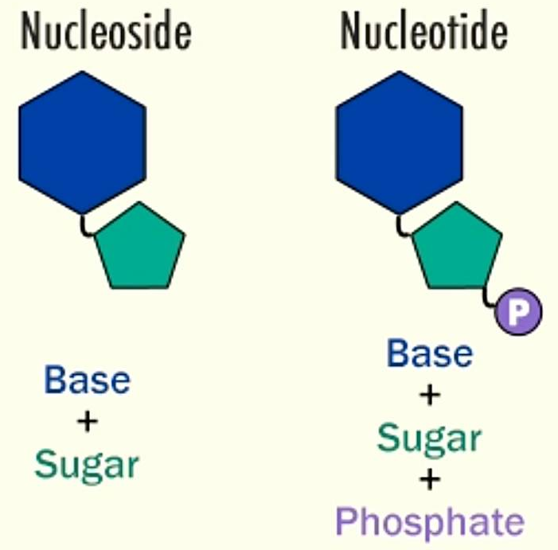
Nucleoside & Nucleotide
Nucleoside
Nitrogen base
+
Sugar
by N-β- glycosidic bond
Nucleotide
Nitrogen base
+
Sugar
+
Phosphate group
by phosphoester bond

Slide 10
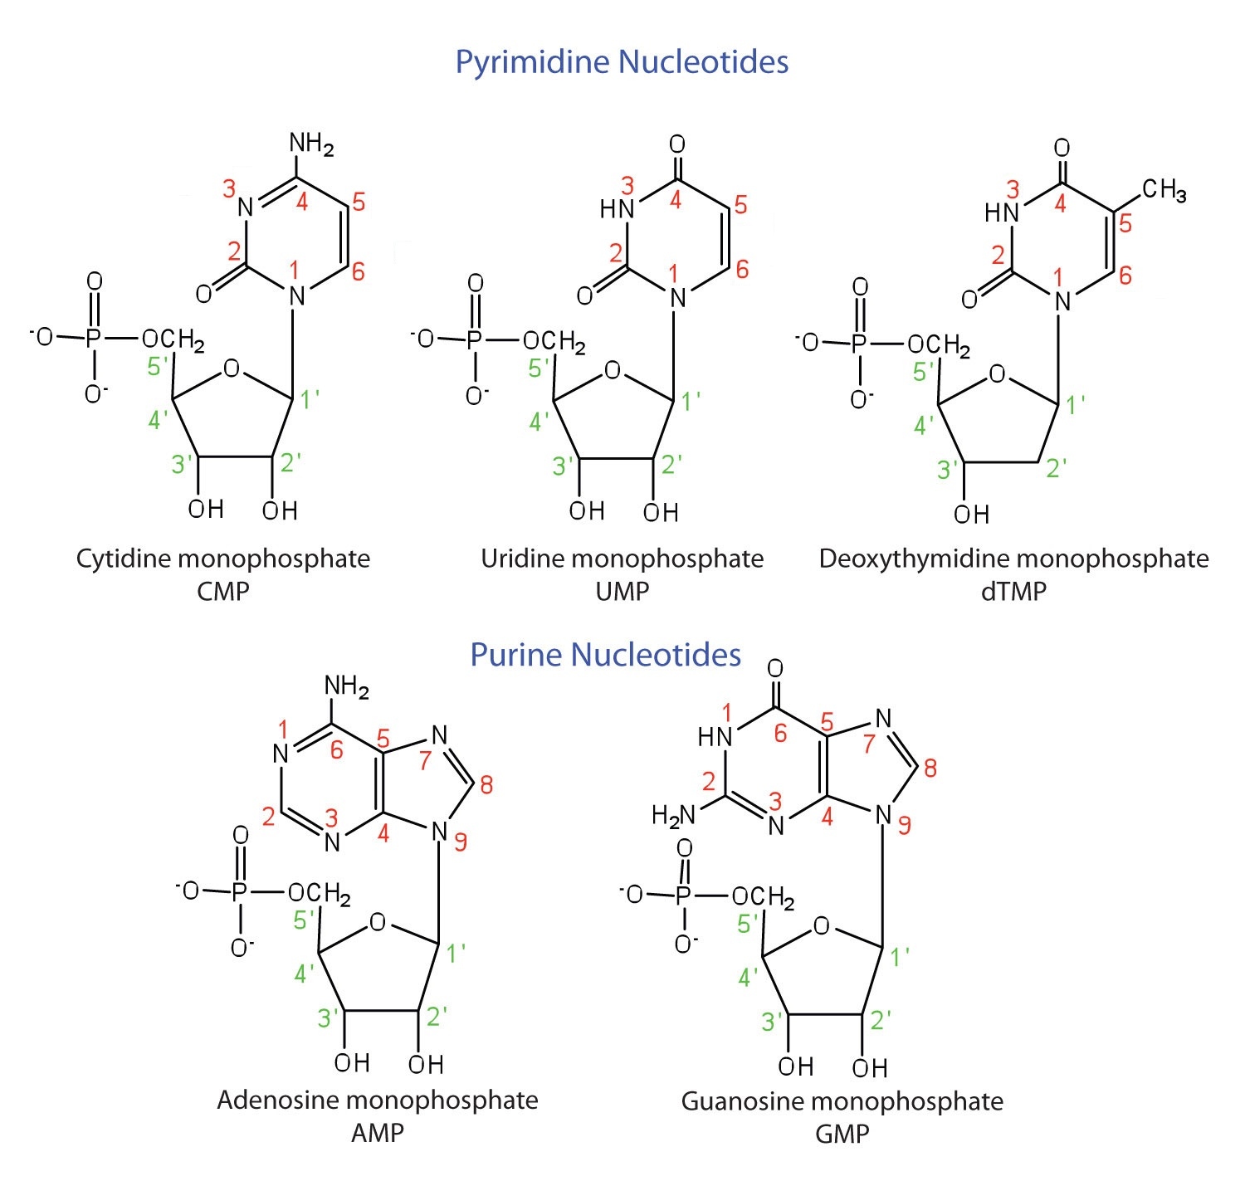
Nucleotide structure
The bond between base and sugar is N-β- glycosidic bond and the bond between sugar and phosphate is an ester bond.
Carbon no:1 in Sugar attached to nitrogen NO. 9 in the case of purine, while carbon no:1 in Sugar attached with nitrogen N0.1 in the case of pyrimidine.

Slide 11
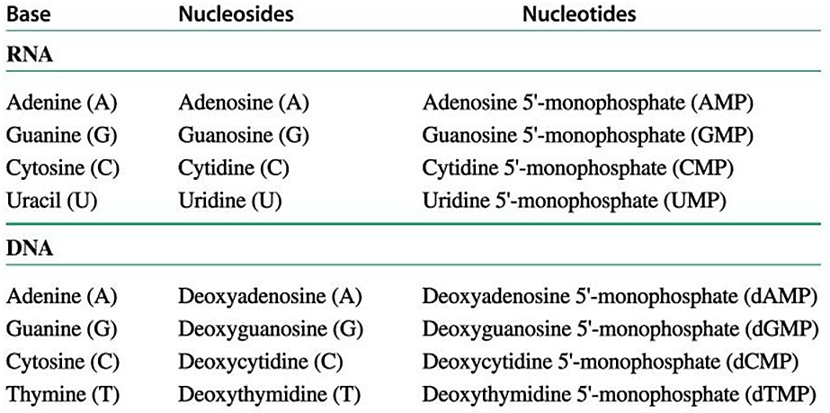
Names of Nucleosides and Nucleotides

Slide 12
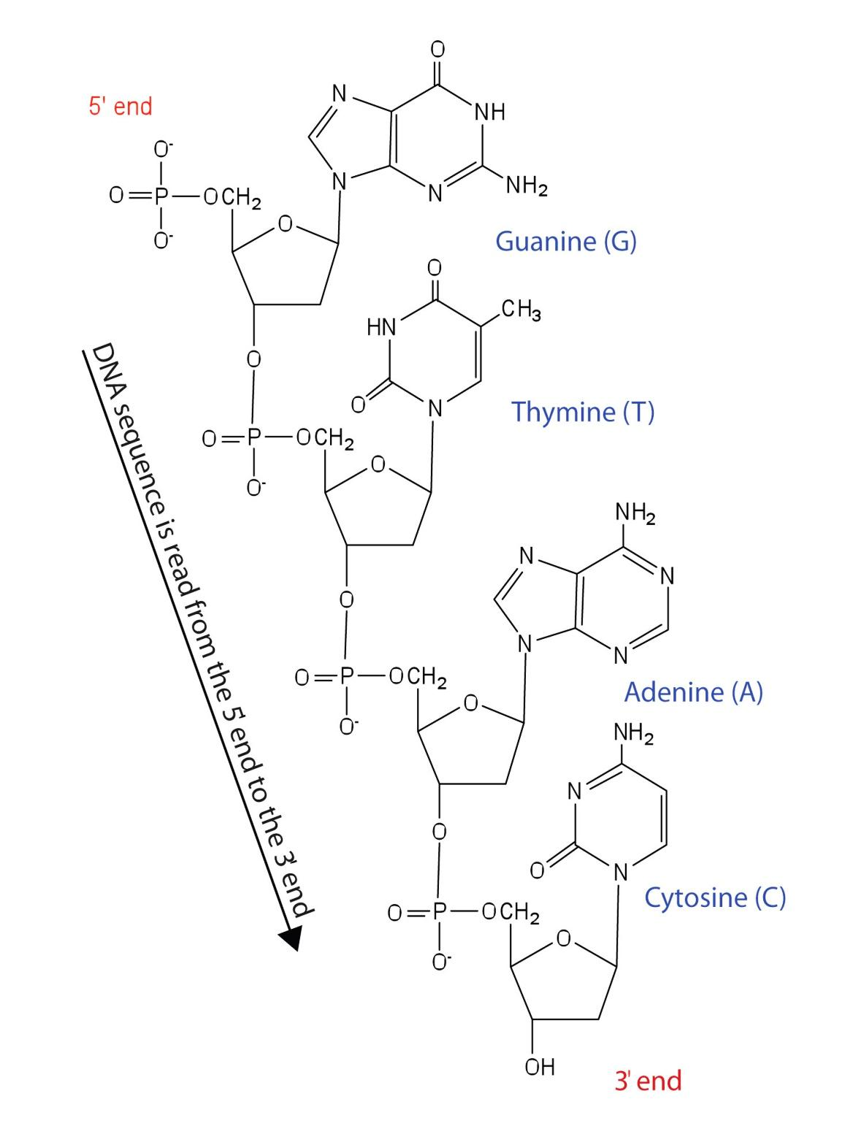
Structure of DNA
1: Primary DNA structure
The primary DNA structure is a single strand and is formed when nucleotides are joined together through the phosphate group of one nucleotide connecting to the OH group on the third carbon atom of the sugar unit of a second nucleotide, this binding occurs via an ester bond. The second nucleotide joins to a third nucleotide, and the process is repeated to produce a long nucleic acid chain.
Among the main difference between DNA and RNA is that the DNA is double-strand while the latter is normally a single strand.

Slide 13
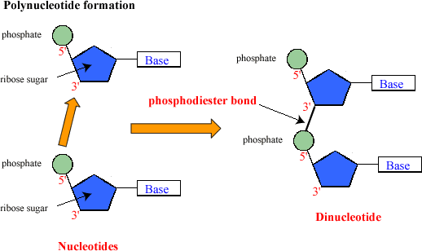
Due to that processes of binding to create primary single strand of DNA, the two ends of the DNA strands were called 3́ OH free end and 5́ P end, and the bond between two adjacent nucleotide is called 3́ 5́ phosphdiester bond .
The backbone of the chain consists of alternating phosphate and sugar units (2-deoxyribose in DNA and ribose in RNA). The purine and pyrimidine bases branch off this backbone.

Slide 14
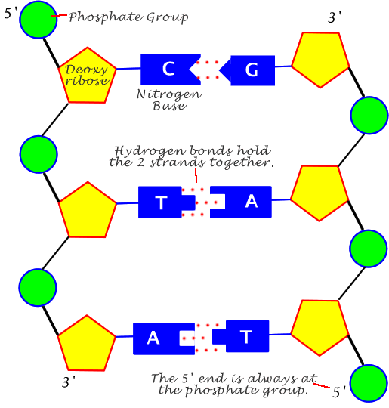
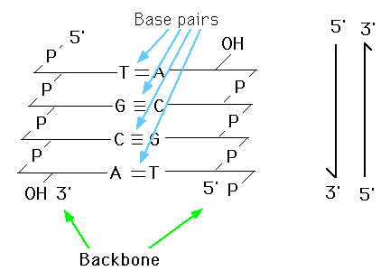
The secondary structure of DNA represent by binding two single strand via two hydrogen bond between adenine and thymine (A=T) and three hydrogen bond between cytosine and guanine (G≡C).the two strand are anti parallel to each in opposite direction (3́ end of one strand face the 5́ end of other strand) twisted together .
2: Secondary DNA structure

Slide 15
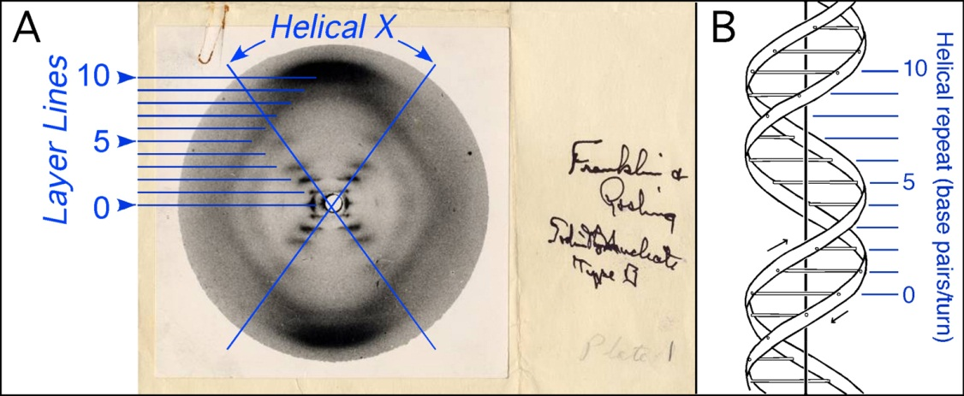
Watson and Crick used stick-and-ball models to test their ideas on the possible structure of DNA. They depend on the structure shape proposed Rosalind Franklin and Maurice Wilkins, who were using X-ray diffraction to know the physical structure of the DNA molecule.
Watson and Crick DNA
In addition, Watson and Crick used another facts to build their DNA structure model (double helix B), such as:
purines equal to pyrimidine bases within the anti parallel strand.
The DNA double helix is stabilized primarily by two forces; hydrogen bonds and base-stacking interactions among aromatic nucleobases.
It contain 2 groove, the major groove, is 22 Å wide and the minor groove, is 12 Å wide.
the backbone directed outside the helix while N.B oriented inside

Slide 16
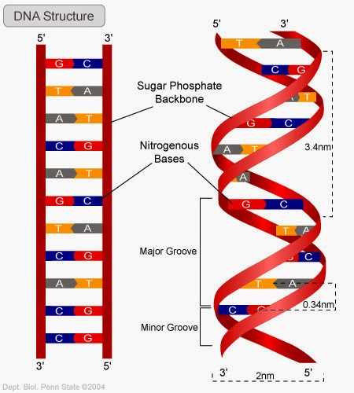
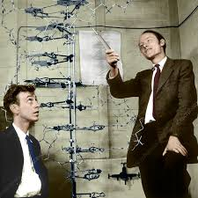
Watson and Crick DNA
The double helix of DNA

Slide 17
The DNA double helix has many features
The backbone of each consists of alternating deoxyribose and phosphate groups.
The phosphate group bonded to the 5' carbon atom of one deoxyribose is bonded to the 3' carbon of the next
The two strands are "antiparallel"; that is, one strand runs 5′ to 3′ while the other runs 3′ to 5 ′
The purine and pyrimidine attached to each other according to complementary base pair (each adenine bind with thymine via two hydrogen bonds & each cytosine bind with guanine via three hydrogen bonds) .
The length of helix could be any measure, but its diameter is 20 Å.
3.4 Å separates the planes in which adjacent base pairs are located.
The double helix makes a complete turn in just over 10 nucleotide pairs, and the distance of each one turn is 34 Å.
The double helix of DNA has two grooves; major and minor.

Slide 18
The DNA three forms
Helix has right handed sense.
Most common DNA conformation in vivo.
Narrower, more elongated helix than A.
Wide major groove & narrow minor groove.
Favored conformation at high water concentrations
B-form
Helix has right handed sense.
Most RNA and RNA-DNA duplex in this form
shorter, wider helix than B.
Narrow major groove & wide minor groove.
favored conformation at low water concentrations
A-form
Helix has left-handed sense
Can be formed in vivo, but function remains obscure.
Narrower, more elongated helix than A or B.
Major groove is not really groove and narrow minor groove.
favored by high salt concentrations.
Z-form

Slide 19
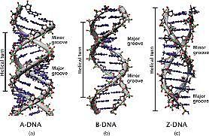
DNA forms
A-DNA
B-DNA
Z-DNA

Slide 20
Difference between three conformation DNA shape
Feature | A-form | B-form | Z-form
Rotation of helix | + 33° | + 36° | - 30°
Bp in one turn | 11 | 10. | 12
Rise of each bp | 2.6 Å | 3.4 Å | 4.56 Å
Rise of each turn | 28.2 Å | 34 Å | 45.6 Å
Helix diameter | 23 Å | 20 Å | 18 Å

