Slide 1
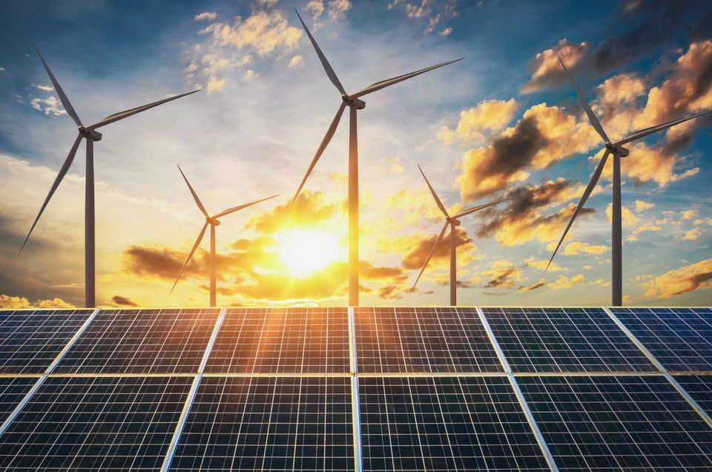
The Course of
Renewable energy
MUSTANSIRIYAH UNIVERSITY
COLLEGE OF SCIENCES
ATMOSPHERIC SCIENCES DEPARTMENT
2019-2020
Dr. Ali Alhafiz
fourth STAGE

Slide 2
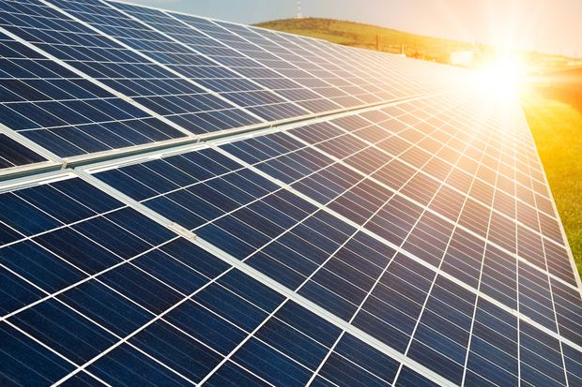
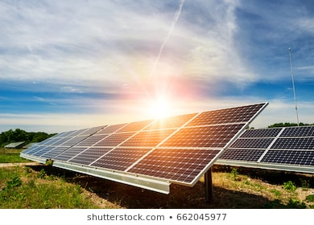
Welcome Students! ☺
To LECTURE seven

Slide 3
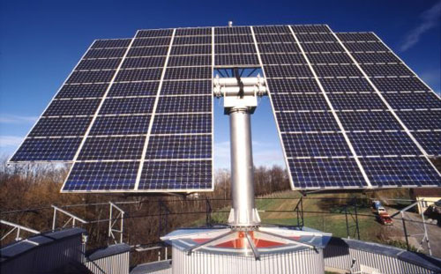

Solar Power
Solar radiation varies from one location to another also varies throughout the year. Iraq is located in the region, which has a very good amount of solar energy with an estimated average number of hours of solar brightness 8.8 hours per day and estimated that the average solar energy received by the per square meter in Iraq( 539 watt)
As for the daily rates for solar energy received in Iraq, we notice that the central region has high proportion of the radiation is due mainly to the influence of the foundation area is Central Air has low clouds compared to the northern area which is the proportion of radiation which a moderate proportion of the large number of clouds and the humidity is low as compared to the southern region that are low, despite being the closest to the equator than the rest of Iraq because of the ratio high humidity.

Slide 4

It is known that Baghdad lay at latitude (˚ 33.23) north, where this causes the site to determine the angle of the sun and the fall of determining the length of day and summer hours to (14) hours and hours of winter days (10) hours, on this basis can be placed in a solar cell horizontal or vertical or inclination
The inclination situation is more better have energy for the vertical or the horizontal situation and generally prove to be the face of the geographical south in the northern hemisphere, and tends on the horizon at an angle equal to latitude of the place and then be the largest amount of radiation incident, to calculate the best angle of inclination of the solar panel at any city we can use the following equations -

Slide 5

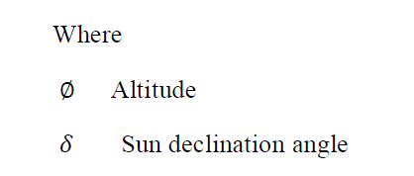
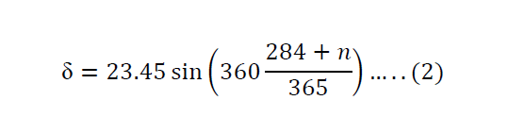
And we can calculated from the equation-
n today's sequence number during the year and ranging in value from (1) in the first of January to the (360) in (31) in December and this February, as (28) days and is always because of its low effect who gets to add or subtract a result of this day of February

Slide 6
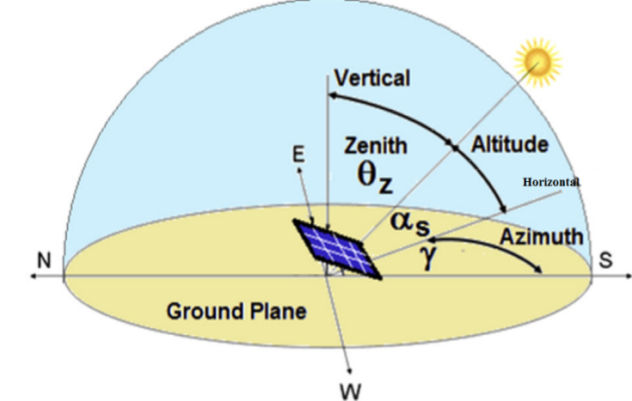
t Time in hours from the noon time to the time required as the noon time r is equal to zero and it s positive before noon and negative in the afternoon, for Baghdad all of the studies showed that the best angle to inclination solar panel is equivalent latitude which is equal to (˚ 33).

Slide 7
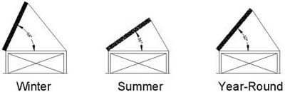
إذا كان الموقع يقع بين خط الأستواء و خط عرض اقل من 25 يتم استخدام المعادلة التالية:
احسن زاوايا ميل الألواح الشمسية = (خط العرض * 0.84) +1
مثال: تقع مدينة جدة علي خط عرض 21 احسن زاوية للألواح علي مدار العام في مدينة جدة = (21* 0.84) + 1= 19 درجة
2- اما إذا كان الموقع يقع بين خط عرض 25 و 50، يتم استخدام المعادلة التالية:
احسن زاوايا ميل الألواح الشمسية = (خط العرض * 0.76) +3
3- اما إذا كان الموقع يقع علي خط عرض اكبر من 50، فيتم استخدام المعادلة التالية:
احسن زاوايا ميل الألواح الشمسية = (خط العرض * 0.66) + 30

Slide 8
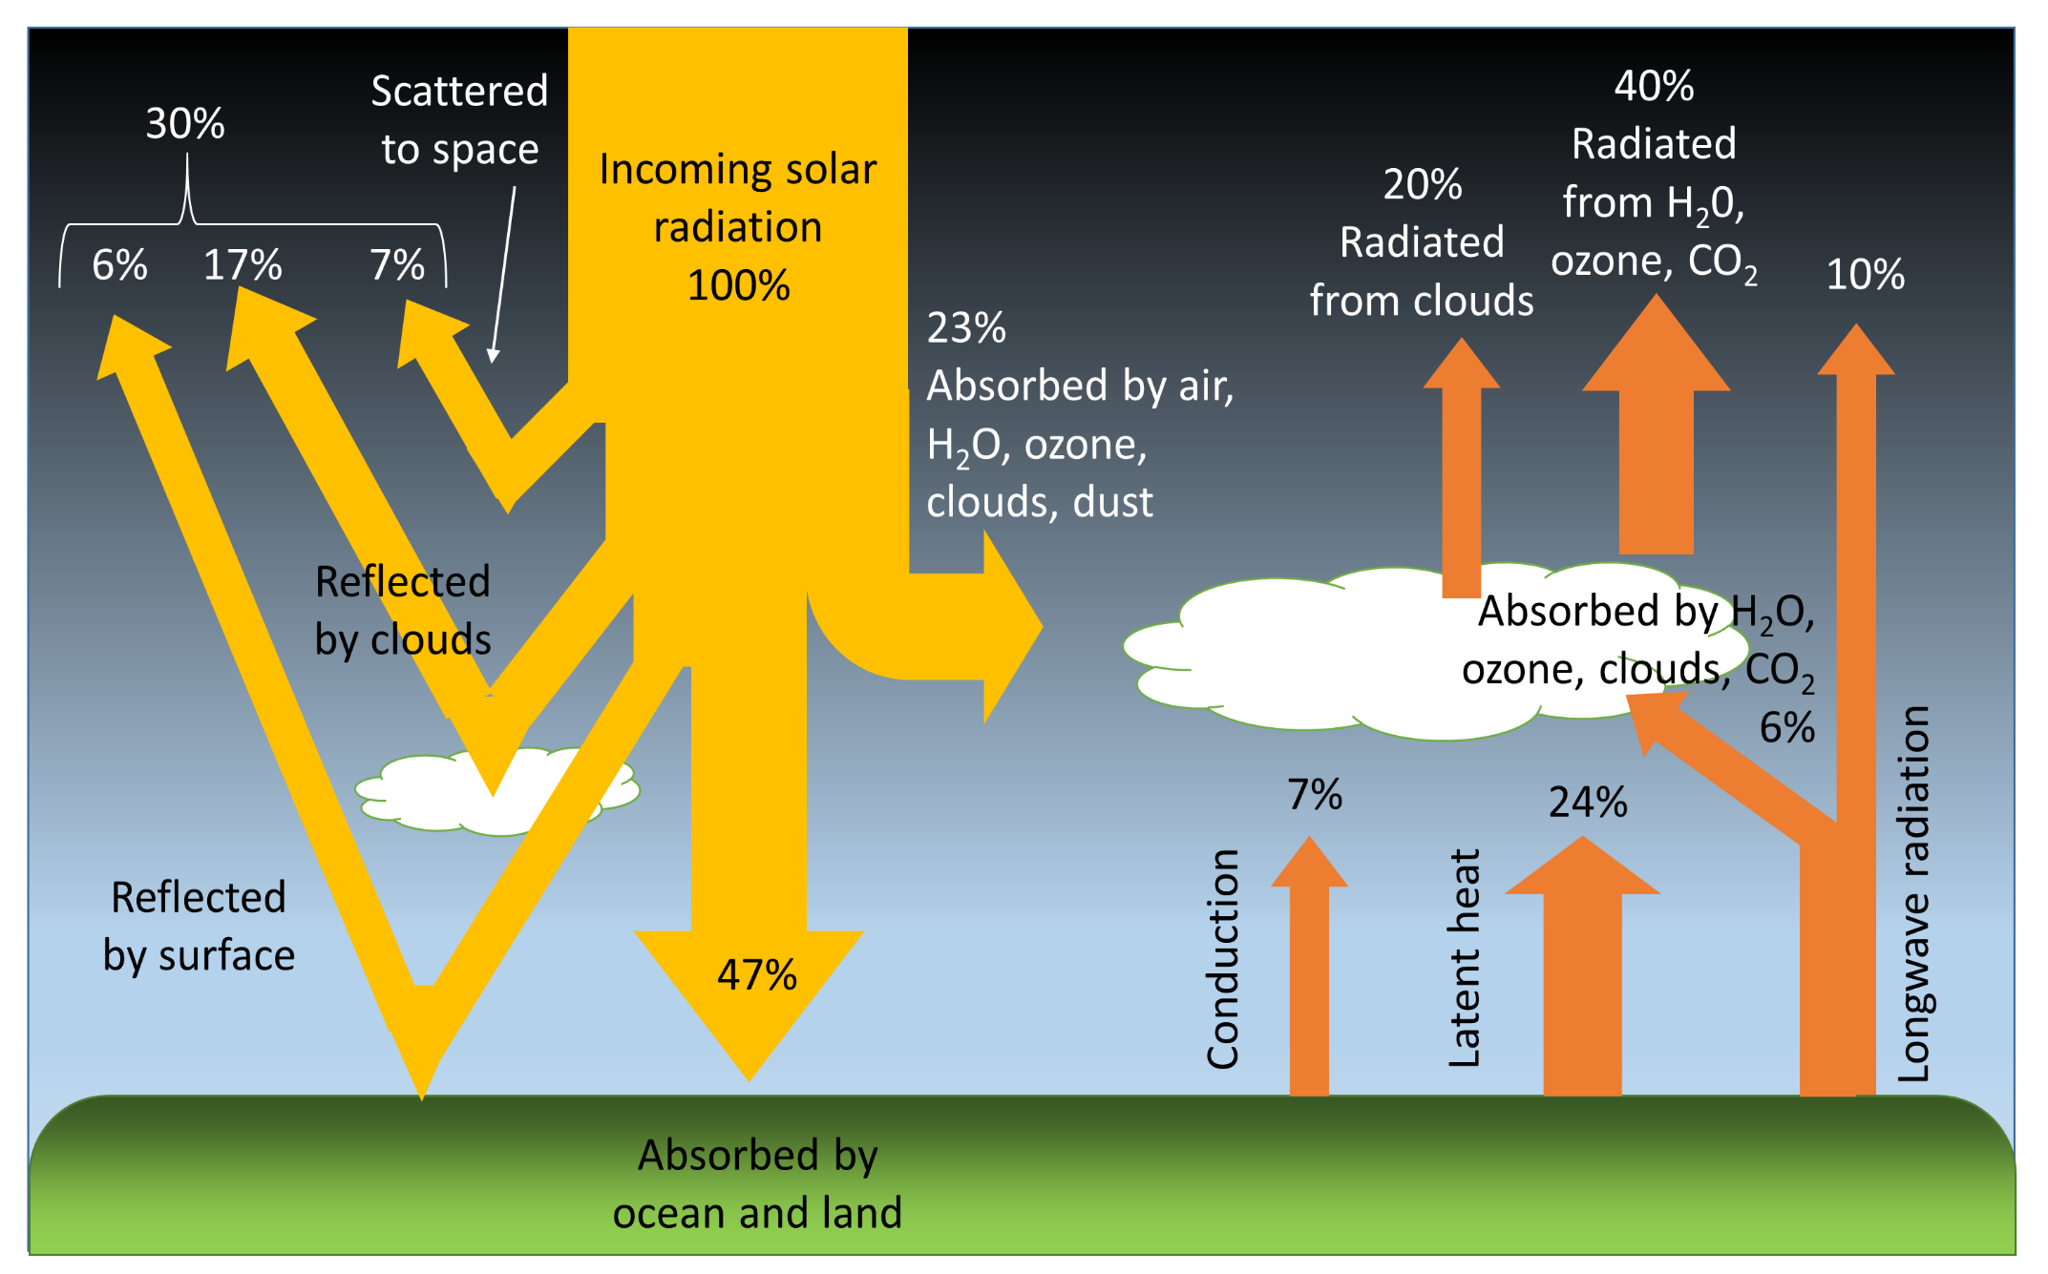
Atmosphere Influence on Solar Radiation

Slide 9
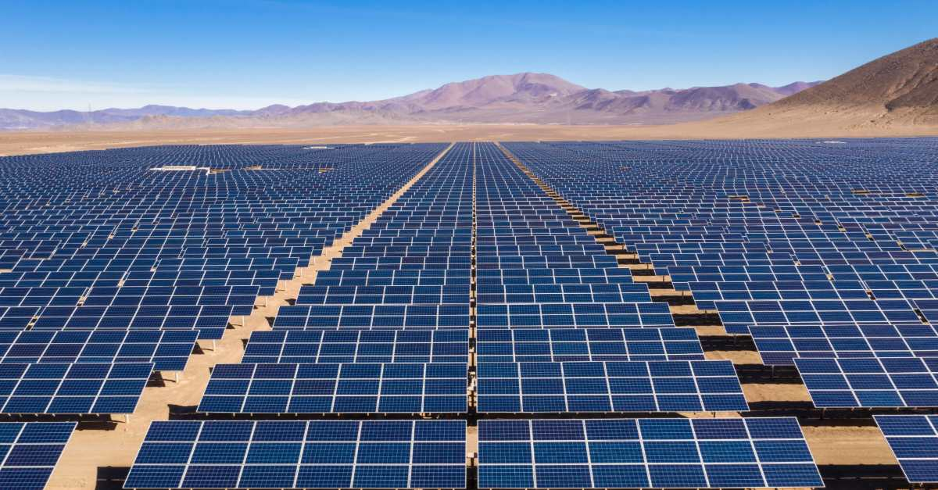
Solar power is the conversion of sunlight to electricity. Sunlight can be converted directly into electricity using photovoltaic (PV), or indirectly with concentrating solar power (CSP), which normally focuses the sun's energy to boil water which is then used to provide power, and technologies photovoltaic. Photovoltaic were initially used to power small and medium-sized applications, from the calculator powered by a single solar cell to off-grid homes powered

Slide 10
Photovoltaic (PV) the word Photovoltaic is a combination of the Greek word for Light and the name of the physicist Allesandro Volta. It is the best known as a method for generating electric power by using solar cells to convert energy from the sun into electricity
1904:Einstein published his paper on the photoelectric effect.
1923: Albert Einstein received the Nobel Prize for his theories explaining the photoelectric effect.
1954: primary work was performed by Rappaport, Loferski and Jenny. Bell Labs researchers Pearson, Chapin, and Fuller reported their discovery of 4.5% efficient silicon solar cells; this was raised to 6% only a few months later (by a work team including Mort Prince)... The photoelectric effect describes the release of positive and negative charge carriers in a solid state when light strikes its surface. Over 95% of all the solar cells produced worldwide are composed of the material Silicon (Si).

Slide 11
Efficiency of solar cell

Slide 12
There are several factors affecting the efficiency of a solar cell manufactured materials and methods of manufacture of these cells through contact in addition to the leakage of part of electricity points, which depends on temperature, in addition to other sources of loss is contrary to the cell of a part of solar radiation and resulting loss of electrical resistance in the cell
Using

Slide 13
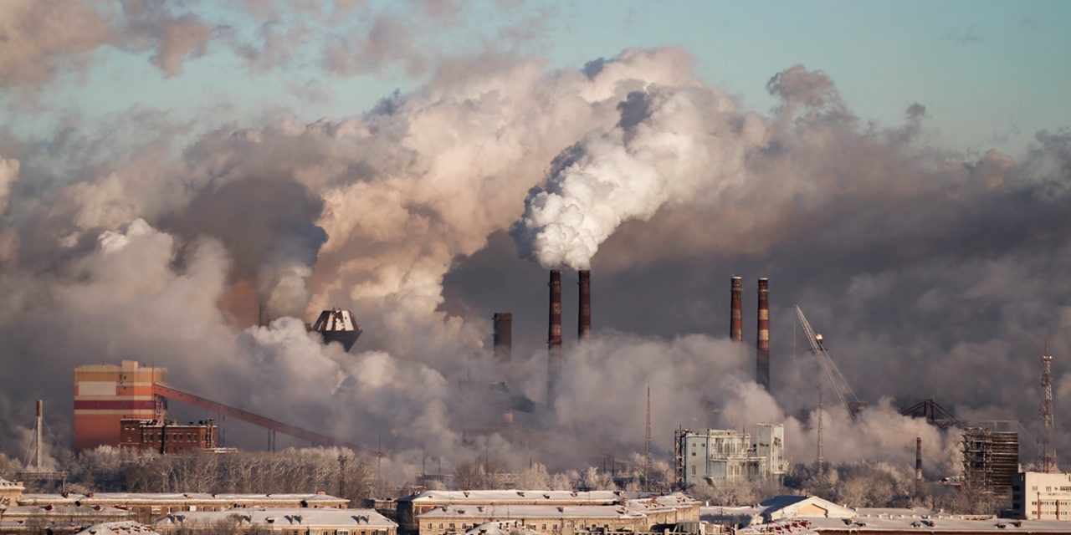
Using PV modules to generate electricity can significantly reduce pollution. The most energy used in creating solar panels is used to purify and crystallize the semiconductor material. No official numbers are available on the exact amount of energy used to create solar panels because there is no industry standard for making the crystals
Estimates regarding pollution prevention suggest that producing 1,000 kWh of electricity through solar power can reduce emissions by 8 pounds of sulfur dioxide, 5 pounds of nitrogen oxide, and 1,400 pounds of carbon dioxide. Lifetime estimates (over a projected 28 years) average in the thousands of pounds of prevented emissions.

Slide 14



