Slide 1
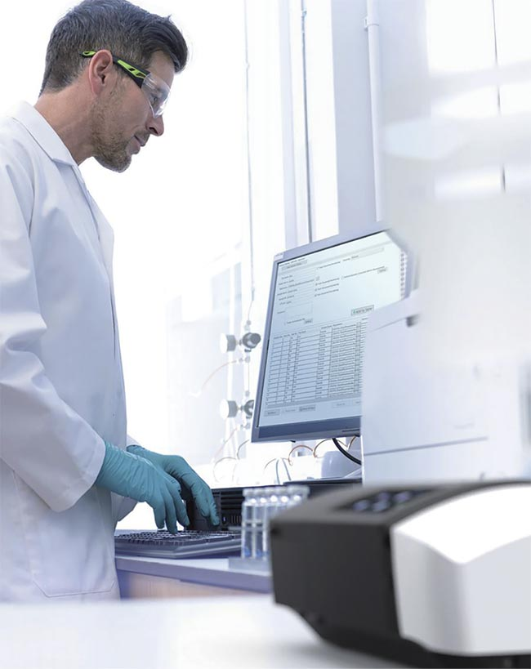
The Blood Collection
Presented By:
DR. Lect . ALI MUNEER
MSC CLINICAL BIOCHEMISTRY

Slide 2
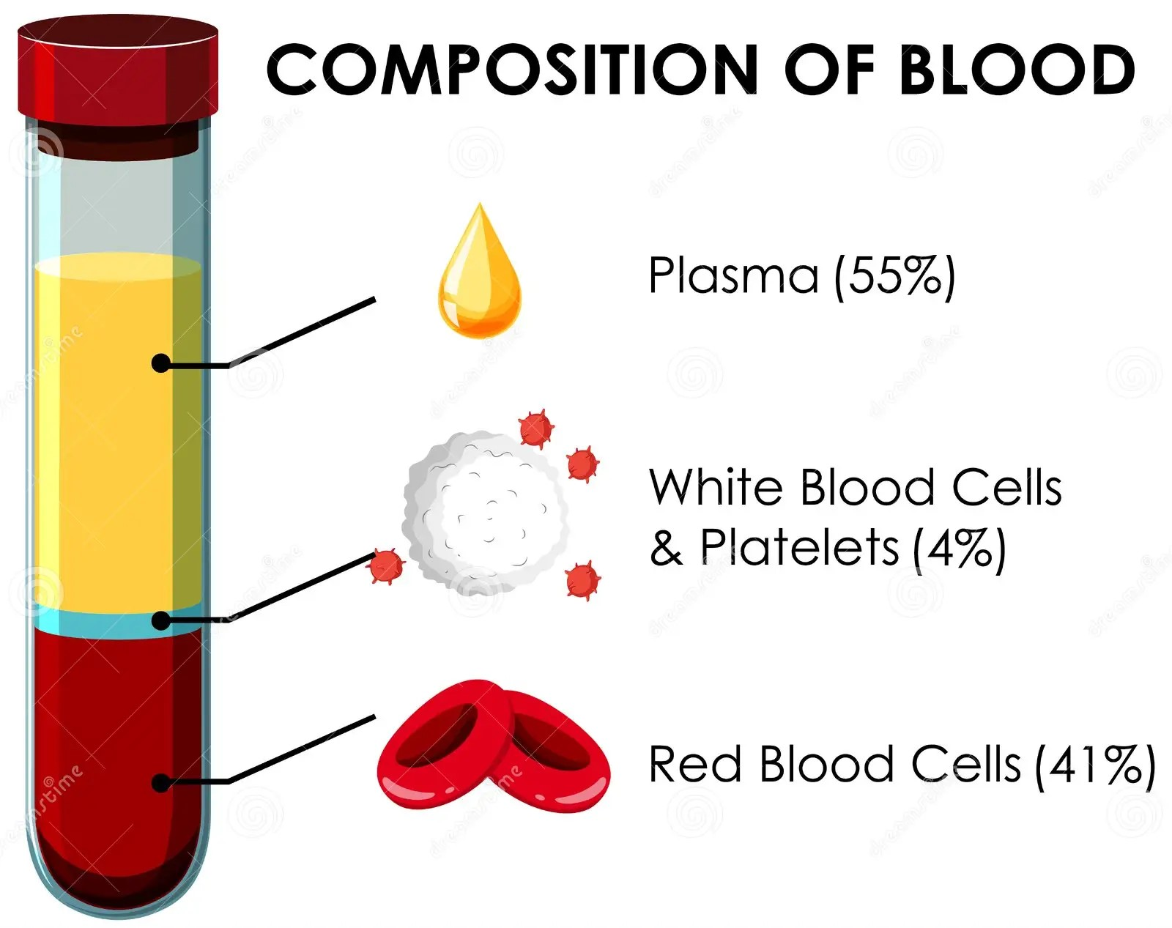
The Blood
Blood is a tissue that circulates in a closed system of blood vessels. It consists of a cellular portion (red, white blood cells, and platelets), which forms (45%) of the blood volume and is suspended in the cellular liquid medium plasma (55%) of blood volume.

Slide 3
Blood Collection
It is a procedure to obtain a sample through a vein or artery to perform required analyses
Blood tests are usually performed on blood taken from veins or arteries
Blood collection methods include
1. Venipuncture (penetrating a vein with a needle) with an evacuated tube system, syringe method, or butterfly infusion set.
2. Capillary blood system whereby the skin puncture is done with the use of a lancet.
Use of the evacuated blood collection system is preferable because it allows the blood to pass directly from the vein into the evacuated tube eliminating the need for specimen transfer.
Venous blood is used in most biochemical tests
Arterial blood is used for some tests such as blood gases

Slide 4
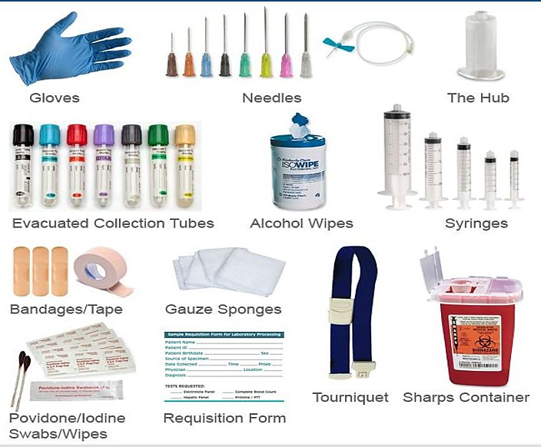
Materials Required For Blood Withdrawal

Slide 5
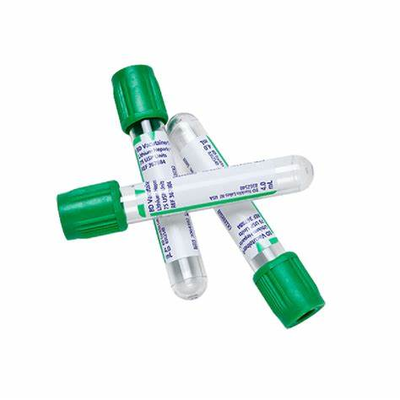
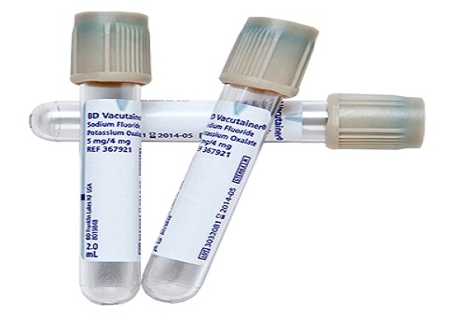
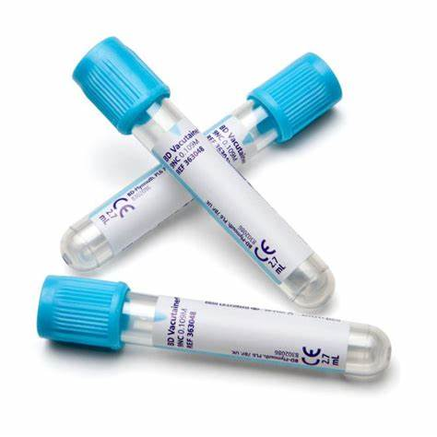
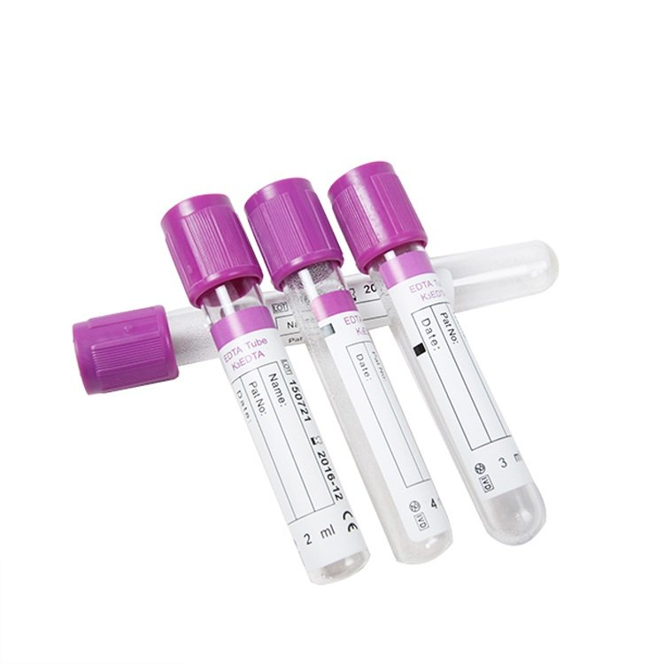
Blood Collection Tubes
The type of tubes depends on the type of tests the laboratory is required to perform
Tubes for obtaining whole blood or plasma
1. Ethylenediamine Tetraacetic Acid (EDTA tube)
2. Trisodium Citrate
3. Sodium Fluoride
4. Heparin Tube

Slide 6
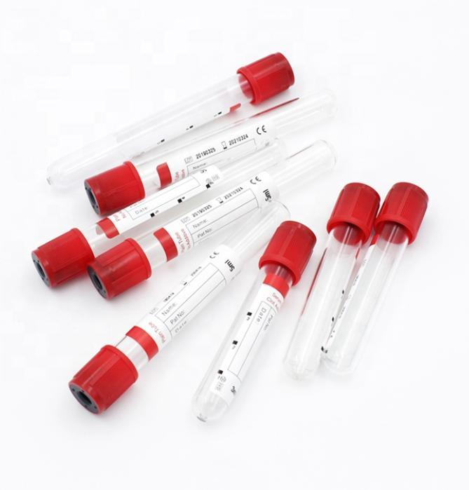
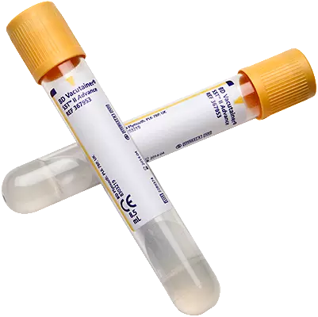
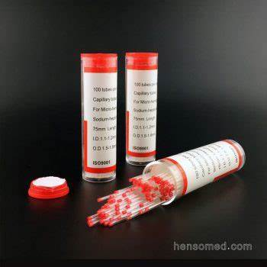
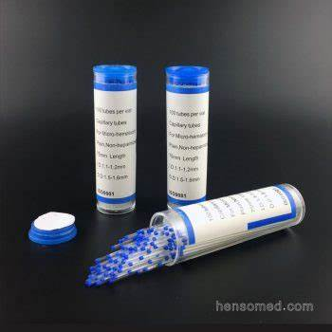
Tubes For Obtaining Serum
Gel Tube
2. Plain Tube
Capillary Tubes
Blue Capillary
2. Red Capillary

Slide 7
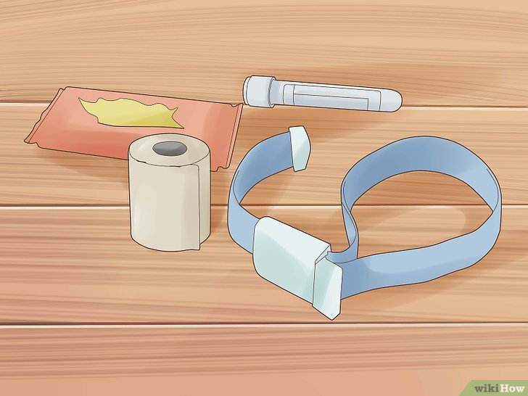

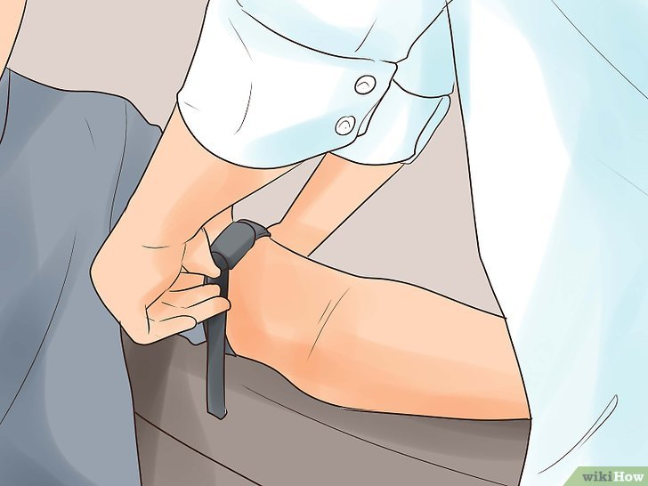
Steps to draw blood
Ensure that you have all the equipment required to draw blood
2. Identify the patient and explain the procedure to them, ensuring their consent and reassuring the patient that the minimum amount of blood required for testing will be drawn.
3. Select an appropriate site for venipuncture, usually the inner elbow area where veins are easily accessible.
4. Wear gloves and place a tourniquet three fingers apart over the intended venipuncture site to congest the veins and make them more visible and accessible.

Slide 8
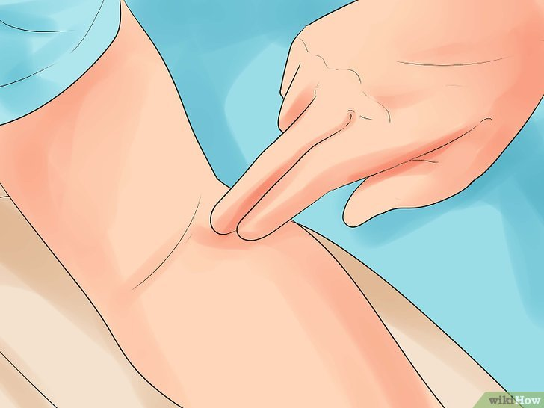
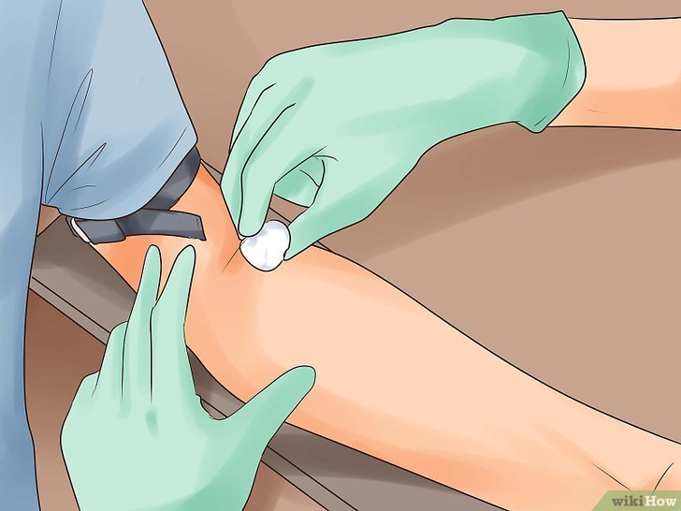
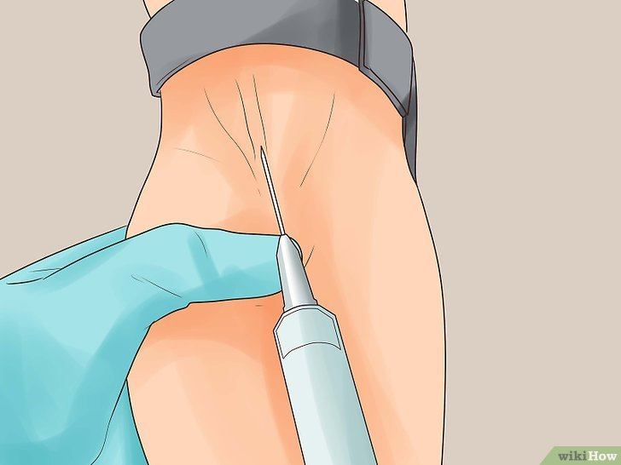
5. Select the appropriate vein carefully, avoid burned, injured, or infected places, if any, and determine the location of the vein by sight and touch
6. Clean the selected venipuncture site with an alcohol 70% swab and allow it to air dry. This helps prevent infections
7. Gently insert the needle through the skin into the vein at a 15 – 30 degree angle and insert about a third of the needle. Once the needle is positioned correctly in the vein, blood will begin to flow into the syringe

Slide 9
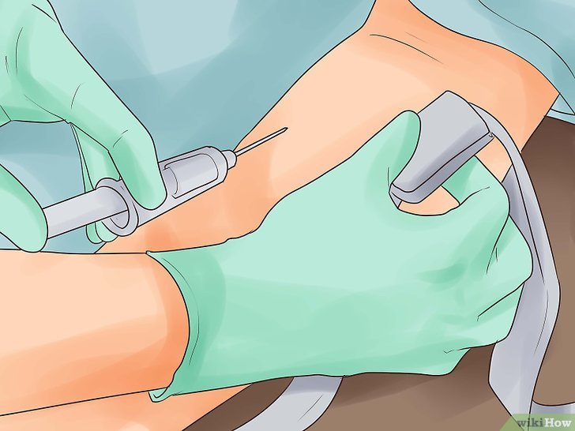
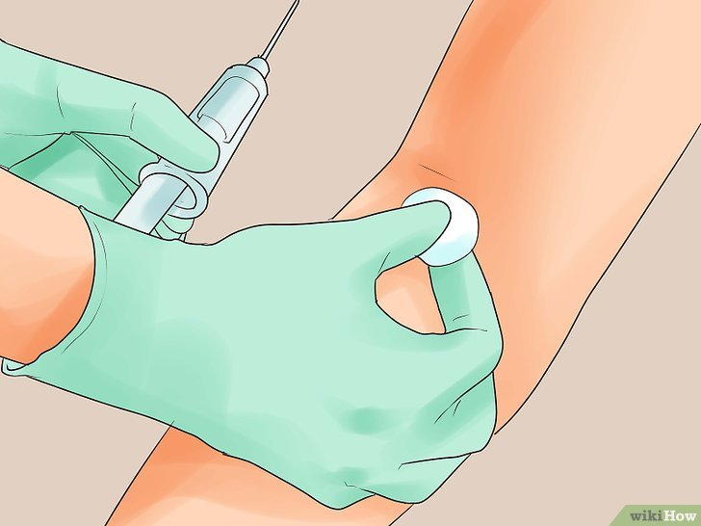
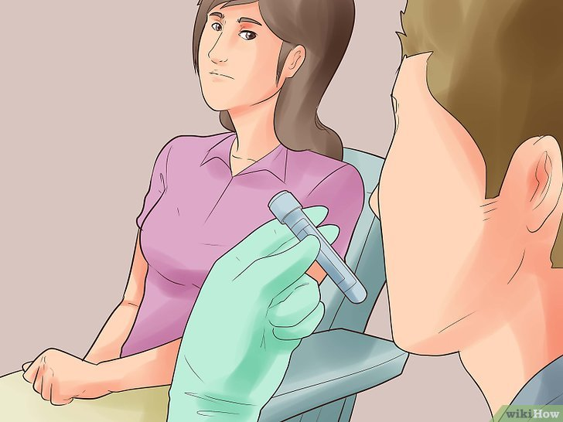
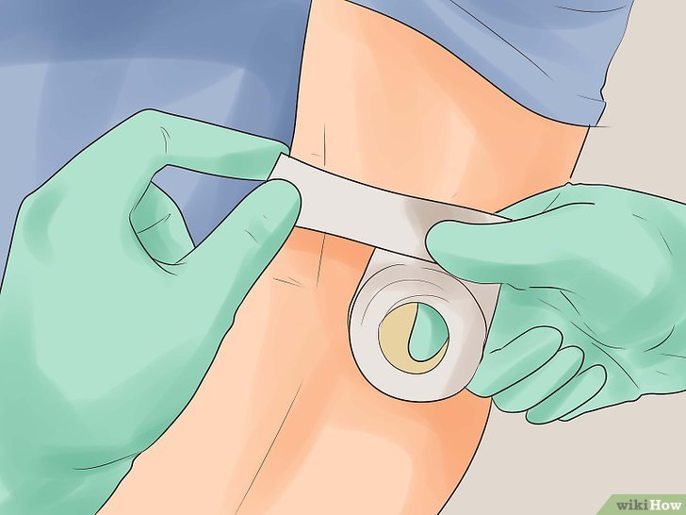
8. Once an adequate amount of blood has been collected, remove the tourniquet withdraw the needle from the vein smoothly, and apply pressure to the puncture site with a sterile gauze pad to stop any bleeding and reduce the risk of bruising.
9. After the procedure, provide the patient with a bandage or adhesive strip to cover the puncture site.
10. Empty the blood in the syringe into the tube used for the required analysis and empty the blood sample slowly so as not to decompose the blood (Hemolysis).
11. Finally, write the patient's information on the sample tube

Slide 10
Notes About Blood Drawing
Do not tie the tourniquet for long periods to search for a vein
Do not tie the tourniquet when performing a calcium test.
Sometimes the patient is asked to clench and open his fist to generate pressure inside the veins to check the vein before withdrawing), but this condition is not desirable when performing a potassium (K) test.
You must check the quality of the syringe, make sure that it is closed and has not been used before, and that it is empty of air, and make sure that the appropriate size and type are used. All of these things help in speeding up the successful completion of the matter.
Some patients become very tired during the blood draw. Ask the patient not to look at the needle while it is inserted into the vein.
If you are drawing a blood sample from a child, suggest that he sit on his father's knee for more comfort and reassurance.

Slide 11




Thank you…

