Slide 1

Data Analytics
3rd IT
2025-2026
1st Semester
Dr.Wurood Albayati
Lect.2

Slide 2
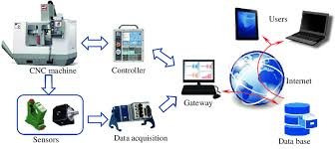
Layouts
Primary data source
Data Acquisition and Management
Acquisition technique
Data Management: The ETL/ELT Pipeline
  Extract
  Load
  Transform
Data Lake Vs Data Warehouse

Slide 3
Primary Data Sources
Data for analytics typically comes from three main types of sources:
1. Transactional Data (Internal): Data generated by a company’s day-to-day operations. This is often the cleanest and most valuable data.
Examples: Sales records, customer orders, inventory movements, point-of-sale (POS) data, and website clickstreams.
2. Operational Data (Internal): Data that describes the functioning of systems and infrastructure.
Examples: Server logs, system monitoring data, security event logs, and machine performance data.
3. External Data: Data gathered from outside the organization, often used to enrich internal data or provide context.
Examples: Social media feeds, government statistics, demographic data, stock market feeds, and weather data

Slide 4
Data Acquisition and Management
Before we can perform any analysis, we must first master the art of getting the data and preparing it for use. This process, often referred to as Data Acquisition and Management. is where analysts spend the majority of their time—often 70% to 80% of a project's effort. If the data is bad, the analysis is useless.
Data acquisition is the process of collecting, retrieving, or harvesting data from various sources and loading it into a system where it can be analyzed. The first critical step in this process is understanding the data format.

Slide 5
Acquisition techniques
API Calls
Database Queries
Web Scraping
File Ingestion
Using Application Programming Interfaces (APIs) to programmatically pull data from services like Google Analytics, Twitter, or external market data providers.
Using tools (like Python libraries: BeautifulSoup, Scrapy) to extract data from public websites.
Using SQL (Structured Query Language) to retrieve structured data directly from internal relational databases (e.g., PostgreSQL, SQL Server).
Loading data from flat files such as CSVs, JSON, XML, or Parquet files, usually stored in a data lake or cloud storage.

Slide 6
Data Management: The ETL/ELT Pipeline
The primary goal of any data pipeline is to consolidate data from various, often messy, source systems (like transactional databases, logs, and APIs) into a single, clean Data Warehouse or Data Lake where business intelligence (BI) and analytics tools can reliably access it.
TL (Extract, Transform, Load) | The traditional method; transformation happens before loading.
ELT (Extract, Load, Transform) | The modern method; raw data is loaded before transformation
The difference lies entirely in where and when the Transform step occurs. This difference is driven by advancements in cloud computing and data storage technology.

Slide 7
Extract (Data Acquisition)
This step involves reading and collecting data from the source systems.
Action: Pulling data from transactional databases (via SQL queries), reading structured files (CSV, JSON), or interacting with external APIs.
Goal: To capture all necessary data and transport it to the next stage.
Challenge: Ensuring data completeness and handling any data integrity issues at the source (e.g., locking tables during extraction)

Slide 8
Transform (Data Preparation and Cleaning)
This is the most time-consuming and critical step, where raw data is converted into a structured, high-quality, and standardized format.
Action:
  Cleaning: Handling missing values, standardizing formats (e.g., converting all dates to YYYY-MM-DD), and removing duplicate records.
  Structuring: Joining multiple tables, aggregating metrics (e.g., summarizing daily transactions into monthly totals), and creating calculated features (e.g., customer lifetime value).
  Validation: Ensuring the data adheres to business rules (e.g., ensuring order quantities are positive).
Goal: To ensure data quality so that all analysts are working with consistent, accurate numbers

Slide 9
Load (Data Storage)
This step writes the data into the final destination system, where it will be stored and used for analysis.
Action: Inserting the structured data into defined tables in a Data Warehouse (e.g., Snowflake, Google BigQuery, Redshift).
Goal: To make the data available and optimized for fast query performance

Slide 10
ETL - The Traditional Approach
ELT - The Modern Approach
Extract → Transform → Load.
In ETL the transformation is performed on a separate, dedicated ETL server before the data is loaded into the Data Warehouse. This server is the bottleneck
Best For: Legacy, on-premise systems with limited database processing power, or when data must be strictly cleaned (e.g., sensitive PII masked) before it is stored anywhere.
Drawback: It is slow and requires complex, expensive ETL servers. It also discards the raw data, meaning if the analytical requirements change, you have to re-extract everything.
Extract → Load → Transform.
The raw data is loaded directly into a Data Lake or a modern cloud Data Warehouse (which can handle massive amounts of raw data cheaply). The transformation is then performed inside the destination system using its native, scalable processing power (e.g., using SQL inside BigQuery).
Best For: Modern cloud platforms, Big Data environments, and scenarios where data volume is massive and real-time insights are needed.
Advantages (The Shift):
Scalability: Leverages the massive, elastic computing power of the cloud Data Warehouse.
Flexibility: The raw data is always preserved, allowing analysts to transform the data multiple ways for different projects without re-extracting.
Speed: The Load step is fast because it involves no computation, getting data available sooner

Slide 11
Group work
What is the future trends in data acquestion from your point of view

Slide 12
Data Lake Vs data warehouse
The Data Lake and the Data Warehouse are both massive data storage systems, but they serve completely different purposes, use different processing models, and hold different types of data. Understanding this distinction drives decisions about where to store data and how to analyze it.
The core difference boils down to when the data is structured
Data Warehouse: Schema-on-Write. Data must be cleaned, transformed, and forced into a strict schema (structure) before it is loaded
Data Lake: Schema-on-Read. Data is dumped into the lake in its raw form. The structure is defined later, only when an analyst needs to query it

Slide 13
Feature | Data Warehouse | Data Lake
Primary Goal | Reporting and Business Intelligence (BI). Answering known questions fast. | Exploration and Data Science. Discovering new patterns.
Data Type | Structured and Treated data (e.g., transactional records, financial summaries). | All Data Types (Structured, Unstructured, Semi-structured—logs, video, sensor data).
Data Quality | High. Data is cleaned and verified before loading. | Raw. Data is stored in its native state, often dirty.
Processing Model | ETL (Extract, Transform, Load) | ELT (Extract, Load, Transform)
User Base | Business Analysts, Executives, BI Professionals. | Data Scientists, Machine Learning Engineers, Advanced Analysts.
Cost | Typically more expensive per unit of storage due to compute required to enforce structure. | Typically cheaper per unit of storage (e.g., cheap cloud object storage).
Performance | Very fast for BI and standard reporting queries. | Performance can be slower for ad-hoc queries on raw data.

Slide 14

What to choice Lake or warehouse for data storage
In today's cloud environment, organizations rarely choose one or the other; they use both and this called The Data Mesh
Data Lake (Storage for ELT): Raw data (logs, sensor data, raw POS transactions) is ingested cheaply and quickly into the Data Lake (often built on systems like S3 or Azure Data Lake Storage). This is the source of truth for all raw data.
Data Warehouse (Storage for BI): Analysts use the Data Lake as the source, run Transformations (the "T" in ELT) to clean and summarize the data, and then load the refined, structured result into the Data Warehouse (like Snowflake or BigQuery).
The Result: The Data Warehouse serves fast, clean data for executive dashboards and standard reports, while the Data Lake provides the deep, raw historical data needed for machine learning and exploratory data science projects.
This combined architecture ensures the business is both fast (BI) and flexible (ML).

Slide 15
Data Format
The format determines how the data is structured, which tools are needed to read it, and how easily it can be transformed into a tabular structure (like a Pandas DataFrame or a SQL table). We will focus on the three most common formats you will encounter as a data analyst: CSV, JSON, and XML.
Notes:
Database name → RK→task → import flat file

Slide 16
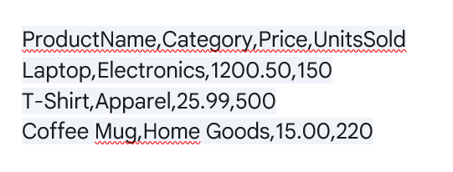
CSV (Comma Separated Values)
The Tabular Workhorse
The CSV format is the simplest and most universally used format for transferring simple tabular data. It is the digital equivalent of a plain spreadsheet
The structure of CSV files :
Plain Text: CSV files are encoded as simple text, making them human-readable and small in size.
Rows and Columns: Each line in the file represents a single record or row. Values within that line are separated by a delimiter (usually a comma, but sometimes a pipe |, semicolon ;, or tab \t).
Header Row: Typically, the first line of the file contains the column names (headers).

Slide 17
CSV Files
Feature | Advantage | Disadvantage
Simplicity | Universally supported by spreadsheets, databases, and programming languages. | Lack of Hierarchy: Cannot easily represent complex nested objects (like a list of phone numbers within a user record).
Readability | Easy to inspect and fix errors manually. | Ambiguity: What if a data field itself contains the delimiter (a comma)? This requires special handling (often quoting).
Storage | Very small file size. | Data Type Loss: All values are treated as strings; data types (integer, float, date) must be inferred by the parsing tool.

Slide 18
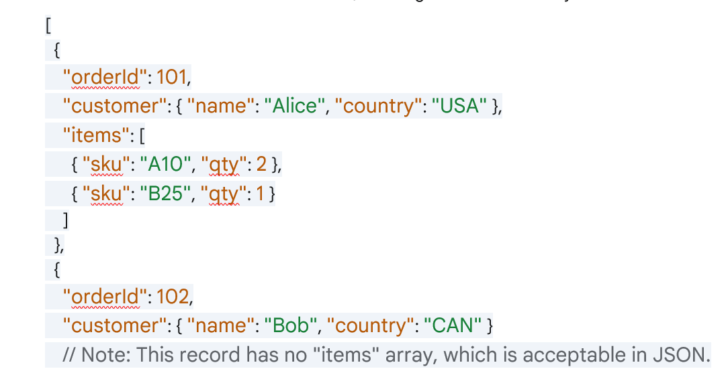
JSON (JavaScript Object Notation)
The Modern Data Standard
JSON is the most popular format for data exchange on the web. It is the lingua franca of Application Programming Interfaces (APIs), making it essential for pulling data from modern web services.
Structure : JSON is built on two primary structures, mirroring object-oriented programming concepts:
Key-Value Pairs: Data is represented as field names (keys) followed by values (e.g., "name": "Alice").
Arrays (Lists): An ordered list of values, enclosed in square brackets []. This is crucial for nesting.
Hierarchy: Unlike CSV, JSON is hierarchical. It can easily represent complex, nested data where one field contains another object or a list of objects.
Schema-less: JSON does not require a predefined structure. Different records in the same file can have different fields, offering immense flexibility

Slide 19
JSON
Feature | Advantage | Disadvantage
Flexibility | Schema-less structure is ideal for messy, varied, and complex data (e.g., social media feeds). | Requires more complex parsing and flattening to be used in tabular tools (SQL, Pandas).
API Integration | Native format for JavaScript and most web APIs. | Less storage efficient than CSV due to repeating keys (e.g., "name" is repeated for every record).
Data Types | Values can explicitly be strings, numbers, booleans, arrays, or objects. | Can sometimes be difficult for non-technical users to read directly.

Slide 20
XML (Extensible Markup Language)
The Legacy Document Standard
XML was the dominant web data exchange format before JSON. It remains highly relevant in large enterprise environments, government data transfers, and applications that rely on strict, defined document structure (like SOAP web services).
Structure:XML is tag-based, similar to HTML, focusing on structuring documents.
Tags: Data is defined by opening and closing tags (e.g., <customer>...</customer>).
Attributes: Tags can contain supplementary information as attributes (e.g., <order id="101">).
Verbosity: Due to the repetitive nature of tags, XML is far more verbose (larger file size) than JSON for the same amount of data.
Validation: XML's strength lies in its ability to be validated against a strict, external definition (DTD or XML Schema), ensuring every document follows the exact same required structure.

Slide 21
XML
Feature | Advantage | Disadvantage
Validation | Extremely strong validation capabilities ensure data quality and format consistency. | High Verbosity: Large file size and network overhead compared to JSON and CSV.
Metadata | Excellent for describing complex document relationships and metadata. | Parsing Difficulty: More complex to parse and navigate than JSON; requires specialized libraries.
Standardization | Common in legacy banking, healthcare, and enterprise systems (e.g., financial reporting formats). | Largely replaced by JSON for modern API development due to complexity and size.

Slide 22
Choosing the Right Format
When acquiring data, the format often dictates the complexity of the cleaning phase.
If your data is simple, flat, and massive (e.g., log files or sensor readings), use CSV for speed and minimal storage.
If your data is coming from a modern API, is nested, or has an evolving structure, JSON is the standard, requiring efficient flattening techniques (often in Pandas).
If you are dealing with government reports or legacy systems where structural integrity is strictly defined, you will need to master XML parsing.
Understanding how to efficiently read and transform these three fundamental formats is the foundation of effective data management.

