Slide 1
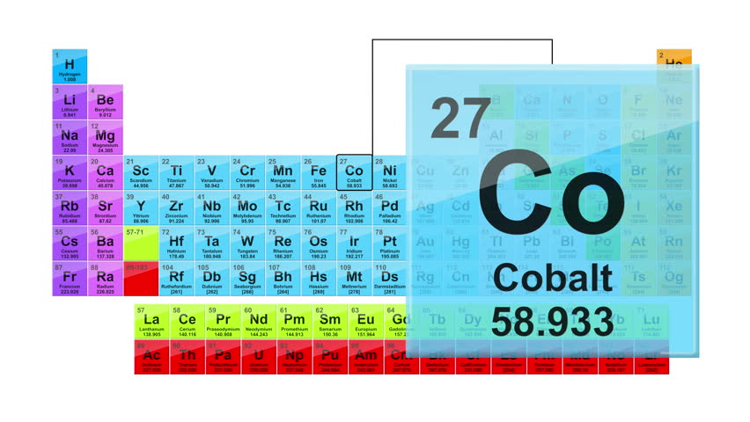
منهاج الكوبلت الالكتروني
صباحي /أ.م.ايناس زهير الهاشمي
م. م. يسرى جليل
مسائي / م. بيادر فاضل

Slide 2
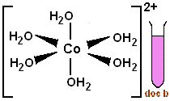
Cobalt(II) ion Reactions:
Detecting Cobalt(II) Ion (Co²⁺) :
This solution is prepared by dissolving (1g) of cobalt (II) nitrate Co(NO₃)₂.6H₂O in water to form a reddish pink solution due to forming complex ion [Co(H₂O)₆]²⁺:
Co(NO₃)₂.6H₂O + H₂O → [Co(H₂O)₆]²⁺
Dark pink solid reddish pink clear
solution
This ion can be abbreviated as (Co²⁺) to carry out the following detections:

Slide 3
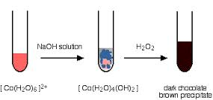
Put (10) drops of [Co(H₂O)₆]²⁺ solution in a test tube, add (2) drops of sodium hydroxide (NaOH), observe the change, divide the product into two quantities,
heat one of them for (5)
mints., and observe the change.
Add (2) drops of hydrogen
peroxide (H₂O₂) to the second
quantity, observe the change,
and write down your notices after each addition.

Slide 4
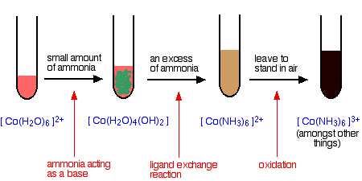
2) Put (10) drops of [Co(H₂O)₆]²⁺ solution in a test tube, add (2) drops of ammonia hydroxide (NH₄OH), then add some more of the same detector, observe the change, and write down your notices in both cases.

Slide 5
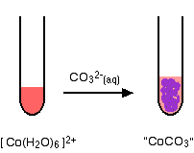
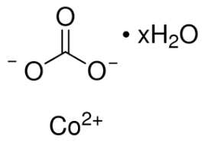
3) Put (10) drops of [Co(H₂O)₆]²⁺ solution in a third test tube, add (2) drops of sodium or potassium carbonate (Na₂CO₃), observe the change, and write down your notices.

Slide 6
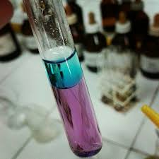
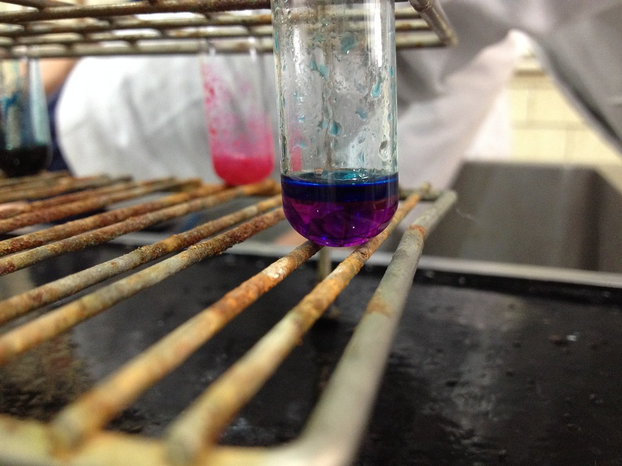
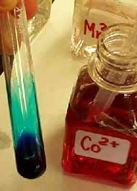
4) Put (10) drops of [Co(H₂O)₆]²⁺ solution in a fourth test tube, add (2) drops of ammonium (or potassium) thiocyanate (NH₄SCN), observe the change,
then add drops of acetone, observe the change,
mix,
and write down your notices.

Slide 7

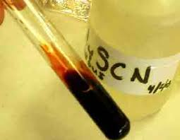
قارن بين الصورتين ؟
من معلوماتك السابقة تجد الحل

Slide 8

NH₄OH
5) Put (10) drops of [Co(H₂O)₆]²⁺ solution in a fifth test tube, add (5) drops of thioacetamide solution (CH₃CSNH₂), observe the change, add (3) drops ammonia solution (NH₄OH), observe the change, then heat the mixture, observe the change, and write down your notices.
ما هو المركب ؟
[Co(H₂O)₆]²⁺ + CH₃SCNH₂ ? ? ?
NH₄OH

Slide 9
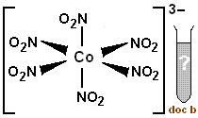
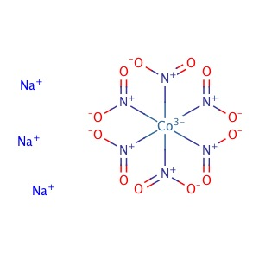
6) Put (10) drops of [Co(H₂O)₆]²⁺ solution in a sixth test tube, add (2) drops of acetic acid (CH₃COOH), observe the change, add (2) drops of sodium nitrite (NaNO₂), observe the change and write down your notices after each addition.

Slide 10
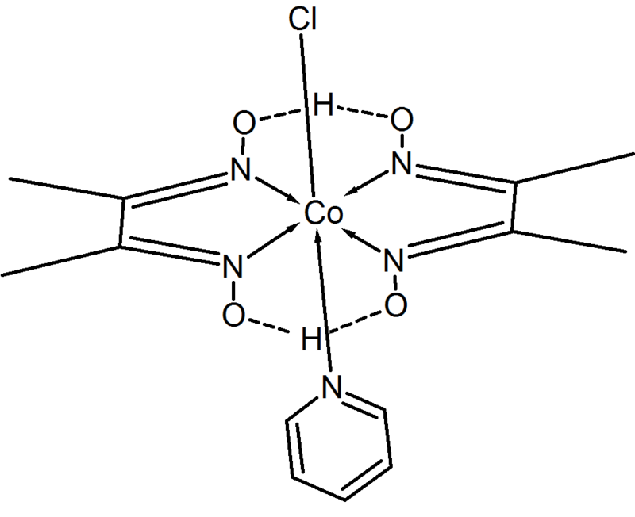
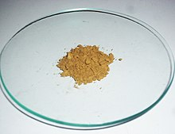
7) Put (10) drops of [Co(H₂O)₆]²⁺ solution in a seventh test tube, add (2) drops of alcoholic dimethyl glycoxim (C₄H₇O₂N₂ (DMG)) (5%), write down your notices, then add (2) drops of ammonia ( or py.)solution, what do you notice?
سوف يكون لدينا راسب زيتوني غامق لوجود الأمونيا مع ثلاث جزيئات من DNGفي التناسق .
اكتب المركب مع الرسم لشكل المعقد والمعادلة الكاملة ؟

Slide 11

Questions:
1) What is the distinguished detection for Cobalt ions?
2) In which of the above mentioned detections Co(II) was oxidized to Co(III)?
3) Why Co(II) salts are stable whereas Co(III) complexes are more stable?

Slide 13
Preparation of Sodium Tricarbonitocobaltate(III) Trihydrate Na₃[Co(CO₃)₃].3H₂O
Theory:
Carbonate ion (co₃) ²⁻ is considered one of the bidentate ligands due to two coordination connection with the central metal, which is a plane regular molecule whose structure:
In this ion, carbon associates with oxygen atom by π double bond and with two oxygen atoms by σ single bond, as each atom has one negative charge by which it coordinates with the metal ion. The complex is olive green powder, does not dissolve in water, stable when it is dry and decomposes at 93ºC without melting.
Procedure:
Dissolve (1.5g) of aqueous cobalt nitrate (Co(NO₃)₂·6H₂O) in (2.5ml) of distilled water, and then add (0.5ml) of Hydrogen peroxide (30%).
In another packer, dissolve (1g) of sodium carbonate (NaHCO₃) in (7.5ml) of distilled water (if did not completely dissolved, heat the solution until completely dissolves).
Cool down the solution prepared in step (2) using icy bath until it reach 0ºC, then add the solution prepared in step (1) drop wise throughout (10) minutes. with continuous stirring, continue stir for (30) mints. keeping the mixture in the icy bath (0ºC).
Filter the formed dark green precipitation, wash it with ethanol, and then dry the precipitation (be careful not to leave any humidity as it would be decomposed into black solid material.
Calculate the ratio of the resulted complex.

Slide 14
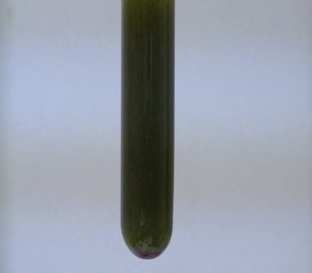
Reaction Equation:
Co(NO₃)₂.6H₂O + H₂O₂ + 10NaHCO₃ ⎯→ 2Na₃[Co(CO₃)₃].3H₂O + 4NaNO₃ + 4CO₂ + 12H₂O
Questions:
-Why hydrogen peroxide and sodium bicarbonate are added?
-Why we wash using ethanol and then using ether?

Slide 15
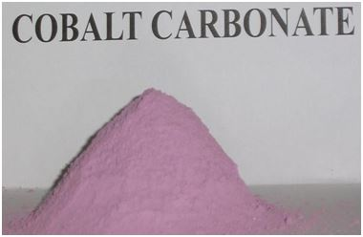
ماهي العلاقة بين المركبين اللذان في الصورتين , مبينا الاسم باللغة العربية والأنكليزية لهما ؟
Na₃[Co(CO₃)₃].3H₂O

Slide 16
Preparation of Mercury(II) Tetraisothiocyanatocobaltate(II)
Hg [Co(NCS) ₄]
Procedure:
In a backer put (2g) of cobalt chloride hexa hydrate (CoCl₂.6H₂O) with (2.2g) of ammonium thiocynate.
Add (4ml) of boiling distilled water to the backer, dissolve the solid materials with keeping high temperature below boiling (backer -1).
In another backer dissolve (1.9g) of mercury(II) chloride in (24ml) of distilled water, boil the solution to help dissolving, filter if the solution was not clear (backer -2).
Add backer -1 contents to backer -2, mix the solution, and boil for (3) minutes.; a dark blue solution will be formed.
Leave the solution to cool, filter and wash the precipitate with water and ethanol, dry at 110ºC.
Calculate the ratio of the resulted complex.

Slide 17
Reaction Equation:
CoCl₂.6H₂O + 4NH₄SCN + HgCl₂ ⎯→ Hg]Co(NCS)₄] + 4NH₄Cl + 6H₂O
Questions:
- Compare Na₃[Co(CO₃)₃].3H₂O with Hg[Co(NCS)₄] for hybrid, center ion oxidative case, geometry, ligands type, magnetic characteristic, coordination number, counter ion type, and crystal color ?
- Does this reaction depend on oxidation and reduction principle?
- What is the benefit of boiling and using mercuric chloride?

Slide 18
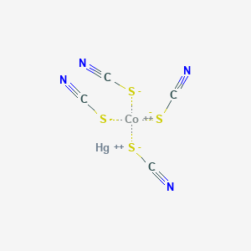
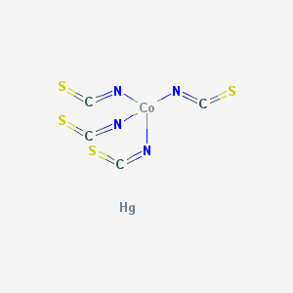
ما نوع هذه الأيزومرات ؟

Slide 19

مختبر الكيمياء اللاعضوية /مرحله ثالثه / شعبه ---- / مجموعه ---
أسم الطالب :
اسم الشريك :
اسم التجربة :
مبدأ التجربة :
معادلة التفاعل :
الترتيب الإلكتروني للذرة المركزية ولأيونها بعد التآصر:
تهجين الذرة المركزية في المعقد :
شكل المعقد في الفراغ:
نوع أوربيتال d:
الصفات المغناطيسية:
لون المعقد وشكل البلورة:

