Slide 1


مراجعة كيمياء الحديد
مختبر الكيمياء اللاعضوية
مرحلة ثالثة
( التعليم الالكتروني )
صباحي ومسائي
أ.م. ايناس زهير الهاشمي
أ.م بيادر فاضل عباس
م.م. يسرى جليل

Slide 2
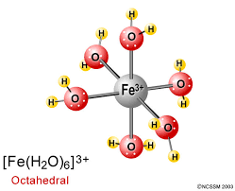
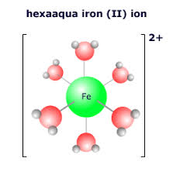
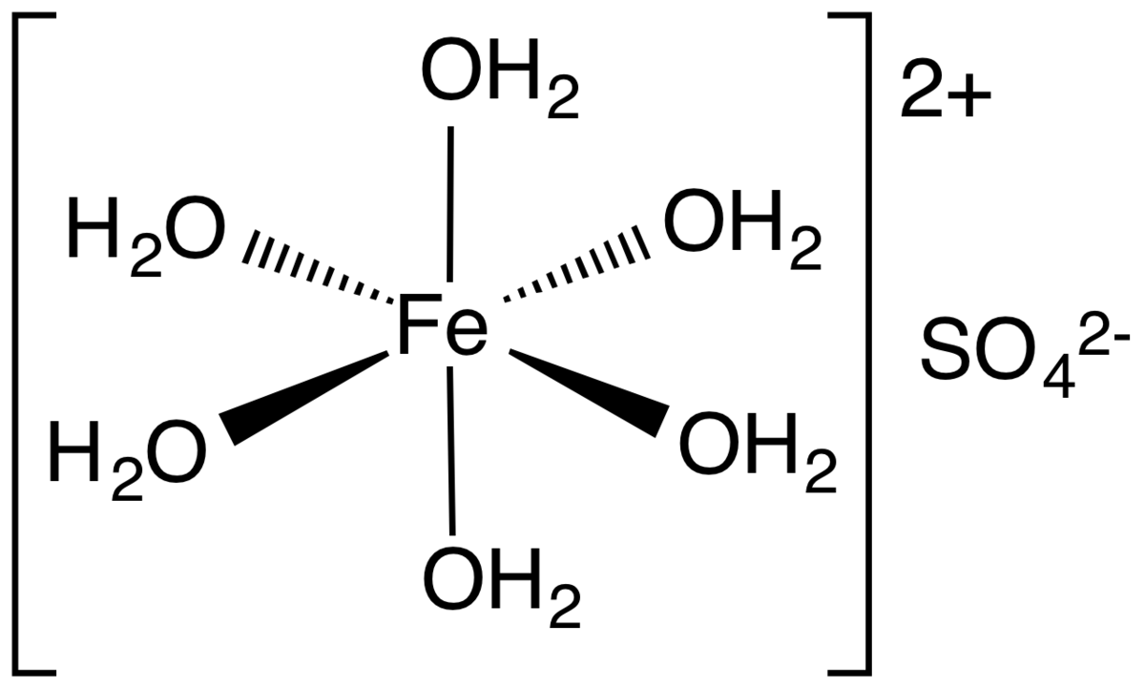
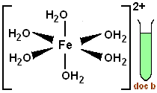
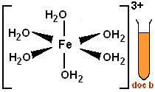
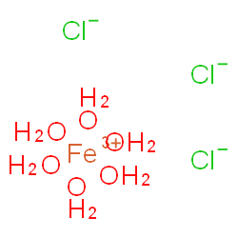
Chemistry of Iron
Ferrous Fe (II) and Ferric Fe(III) form many complexes whose octahedral structure in which the coordination number is six;
as in aqueous solutions of ferrous salts (FeSO₄.6H₂O)the complex ion [Fe(H₂O)₆]²⁺ is formed which is very light greenish blue.
Where as, the complex ion [Fe(H₂O)₆]⁺³ is formed in aqueous solutions of ferric
salts (FeCl₃.6H₂O).

Slide 3
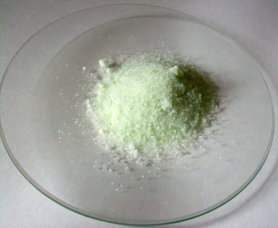
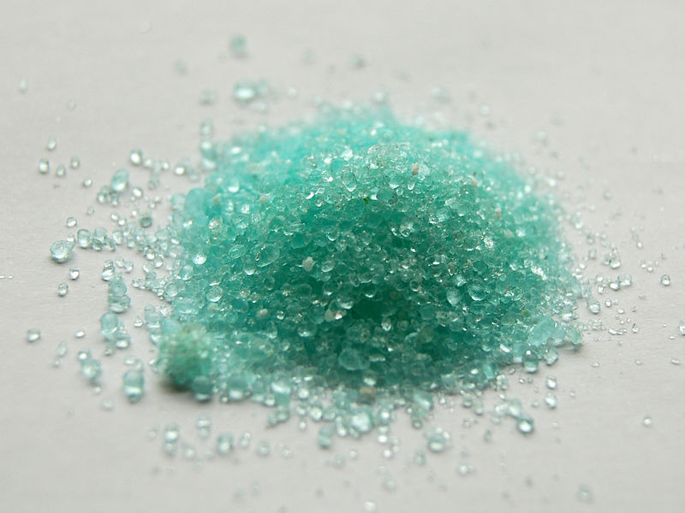
Preparing a solution of (Fe²⁺):
Iron solution can be prepared by dissolving ammoniac salt of Iron(II) sulfate (NH₄)₂SO₄.FeSO₄.6H₂O or simple iron sulfate (FeSO₄.6H₂O) in acidic water with H₂SO₄
to form bluish light green solution due to the formation of [Fe(H₂O)₆]²⁺, which can be abbreviated into (Fe²⁺)to carry out detection.
(NH₄)₂SO₄.FeSO₄.6H₂O + H₂O → [Fe(H₂O)₆] ²⁺
Greenish gray solid clear bluish light green
FeSO₄.6H₂O + H₂O → [Fe(H₂O)₆] ²⁺
Light blue solid clear bluish light green

Slide 4
pH of Aqueous ferrous solution (Fe²⁺):
Put (10) drops of [Fe(H₂O)₂]²⁺ in a test tube and measure pH by using Litmus paper (the reaction starts before adding H₂SO₄, why?). you will notice that acidic solution is weak due to weak ionization.

Slide 5
Detection of iron (II) (Fe²⁺)

Slide 6
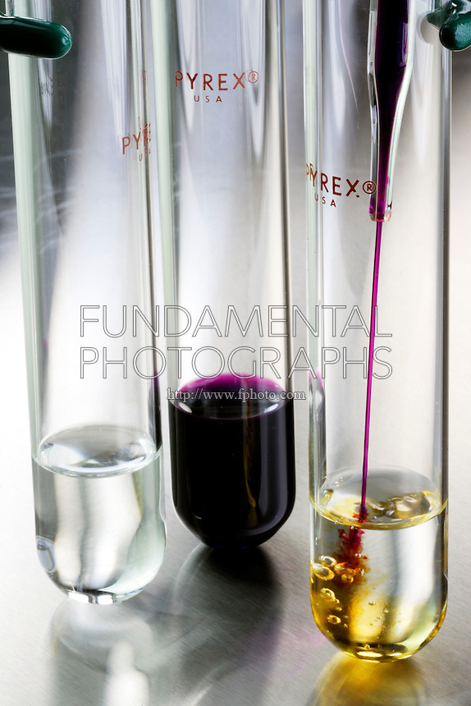
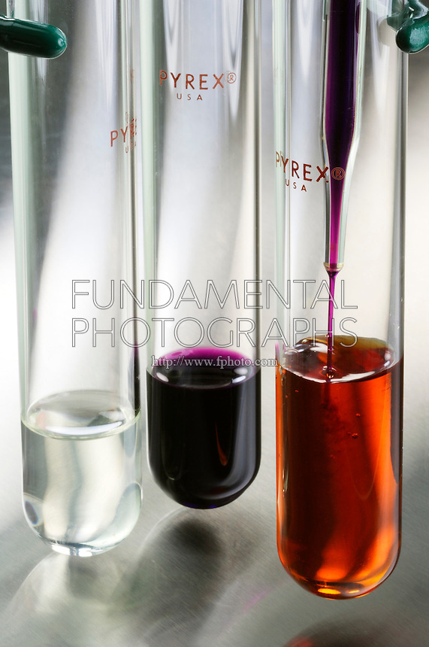
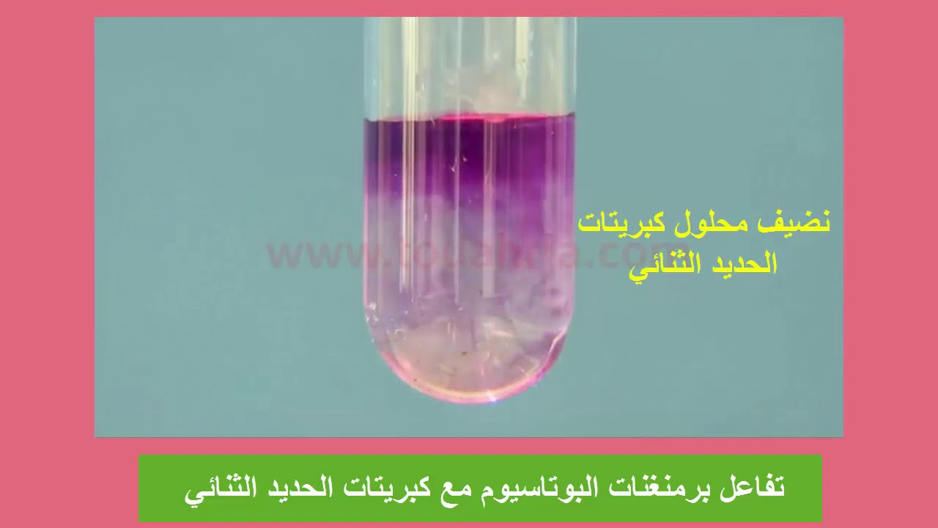
1) Put (10) drops of [Fe(H₂O)₆]²⁺ solution in a test tube, add Potassium Permanganate solution (KMnO₄) drop wise, observe the change, and write down your notices.
تفاعل كبريتات الحديد الامونياكي مع برمنغنات البوتاسبوم

Slide 7
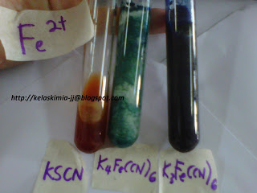
2) Put (10) drops of [Fe(H₂O)₆]²⁺ solution in a test tube, add (2) drops of potassium ferric cyanide solution (K₃[Fe^{III}(CN)₆]), you will notice a dark blue precipitate , and write down your notices.
3) Put (10) drops of [Fe(H₂O)₆]²⁺ solution in a test tube, add (2) drops of Potassium ferro cyanide solution (K₄[Fe^{II}(CN)₆]), you will notice a white precipitate, and write down your notices (the precipitate will change to blue when exposed to air due to oxidation).
4) Put (10) drops of [Fe(H₂O)₆]²⁺ solution in a test tube, add (2) drops of ammonium or Potassium thiocyanate ( (NH₄SCN or KSCN), observe the change, and write down your notices.

Slide 8
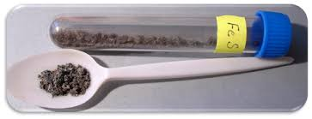
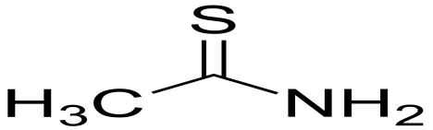
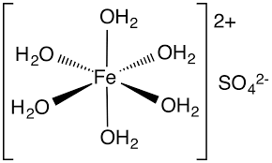
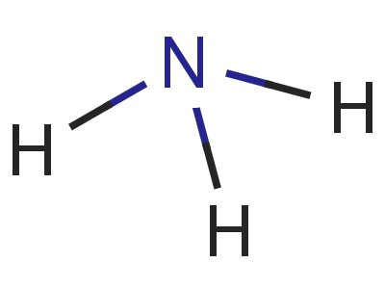
5) Put (10) drops of [Fe(H₂O)₆]²⁺ solution in test tube, add (5) drops of thio acetamide solution (CH₃CSNH₂), observe the change, add (3) drops of concentrated ammonia NH₃(aq), you will notice a black precipitate, and write down your notices.
?

Slide 9
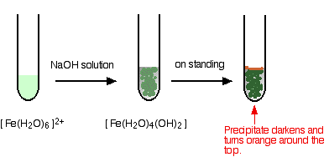
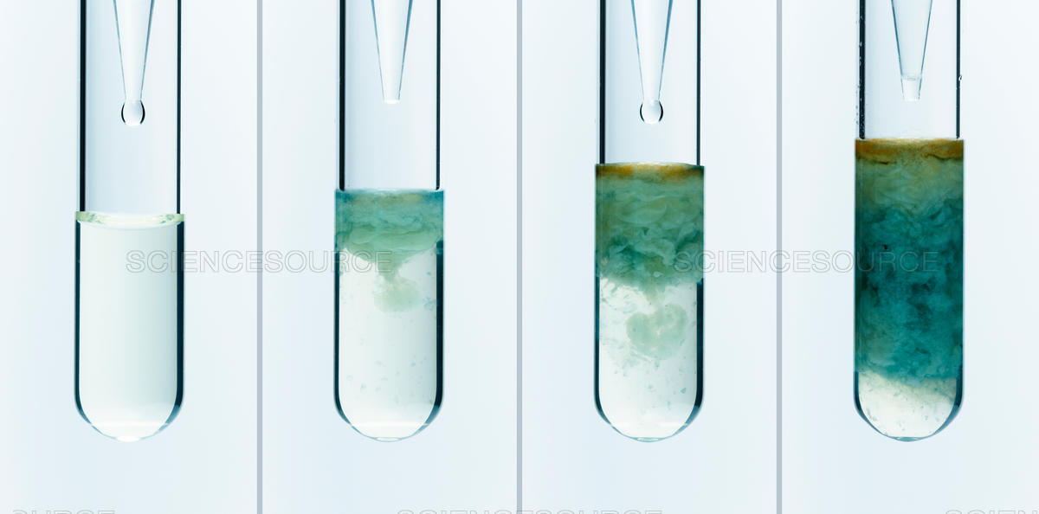
6) Put (10) drops of [Fe(H₂O)₆]²⁺ solution in a test tube, add (2) drops of sodium hydroxide solution (NaOH), you will notice a blackish green precipitate, write down your notices.

Slide 10
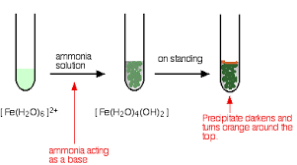
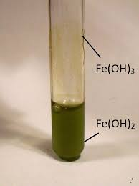
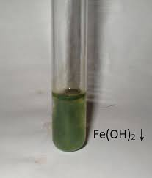
7)Put (10) drops of [Fe(H₂O)₆]²⁺ solution in a test tube, add (2) drops of concentrated ammonia NH₃(aq), you will notice a blackish green precipitate, write down your notices.

Slide 11
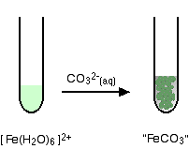
8) Put (10) drops of [Fe(H₂O)₆]²⁺ solution in a test tube, add (2) drops of sodium carbonates (Na₂CO₃), you will notice a green precipitate, write down your notices.

Slide 12
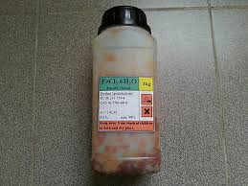
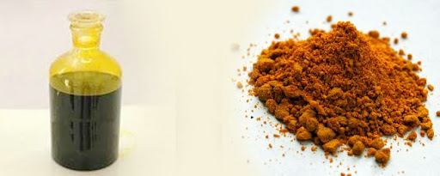
Preparing Solution of (Fe³⁺):
This solution can be prepared by dissolving ferric chloride salt (FeCl₃.6H₂O) in water to form a yellow-orange solution due to formation of the complex ion [Fe(H₂O)₆]³⁺, which can be abbreviated as (Fe³⁺) to carry out detections.
FeCl₃.6H₂O + H₂O → [Fe(H₂O)₆] ³⁺
Brown solid clear orange light

Slide 13
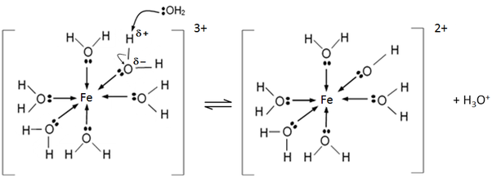
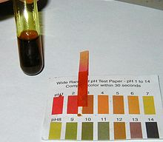
pH of Aqueous ferric solution (Fe³⁺):
Put (10) drops of [Fe(H₂O)₆]³⁺ solution in a test tube, measure solution pH by using Litmus paper, you will observe that the solution is very acidic due to the previously mentioned ionization.

Slide 14
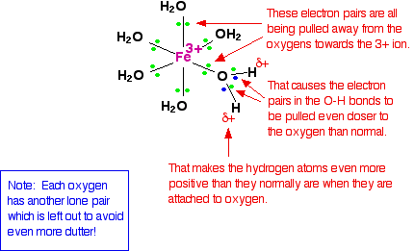
ممكن تفسير الحامضية على ضوء هذا المخطط

Slide 15
Detection of iron (III) (Fe³⁺)

Slide 16
1)Put (10) drops of [Fe(H₂O)₆]³⁺ solution in a test tube, add Potassium Permanganate solution (KMnO₄) drop wise, observe the change, and write down your notices.
يوجد تفاعل ؟

Slide 17
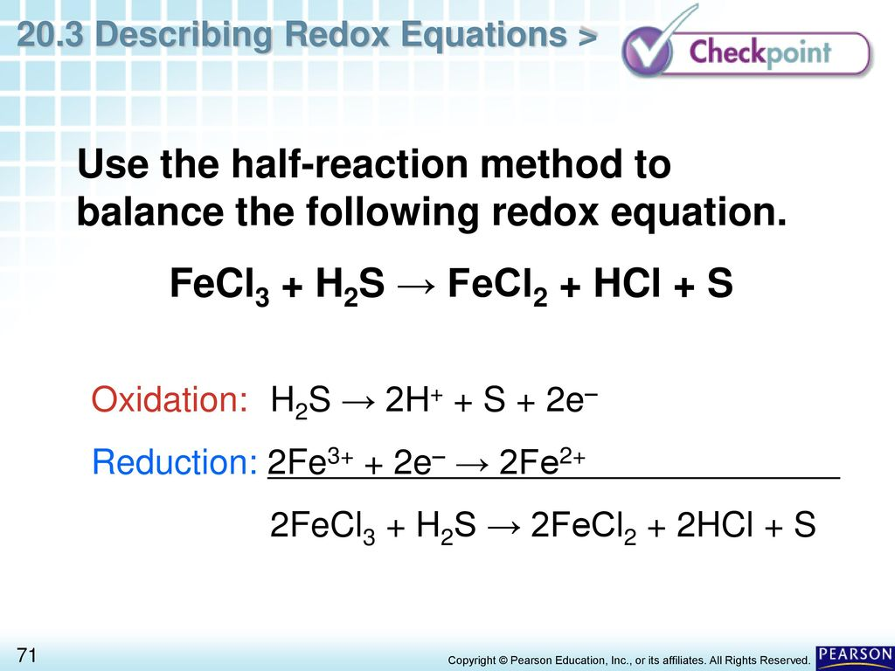
2) Put (10) drops of [Fe(H₂O)₆]³⁺ solution in a test tube, add (5) drops of thioacetamide solution (CH₃CSNH₂), observe the change, add (3) drops of diluted hydrochloric acid HCl, you will notice a white yellowish precipitate , write down your notices.

Slide 18
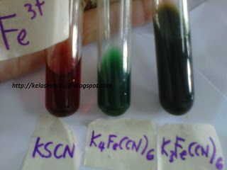
3) Put (10) drops of [Fe(H₂O)₆]³⁺ solution in a test tube, add (2) drops of potassium feeric cyanide solution (K₃[Fe^{III}(CN)₆]), you will notice a brown precipitate , write down your notices.
4) Put (10) drops of [Fe(H₂O)₆]³⁺ solution in a test tube, add (2) drops of Potassium ferrocyanide solution (K₄[Fe^{II}(CN)₆]), you will notice a blue precipitate, write down your notices.
5) Put (10) drops of [Fe(H₂O)₆]³⁺ solution in a test tube, add (2) drops of ammonium (or Potassium) thiocyanate ( (NH₄SCN), you will observe a dark red solution, write down your notices.

Slide 19
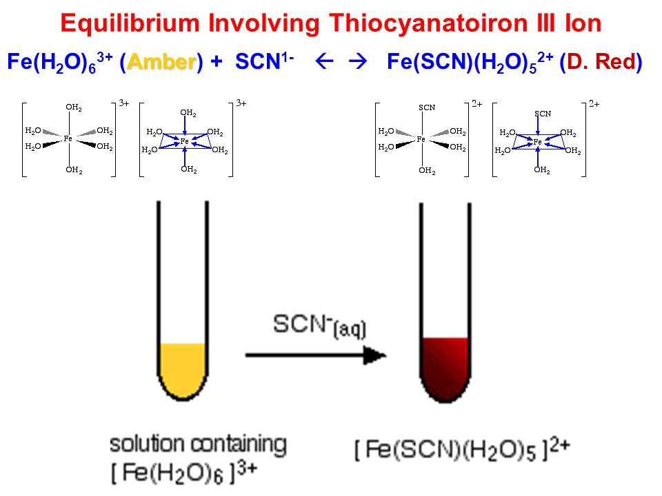
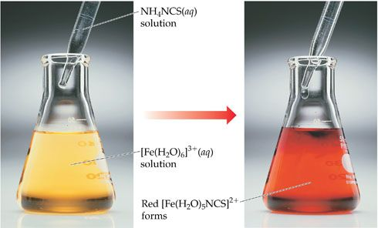

Slide 20
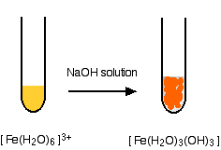
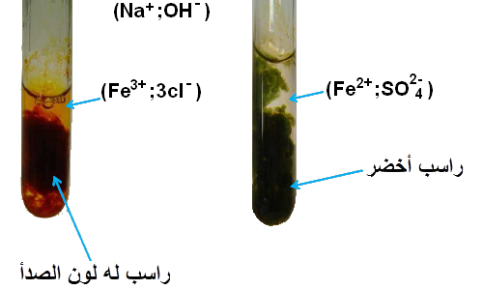
6) Put (10) drops of [Fe(H₂O)₆]³⁺ solution in a test tube, add (2) drops of sodium hydroxide solution (NaOH), you will notice a dark brown precipitate , write down your notices.
لاحظ الفرق وقارن ؟

Slide 21
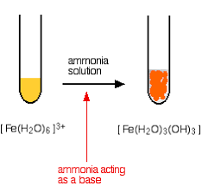
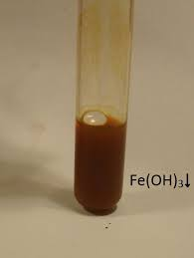
7) Put (10) drops of [Fe(H₂O)₆]³⁺ solution in a test tube, add (2) drops of the concentrated ammonia NH₃(aq), you will notice a dark brown preciptate, write down your notices.

Slide 22
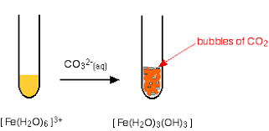
8) Put (10) drops of [Fe(H₂O)₆]³⁺ solution in a test tube, add (2) drops of sodium carbonates (Na₂CO₃), observe the change, and write down your notices.

Slide 23
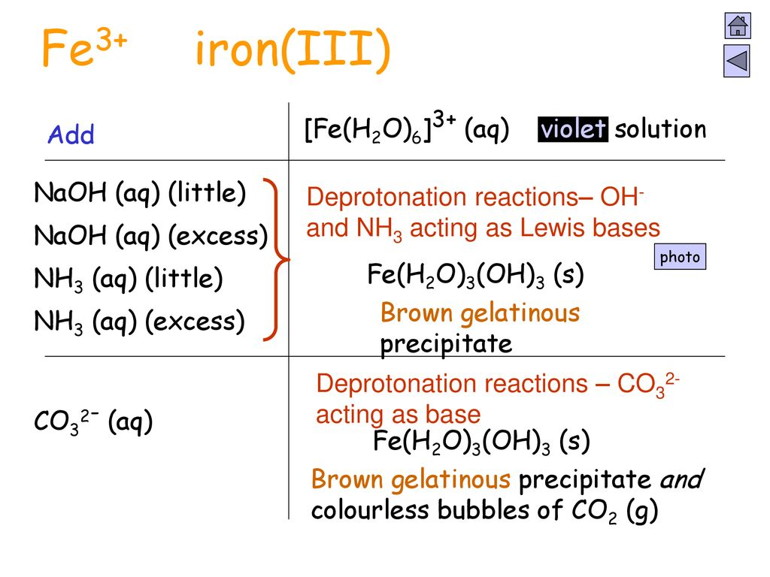
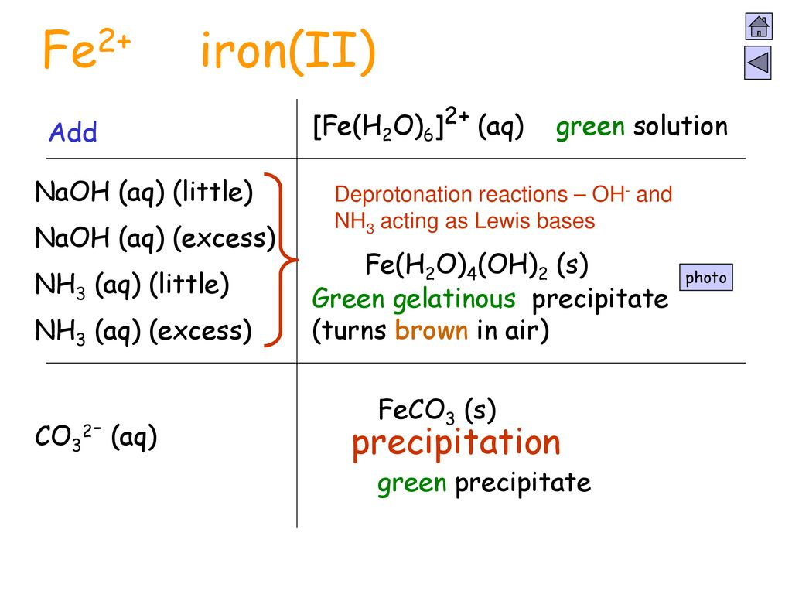
ملاحظات مهمة تبقى معك
؟
يوجد شيء خطأ حاول تجده ؟

Slide 24
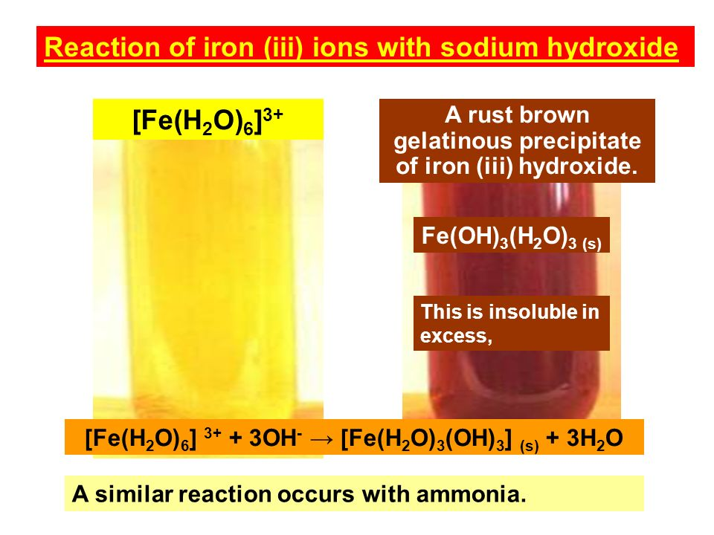
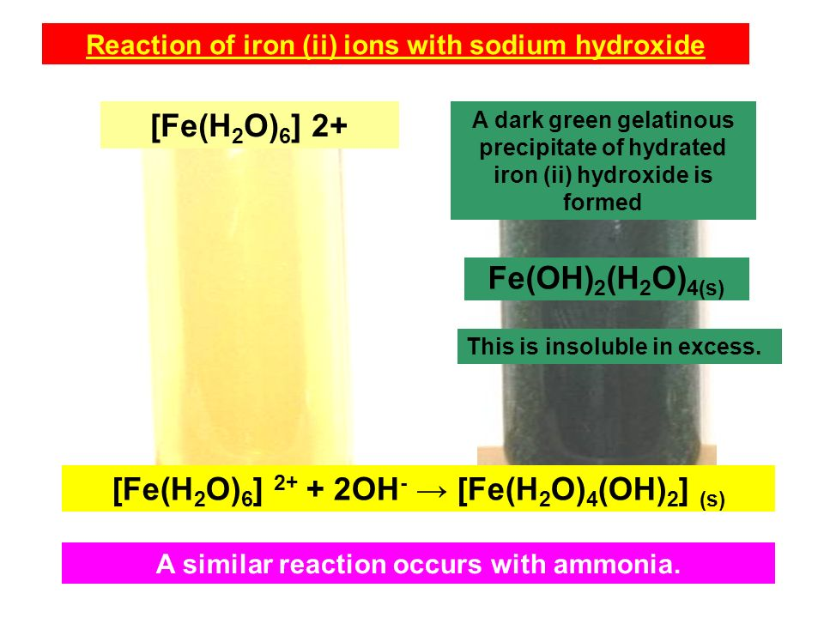

Slide 25
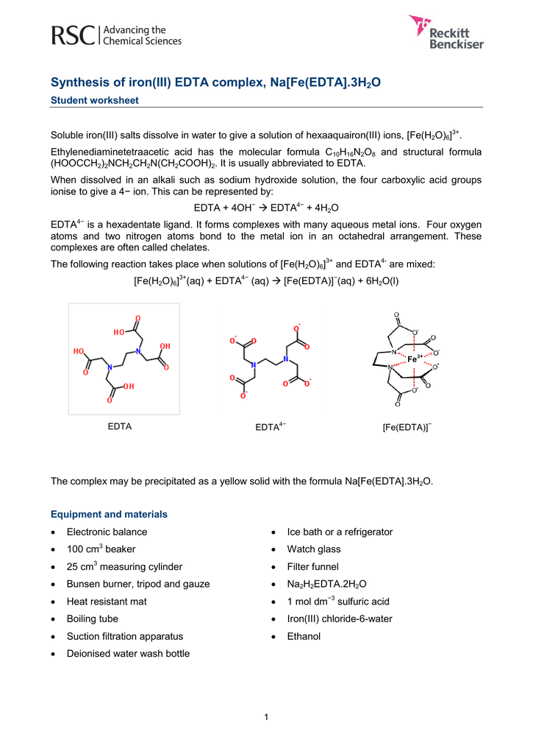
Preparation of Sodium ethylenediaminetetraacetatoferrate (III) trihydrate Na [Fe (EDTA)].3H₂O:
Dissolve (0.4 g) of sodium hydroxide in a beaker consists of (10 mL) of water then add (3.8g) of Na₂H₂EDTA.2H₂O solution to the beaker. Heat the mixture gently until the solid dissolves.
Dissolve (2.5 g) of iron(III) chloride hexa hydrate in (5 mL) of water in other beaker.
Pour the iron(III) chloride solution into the beaker( step 1), stirr the mixture.
Warm the mixture until the boiling , evaporate gently some of the water until a yellow powder precipitates appears , this may take about five minutes.
Let the mixture cool, collect and filter the precipitate , wash it well with ice-cold
water and ethanol , Dry the resulted crystals, weight and calculate the ratio
⁻

Slide 26
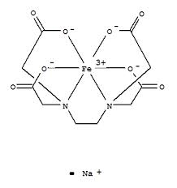
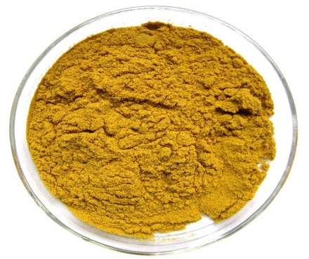
معادلات في التفاعل.. لكن ما هي معادلة التفاعل ألعامة؟

Slide 27
Questions :
1) What is the benefit of using NaOH?
2) Which of these ligands is a chelate (OH⁻, CN⁻, and H₂NCH₂CH₂NH)?
3) Does this experiment depend on oxidation and reduction principle?
4) Write down this complex preparation equations

