Slide 1
  Mixed Layer

Slide 2
Mixed Layer
The turbulence in the mixed layer is usually convectively driven, although a nearly well-mixed layer can form in regions of strong winds.
Convective sources include heat transfer from a warm ground surface, and radiative cooling from the top of the cloud layer. The first situation creates thermals of warm air rising from the ground, while the second creates thermals of cool air sinking from cloud top. Both can occur simultaneously, particularly when a cool stratocumulus topped mixed layer is being advected over warmer ground.
Even when convection is the dominant mechanism, there is usually wind shear across the top of the ML that contributes to the turbulence generation.
On initially cloud-free days, however, ML growth is tied to solar heating of the ground. Starting about a half hour after sunrise, a turbulent ML begins to grow in depth. This ML is characterized by intense mixing in a statically unstable situation where thermals of warm air rise from the ground (Fig 1.8). The ML reaches its maximum depth in late afternoon.
As the tops of the highest thermals reach greater and greater depths during the course of the day, the highest thermals might reach their lifting condensation level, LCL, if sufficient moisture is present.
High or middle overcast can reduce the insolation at ground level. This, in turn, reduces the intensity of thermals. On these days the ML may exhibit slower growth, and may even become non-turbulent or neutrally-stratified if the clouds are thick enough.

Slide 3
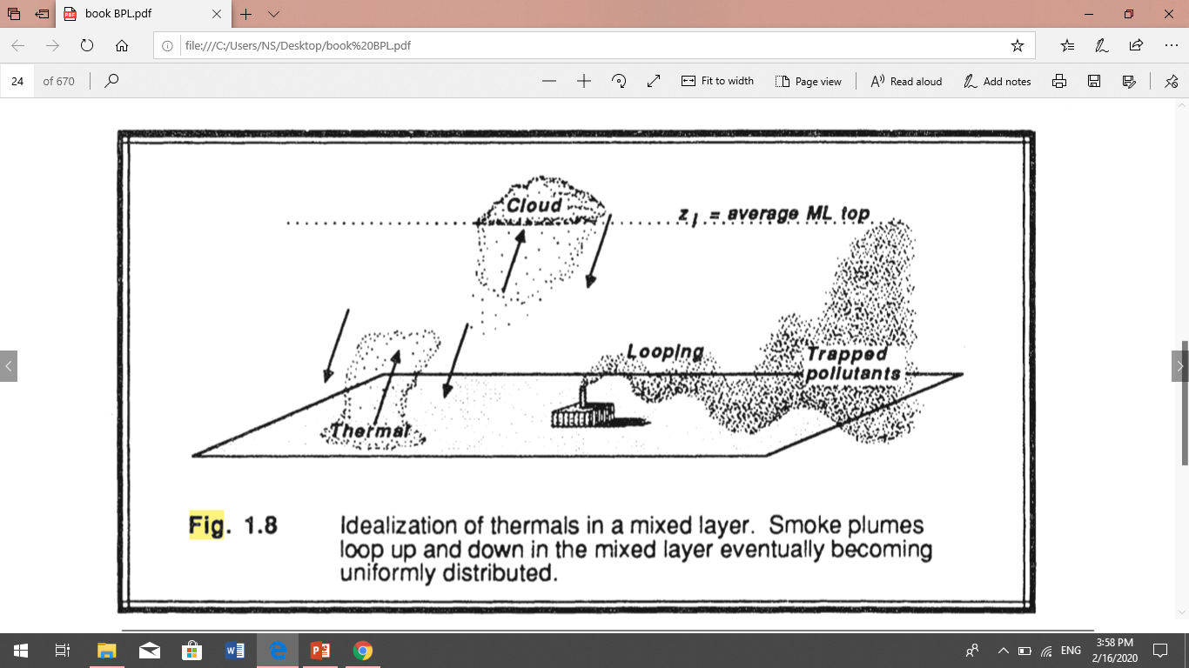
Pollutants emitted from smoke stacks exhibit a characteristic looping as those portions of the effluent emitted into warm thermals begin to rise. Smoke plumes loop up and down in the mixed layer eventually becoming uniformly distributed.

Slide 4
The resulting profiles of virtual potential temperature, mixing ratio, pollutant concentration, and wind speed frequently are as sketched in Figure 1.9.
Virtual potential temperature
are nearly adiabatic in the middle portion of the ML. In the surface layer one often finds a super adiabatic layer adjacent to the ground. A stable layer at the top of the ML acts as a lid to the rising thermals, thus restraining the domain of turbulence. It is called the entrainment zone because entrainment into the ML occurs there. the absolute temperature increases with height. The most common symbol for ML depth is zi' which represents the average height of the inversion base.
Wind speeds
are sub geostrophic throughout the ML, with wind directions crossing the isobars at a small angle towards low pressure. The middle portion of the ML frequently has nearly constant wind speed and direction. Wind speeds decrease towards zero near the ground. resulting in a wind speed profile that is nearly logarithmic with height in the surface layer.
Mixing ratios
tend to decrease with height, even within the center portion of the ML. This reflects the evaporation of soil and plant moisture from below, and the entrainment of drier air from above. The moisture decrease across the top of the ML is very pronounced.
Most pollutant
sources are near the earth's surface. Thus, pollutant concentrations can build up in the ML while FA concentrations remain relatively low. Pollutants are transported by eddies such as thermals.

Slide 5
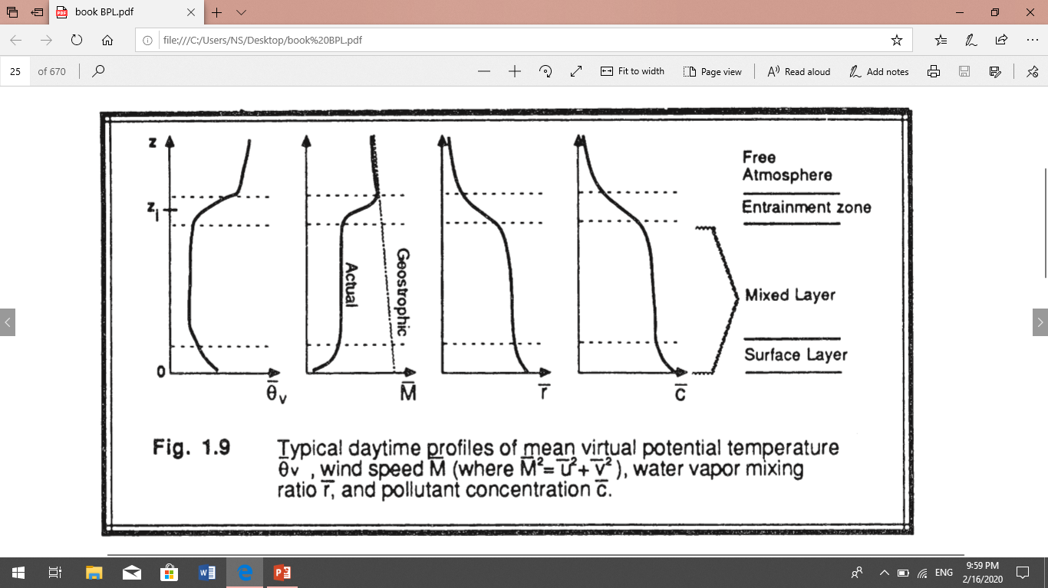

Slide 6
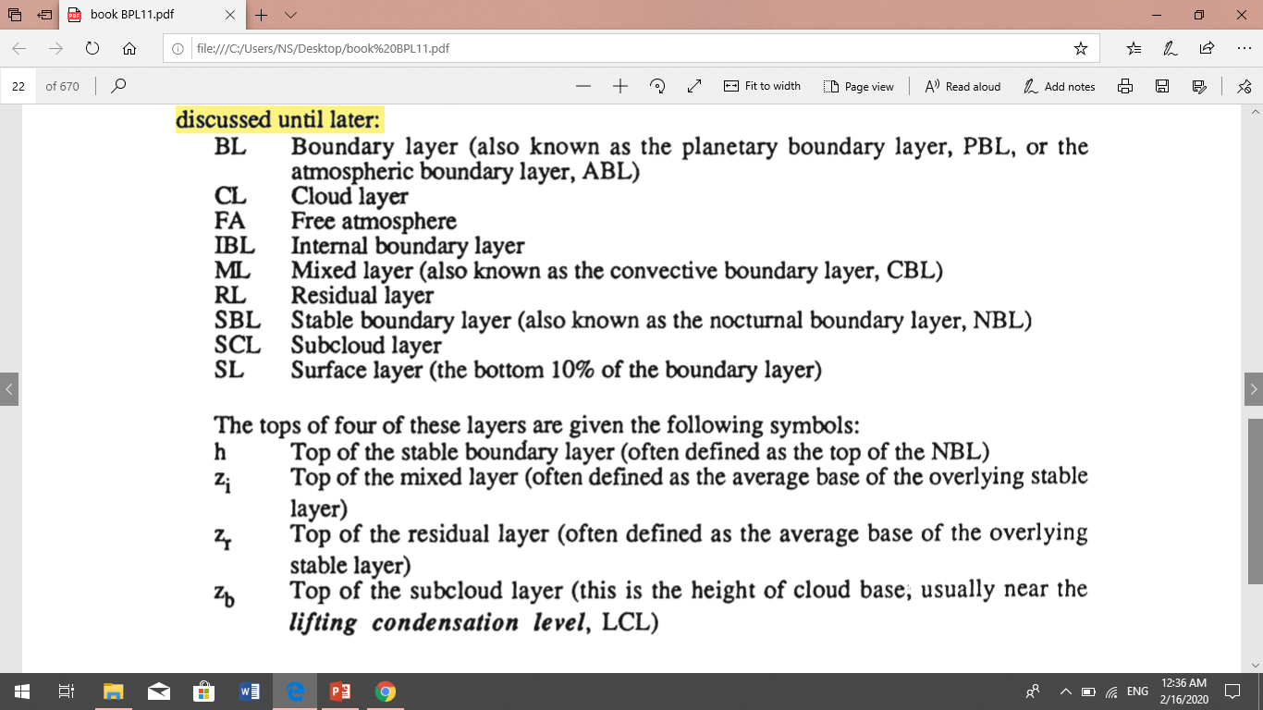

The virtual potential temperature profile is usually sufficient to identify the parts of the boundary layer. The structure of the BL is clearly evident. Fig 1.12 shows the resulting virtual potential temperature profile evolution.

Slide 7
