Slide 1




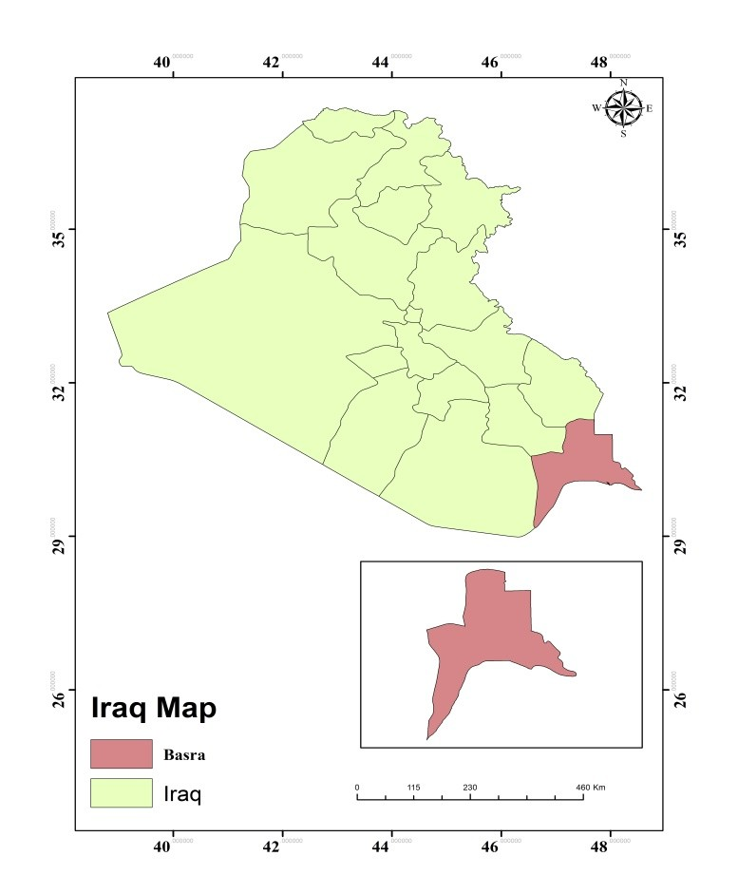

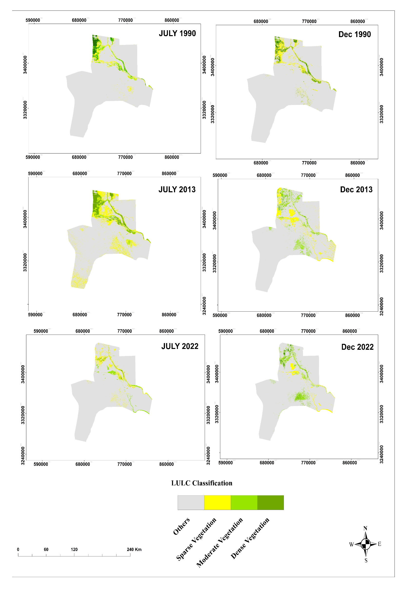
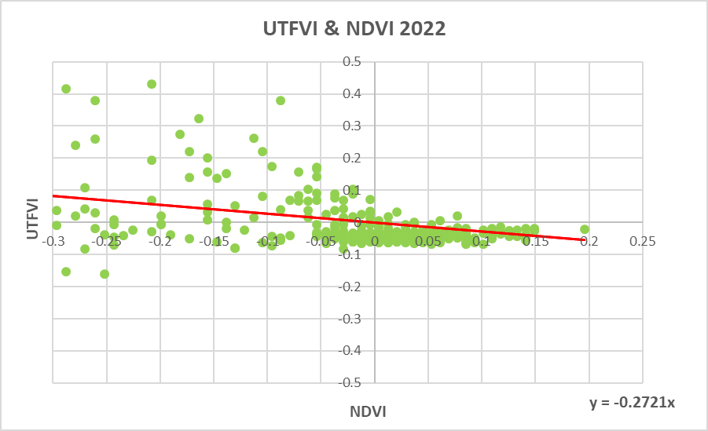

Relationship between Vegetation Cover and Land Surface Temperature in Basra, Iraq
Assist Lect. Marwa K. Tawfik
Dr. Alaa M. Al-Lami
Department of Atmospheric Science, College of Science , Mustansiriyah University
Abstract
Study area
This study analyzes the changes in vegetation cover and their relationship with land surface temperature (LST) in Basra Province, Iraq, from 1990 to 2024 using Landsat 5 and 8 satellite imagery. NDVI was used to classify vegetation into dense, moderate, sparse, and non-vegetated categories. Results show a significant and continuous decline in dense vegetation from 4.8% in 1990 to 1.0% in 2024, alongside an increase in non-vegetated land from 67.4% to 79.3%. The NDVI–LST relationship weakened over time, with R² decreasing from 0.11 in 1990 to 0.06 in 2024, indicating reduced cooling effects of vegetation due to rapid urban expansion, desertification, and climate stress. These findings highlight substantial environmental degradation in Basra and emphasize the need for sustainable land management, afforestation, and climate adaptation strategies.
Vegetation plays a critical role in climate regulation, ecological stability, and land surface cooling. NDVI is widely used to evaluate vegetation health and density. Basra has experienced severe climatic stress, rapid urban growth, and increasing land degradation, making it essential to assess long-term vegetation changes and their impact on LST.
Basra Province lies in southern Iraq and has an extremely hot desert climate, with summer temperatures above 45°C and rainfall below 100 mm. The area is flat, very dry, and highly vulnerable to vegetation loss and rising land surface temperatures.
Introduction
shows the location of Basra in Iraq
Results
NDVI–LST Relationship
Dense vegetation decreased from 4.8% (1990) to 1.0% (2024)• Non-vegetated areas increased from 67.4% to 79.3%• Sparse vegetation peaked in early 2000s, then declined• Winter values show the same declining trend
R² declined from 0.1124 (1990) to 0.0633 (2022)
Higher NDVI consistently associated with lower LST
Weakening relationship indicates loss of vegetation cooling effect
Urban heat islands intensified due to impervious surfaces
Relationship between NDVI and LST during 2022
Conclusion
Vegetation cover in Basra has declined sharply over three decades, resulting in weakened temperature regulation and intensified heat stress. The decreasing NDVI–LST correlation reflects the growing dominance of urban heat islands and environmental degradation. Long-term strategies such as afforestation, improved water management, and sustainable urban planning are essential to restore ecological balance and reduce LST.
Spatiotemporal Distribution NDVI for Basra

