Slide 1


Lab. ( 5 )
General Methods of Extraction of Medicinal Plants
• M.Sc. Dhuha Mohsen Abbas
• University of Mustansiriyah,
• College of Science,
• Department of Biology,
• Medicinal Plants
• Plant physiology

Slide 2
1 -Maceration:
2-Infusion:
3-Digestion:
4-Decoction:
5-Percolation:
6-Hot Continuous Extraction (Soxhlet):
7-Aqueous Alcoholic Extraction by Fermentation:
8-Counter-current Extraction: (CCE)
9-Ultrasound Extraction (Sonication):
10-Supercritical Fluid Extraction:

Slide 3
Maceration: In this process, the whole or coarsely powdered crude drug is placed in a stoppered container with the solvent and allowed to stand at room temperature for a period of at least 3 days with frequent agitation until the soluble matter has dissolved. The mixture then is strained, the marc (the damp solid material) is pressed, and the combined liquids are clarified by filtration or decantation after standing.
Infusion: Fresh infusions are prepared by macerating the crude drug for a short period of time with cold or boiling water. These are dilute solutions of the readily soluble constituents of crude drugs.
Digestion: This is a form of maceration in which gentle heat is used during the process of extraction. It is used when moderately elevated temperature is not objectionable. The solvent efficiency of the menstruum is thereby increased. Decoction: In this process.
Decoction: In this process, the crude drug is boiled in a specified volume of water for a defined time; it is then cooled and strained or filtered. This procedure is suitable for extracting water- soluble, heat-stable constituents.
This process is typically used in preparation of Ayurvedic extracts called “quath” or “kawath”. The starting ratio of crude drug to water is fixed, e.g.1:4 or 1:16; the volume is then brought down to one-fourth its original volume by boiling during the extraction procedure. Then, the concentrated extract is filtered and used as such or processed further

Slide 4
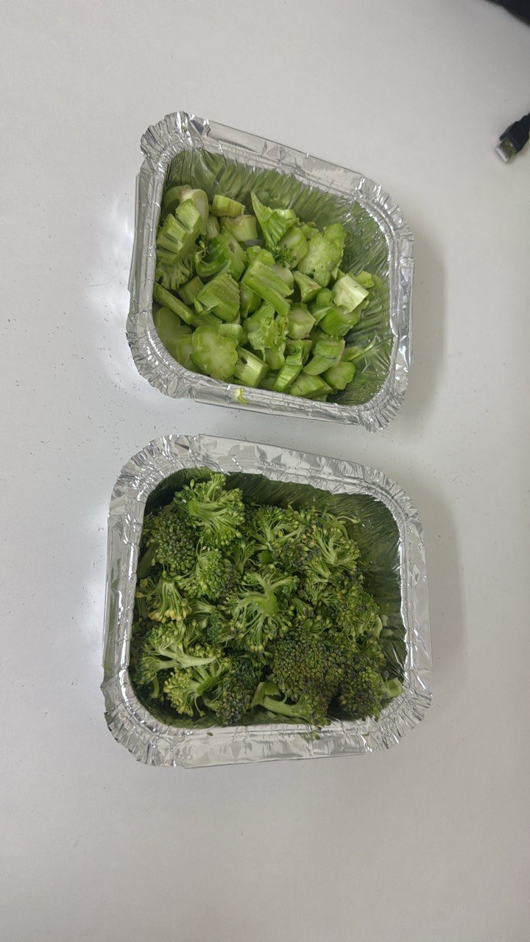
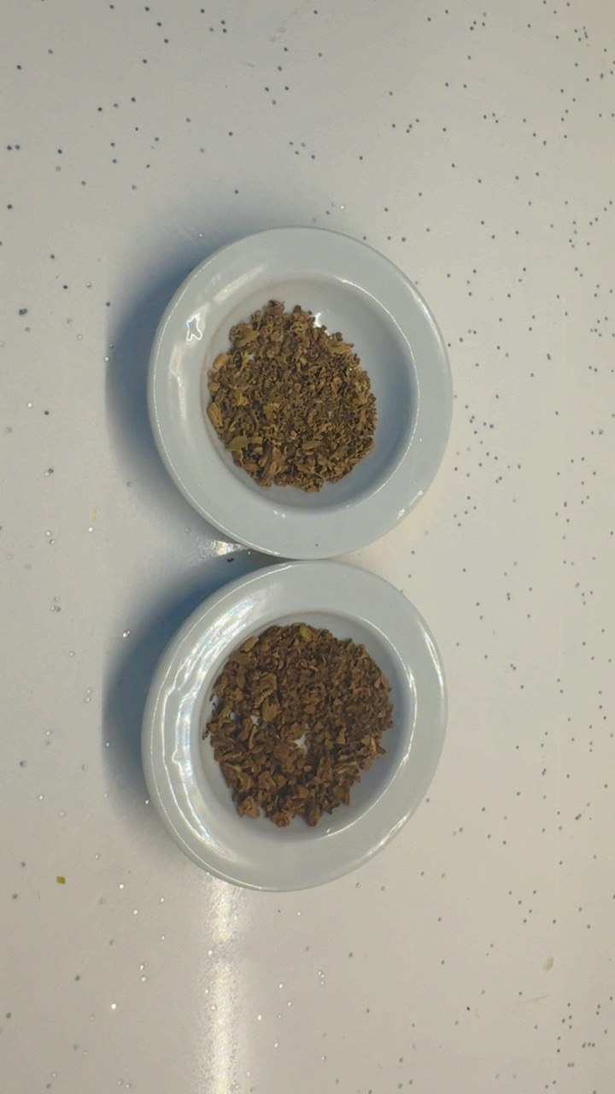

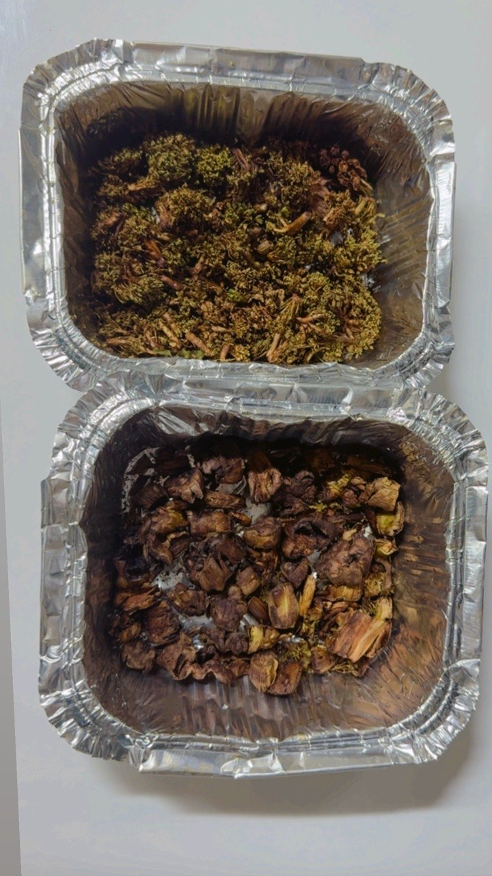
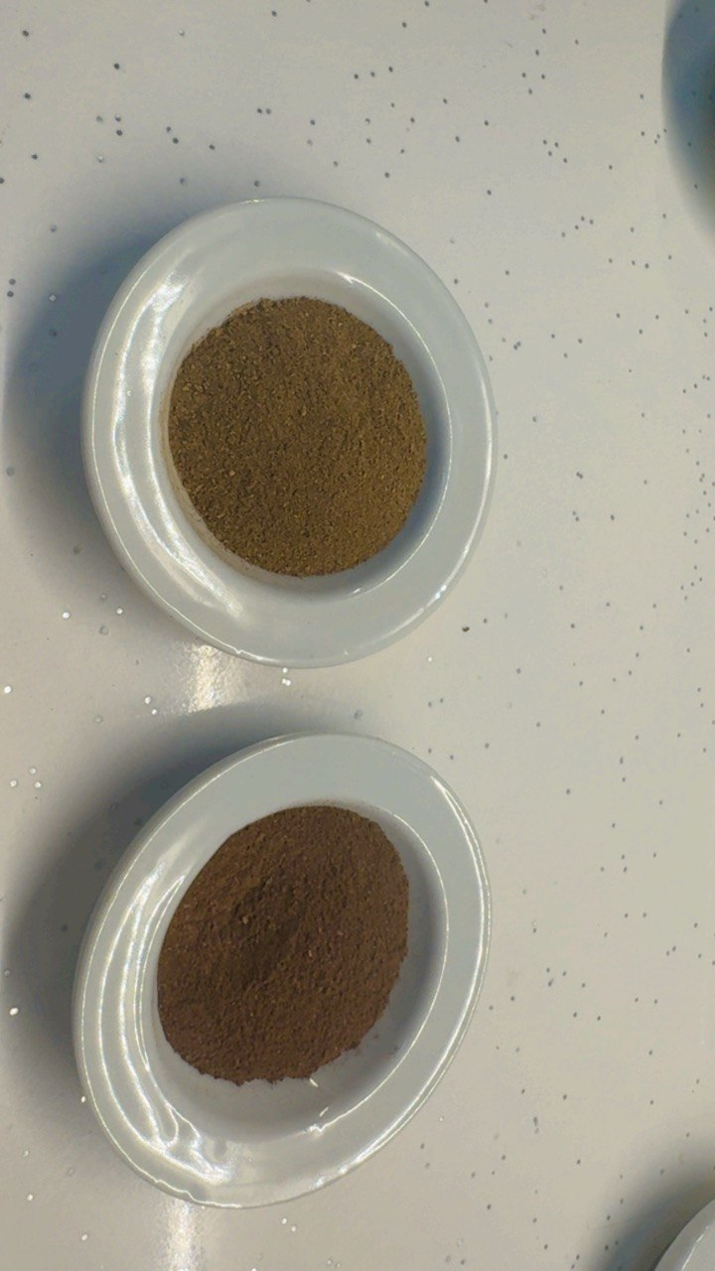

Slide 5
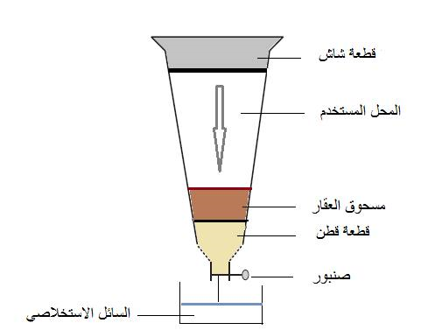
Percolation:
This is the procedure used most frequently to extract active ingredients in the preparation of tinctures and fluid extracts. A percolator (a narrow, cone-shaped vessel open at both ends) is generally used (Figure 1). The solid ingredients are moistened with an appropriate amount of the specified menstruum and allowed to stand for approximately 4 h in a well closed container, after which the mass is packed and the top of the percolator is closed. Additional menstruum is added to form a shallow layer above the mass, and the mixture is allowed to macerate in the closed percolator for 24 h. The outlet of the percolator then is opened and the liquid contained therein is allowed to drip slowly. Additional menstruum is added as required, until the percolate measures about three-quarters of the required volume of the finished product. The marc is then pressed and the expressed liquid is added to the percolate. Sufficient menstruum is added to produce the required volume, and the mixed liquid is clarified by filtration or by standing followed by decanting.

Slide 6
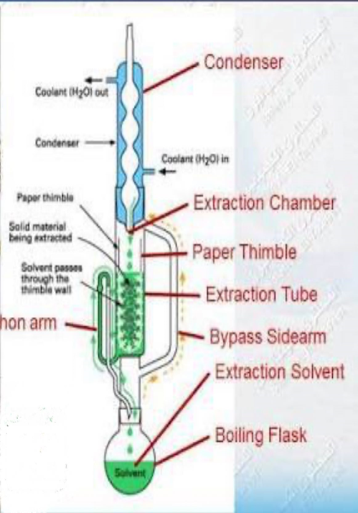
6-Hot Continuous Extraction (Soxhlet):
Hot Continuous Extraction (Soxhlet):
In this method, the finely ground crude drug is placed in a porous bag or
“thimble” made of strong filter paper, which is placed in chamber E of the Soxhlet
apparatus (Figure 2).
The extracting solvent in fl ask A is heated, and its vapors condense in condenser
D. The condensed extractant drips into the thimble containing the crude drug,
and extracts it by contact. When the level of liquid in chamber E rises to the top
of siphon tube C, the liquid contents of chamber E siphon into fl ask A.
This process is continuous and is carried out until a drop of solvent from the siphon
tube does not leave residue when evaporated. The advantage of this method,
compared to Previously described methods, is that large amounts of drug can be
extracted with a much smaller quantity of solvent. This effects tremendous economy
in terms of time, energy and consequently financial inputs. At small scale, it is
employed as a batch process only, but it becomes much more economical and
viable when converted into a continuous extraction procedure on medium or large scale.

Slide 7
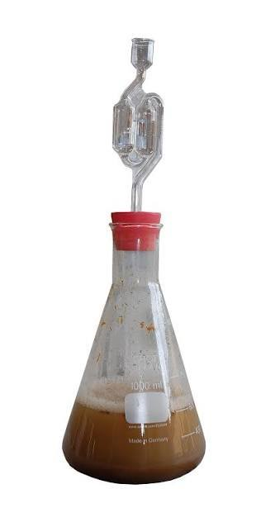
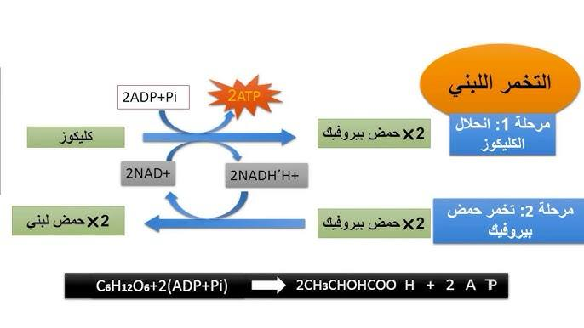
Aqueous Alcoholic Extraction by Fermentation:
Some medicinal preparations of Ayurveda (like asava and arista) adopt the technique of fermentation for extracting the active principles. The extraction procedure involves soaking the crude drug, in the form of either a powder or a decoction (kasaya), for a specified period of time, during which it undergoes fermentation and generates alcohol in situ; this facilitates the extraction of the active constituents contained in the plant material. The alcohol thus generated also serves as a preservative. If the fermentation is to be carried out in an earthen vessel, it should not be new: water should first be boiled in the vessel. In large-scale manufacture, wooden vats, porcelain jars or metal vessels are used in place of earthen vessels. Someة examples of such preparations are karpurasava, kanakasava, dasmularista.
In Ayurveda, this method is not yet standardized but, with the extraordinarily high degree of advancement in fermentation technology, it should not be difficult to standardize this technique of extraction for the roduction of herbal drug extracts.

Slide 8
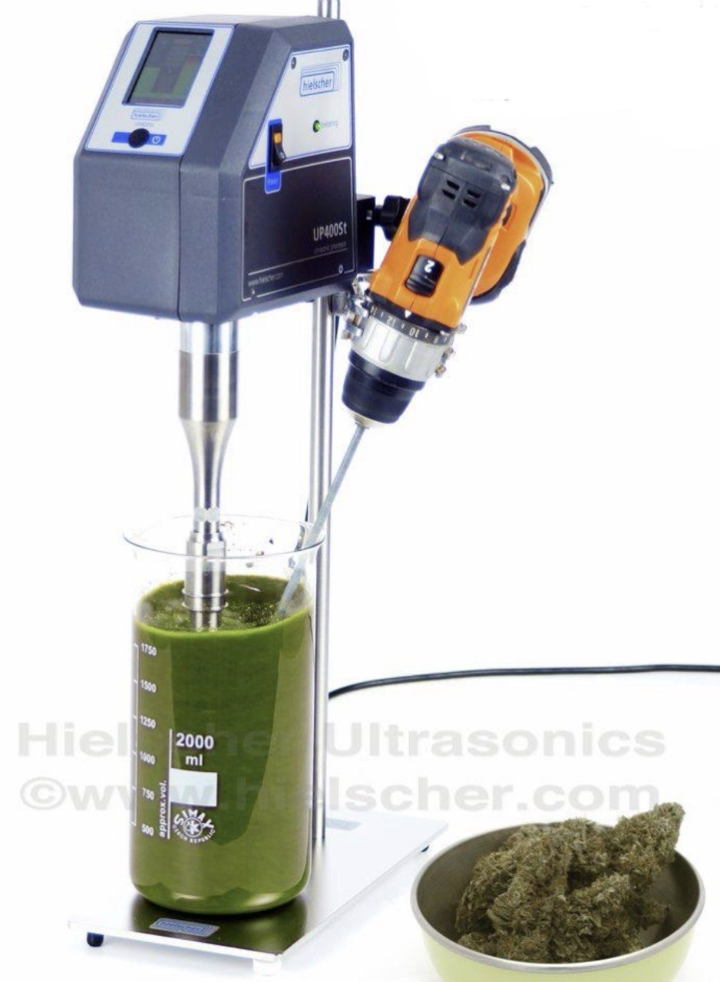
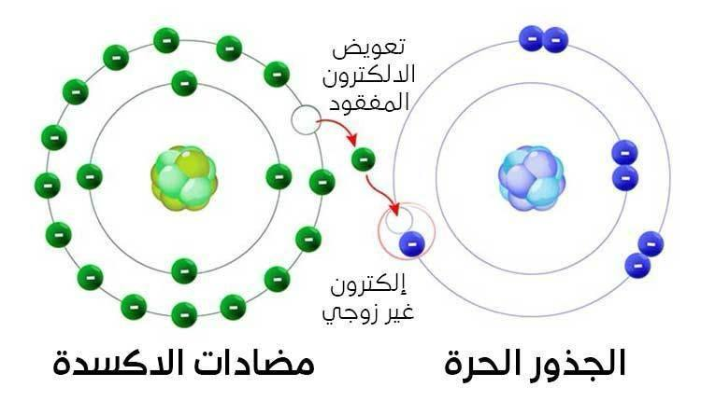
Counter-current Extraction: In counter-current extraction (CCE), wet raw material is pulverized using toothed disc disintegrators to produce a fi ne slurry. In this process, the material to be extracted is moved in one direction (generally in the form of afine slurry) within a cylindrical extractor where it comes in contact with extraction solvent. The further the starting material moves, the more concentrated the extract becomes.
Complete extraction is thus possible when the quantities of solvent and material and their fl ow rates are optimized.
The process is highly efficient, requiring little time and posing no risk from high temperature. Finally, sufficiently concentrated extract comes out at one end of the extractor while the marc (practically free of visible solvent) falls out from the other end.
This extraction process has significant advantages: i) A unit quantity of the plant material can be extracted with much smaller volume of solvent as compared to other methods like maceration, decoction, percolation. ii) CCE is commonly done at room temperature, which spares the thermo labile constituents from exposure to heat which is employed in most other techniques. iii) As the pulverization of the drug is done under wet conditions, the heat generated during comminution is neutralized by water. This again spares the thermo labile constituents from exposure to heat. iv) The extraction procedure has been rated to be more efficient and effective than continuous hot extraction.

Slide 9
Ultrasound Extraction (Sonication):
The procedure involves the use of ultrasound with frequencies ranging from 20 kHz to 2000 kHz; this increases the permeability of cell walls and produces cavitation. Although the process is useful in some cases like extraction of rauwolfi a root, its large-scale application is limited due to the higher costs. One disadvantage of the procedure is the occasional but known deleterious effect of ultrasound energy (more than 20 kHz) on the active constituents of medicinal plants through formation of free radicals and consequently undesirable changes in the drug molecules.
Supercritical Fluid Extraction: Supercritical fl uid extraction (SFE)
is an alternative sample preparation method with general goals of reduced use of organic solvents and increased sample throughput. The factors to consider include temperature, pressure, sample volume, analyte collection, modifier (cosolvent) addition, flow and pressure control, and restrictors. Generally, cylindricalextraction vessels are used for SFE and their performance is good beyond any doubt. The collection of the extracted analyte following SFE is another important step: significant analyte loss can occur during this step, leading the analyst to believe that the actual efficiency was poor. There are many advantages to the use of CO2 as the extracting fluid. In addition to its favorable physical properties, carbon dioxide is inexpensive, safe and abundant. But while carbon dioxide is the preferred fluid for SFE, it possesses several polarity limitations. Solvent polarity is important when extracting polar solutes and when strong analyte-matrix interactions are present. Organic solvents are frequently added to the carbon dioxide extracting fluid to alleviate the polarity limitations. Of late, instead of carbon dioxide, argon is being used because it is inexpensive and more inert. The component recovery rates generally increase with increasing pressure or temperature: the highest recovery rates in case of argon are obtained at 500 atm and 150° C. The extraction procedure possesses distinct advantages: i) The extraction of constituents at low temperature, which strictly avoids damage from heat and some organic solvents. ii) No solvent residues. iii)Environmentally friendly extraction procedure. The largest area of growth in the development of SFE has been the rapid expansion of its applications. SFE finds extensive application in the extraction of pesticides, environmental samples, foods and fragrances, essential oils, polymers and natural products. The major eterrent in the commercial application of the extraction process is its prohibitive capital investment.

Slide 10
Aromatic Plant Extracts
1. Concrete
2. Absolutes
3. Resinoids
4. Hydrodistillation
5. Essential Oil Extraction by Expression
In order to isolate essential oils by hydrodistillation, the aromatic plant material is packed in a still and a sufficient quantity of water is added and brought to a boil; alternatively, live steam is injected into the plant charge. Due to the influence of hot water and steam, the essential oil is freed from the oil glands in the plant tissue. The vapor mixture of water and oil is condensed by indirect cooling with water. From the condenser,distillate fl ows into a separator, where oil separates automatically from the distillate water.

Slide 11
A. Water distillation: In this method, the material is completely immersed in water, which is boiled by applying heat by direct fi re, steam jacket, closed steam jacket, closed steam coil or open steam coil. The main characteristic of this process is that there is direct contact between boiling water and plant material. The laboratory apparatus recommended for trial distillations is the Clevenger system. Figure: Clevenger-type laboratory-scale hydrodistillation apparatus.
B. Water and steam distillation: In water and steam distillation, the steam can be generated either in boiler or within the still. water and steam distillation does not require a great deal more capital expenditure than water distillation. Also, the equipment used is generally similar to that used in water distillation, but the plant material is supported above the boiling water on a perforated grid.
C. Direct steam distillation: As the name suggests, direct steam distillation is the process of distilling plant material with steam generated outside the still in a satellite steam generator generally referred to as a boiler. As in water and steam distillation, the plant material is supported on a perforated grid above the steam inlet. A real advantage of satellite steam generation is that the amount of steam can be readily controlled. Because steam is generated in a satellite boilشer, the plant material is heated no higher is the most widely accepted process for the production of essential oils on large scale. Throughout the flavor and fragrance supply business, it is a standard practice.

Slide 12
5- Essential Oil Extraction by Expression:
Expression or cold pressing, as it is also known, is only used in the production of citrus oils. The term expression refers to any physical process in which the essential oil glands in the peel are crushed or broken to release the oil. One method that was practiced many years ago, particularly in Sicily (spugna method), commenced with halving the citrus fruit followed by pulp removal with the aid of sharpened spoon-knife (known as arastrello). The oil was removed from the peel either by pressing the peel against a hard object of baked clay (concolina) which was placed under a large natural sponge or by bending the peel into the sponge. The oil emulsion absorbed by the sponge was removed by squeezing it into the concolina or some other container. It is reported that oil produced this way contains more of the fruit odor character than oil produced by any other method.
Experiments (1):- Preparation of water extracts: 1) 50 g of dried plant parts could be taken such as (Nerium oleander, Vinca rosa), and put it in 250ml of Boiled sterilized distilled water with continuums stirring until it cool down. 2) Filtrate the resulted solution with filter paper and replace it in closed sterilized container prior to be stored in the fridge until use.

Slide 13
Experiments (2):- Preparation of alcoholic extracts:
1. Followed the same method in 1 but replace the boiled water with ethanol. Separating funnel used in this experiment with continuous stirling for 24-48 hr.
2. Saxhlet apparatus used in this method for extraction and the same amount of dried plant parts and alcohol used in this apparatus for 6-8 hr. then filtrate the extract resulted which should be put in sterilized container in the fridge until used.
Experiments (3): Extraction of oil (Essential oils)
1) Take 50 g from Aromatic plant such as: Linum usitatissimum, Nigella sativa, Sesamum orientale.
2) 250 ml of Hexane added and replace it in the continuous extractor or steam distillators.
3) Collect theresulted oil in the flask and keep it in the fridge until use.
Experiments (4): Extraction of volatile oils: (Eucalyptus sp., Myrtus communis)
1) 15 g of plant part (dried and in powder form) and 50 ml of Boiled distilled water adding to it with continuous stirling until it cool down.
2) Filtrate the extract.
3) Store the extract with sterilized clean container.
4) 1 ml of the extract (water extract) take and one drop of the reagent added to it.
5) Registar the reagents results .

