Slide 1
Botany Lab.2
Introduction in Plant groups
M.Sc. Dhuha Mohsen Abbas
University of Mustansiriyah,
College of Science,
Department of Biology
Botany

Slide 2
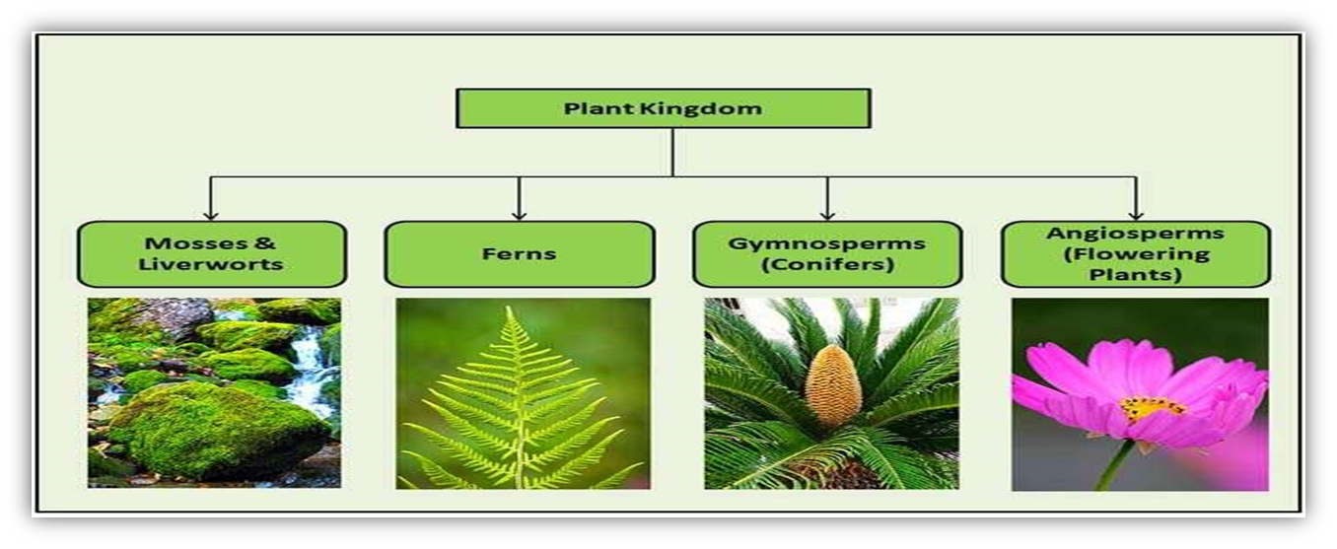
Plant groups
Introduction
Plants are multicellular Eukaryotes, that consider primary producers in the food chain. All the members of the plant kingdom can make their own food by (utilizing sunlight, carbon dioxide, water, photosynthetic pigments( such as chlorophyll a, b, and carotenoid pigments. This process is known as (photosynthesis(. Only plants can make their food. All other living organisms are dependent on plants to derive food and energy.
Kingdom Plantae: was first separated from heterotrophic fungi and unicellular prokaryotic cyanobacteria by Whittaker in 1969 while proposing a five-kingdom classification system. According to this classification, all the known living organisms on the earth weredivided into five categories:
1. Kingdom Monera
2. Kingdom Protista
3. Kingdom Fungi
4. Kingdom Animalia
5. Kingdom Plantae

Slide 3
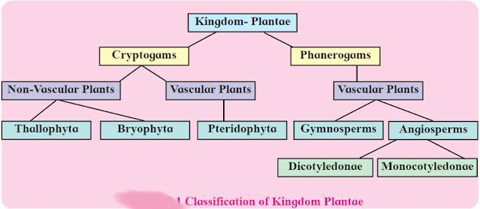
Classification of Kingdom Plantae
There are 270,000 species of plants identified and classified to date. A.W. Eichler (1883(classification. gave a system of divided plants according to the presence of specialized tissues that classification of the plant kingdom.It is the phylogenetic system of transfer water and nutrients in plants. Into two sub-kingdoms,)Cryptogams and Phanerogams(.
1- Non-Vascular Plant (Cryptogams): These plants lack composed vascular tissue,which is one of their characteristics. The root, stem, and leaves, as well as from woodand bark, and reproduces by spores.
a. Thallophyta
b. Bryophyta (Mosses)

Slide 4
2- Vascular Plant (Phanerogams ): These plants have actual vascular tissue madeXylem and phloem as one of their distinguishing characteristics. They also have leaveroots, and stems that reproduce by seeds and spores.
The vascular plants are divided into two groups :
a) Seedless They are plants that reproduce by spores, which are carried on leaves. It is divided intLichens & Pteridophyta (ferns)
b) Seedling They are plants that reproduce by seed It is divided into:
1. Gymnosperms:
2. Angiosperms: divided into Dicotyledonous and monocotyledonous plants

Slide 5
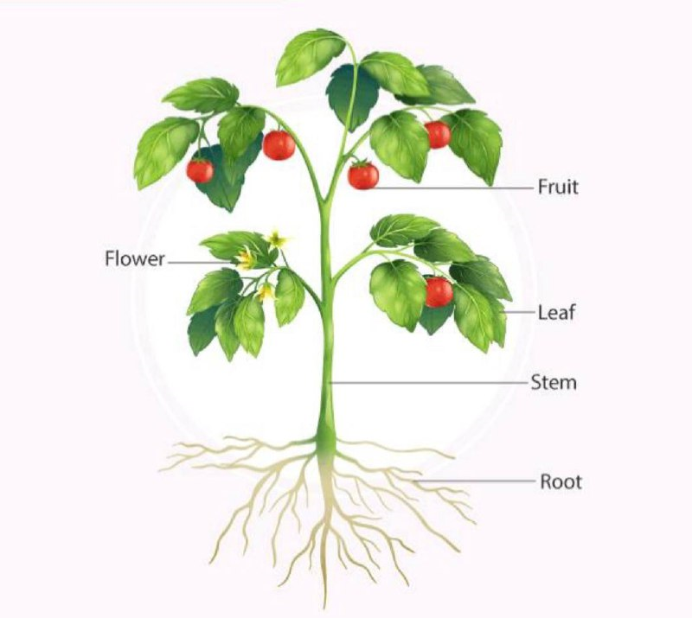
Plant Parts
1. Root .
2. Stem .
3. Leaves (Leaf) .
4. Flower .
5. Fruit .

Slide 6
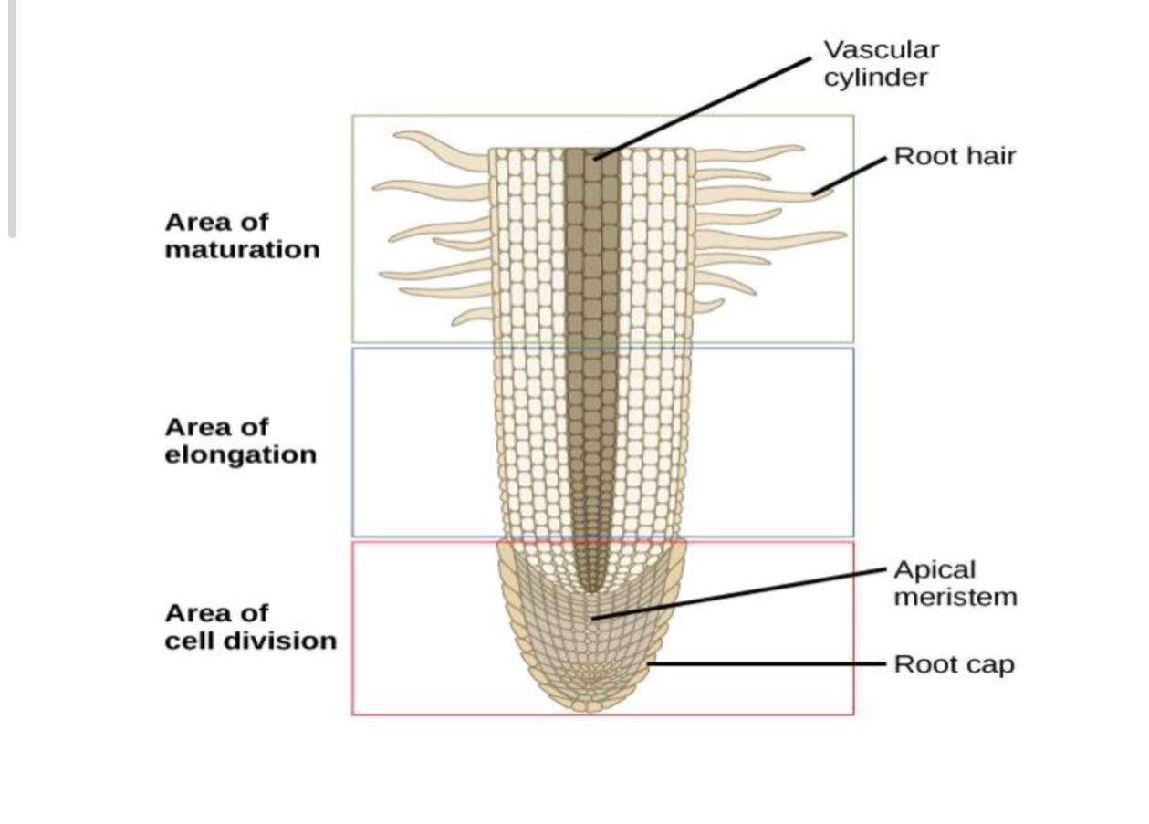
❖ ROOT:
1. Root cup .
2. Zone of cell Division (Apical Meristem).
3. Zone of Enlongation(cell increase in size & long ).
4. Zone of Maturation .
Function:
1. Root system anchors the plant in soil .
2. Absorb water & minerals from soil .
3. Store the product of photosynthesis recived from.

Slide 7
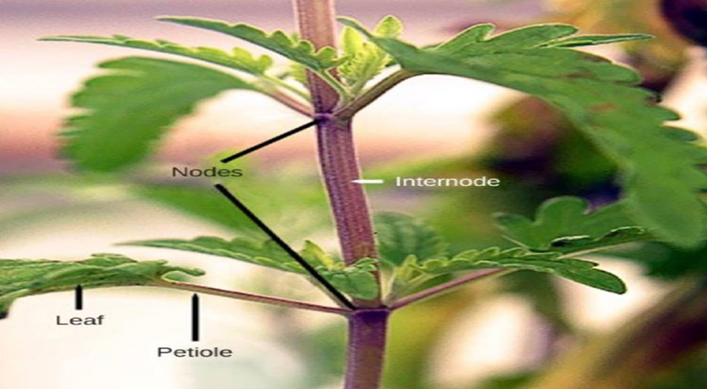
❖STEM.
1. Nodes .
2. Internodes .
3. Terminal Buds (Apical meristem)[ Apical Branches],and (Axillary buds )
[Lateral Branches].
Function :
1. Support the stractures of plant (flowers , fruits , leaves ).
2. Bring water and menirals to leaves and distributed photosynthesis products to roots .
3. storage water and food and important in vegetative reproduction.

Slide 8
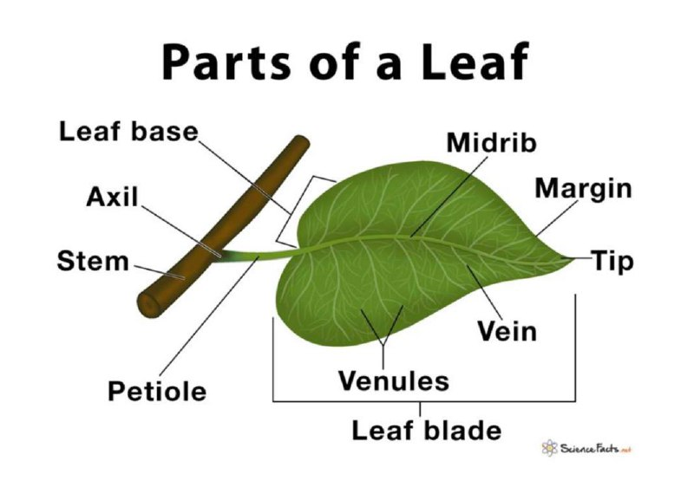
❖ LEAF.
Is the organ that produce food in plant .
Parts :
1. Flat Blade .
2. Midrib .
3. Petiole .
4. Veins .
Function :
1. produce energy compounds (ATP) or food by photosynthesis process .
2. leaf surface have stomata ( pores ) ,which through them the gas exchange done
and remove water from plant body ( Transmission process ).

