Slide 1
Lab 3 plants tissue practical botan
The third level
M.Sc. Dhuha Mohsen Abbas
University of Mustansiriyah
College of Science
Department of Biology
Botany

Slide 2
A tissue : is a group of similar cells from the same origin that together carry out a specific function .
Plant tissue
permanent cells
mature cells incapable
cell division
Meristem cells
Cells are capable of
cell division
Dermal tissue
Grown tissue1
Sclerenchyma
Collenchyma
Parenchyma
Xylem
Phloe
Complex tissue

Slide 3
a-Meristem tissue : is the tissue in most plants consisting of (undifferentiated cell ) . the term meristem meaning to divide , meristematic cells are capable of continued cellular division , as a result the meristimatic cell site of (cell division ) in plants .
- This tissue founds in zones of plant where growth take place and keep the plant growing . the cell produced in the meristems soon become differentiated into one or another several types .
- characteristices of merismatic cells : small , diametric cell , with large nuclear , small vacuoles , no intercellular cavities between cells very thin primary cell wall , rich in cytoplasm .

Slide 4
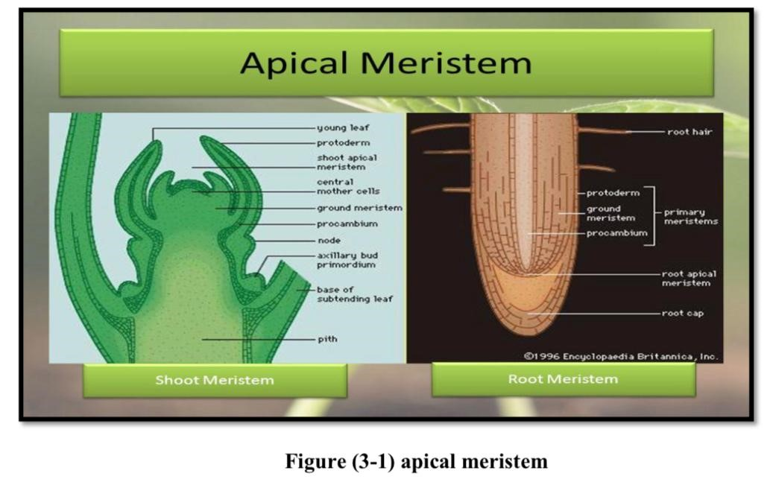
Plants have four types of meristems :-
1- Apical meristems :Meristematic cells location near the tips of roots and shoots and produce primary tissues. The meristems produce for primary growth , which Plays an important role in the elongation of roots and shoots .
❖ Apical meristems found in the root is called (root apex ) .
❖ Apical meristems found in the stem is called (shoot apex) .

Slide 5
2- Lateral meristems :-
Cylindrical tissue which form in mature regions of roots and shoots , this meristems produce secondary growth which increases the width of the plant by (vascular cambium) and (cork cambium) .
A: vascular cambium :
lateral meristem present between xylem and phloem tissue ,each year the cambium produces a new layer of tissue xylem in the side and phloem on the outside . this happen in perennial plants .
▪ activity of vascular cambium will increase the diameter of root and stems so this will provide extra support to plant and more vascular tissue .
▪ found in the plant which produces secondary tissue at the secondary growth .
▪ also vascular cambium found in dicotyledonous plants from gymnosperm and angiosperm cells .

Slide 6
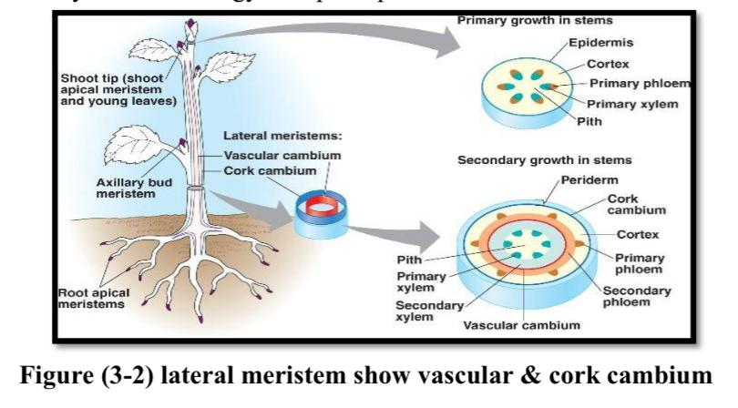
B:cork cambium (phellogen) :-
is a lateral meristem originates under the epidermis of primary body .
▪ activity of this cambium will produce cork cells(phellem) on the outside and secondary cortex (phelloderm) in the side .
▪ the result of this activity of cork cambium will form (periderm) in the dicotyledonous and gymnosperm plants .

Slide 7
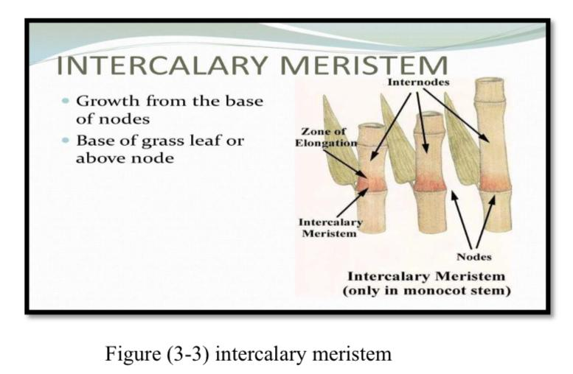
3- Intercalary meristems :-
Also primary meristem , it is located in between permanent tissue ,it is usually present at the base of leaves and above the node and at the base of inter node in many monocot stems and grasses , it is responsible for the elongation of the internodes regions and the formation of branches at the nodal regions .

Slide 8
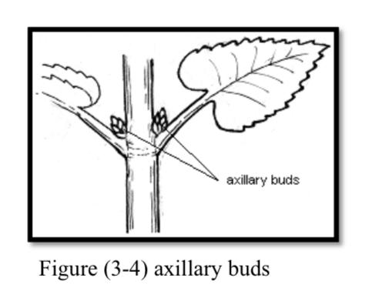
4- Axillary buds:-
Occur in the axial of a leaf , this buds important to form a branch leaf or flower when the bud breaks dormancy .

Slide 9
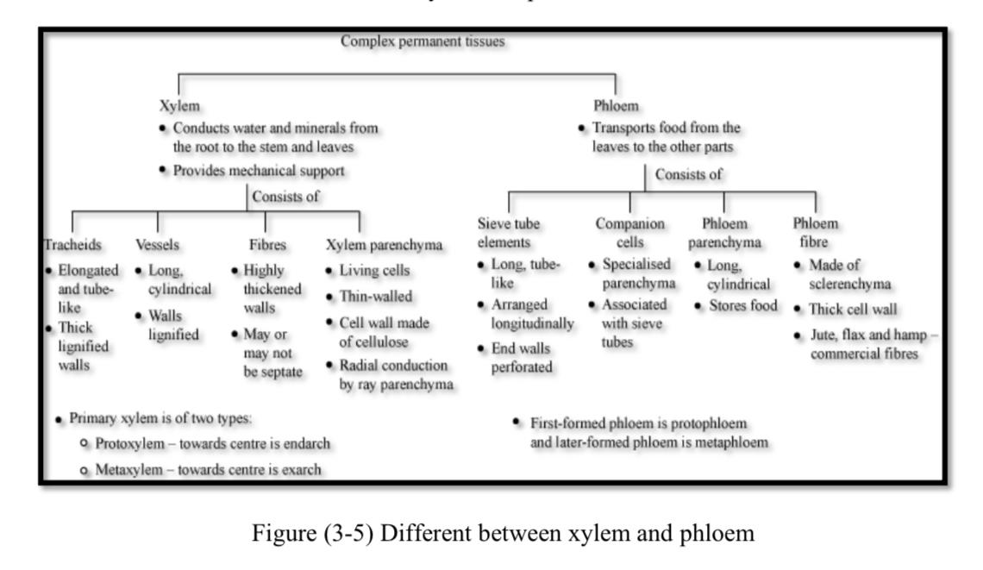
Permanent complex tissue ( vascular tissue) :-
Types of tissue specialized for long distance transport of water and dissolved solutes such as sucrose from photosynthesis or minerals absorbed from the soil to other region of plant . Shape is like the long pipes that spread throughout the plant . Vascular tissue consiste of two kinds xylem and phloem .

Slide 10
a- Xylem tissue
Xylem tissue Xylem transports water and minerals ,mostly from the roots to all parts of plants also provide structural support for plant .
Xylem tissue consist of :-
1- Tracheids : Elongated cells with long tapering end wall. Have only (pit pairs) present at the regions of union with other trancheids at the cell wall , have also closed end , cell wall are thickened with lignin so that trancheids support the plant . foundation most of the gymnosperm and few angiosperm . Lab 3 plants tissue practical botany
2- Vessels or trachea :- Cylindrical cell , not tapered at the end ,vessels are joined end to end to form continuous tubular structure with perforations in their end wall (cross wall), water and minerals are conducted through these perforations , have pits in primary cell wall , also have cell wall reinforced by ringed (annular) spiral ,pitted, reticular, scalar form thickening . Vessels are present in most of the angiosperms and also in lower plants .
3- Parenchyma cells :- This cells is the only living component in the xylem tissue , it is represented by groups that are found between the vessels and fibers ,are responsible for storage of reserve food .
4- Fibers :- Found between vessels cell and tracheids, they are meant for providing mechanical support to essential elements with the lignified cell wall and the cell wall thick more than the cell wall in tracheids , with circular shape in cross section .

Slide 11
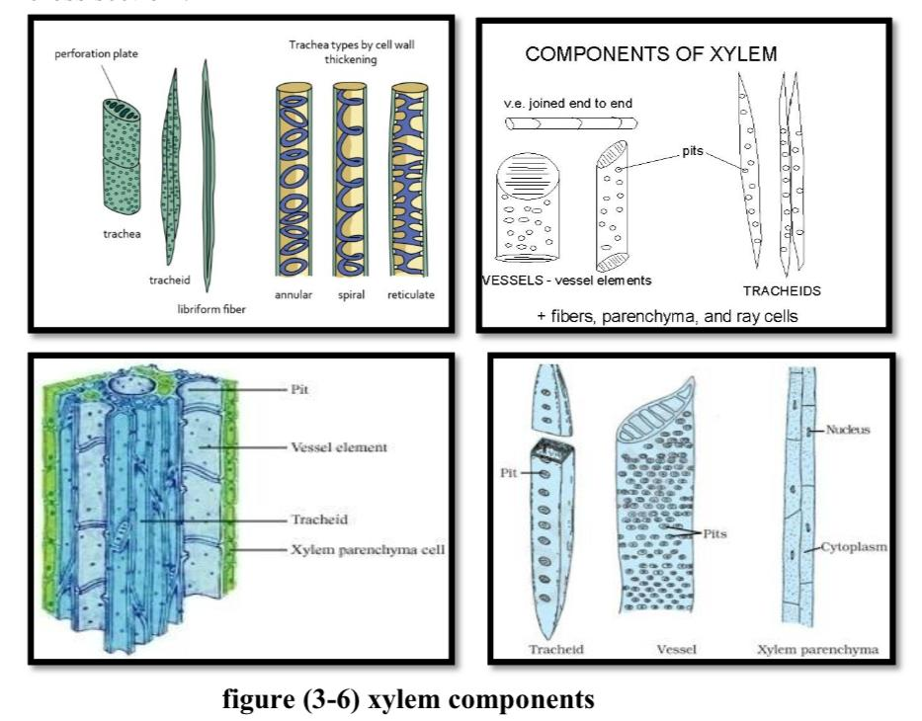
Xylem tissue consist of :-

Slide 12
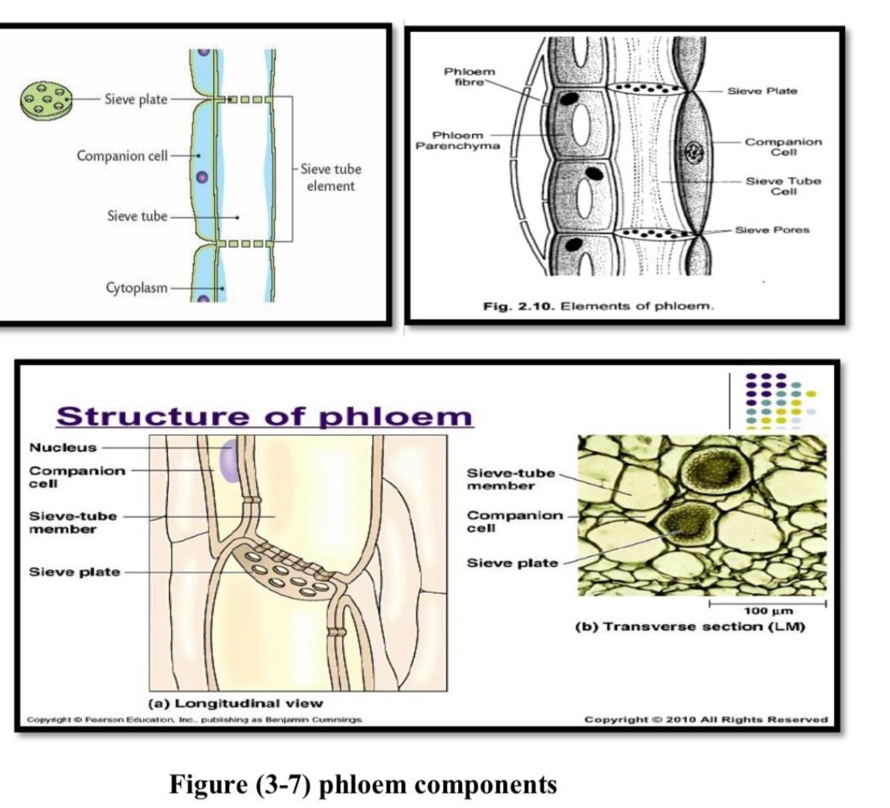
b:Phloem tissue consist of :-
a- Sieve tube cells :- Cylindrical cells , ending in porous (sieve plats) which join end to end sieve tube cells contain cytoplasm but no nucleus .
b- Companion cell :- Spindle shaped cells , narrow ,long associated with the sieve tube cell , contains cytoplasm with large nucleus .
c- Parenchyma cells :- Containing various substances such as starch, tannins and crystals . located next to sieve element in phloem .
d- Fibers :- Long cell ,with thick walls , living or non living at maturity, providing mechanical support .

