Slide 1


Lab 4 practical botany
Ground tissues
The third level
M.Sc. Dhuha Mohsen Abbas
M.Sc. Sahar Ahmed Taha
University of Mustansiriyah
College of Science
Department of Biology
Botany

Slide 2
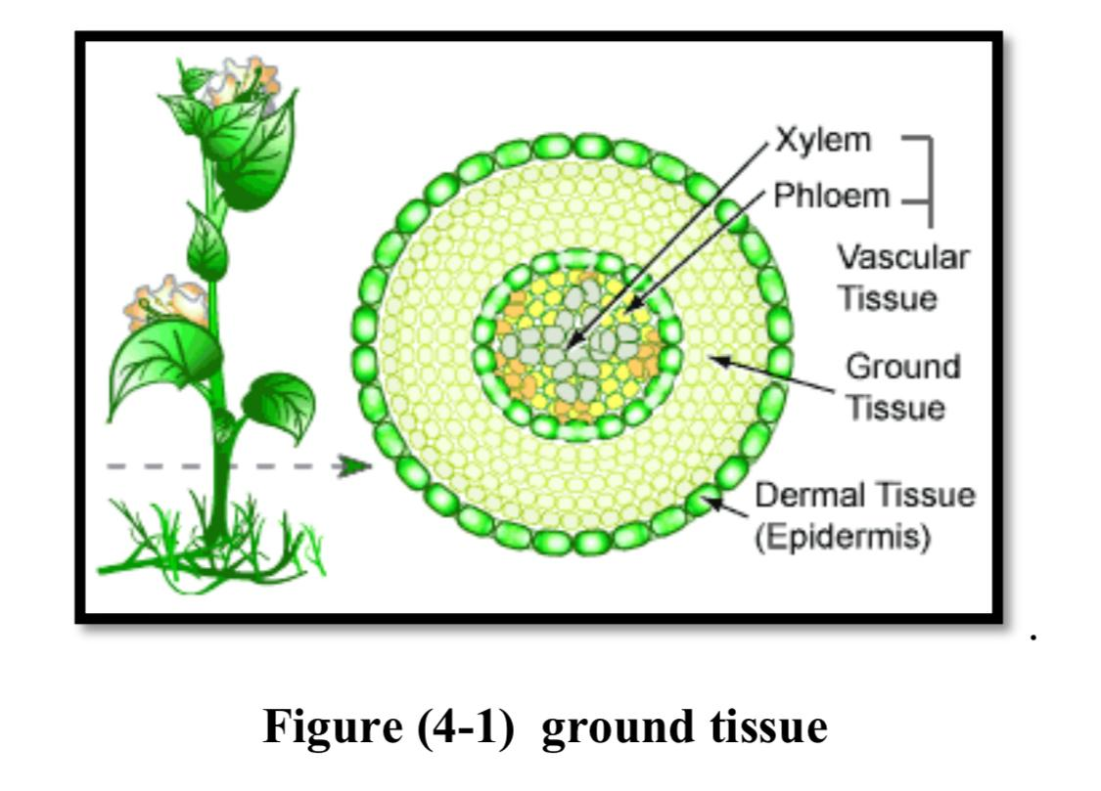
Ground tissue
Ground tissue :- The tissue of a plant other than the epidermis, periderm, and vascular tissues .
It can be divided into three types based on the nature of the cell walls.
1- Parenchyma tissue
2- Collenchyma tissue
3- Sclerenchyma tissue

Slide 3
1- Parenchyma tissue
it is the main part of ground tissue system and is found in plant organs
forming continuous tissue as in flesh of fruits floral parts and even in xylem
and phloem .
Parenchyma tissue features: -
a- Living cells
b- Capable of growth and division , the protoplast have (meristematic activity)
for that reason the phenomena of (wound healing ) regeneration formation of adventitious root and shoots are made possible .
c- Thin primary cell wall.
d- Cells are arranged with inter cellular spaces as in cortex and pith .
e- Contain dense cytoplasm and normal nucleate .

Slide 4
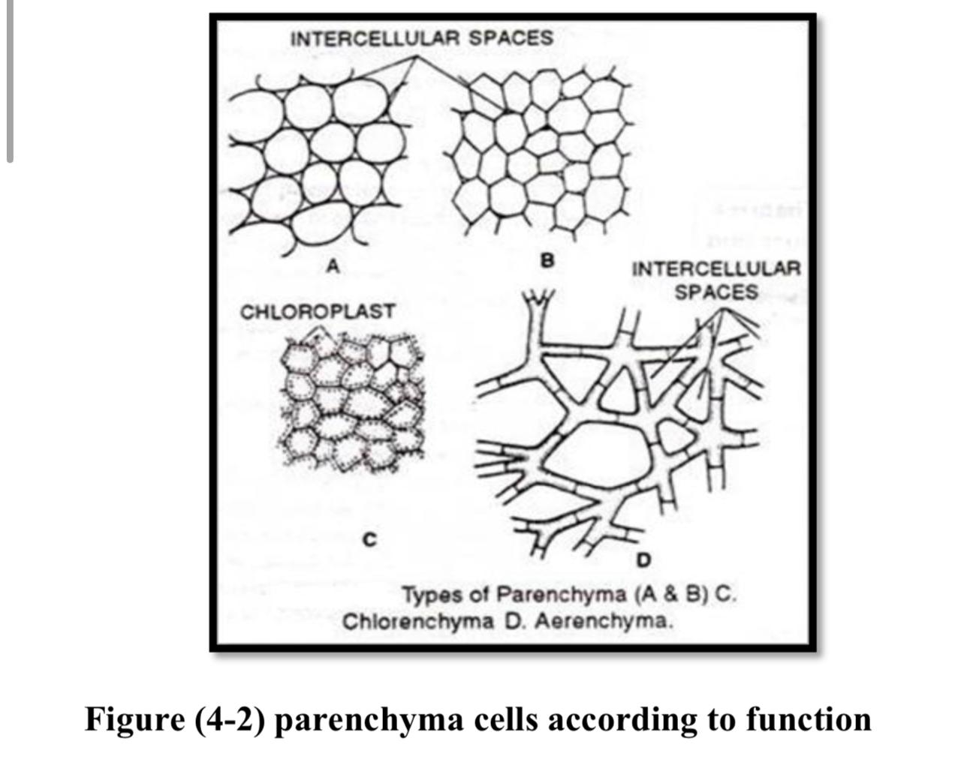
Types of parenchyma cells according to shape
1- Ordinary parenchyma as in → Zea mays stem
2- Stellate parenchyma as in → Cana indica leaf
3- Columnor parenchyma as in → Nerium olender leaf
4- Lobed parenchyma as in → Nerium olender leaf
5- Folded parenchyma as in → Mesophyll of Pinus leaf

Slide 5
Types of parenchyma cells according to function :-
1- Chlorenchyma contains chloroplast as in → bougain villaea stem
2- Food storage parenchyma as in → Ricinus communis seeds
3- Water storage parenchyma as in → Ficus elastica leaf
4- Air storage parenchyma as in → Cyperus papyrus stem

Slide 6
2- Collenchyma tissue
Living tissue , it is usually regarded as (supporting tissue ) , this supporting of
collenchymas is used against the mechanical stresses like wind .
Collenchyma tissue features: -
A- Cells are more elongated and narrow than parenchyma .
B- Collenchymas consists of thick cell wall because it contains cellulose , large
amount of pectin and hemicelluloses but no lignin .
C- Cells also have meristematic activity .
D- It is found in stems , leaves and floral parts of dicots and it is usually absent
in stems a leaves of monocot plants .

Slide 7
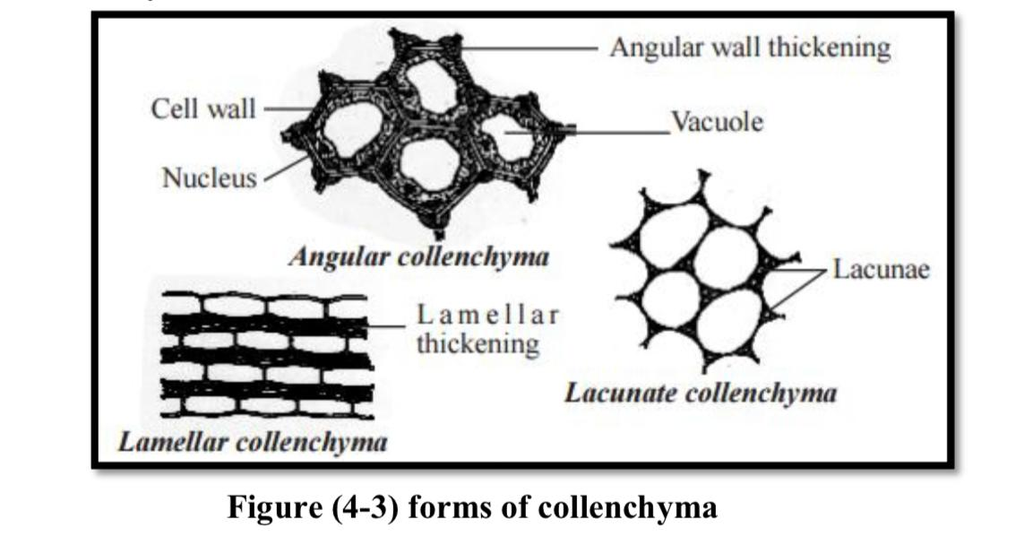
The forms of collenchyma are recognized based on the types of thickenings
1- Thickening is on the tangential wall it is called lamellar collenchyma.
2- Deposition of pactin is in the corner. where several cells meet it is called angular collenchymas .
3- Thickening are around the inter cellular spaces it is called lacunar collenchymall .

Slide 8
3 - Sclerenchyma tissue
a- The cells of sclerenchyma are thick secondary wall and are usually lignified The thickness in sclerenchyma due to formation of lignin.
b- At maturity usually the cells lack protoplast and became (dead cells ).
c- This tissue is found in the stem , roots , leaves , fruits of many plants (in all part of the plant body) .
d- Sclerenchyma cells wall encloses cavity lumen also on the cell wall pits are usually present .
e- The primary function is mechanical support .

Slide 9
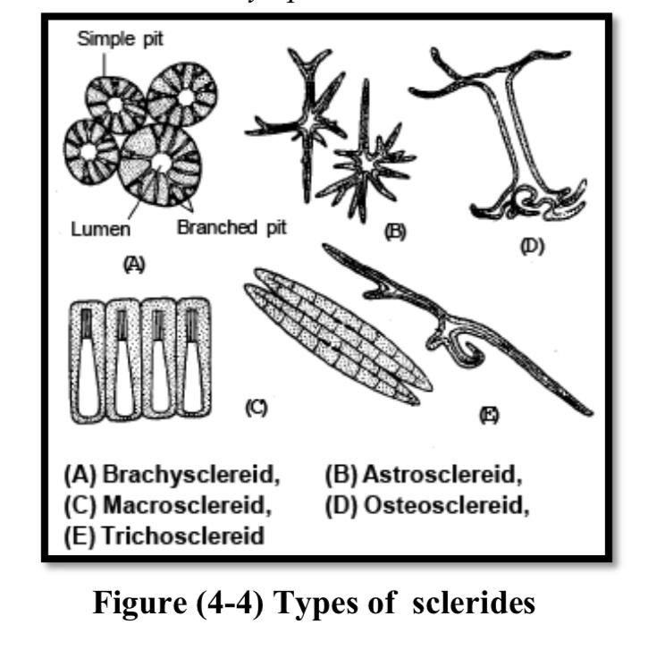
Forms of cell in sclerenchyma tissue
a- Sclerides
Are vary in shape from polyhedral to elongated and may be much branched .
Types of sclerides :-

Slide 10
1- Macrosclereids →in epiderm of allium sativum or allium cepa
2- Stone cell → in fruit flesh of pyrus communis (pear)
3- Osteosclereids → in fruit of phoenix dactylifera
4- Tricho sclereids → in the mesophyll of olea europaea olive)
5- Astero sclereids → in nymphaea leaf

Slide 11
b- Fibers :-
Generally long and thick cell wall and divided in two types
1- Extra xylary fibers :
Found out of vascular bundle like hypodermal fiber , cortical fiber ,
perivascular fiber , phloem fibers , bundle cap fiber.
2- Intra xylary fibers :
(Xylem or wood) fiber it is found inside the cambium .

Slide 12
Dermal tissues
Dermal tissues are system makes up the outside covering of plant .
Functions of dermal tissues :-
a- Protection against water loss
b- Regulation of gas exchange
c- Secretion
d- Absorption of water and mineral nutrient .
Dermal tissues consist of : epidermis and periderm

Slide 13
Epidermis :
All surface of the plant consist of a single layer of cells called pidermis or
surface tissue .most of the epidermal cells are relatively flat,the outer and the
lateral walls are often thicker than thinner wall , it is including guard cells and
trichomes , the cells form a continuous sheet without cellular spaces .
Epidermis Play a role in : -
a- protects all parts of the plant
b- support
c- reduction of water loss .

Slide 14
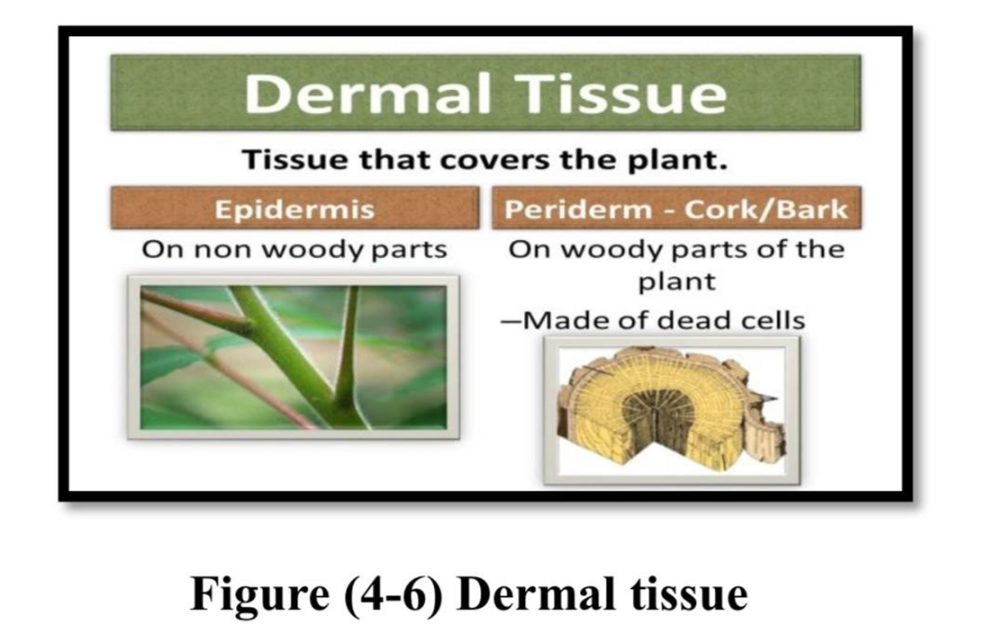
periderm (Bark) :
= when plants increase the girth due to secondary growth, then slough off their
= epidermal tissue and replace them with priderm it is composed of cork cells
= (phellem) that hare thick walls with suberin (cutin + lignine) substance which
= protects the surface of cells , also contains secondary cortex (phelloderm) and cork
= cambium all them are called periderm .

