Slide 1
Detailed Investigating the properties of Black Powder

Slide 2
What is black powder?
Black Powder is a common corrosion-related contaminant prevalent in pipelines transporting LPG, LNG, and hydrocarbon condensates. Studies of particle size distribution have shown a variation in size from fine to sub-micronic. It’s referred to as being black generally due to visual appearance, which is often black or grey, but it can equally be a lighter color. The typical composition of black powder in gas pipelines is iron oxide, accelerated by sour gas and poses a significant threat to pipeline integrity.

Slide 3
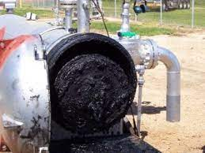

Slide 4
The Impact of Black Powder
The presence of black powder in incoming LNG/LPG to ethylene furnaces can negatively impact their performance. As a result, furnace run times decrease while maintenance costs are higher.
Other consequences include:
Accelerated coking reactions in the tubes and fouling in the convection section
Formation of CO in cracked gas
Loss of furnace capacity during pigging operations of the pipelines
Severe corrosion resulting in frequent replacement of damaged furnace tubes

Slide 5
In natural gas pipelines, the problems caused by black powder and water/hydrocarbon include:
Product with high water content in condensate or crude that upsets the process
Foaming in amine sweetening units and glycol dehydration units
Equipment failures leading to fouling and plugging of reboilers in the fractionation plants
Poor accuracy of meters/valves
Failure of critical instrumentation
Safety and environmental issues such as gas releases

Slide 6
