Slide 1
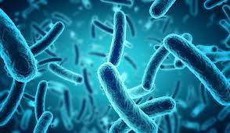
بسم الله الرحمن الرحيم
Lecture-4 –
2024-2025
Bacterial taxonomy
Domain : Bacteria

Slide 2
2-Domain: Bacteria
According to Bergey's Manual of Systematic Bacteriology, true bacteria are divided into a large number of phyla. In this semester, we will discuss the most important phyla.
The2nd edition of Bergey’s Manual of Systematic Bacteriology divides domain Bacteria into 23 phyla.here some of the most important:

Slide 3
1-Phylum Aquiflexa
2-Phylum Thermotogota
3- Phylum Deinococcus-Thermus
4-Phylum Tenericutes
Photosynthetic Bacteria
5-Phylum :Cyanobacteria
6-Phylum :Chlorobi
7-Phylum Firmicutes
8-Phylum: Proteobacteria
9-Phylum Actinobacteria
10-Phylum Chlamidiae
11-Phylum Spirochaetes
12-phylum Bacteroidetes

Slide 4
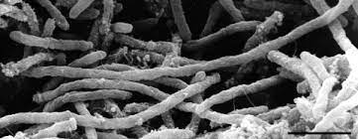
1-Phylum: Aquificae
Thought to be deepest (oldest) branch of Bacteria. Contains one class, one order, and Three families .Two best studied genera are Aquifex and Hydrogenobacter.
Domain :Bacteria
Phylum :Aquificota
Class : Aquificae صانعة الماء
Order : Aquificales
1-Family : I Aquificaceae 2- Family :Desulfurobacteriaceae
Genus : l Aquifex
Genus :ll Hydrogenobaculum
Genus : lll Hydrogenobacter
Genus : lV Thermocrinis 3- Family:Hydrogenothermaceae
Genus : V Hydrogenivirga

Slide 5
Genus: Aquifex
General characteristics
1-Are Gram-negative rod-shaped bacteria with a length of 2 to 6 µm, have a diameter of around 0.5 µm and are motile.
2- They are non spore-forming .
3-Aquifex means water-maker in Latin, and refers to the fact that its method of respiration creates water. 4-Aquifex tend to form cell aggregates composed of up to 100 individual cells.
5- Thermophile, growth optimum 85°C , maximum 95°C.
6-Microaerophilic & Chemolithoautotroph (uses hydrogen, thiosulfite, and sulfur as electron donor , uses oxygen as electron acceptor).

Slide 6
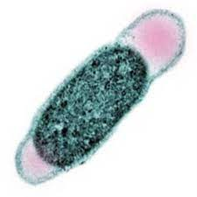
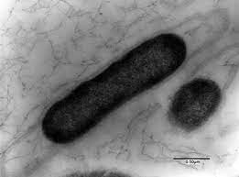
2-Phylum: Thermotogota
Second deepest branch of Bacteria. Contains one class, one order, and six genera ( best studied genus is Thermotoga) .
Domain :Bacteria
Phylum :Thermotogota
Class :Thermotogae
Order :Thermotogales
Family : Thermotogaceae
Genus : Thermotoga

Slide 7
Genus :Thermotoga
General characteristics
1-Gram-negative rods outer sheath-like envelope balloons from ends of cell, called a "toga".
2-Thermophiles (optimum 80°C; maximum 90°C). Grow in active geothermal areas (marine hydrothermal vents).
3- Chemoheterotrophs, have functional glycolytic pathway and can grow anaerobically on carbohydrate/protein digests.
4-~24% of coding sequences similar to archaeal genes(may be due to horizontal gene transfer).

Slide 8
3-Phylum: Deinococcus-Thermus
1-Spherical or rod-shaped; in pairs or tetrads.
2-Gram-positive (lack typical Gram-positive cell wall, layered outer membrane similar to Gram negatives , L-ornithine in peptidoglycan & lacks teichoic acid.
3-Aerobic, catalase positive. 4-Resistant to desiccation and radiation.
Radiation resistance due to ability to repair genome when it is severely damaged efficient proteins (protected by manganese) and enzymes for DNA repair (Within 12–24 hours can repair chromosomes fragmented by exposure to radiation).
5-Isolated from ground meat, feces, air, fresh water, and other sources, but natural habitat unknown.
6- Genome consists of two circular chromosomes, a megaplasmid, and a small plasmid.

Slide 9
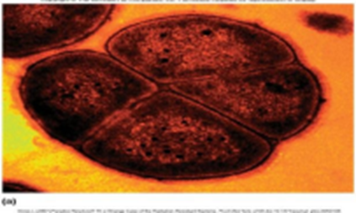
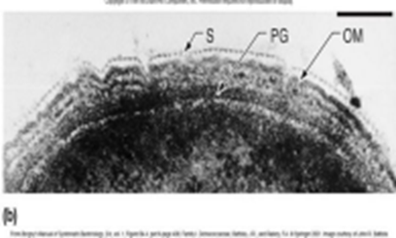
Contains one class, two orders &three genera (genus Deinococcus is best studied).
9 of 11 species are mesophilic;
2 species are thermophilic.
Domain: Bacteria
Phylum :Deinococcota
( Deinococcus Thermus )
Class :Deinococci
Order l : Deinococcales
Family :Deinococcaceae
Genus :Deinococcus
Order ll :Thermales
Family :Thermaceae
Genus l :Thermus
Genus ll : Meiothermus

Slide 10
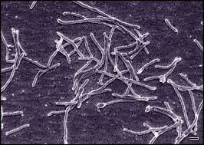
Thermus aquaticus
General characteristics
1-an extremely thermophilic bacterium which can grow at temperatures above 70°C, also possesses a thermostable aminopeptidase activity.
2- This bacterium is the source of the heat-resistant enzyme Taq DNA polymerase, one of the most important enzymes in molecular biology because of its use in the polymerase chain reaction (PCR) DNA amplification technique

Slide 11
4-Phylum: Tenericutes
Class : Mollicutes (The Mycoplasmas ) : Contains five orders and six families.
1- Smallest bacteria capable of self-reproduction.
2-Cannot synthesize peptidoglycan precursors . Lack cell walls and are pleomorphic.
3- Grow as fried egg appearance on agar surface.
4-Have genomes less than 1000 genes (one of the smallest found in Prokaryotes).
5-Most non-motile , some have gliding motility .
6-self surface proteins surround “neck” of cell ,attach to cytoskeletal proteins; function like microscopic legs ,powered by ATP hydrolysis) see the figure below

Slide 12
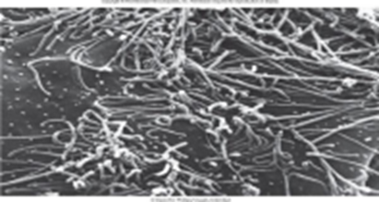
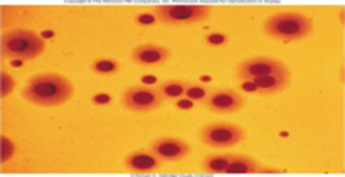
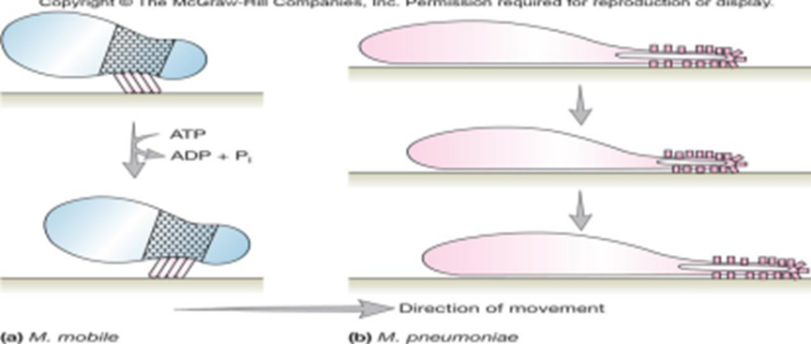

Slide 13
Important Pathogens:
Mycoplasma mycoides | pleuropneumonia in cattle
Mycoplasma gallisepticum | chronic respiratory disease in chickens
Mycoplasma hyopneumoniae | swine pneumonia
Mycoplasma pneumoniae | primary atypical pneumonia in humans
Ureaplasma urealyticum | premature birth, neonatal meningitis and pneumonia
Spiroplasmas | pathogenic in insects, ticks, and a variety of plants

Slide 14
Photosynthetic Bacteria:
There are 5 Phyla of Photosynthetic Bacteria:
1-Phylum Chlorobi – green sulfur bacteria
2-Phylum Chloroflexi – green non-sulfur bacteria
3-Phylum Cyanobacteria
4-Purple bacteria divided into 3 groups : purple sulfur (2 ,Proteobacterial families: Chromatiaceae and Ectothiorhodospiraceae ) and purple non-sulfur (distributed between α- and β-Proteobacteria ).
5-Phylum Firmicutes – Heliobacteria

Slide 15
1-Phylum: Chlorobi
Green sulfur bacteria. Consists of one class, Chlorobia; one order, Chlorobiales; one family, Chlorobiaceae. Representative genera are Chlorobium, Prosthecochloris.
Morphologically diverse. Thrive in sulfide rich areas. Have chlorosomes.
Chlorosomes: Ellipsoidal vesicles attached to plasma membrane , contain accessory photosynthetic pigments.
Lack flagella; Nonmotile. Some have gas vesicles( adjust depth of cell for light/H2S ). Obligate anaerobic photolithoautotrophs

Slide 16
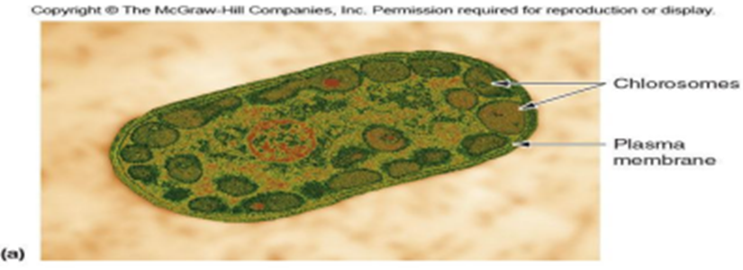
Phylum: Chloroflexi (Chloroflexota)
Green non-sulfur bacteria. Has both :
Photosynthetic members :e.g., genus Chloroflexus
Non -photosynthetic members: e.g., genus Herpetosiphon.

Slide 17
Domain: Bacteria
Phylum :Chloroflexota
Class :Chloroflexia
Order l :Chloroflexales
Family :Chloroflexaceae
Genus :Chloroflexus
Order ll :Herpetosiphonales
Family :Herpetosiphonaceae
Genus :Herpetosiphon

Slide 18
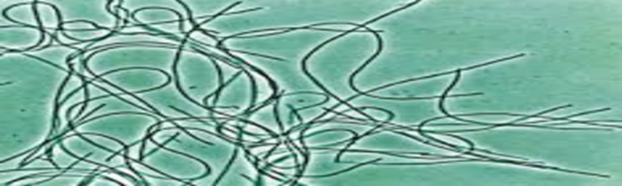
Genus: Chloroflexus
1-Filamentous (with gliding motility).
2-Thermophilic , often isolated from neutral to alkaline hot springs;
3- grow in orange-reddish mats.

Slide 19
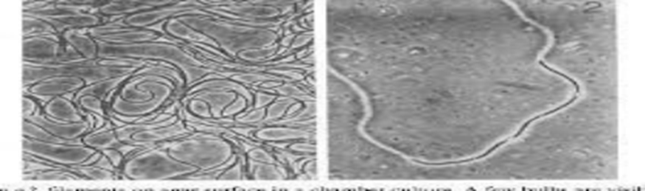
Genus: Herpetosiphon
1-Non-photosynthetic,
2-gliding,
3-rod-shaped, or filamentous. Aerobic
4-chemoorganotrophs with respiratory metabolism.
5-Isolated from fresh water and soil habitats.

Slide 20


